Slide 1
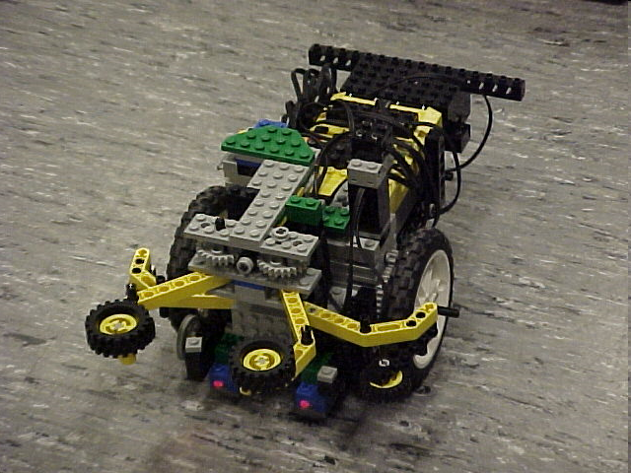
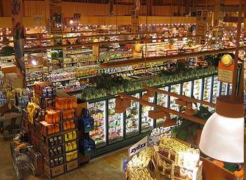
Semester-Long Design Project

Slide 2
Project Introduction
Project duration: 10 weeks
Teams of 2-3 people
Projects to choose from:
  Supermarket
  Robot (seven types)

Slide 3
Project Grading
Item | % of Grade
Benchmarks and Commissioning | 50%
Final Presentation | 50%
NOTE: The SLDP counts toward 30% of your course final grade!

Slide 4

Project Grading
Benchmarks:
  Completion of a specified portion of the project
  2 Benchmarks throughout semester
  Refer to schedule for due dates
  Penalties for not completing on time
  They are cumulative, i.e. Benchmark B includes Benchmark A

Slide 5
Project Grading
Commissioning:
  Completion of all required tasks
  Last phase of project
  Refer to syllabus for due dates
  Failure to commission will result
  in penalties (partial commissioning)

Slide 6
Project Grading
Partial Commissioning:
  If you have reached up at least to Benchmark A, you’ve earned at least 30% for commissioning
  If you have reached up at least to Benchmark B, you’ve earned at least 70% for commissioning
  Any value higher than your benchmarks is decided by two TAs watching a full run

Slide 7
Project Grading
Project Submission:
  Submit Technical and Managerial related documents via an online form provided toward end of semester
  Must be received in order to obtain SLDP grade (30%)
  Any missing items will result in penalties
  Refer to syllabus for deadline
  Refer to Submission Guidelines

Slide 8
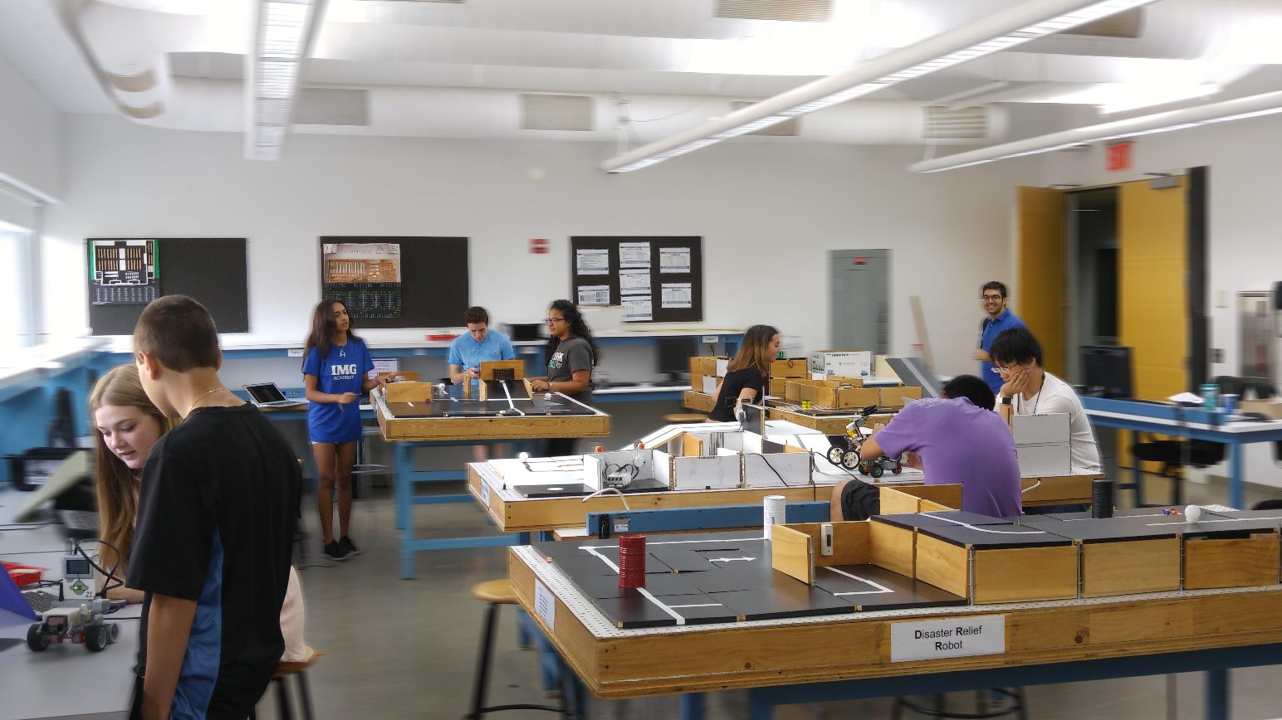
SLDP Options
Seven Robot Variants
Supermarket Logistics System

Slide 9
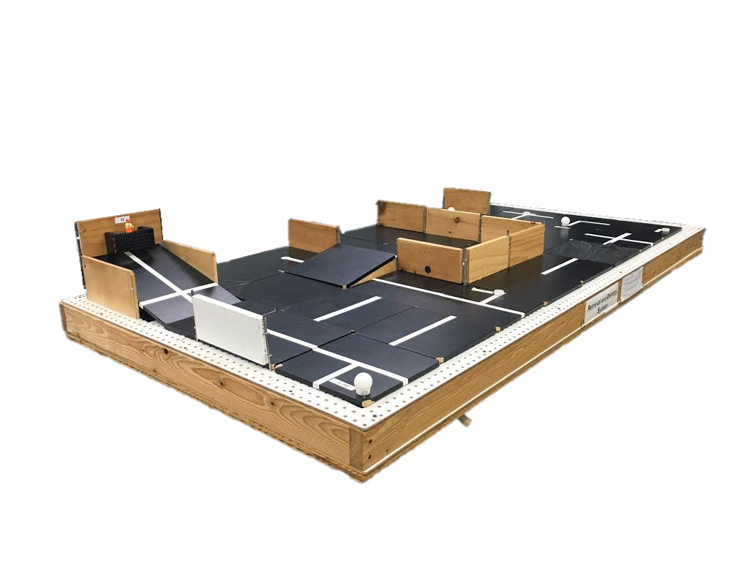
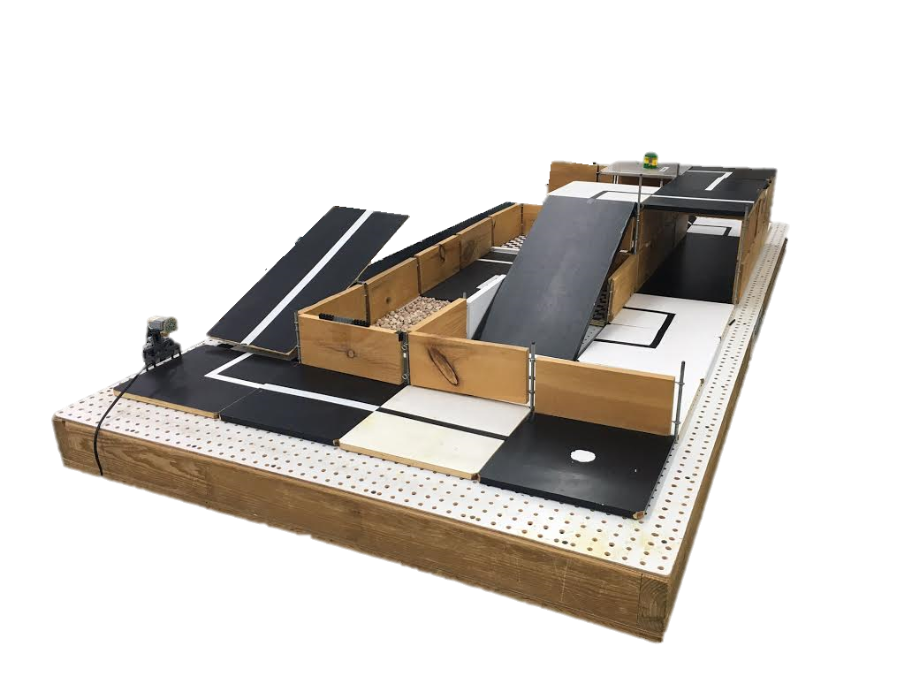
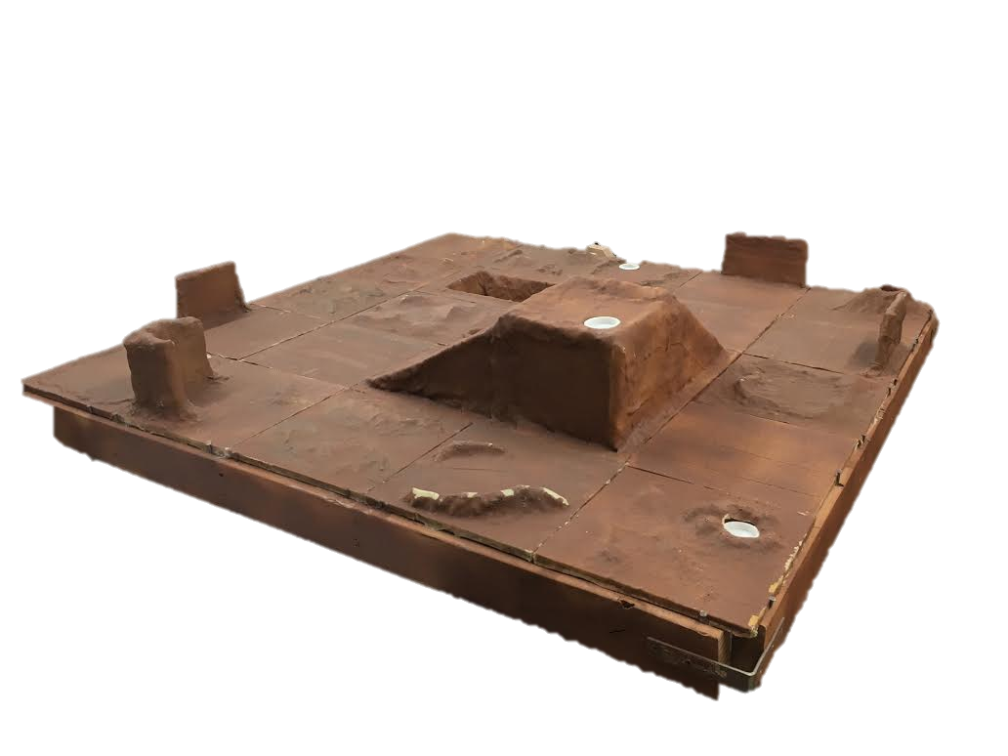
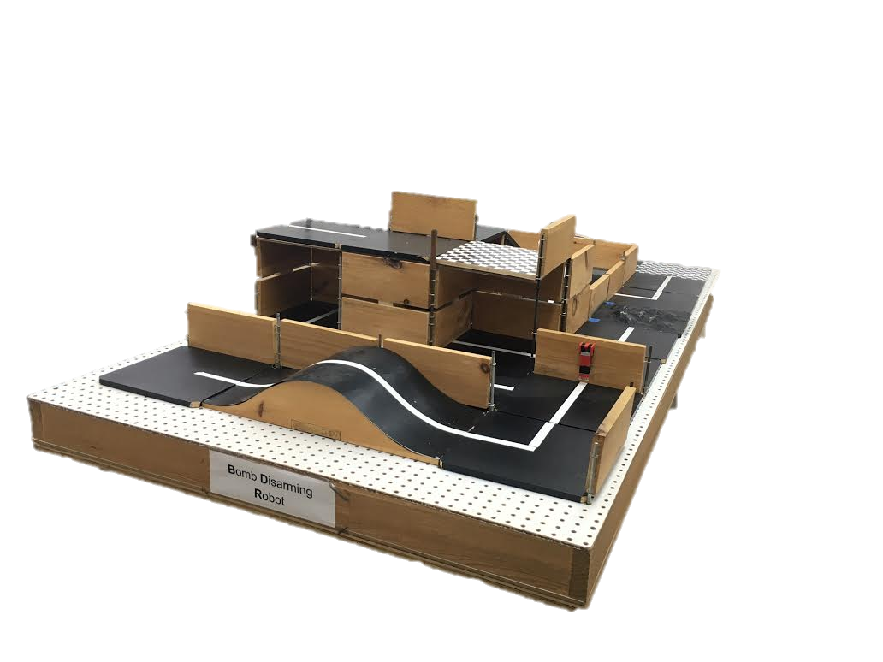
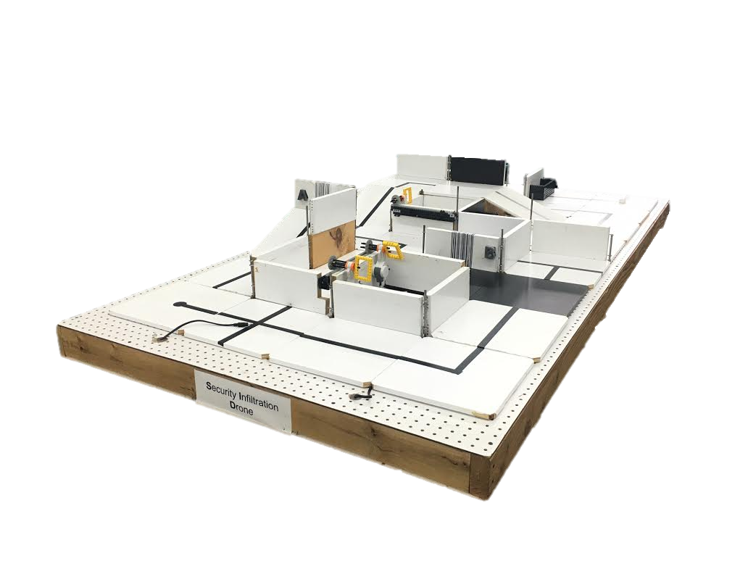
SLDP Options
Robot Variants

Slide 10
SLDP Options
Mars Rover Robot (MRR)
Collect one soil and one water reading
Pick up sensor between readings if necessary
Answer Data Specifications questions

Slide 11
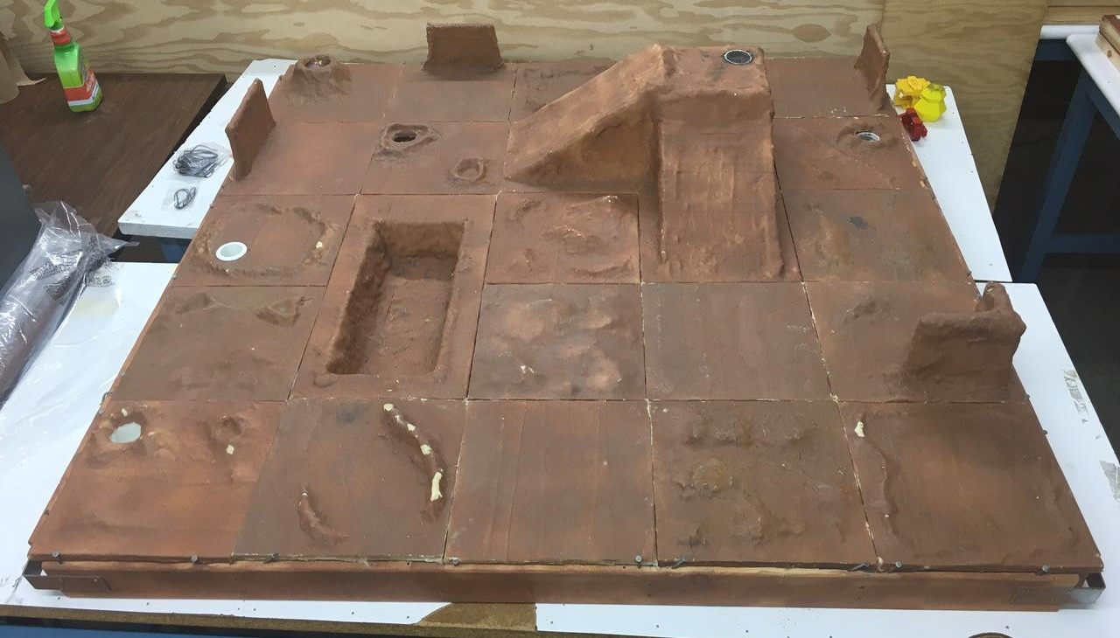
SLDP Options
Extra Credit Soil (Fuel Test)
Extra Credit Soil (pH test)
Soil Sample
(Fuel Test)
Soil Sample (pH test)
Water Sample
Extra Credit Water Sample
Start Tile
*Pavel sold separately

Slide 12
SLDP Options
Mars Rover Robot (MRR)
Benchmark A:
Obtain one reading
Benchmark B:
Obtain first reading
Return to pick up module if necessary
Obtain second different reading
Commission:
Obtain water and soil reading
Return to landing site
Conduct all corresponding tests

Slide 13
SLDP Options
Mars Rover Robot (MRR)
Extra Credit:
Obtain all 3 types of readings
Cross the canyon
Traverse up and down mountain
Collect reading from an EC tile

Slide 14
SLDP Options
Search & Recovery Robot (SRR)
Retrieve lost space module Zarya from moon and return to start
The robot must fit in a start area that is 25cm x 25cm

Slide 15
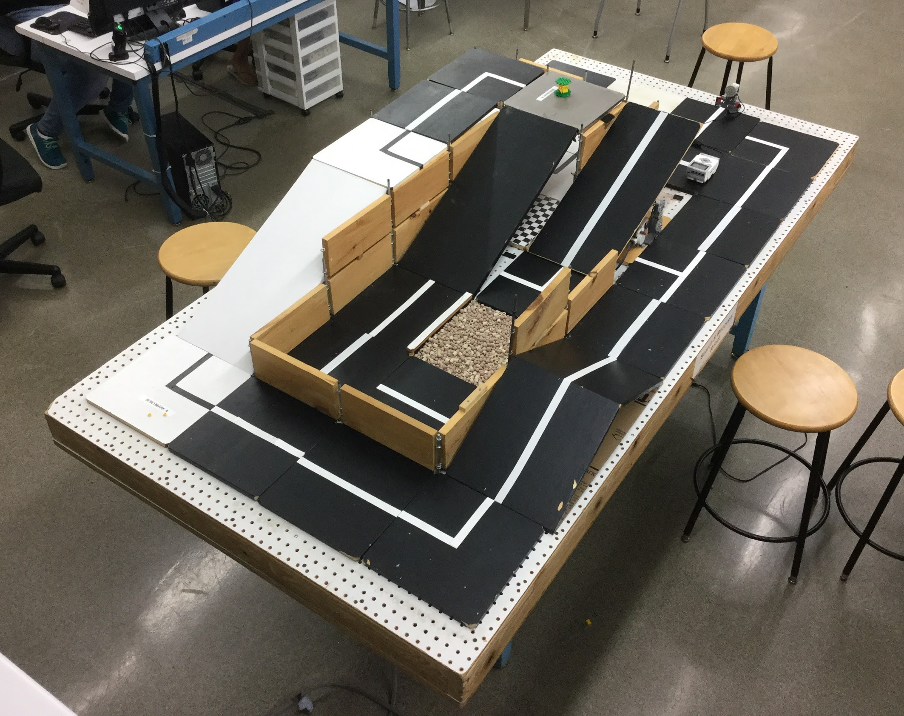
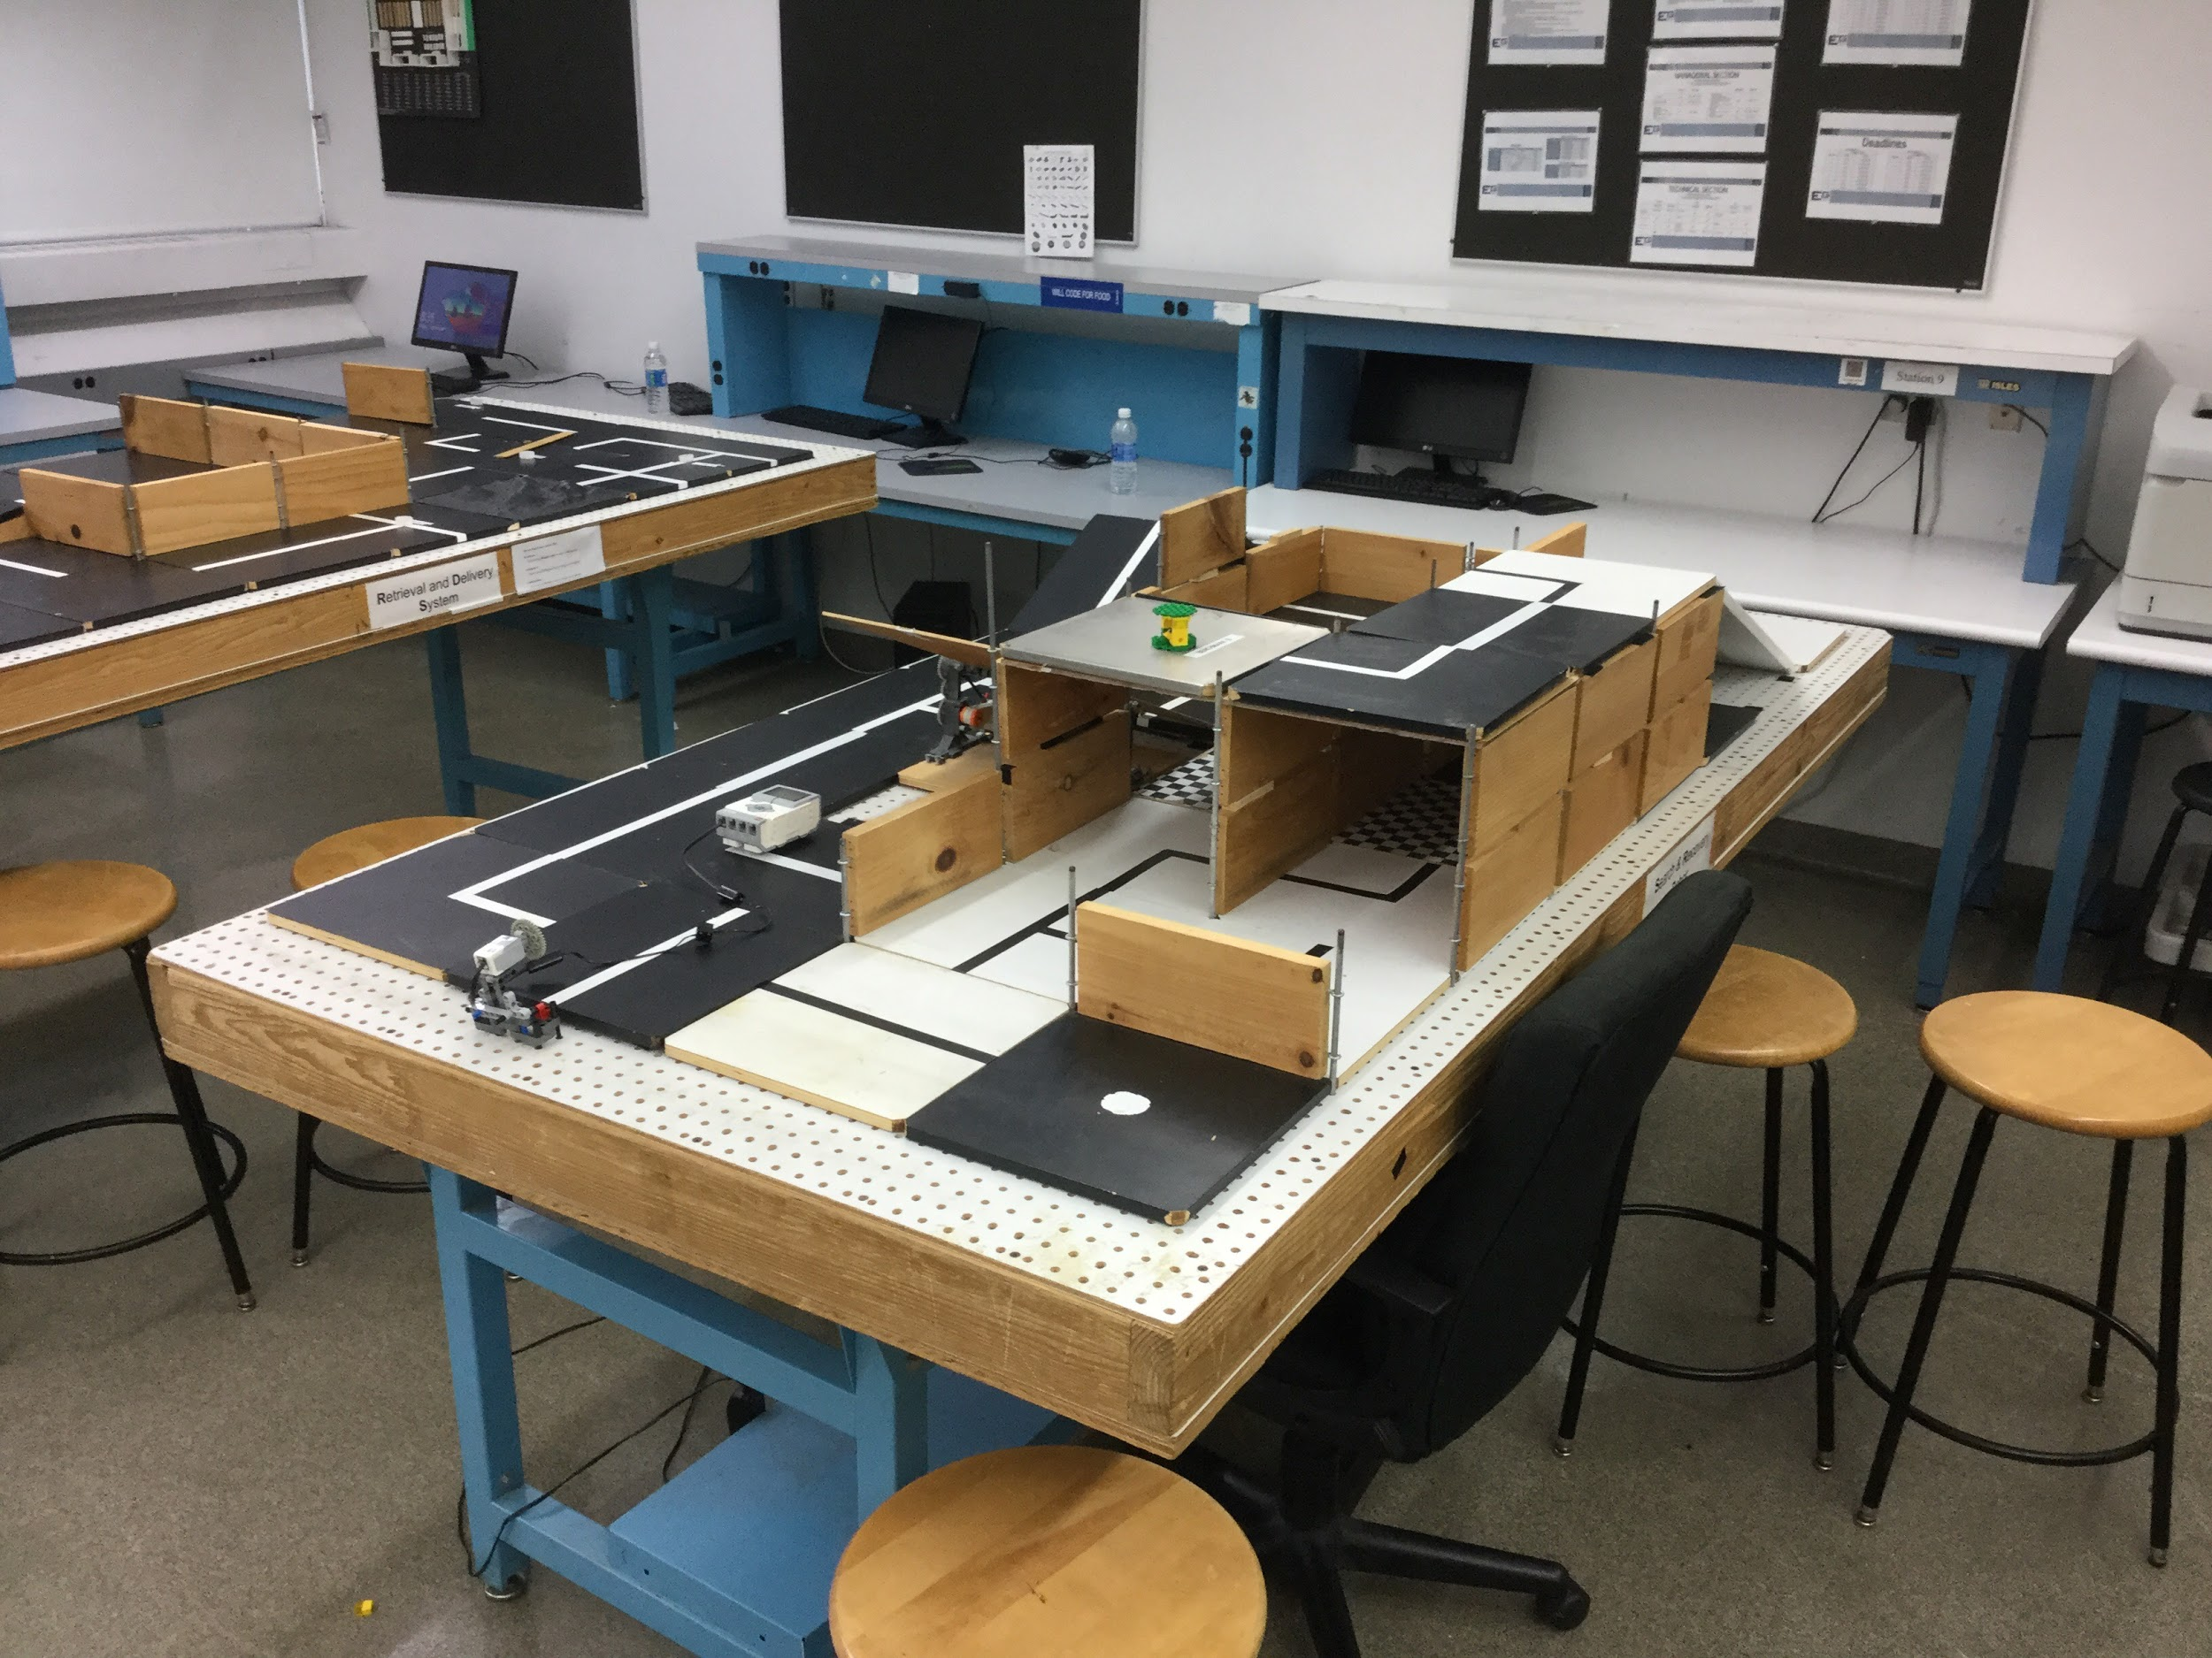
SLDP Options
Search & Recovery Robot (SRR)

Slide 16
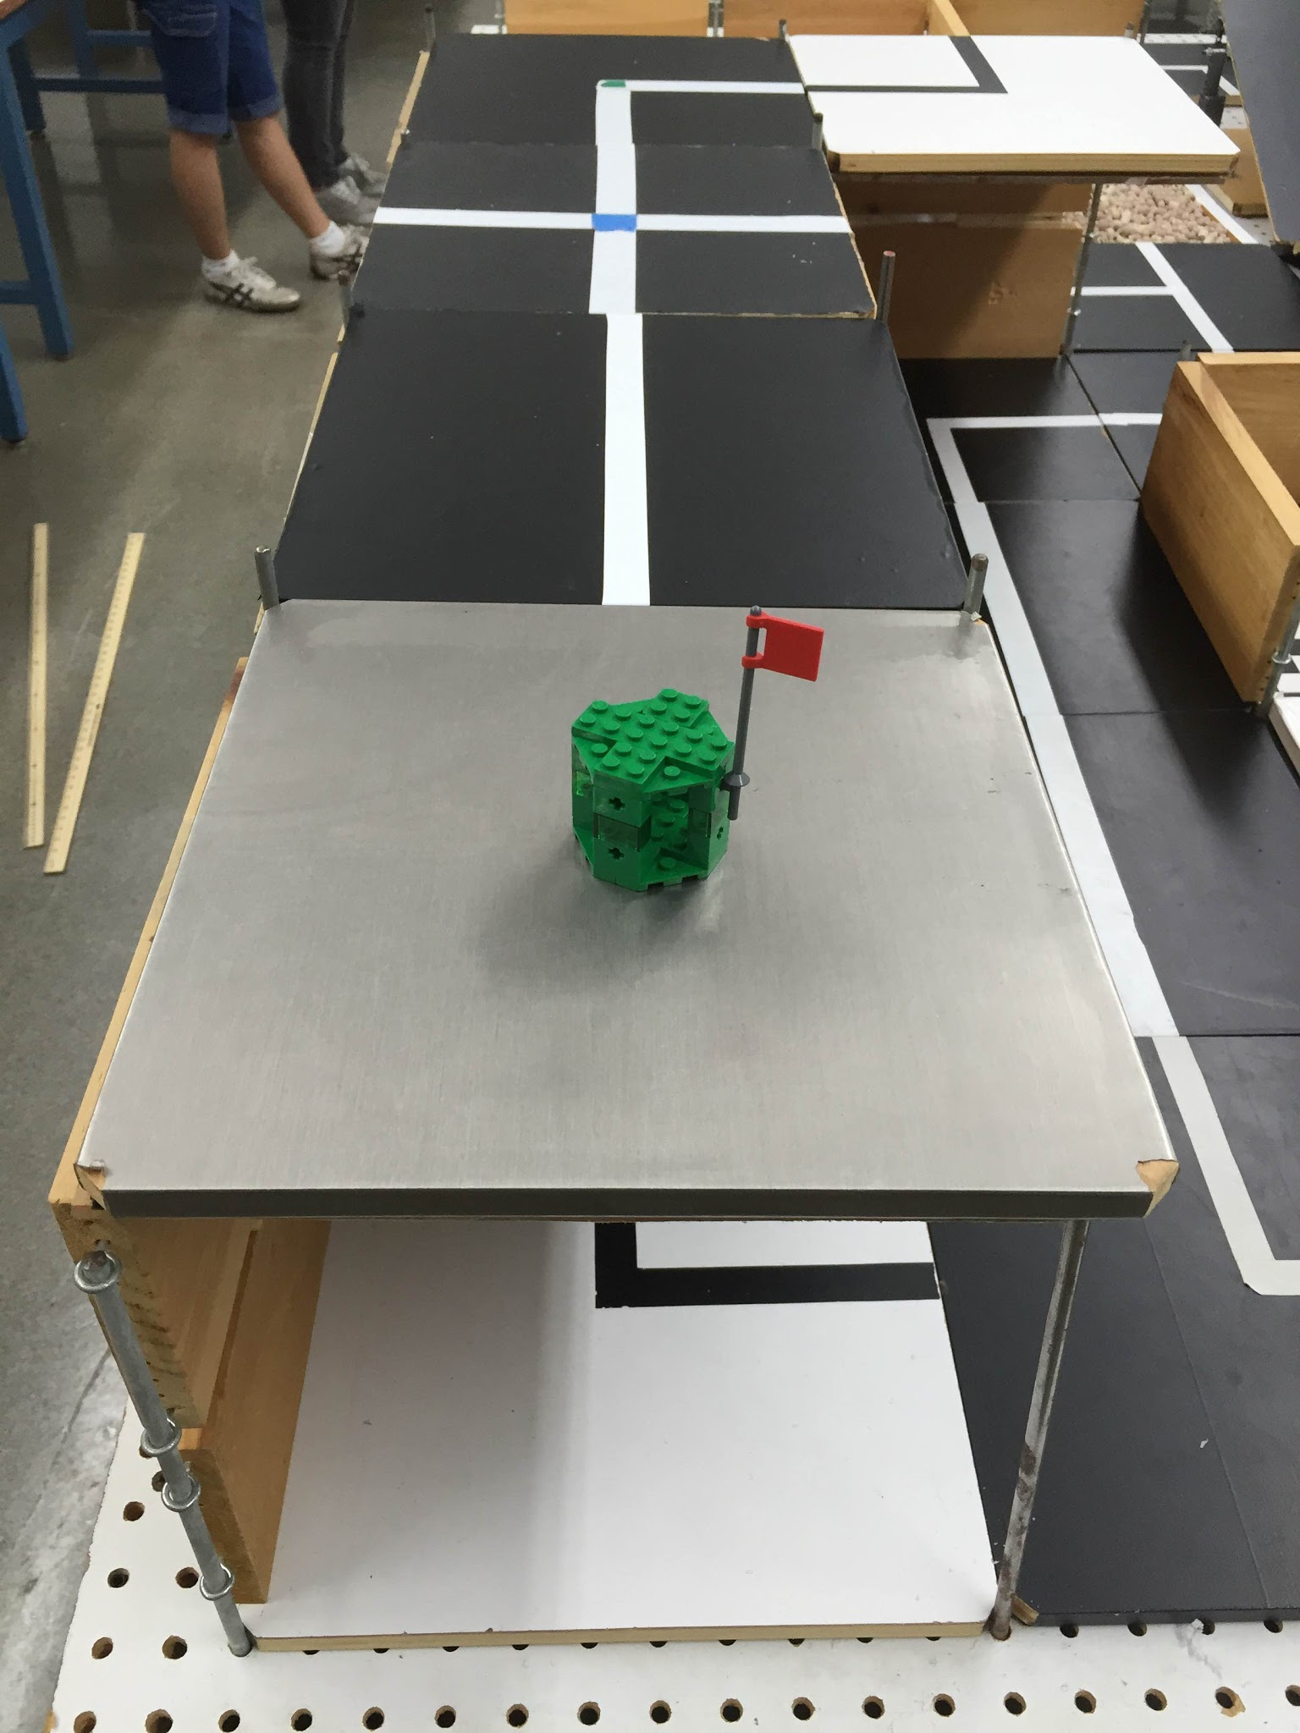
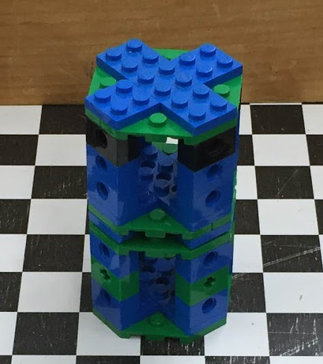
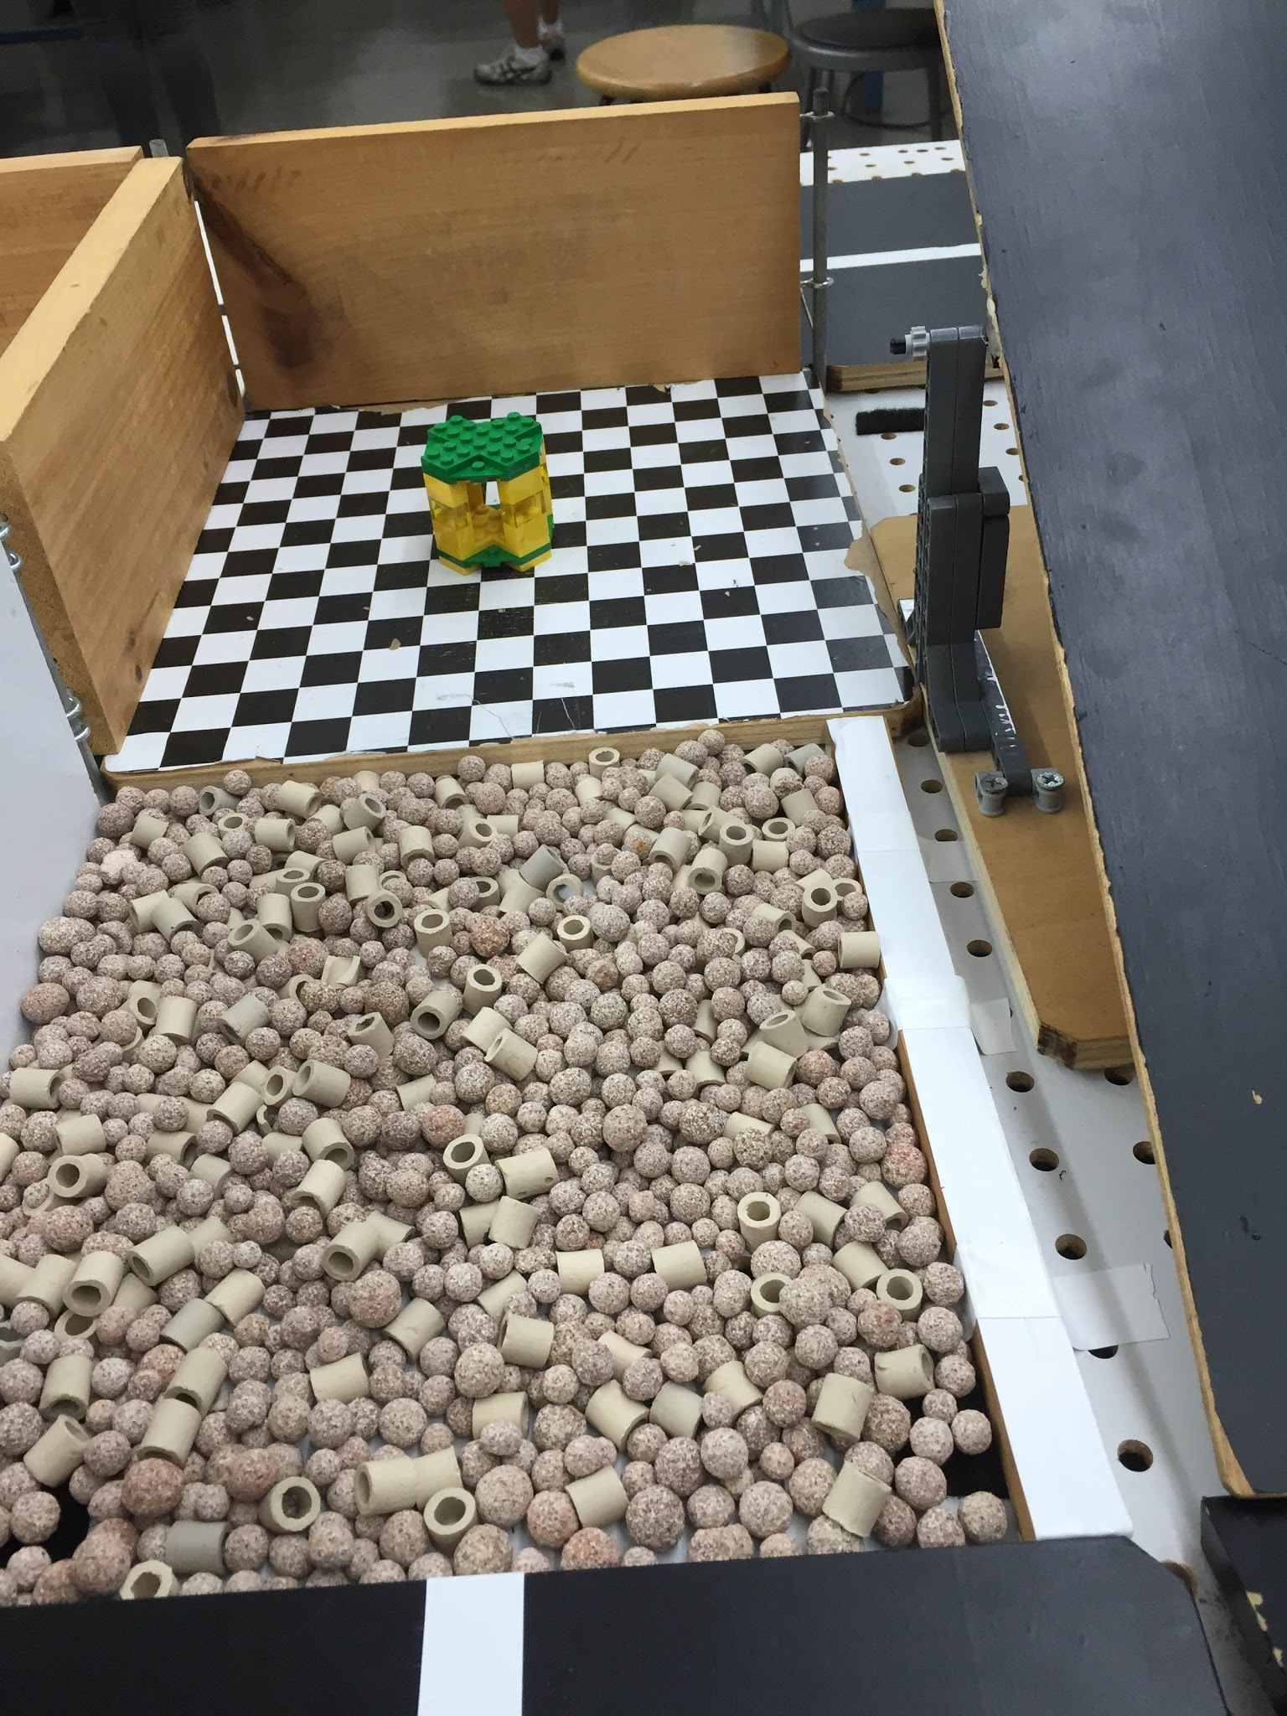
SLDP Options
Search & Recovery Robot (SRR)
Modules
Zarya
(Mandatory)
Unity
(Optional)
Quest
(Optional)

Slide 17
SLDP Options
Search & Recovery Robot (SRR)
Benchmark A:
Traverse Hill Tile (Path 1)
Traverse Bridge (Path 2)
Benchmark B:
Retrieve Zarya
Commission:
Return to start with Zarya

Slide 18
SLDP Options
Search and Recovery Robot (SRR)
Extra Credit:
Retrieve other modules
Traverse moon dust

Slide 19
SLDP Options
Bomb Disarming Robot (BDR)
Disarm bomb and return to start
Avoid decoy bombs
Robot must be able to autonomously
navigate the obstacle course provided
Robot must fit in a start area that is 25cm x 25cm
Maximum height is 20cm

Slide 20
SLDP Options
Bomb Disarming Robot (BDR)
Allowed
Jumping off
upper levels
Climbing walls
Prohibited
Arms
Slingshots
Projectiles

Slide 21
SLDP Options
Bomb Disarming Robot (BDR)
Benchmark A:
Pass two hills
Benchmark B:
Disarm bomb
Commission:
Return to start

Slide 22
SLDP Options
Bomb Disarming Robot (BDR)
Extra Credit:
Disable and retrieve triangulation device(s)

Slide 23
SLDP Options
Security Infiltration Drone (SID)
Solve puzzle to deactivate gates by scanning barcodes
Reach exit point
Robot must fit in a start area that
is 25cm x 25cm

Slide 24
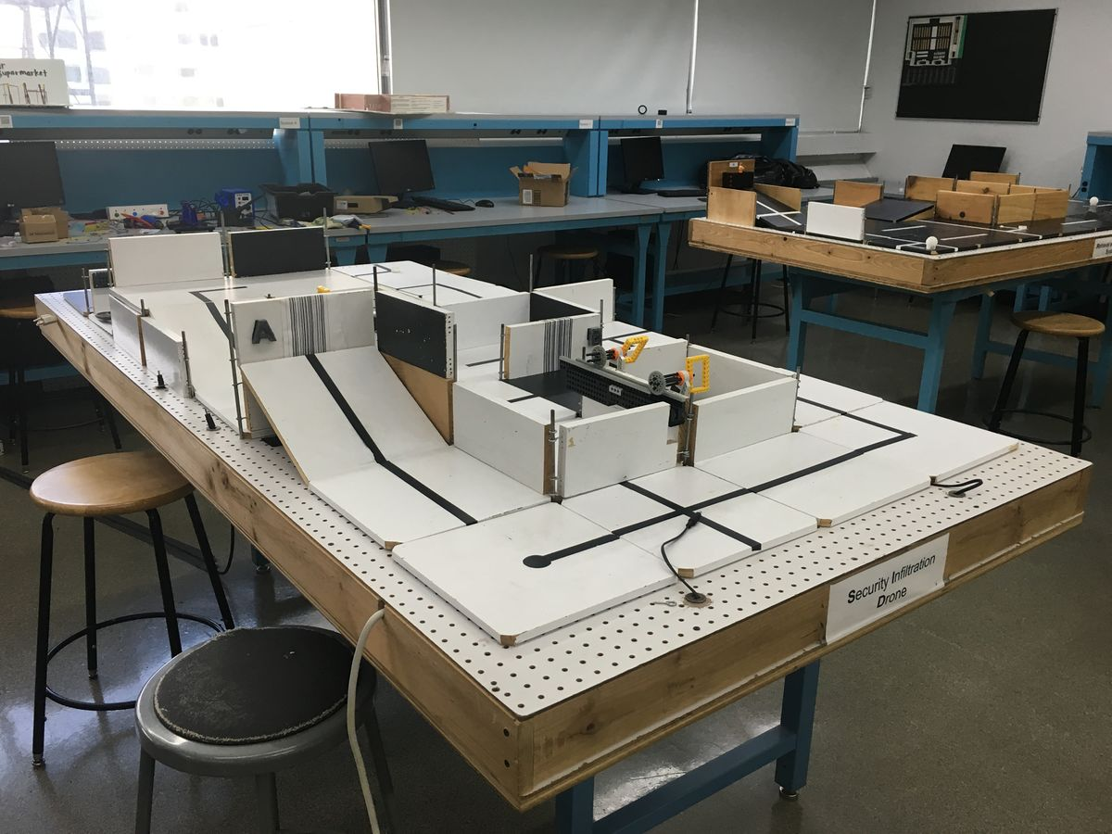
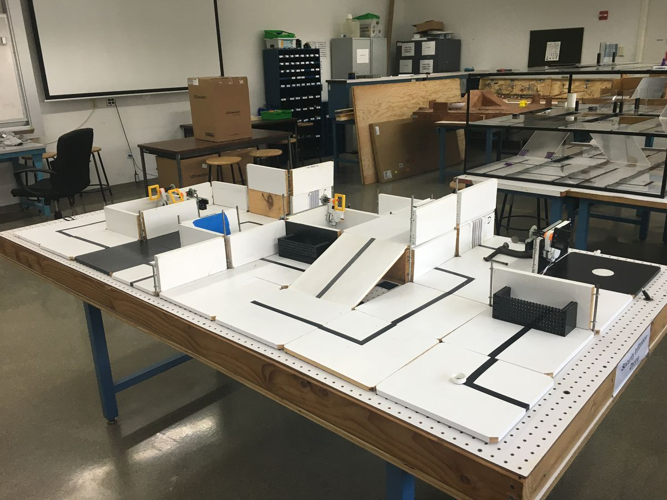
SLDP Options
Security Infiltration Drone (SID)
C
3
B
D
4
A
2
1
Numbers are gates
Letters are barcodes

Slide 25
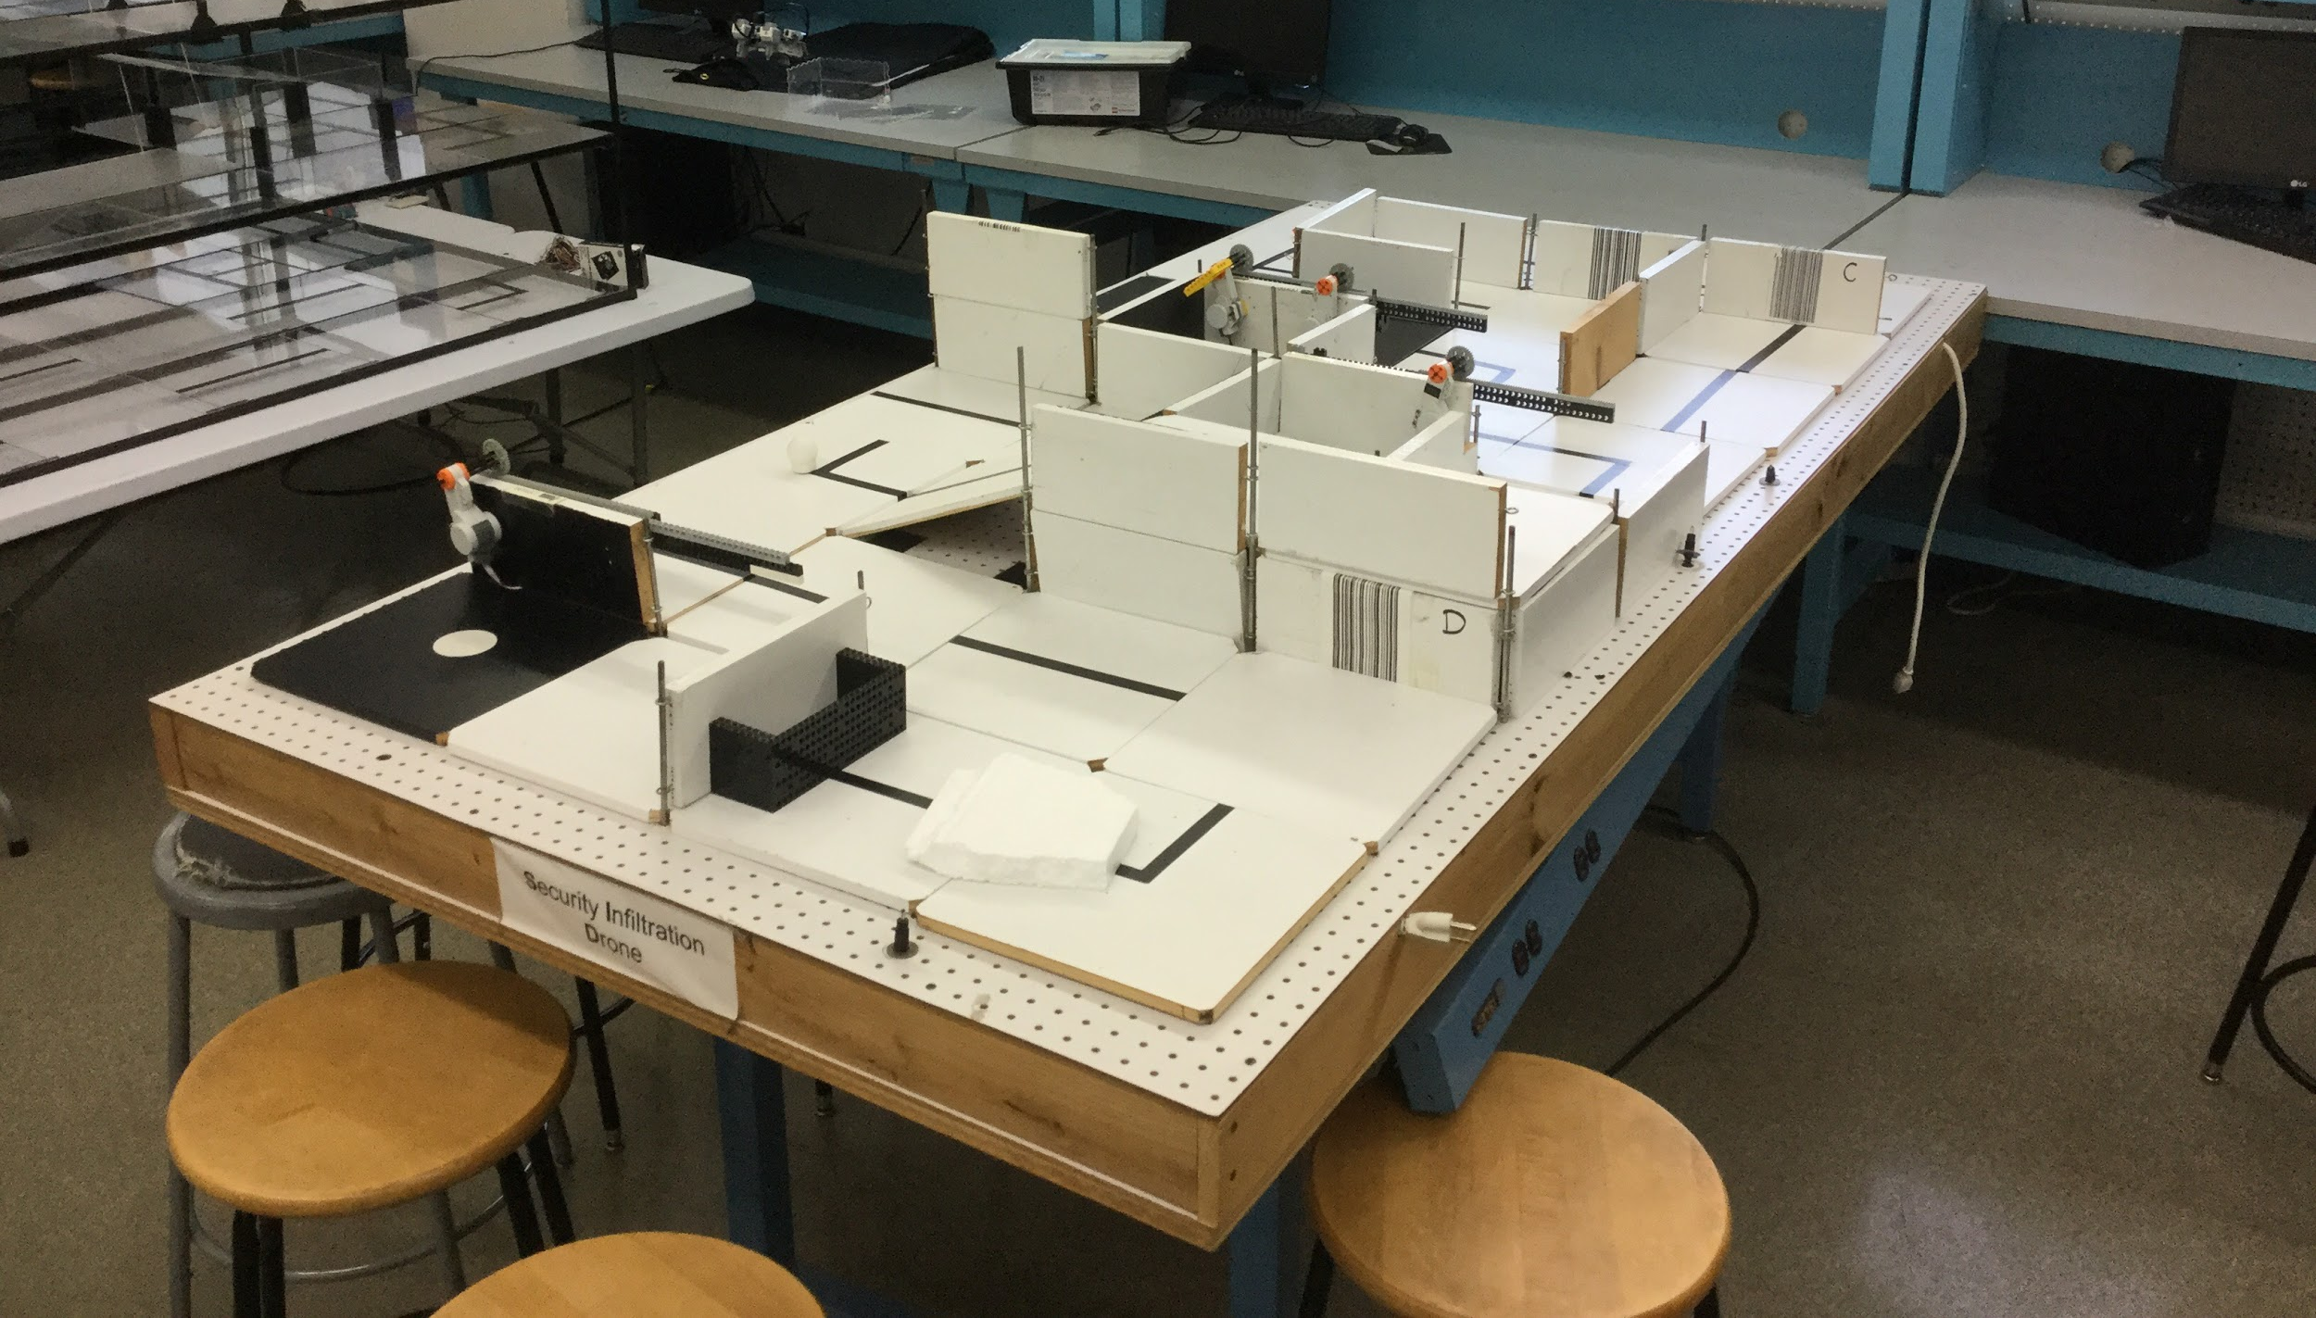
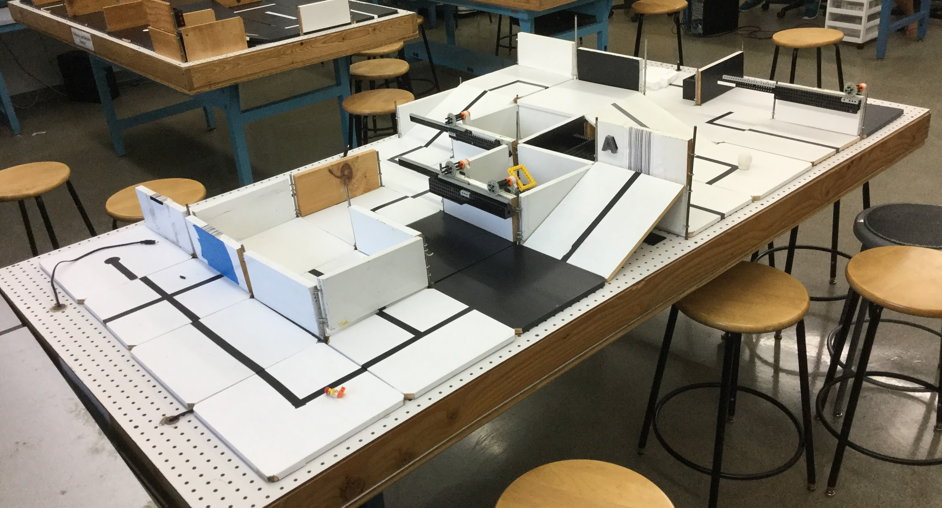
SLDP Options
Security Infiltration Drone (SID)
B
C
4
D
Barcode A: Gates 2 and 4
Barcode B: All gates
Barcode C: Gates 1 and 3
Barcode D: Gate 2 (delayed by 2 min)
3
A
2
START
1

Slide 26
SLDP Options
Security Infiltration Drone (SID)
Benchmark A:
Show puzzle solution
Scan first barcode in sequence
Benchmark B:
Scan 3 barcodes in sequence
Commission:
Reach exit (black tile)

Slide 27
SLDP Options
Security Infiltration Drone (SID)
Extra Credit:
Retrieve data canisters
(with robotic arm)

Slide 28
SLDP Options
Retrieval & Delivery System (RDS)
Retrieve fuel cells
Deliver them to three different hospitals
Hospitals consume power at different
levels of efficiency
Deliver a total of at least 200 hours of battery life
The robot must fit in a start area that is 25cm x 25cm

Slide 29
SLDP Options
Retrieval & Delivery System (RDS)
Fuel Cells
Center of tile = 25 hrs
Edge of tile = 30 hrs
Corner of tile = 35 hrs
Power Supply
Yellow = 1x
Blue = 2x
Red = 3x

Slide 30
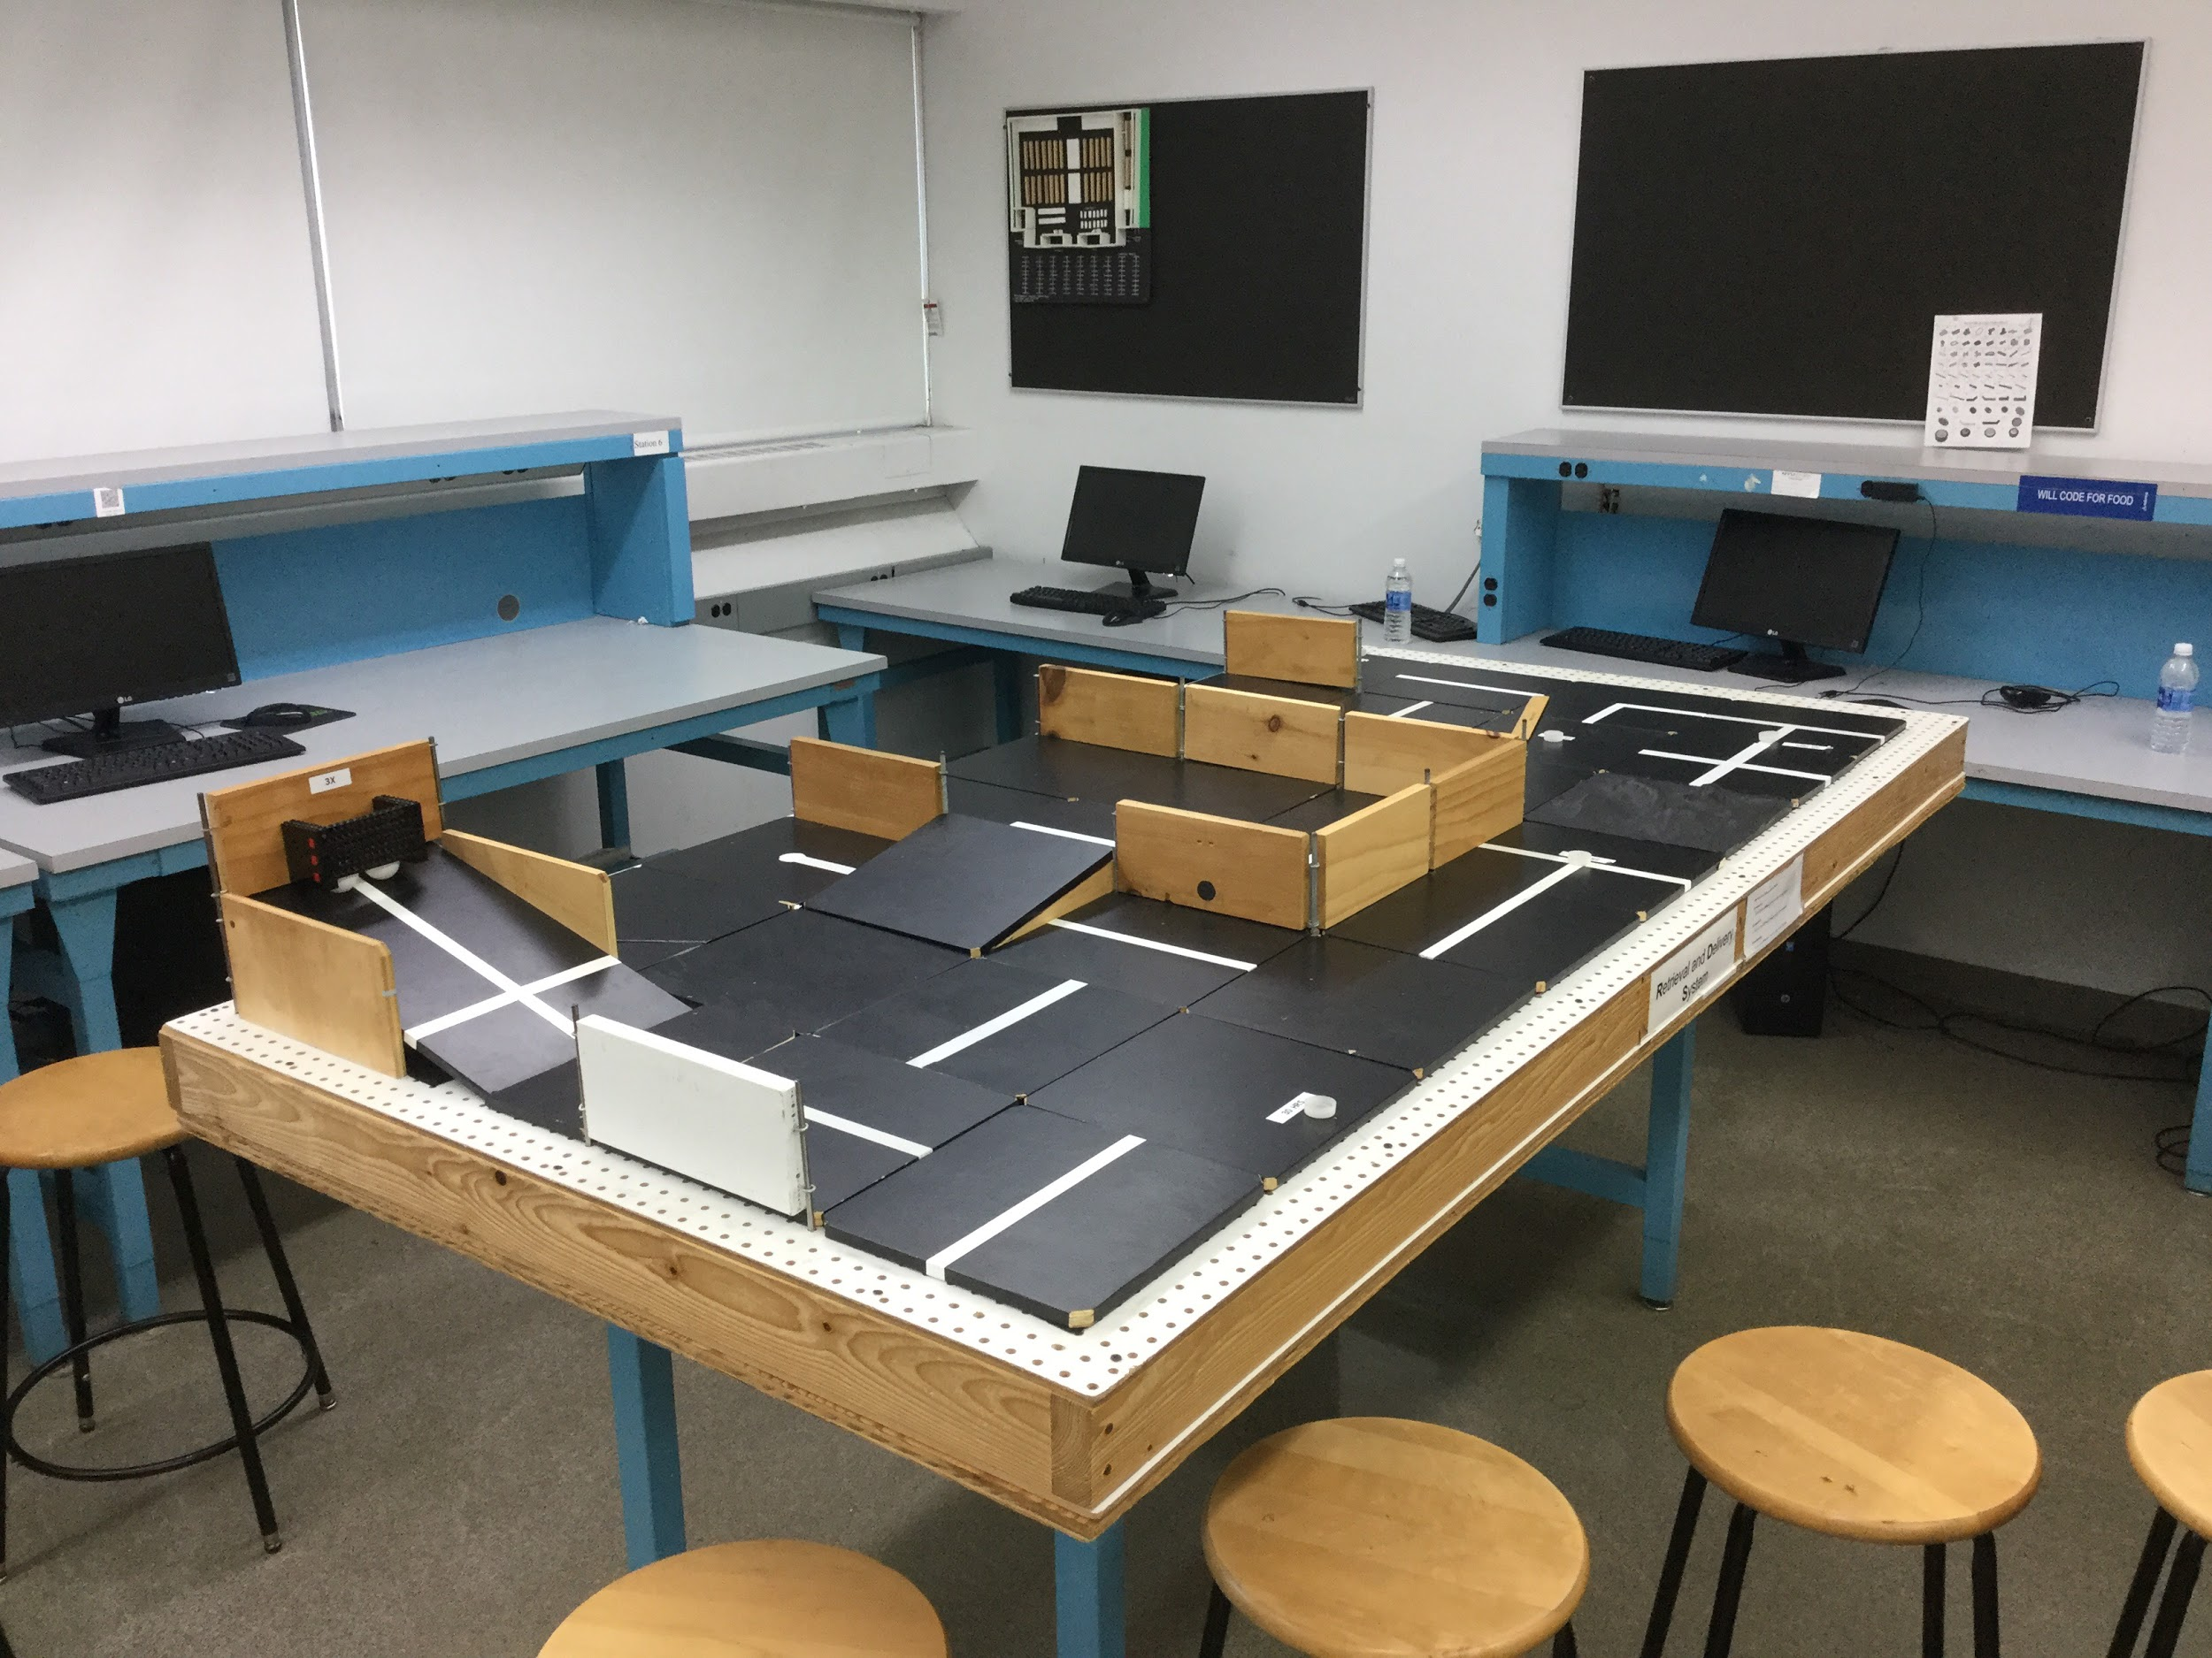
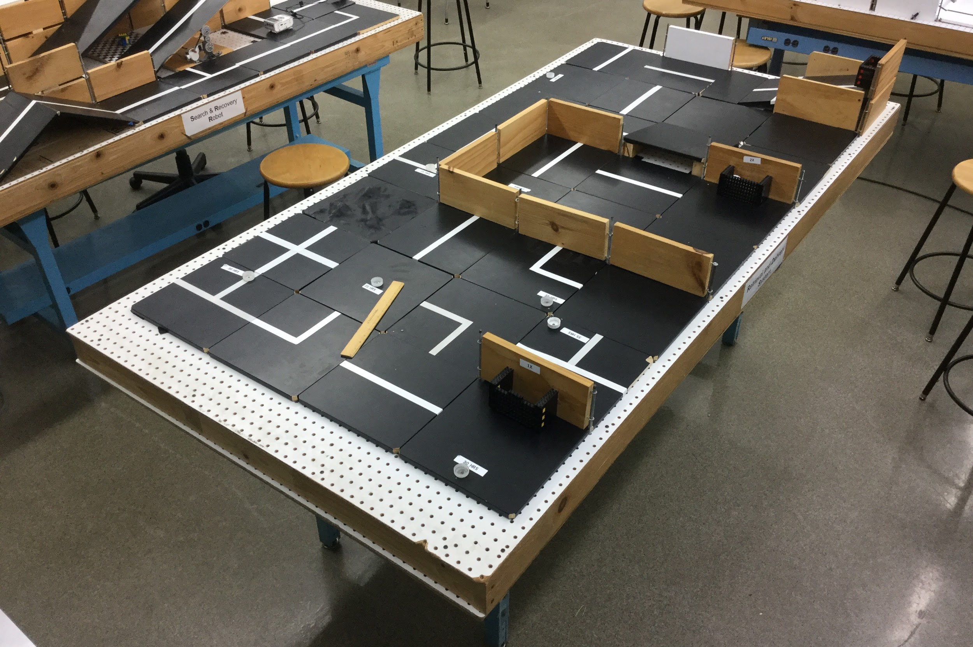
SLDP Options
Retrieval & Delivery System (RDS)
3x Multiplier
2x Multiplier
1x Multiplier

Slide 31
SLDP Options
Retrieval & Delivery System (RDS)
Benchmark A:
Deliver 50 hrs
Benchmark B:
Deliver 125 hrs total
Commission:
Deliver 200 hrs total

Slide 32
SLDP Options
Retrieval & Delivery System (RDS)
Extra Credit:
Additional full cells
Does not depend on hours
Depends on extra number of cells

Slide 33
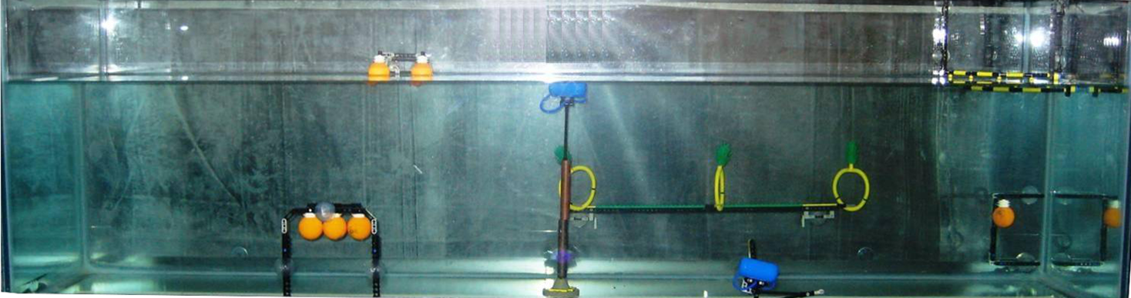
SLDP Options
Autonomous Underwater Vehicle (AUV)
Construct a robot that functions underwater
Perform tasks for a total
of 100 points
AUV must fit into a
1’ x 1’ x 1’ box
Must use waterproofed sensors and case
Oil spill task

Slide 34
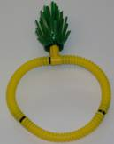
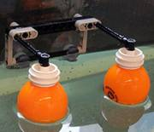
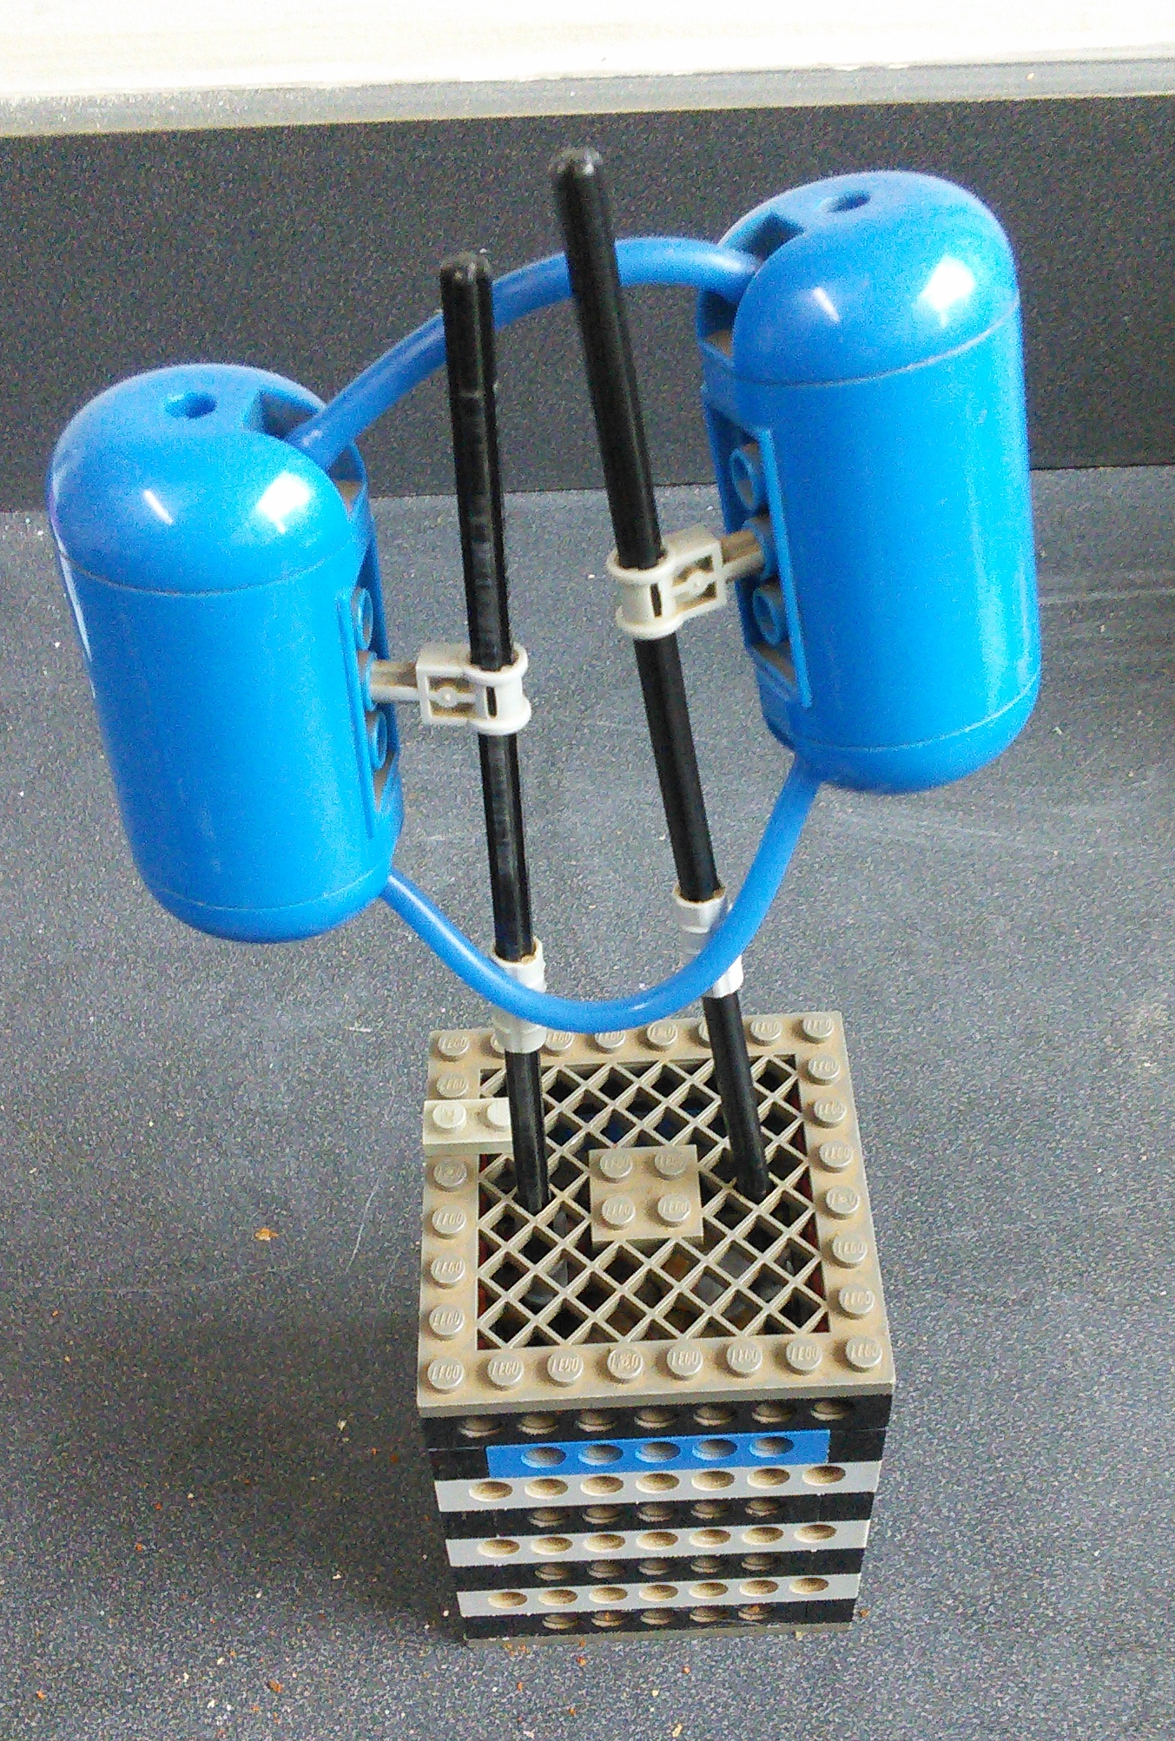
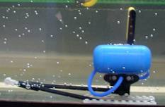
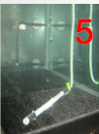
SLDP Options
1
2
Autonomous Underwater Vehicle (AUV)
Marine Plant Samples
5 points
15 points if brought back to start
Data Canisters
10 points
Oceanographic Sensor
20 points
Seismic Reader
10 points
Oil Spill
40 points
3
4

Slide 35
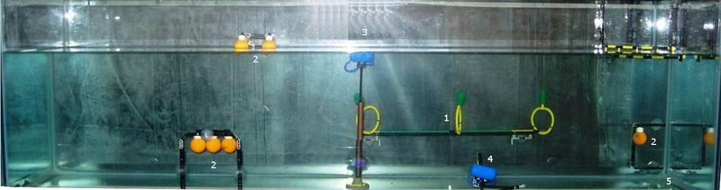
SLDP Options
Autonomous Underwater Vehicle (AUV)
20 points
5 or 15 points
10 points
40 points
10 points

Slide 36
SLDP Options
Autonomous Underwater Vehicle (AUV)
Benchmark A:
Earn 25 points
Benchmark B:
Earn 60 points
Commission:
Earn 100 points

Slide 37
SLDP Options
Autonomous Underwater Vehicle (AUV)
Extra Credit:
Rover design (stays underwater): 5 pts
Skimmer design (skims water surface): 10 pts
Hybrid design (floats underwater, changes elevation): 15 pts

Slide 38
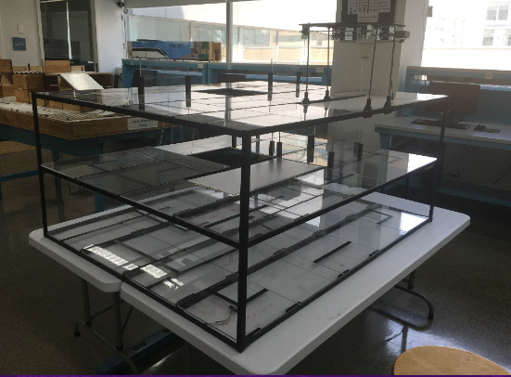
SLDP Options
Subterranean Infiltrator & Fortune Retriever (SIFR)
Solve puzzle
Activate ramps via Hall Effect sensors
Reach the “treasure” at the bottom of the course
Optional:
Return to start

Slide 39
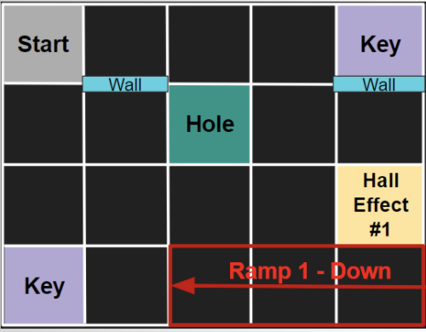
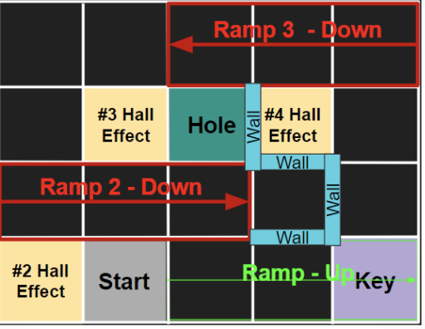
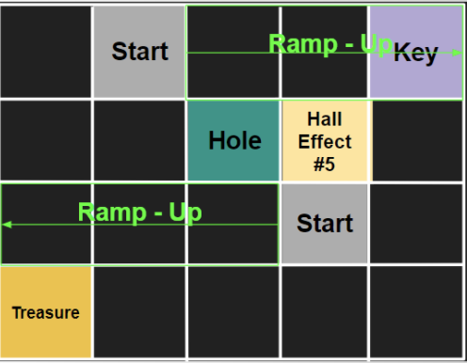
SLDP Options
Subterranean Infiltrator & Fortune Retriever (SIFR)
Top
Middle
Bottom

Slide 40
SLDP Options
Subterranean Infiltrator & Fortune Retriever (SIFR)
Benchmark A:
Show TA the puzzle solution
Activate Ramp 1
Benchmark B:
Activate Ramp 1
Activate Ramp 2 or 3
Commission:
Retrieve “Treasure”
Have “escape route” ready

Slide 41
SLDP Options
Subterranean Infiltrator & Fortune Retriever (SIFR)
Extra Credit:
Using Ramp 3 / Hall Effect 4
Return to Middle Layer
Return to Start

Slide 42
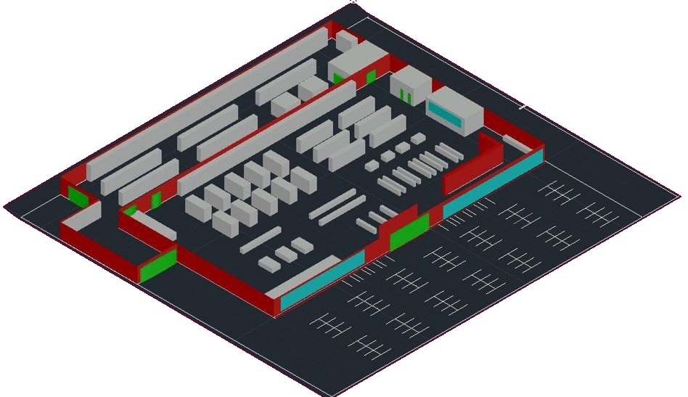
SLDP Options
Supermarket Logistics System (SLS)
  Create 3D AutoCAD
  of supermarket (No physical model)
  Plan utilities layout
      Electrical system
      Plumbing system
Create LabVIEW VI’s
    Lighting System
    Heating/ Cooling system
    Security System

Slide 43
SLDP Options
Supermarket Logistics System (SLS)
Benchmark A:
  Floor plan
  Front elevation
  Most detailed side
  Lighting system VI
    8 lights w breaker switch
Benchmark B:
  Everything from Benchmark A
  Plumbing layer
  Electrical layer
  Most detailed side
  Heating & cooling VI

Slide 44
SLDP Options
Supermarket Logistics System (SLS)
Commission:
LabVIEW VI’s
  Lighting system
  Heating & cooling system
  Alarm system
Model of building & parking lot
  3D AutoCAD or Revit
  No physical models
AutoCAD drawings
  Floor plan
  Plumbing system
  Electrical system
  Front elevation
  Most detailed side

Slide 45

SLDP Options
Supermarket Logistics System (SLS)
Extra Credit:
Incorporate LEED certification
into the design of supermarket
Different levels of certification
  LEED Silver (2 categories)
  LEED Gold (4 categories)
  LEED Platinum (All 6 categories)
Teams choose the ones that best fit their design

Slide 46
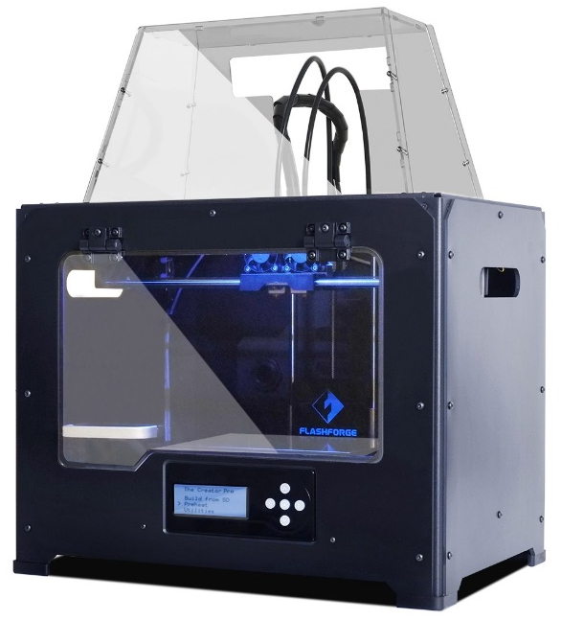
3D Printing Extra Credit
Design your own SLDP team logo
  Due by Milestone 2 Presentations
Be creative with your design (2 pts EC)
  Your design will need approval by a 3D printing TA
  Can’t be text like Lab 1
  Multiple colors are available: purple, black, white,
  yellow, red, green, pink, light blue, blue, clear
  More info on 3D Printing Extra Credit page on lab manual

Slide 47
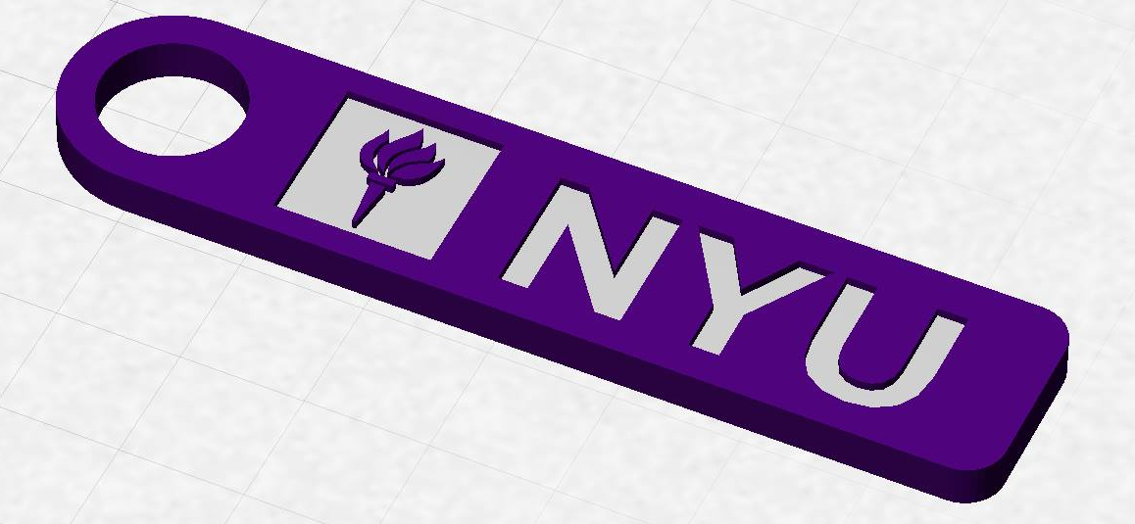
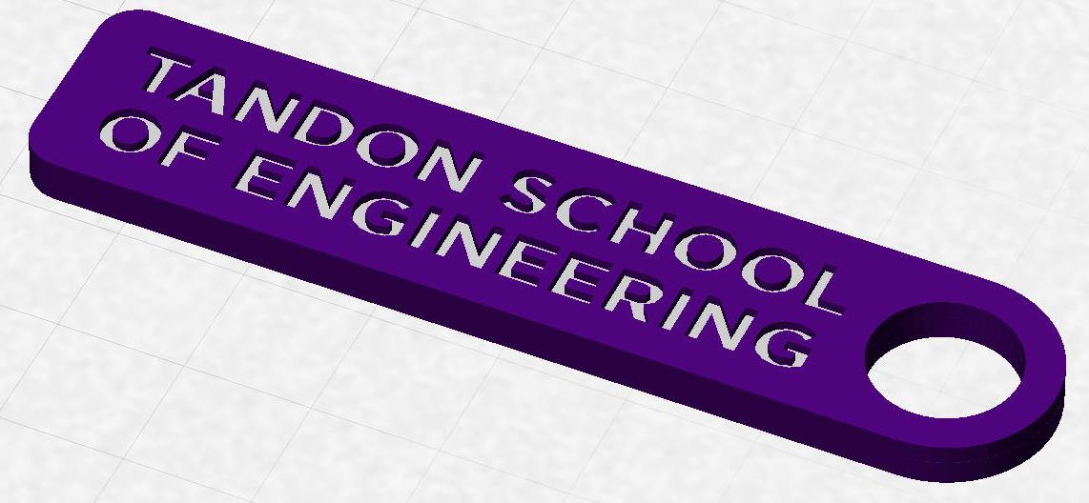
3D Printing Extra Credit
Constraints:
  Maximum weight of 15 grams
  No copyrighted logos
  Must be attached to robot or worn
  as pin during Final Presentation

Slide 48
3D Printing Extra Credit ADVANCED
An experimental opportunity to create a prototype of a custom,
3D-printed robot part or terrain modification (4 pts EC)
Constraints:
  Due by Milestone 2 Presentations
  YOU MUST HAVE A CONTINGENCY PLAN if the piece does not
  work or cannot be printed
  For full list of constraints see the 3D Printing Extra Credit page on lab manual
You may print parts at the MakerSpace, or you can receive one-on-one instruction in the EG Prototyping Lab (Rogers Hall 223)

Slide 49
3D Printing Extra Credit Submission
Submit your design at eg.poly.edu under the
3D Printing Submission tab
  Your first submission is due by Milestone 2
  Your design must be a .stl file
  After your submission has been received you will be contacted by a TA to come start your print

Slide 50
Closing
Refer to manual.eg.poly.edu for details
Think about which project interests you
Brainstorm ideas
Speak with professors and TAs regarding projects

Slide 51

Semester-Long Design Project
QUESTIONS?

