Slide 1
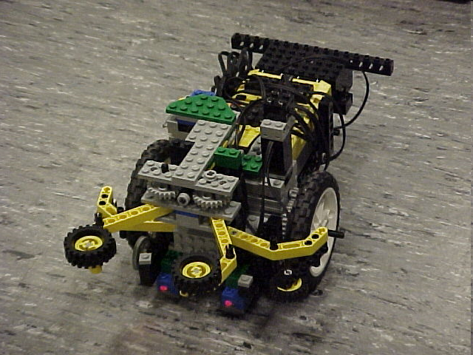
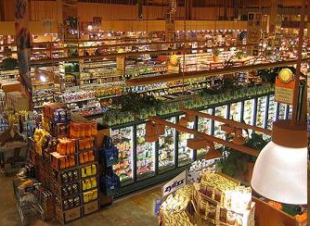
Semester-Long Design Project

Slide 2
Project Introduction
Project duration: 10 weeks
Teams of 2-3 people
Projects to choose from:
  Supermarket
  Robot (seven types)

Slide 3
Project Grading
Item | % of Grade
Benchmarks and Commissioning | 50%
Final Presentation | 50%
NOTE: The SLDP counts toward 30% of your course final grade!

Slide 4

Project Grading
Benchmarks:
  Completion of a specified portion of the project
  2 Benchmarks throughout semester
  Refer to schedule for due dates
  Penalties for not completing on time
  They are cumulative, i.e. Benchmark B includes Benchmark A

Slide 5
Project Grading
Commissioning:
  Completion of all required tasks
  Last phase of project
  Refer to syllabus for due dates
  Failure to commission will result
  in penalties (partial commissioning)

Slide 6
Project Grading
Partial Commissioning:
  If you have reached up at least to Benchmark A, you’ve earned at least 30% for commissioning
  If you have reached up at least to Benchmark B, you’ve earned at least 70% for commissioning
  Any value higher than your benchmarks is decided by two TAs watching a full run

Slide 7
Project Grading
Project Submission:
  Submit Technical and Managerial related documents via an online form provided toward end of semester
  Must be received in order to obtain SLDP grade (30%)
  Any missing items will result in penalties
  Refer to syllabus for deadline
  Refer to Submission Guidelines

Slide 8
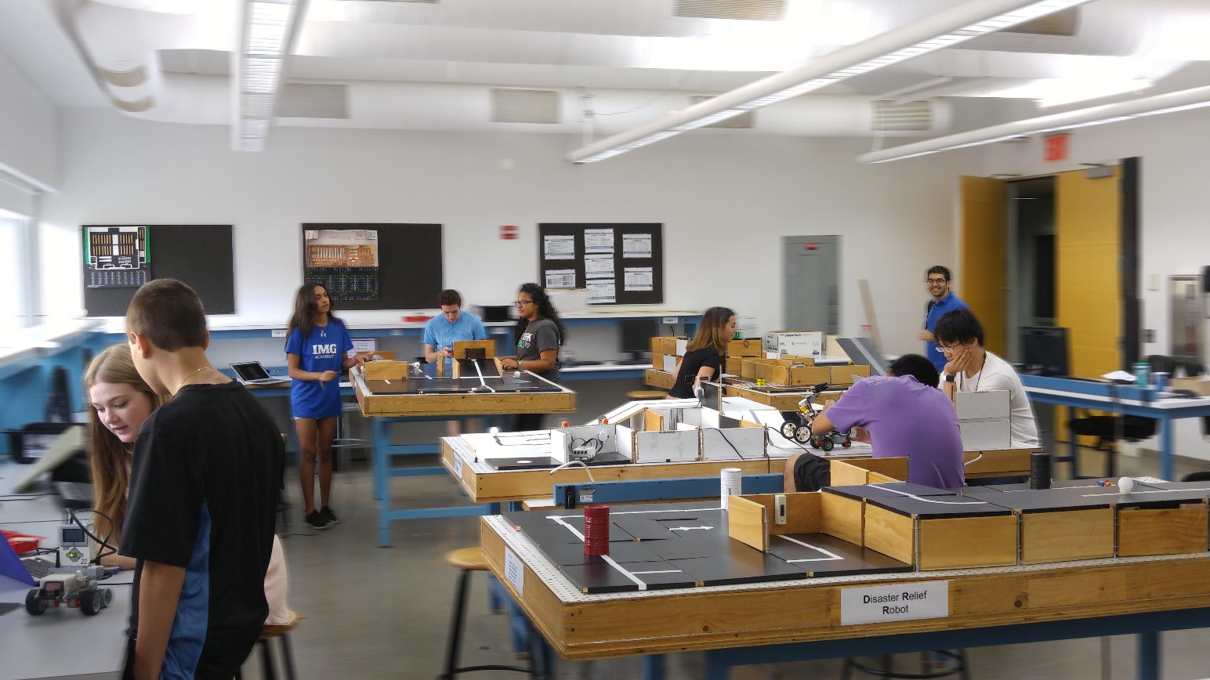
SLDP Options
Seven Robot Variants
Housing and Innovation
in Revit

Slide 9
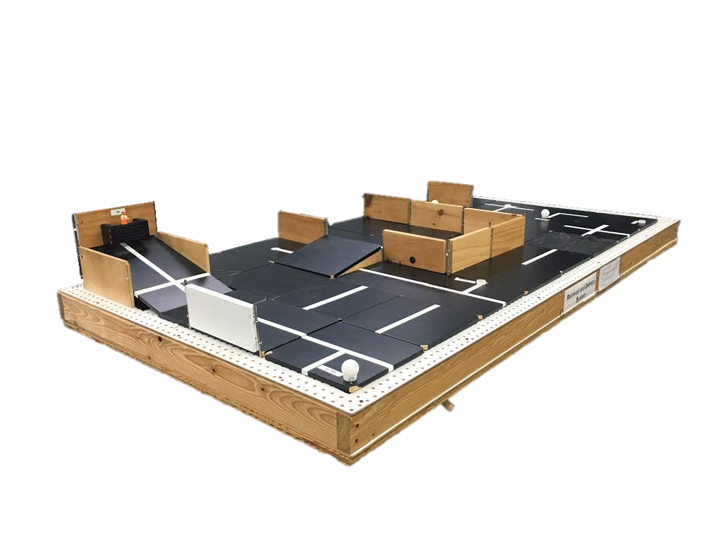
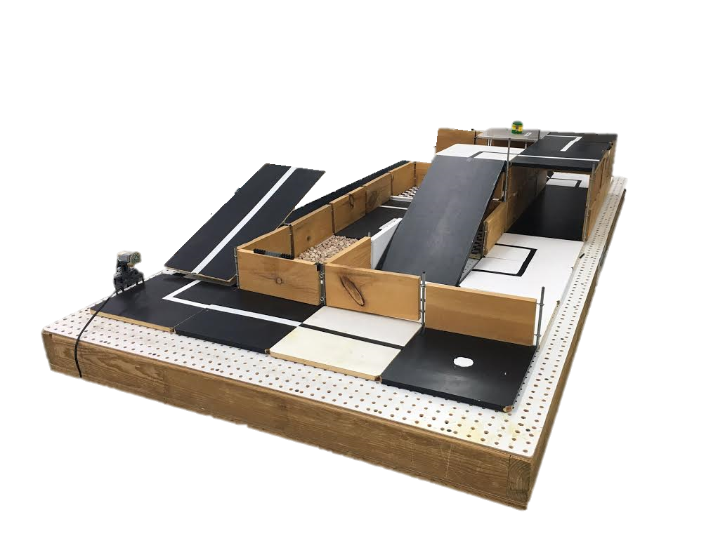
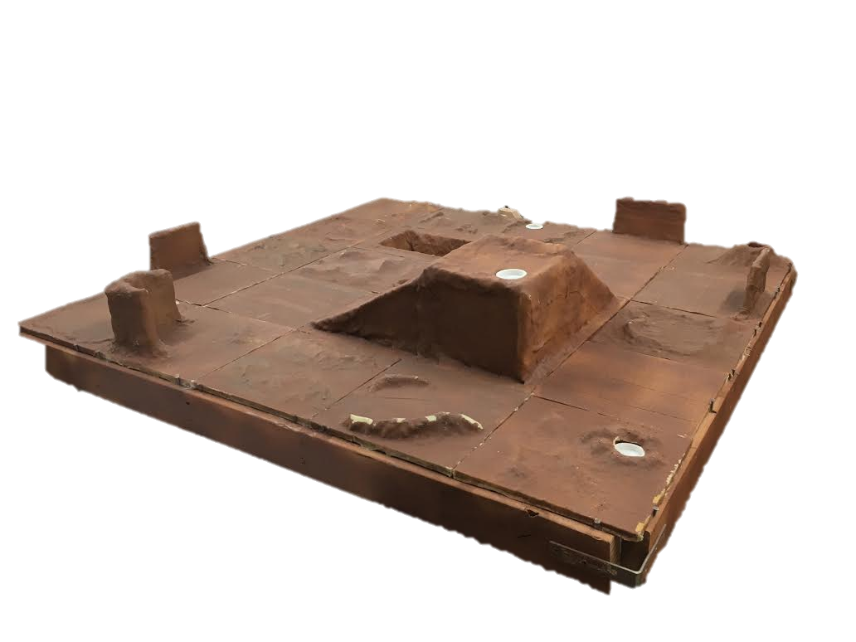
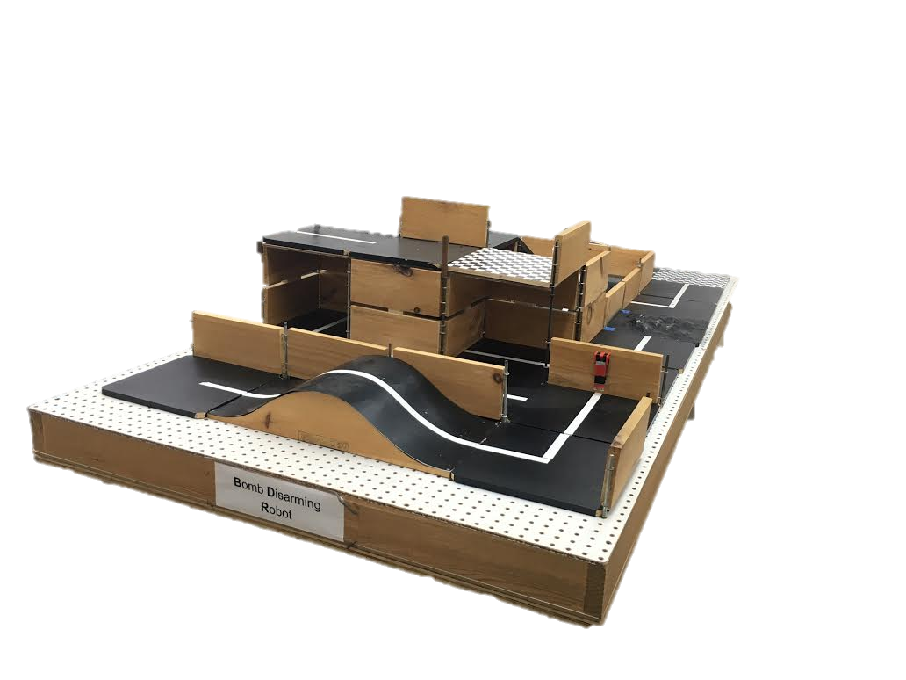
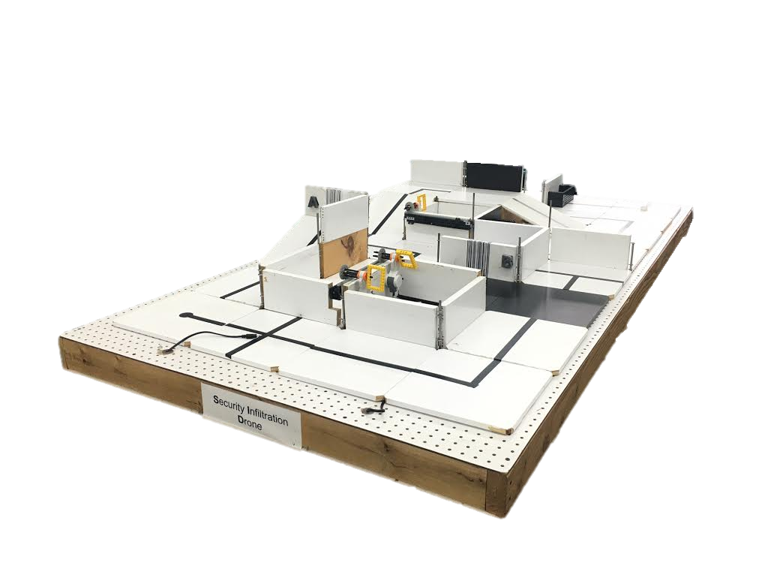
SLDP Options
Robot Variants

Slide 10
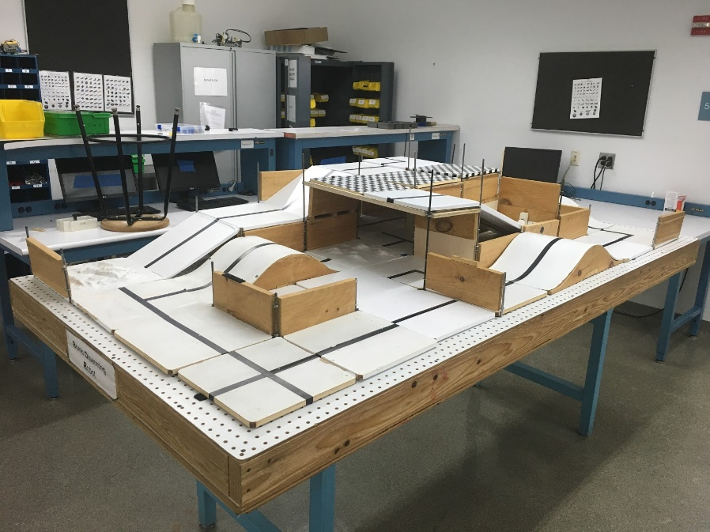
SLDP Options
Bomb Disarming Robot (BDR)
Disarm bomb and return to start
Avoid decoy bombs
Robot must be able to autonomously
navigate the obstacle course provided
Robot must fit in a start area that is 25cm x 25cm
Maximum height is 20cm

Slide 11
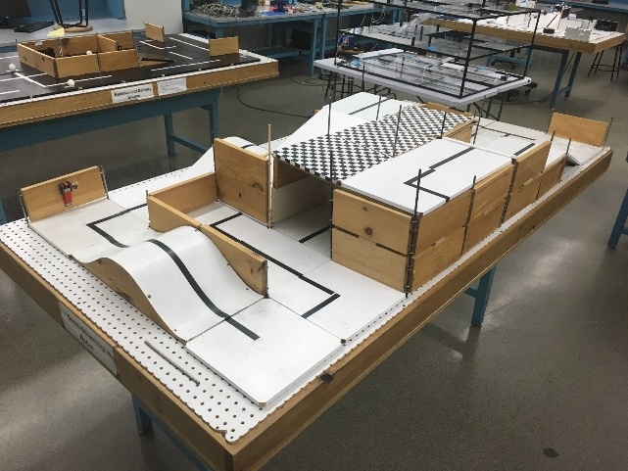
SLDP Options
Bomb Disarming Robot (BDR)
Allowed
Jumping off
upper levels
Climbing walls
Prohibited
Arms
Slingshots
Projectiles

Slide 12

SLDP Options
Bomb Disarming Robot (BDR)
Benchmark A:
Pass two hills
Benchmark B:
Disarm bomb
Commission:
Return to start

Slide 13

SLDP Options
Bomb Disarming Robot (BDR)
Extra Credit:
Disable and retrieve triangulation device(s)

Slide 14
SLDP Options
Mars Rover Robot (MRR)
Collect one soil and one water reading
Pick up sensor between readings if necessary
Carry module(s) FROM start TO respective tile
Answer Data Specifications questions

Slide 15
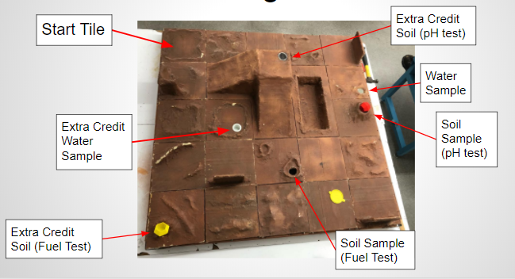
SLDP Options
*Pavel sold separately

Slide 16
SLDP Options
Mars Rover Robot (MRR)
Benchmark A:
Obtain one reading
Benchmark B:
Obtain first reading
Return to pick up module if necessary
Obtain second different reading
Commission:
Obtain a water and soil reading
Return to landing site
Conduct all corresponding tests

Slide 17
SLDP Options
Mars Rover Robot (MRR)
Extra Credit:
Obtain all 3 types of readings
Cross the canyon
Traverse up and down mountain
Collect reading from an EC tile

Slide 18
SLDP Options
Retrieval & Delivery System (RDS)
Retrieve fuel cells
Deliver them to three different hospitals
Hospitals consume power at different
levels of efficiency
Deliver a total of at least 200 hours of battery life
The robot must fit in a start area that is 25cm x 25cm

Slide 19
SLDP Options
Retrieval & Delivery System (RDS)
Fuel Cells
Center of tile = 25 hrs
Edge of tile = 30 hrs
Corner of tile = 35 hrs
Power Supply
Yellow = 1x
Blue = 2x
Red = 3x

Slide 20
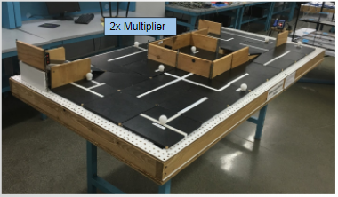
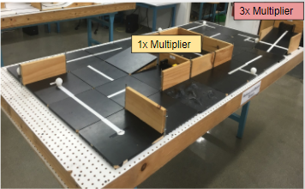
SLDP Options
Retrieval & Delivery System (RDS)

Slide 21
SLDP Options
Retrieval & Delivery System (RDS)
Benchmark A:
Deliver 50 hrs
Benchmark B:
Deliver 125 hrs total
Commission:
Deliver 200 hrs total

Slide 22
SLDP Options
Retrieval & Delivery System (RDS)
Extra Credit:
Additional full cells
Does not depend on hours
Depends on extra number of cells

Slide 23
SLDP Options
Search & Recovery Robot (SRR)
Retrieve lost space module Zarya from moon and return to start
The robot must fit in a start area that is 25cm x 25cm

Slide 24
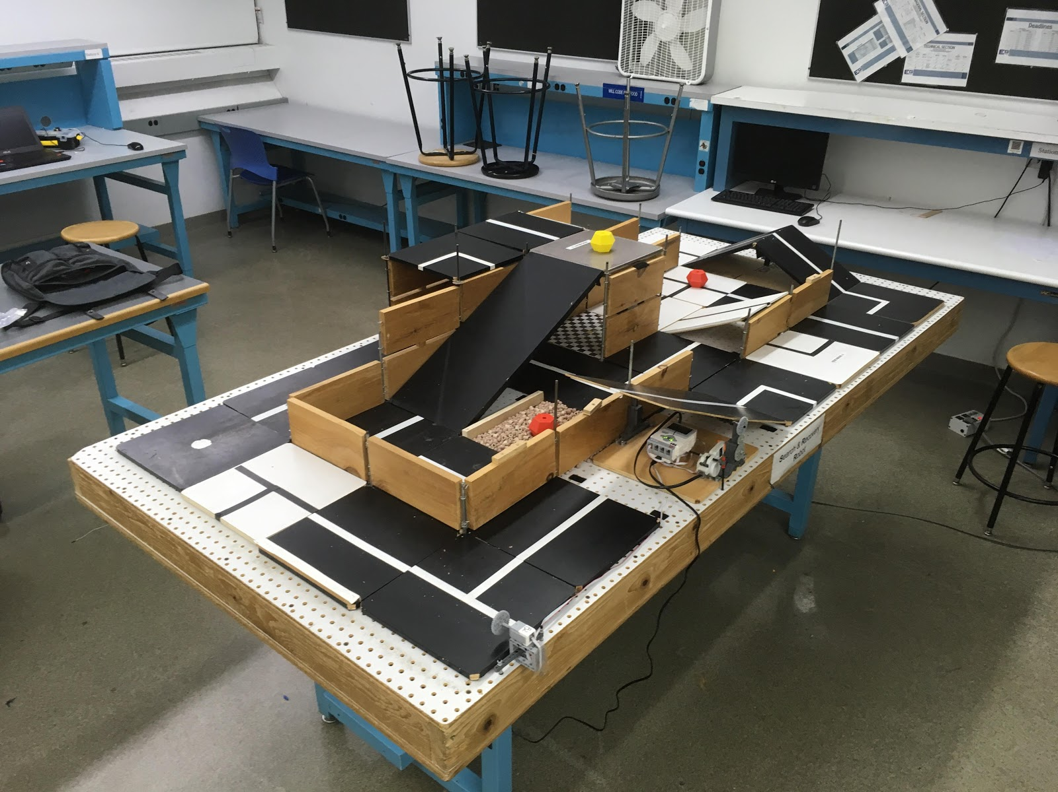
SLDP Options
Search & Recovery Robot (SRR)

Slide 25
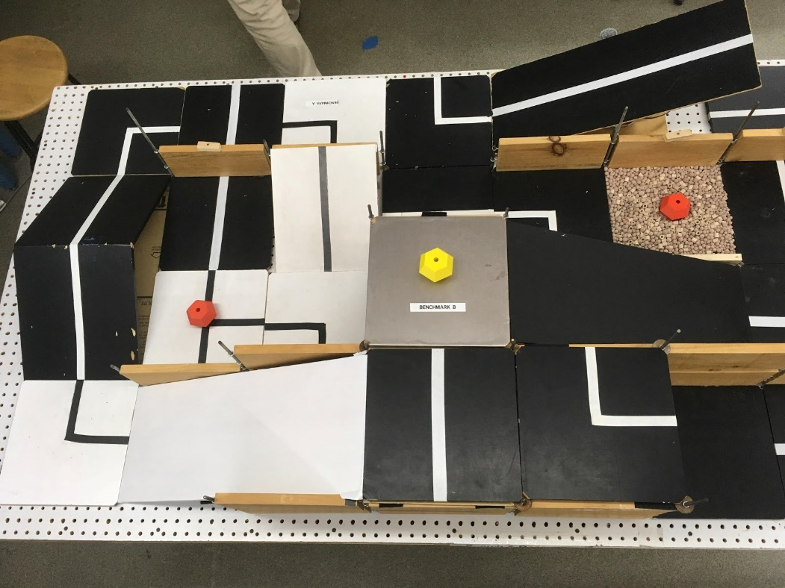
SLDP Options
Search & Recovery Robot (SRR)
Modules
Quest Zarya Unity

Slide 26
SLDP Options
Search & Recovery Robot (SRR)
Benchmark A:
Traverse Hill Tile (Path 1)
Traverse Bridge (Path 2)
Benchmark B:
Retrieve Zarya
Commission:
Return to start with Zarya

Slide 27
SLDP Options
Search and Recovery Robot (SRR)
Extra Credit:
Retrieve other modules
Traverse moon dust

Slide 28
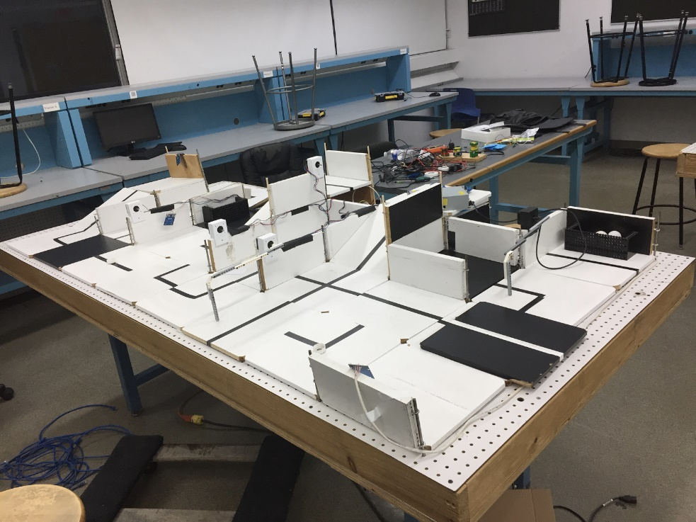
SLDP Options
Security Infiltration Drone (SID)
Solve puzzle to deactivate gates by activating RFID tags
Reach exit point
Robot must fit in a start area that
is 25cm x 25cm

Slide 29
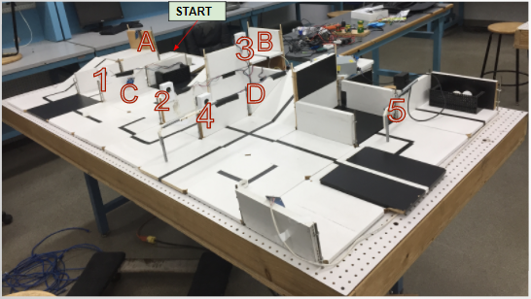
SLDP Options
Security Infiltration Drone (SID)
Numbers are gates
Letters are RFIDs

Slide 30

SLDP Options
Security Infiltration Drone (SID)
Benchmark A:
Show puzzle solution
Activate first tag in sequence
Benchmark B:
Activate 3 tags in sequence
Commission:
Reach exit (black tile)

Slide 31
SLDP Options
Security Infiltration Drone (SID)
Extra Credit:
Retrieve data canisters

Slide 32
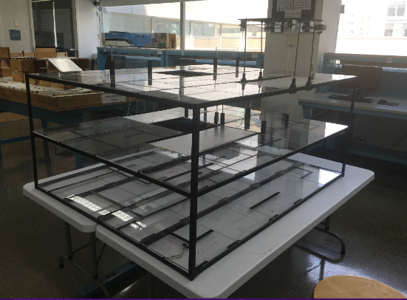
SLDP Options
Subterranean Infiltrator & Fortune Retriever (SIFR)
Solve puzzle
Activate ramps via RFID sensors
Reach the “treasure” at the bottom of the course
Optional:
Return to start

Slide 33
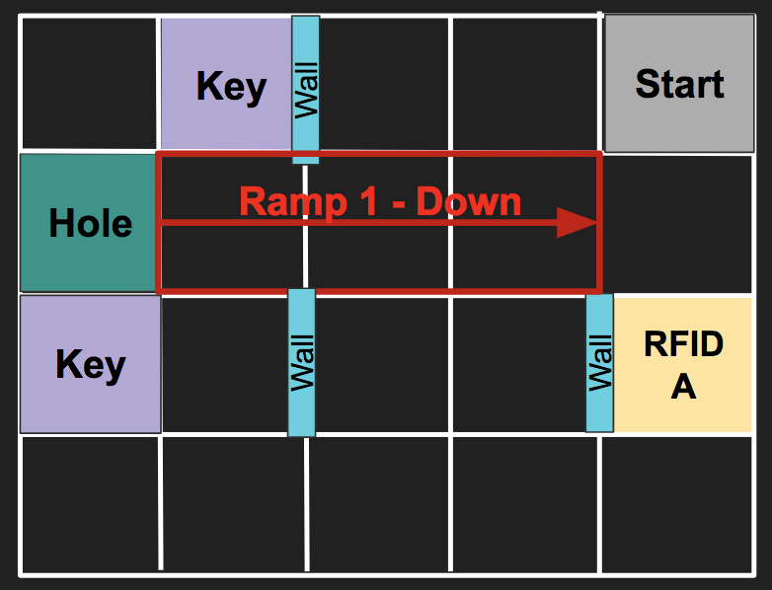
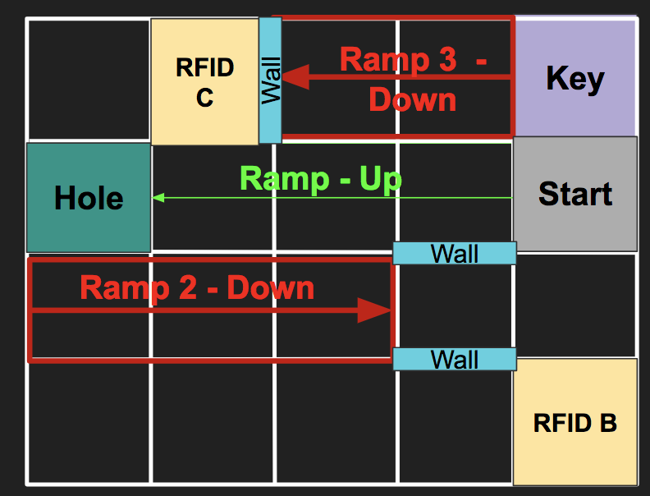
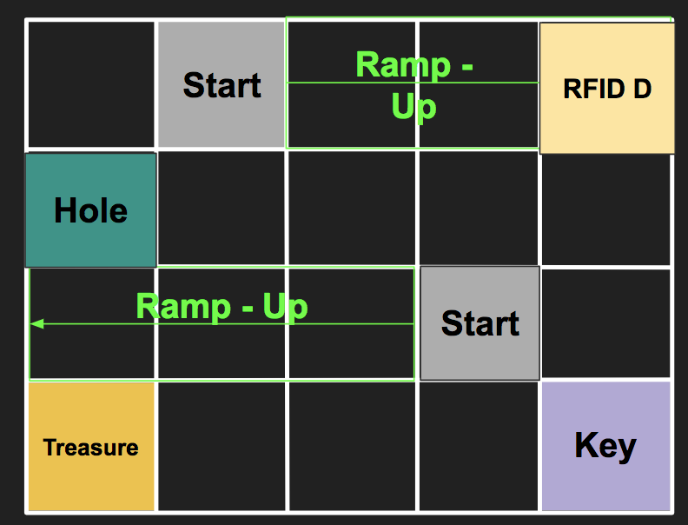
SLDP Options
Subterranean Infiltrator & Fortune Retriever (SIFR)
Top
Middle
Bottom

Slide 34
SLDP Options
Subterranean Infiltrator & Fortune Retriever (SIFR)
Benchmark A:
Show TA the puzzle solution
Activate Ramp 1
Benchmark B:
Activate Ramp 1
Activate Ramp 2 or 3
Commission:
Retrieve “Treasure”
Have “escape route” ready

Slide 35
SLDP Options
Subterranean Infiltrator & Fortune Retriever (SIFR)
Extra Credit:
Using Ramp 3 / Tag 4
Return to Middle Layer
Return to Start

Slide 36
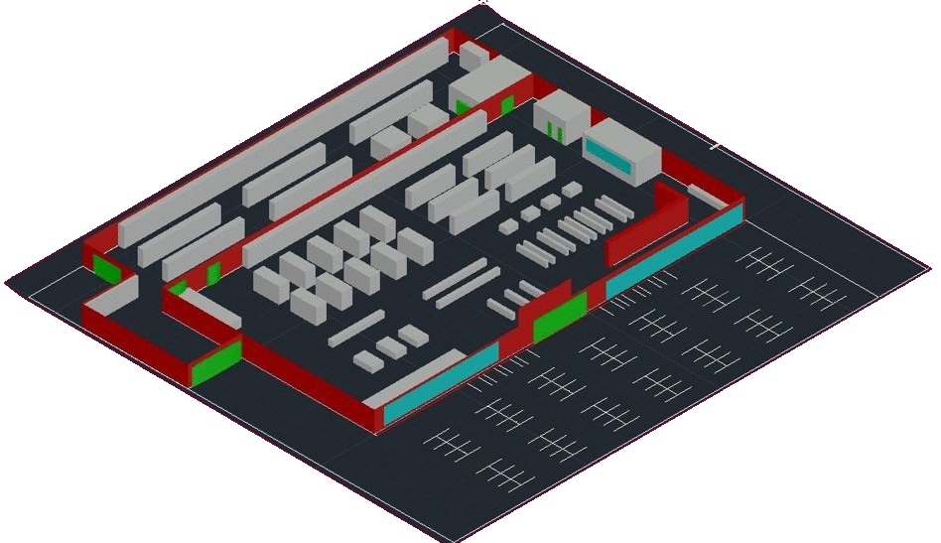
SLDP Options
NYU Housing and Innovation in Revit
Create a 3D Revit Model of a
college campus extension to
NYU Tandon (No physical model)
  Plan utilities layout
      Electrical system
      Plumbing system
      HVAC system
Create LabVIEW VI’s
    Lighting System
    Heating/ Cooling system
    Security System

Slide 37
SLDP Options
Housing and Innovation in Revit (HIR)
Benchmark A
  One Recreational Space Design
  One 20 student classroom design
  One 40 student classroom design
Benchmark B
  Everything from Benchmark A
  All Classroom designs
  Facility of choice
  Electrical, plumbing, and HVAC for one dorm

Slide 38
SLDP Options
Housing and Innovation in Revit (HIR)
Commission:
Revit drawings
  Floor plan for all floors (minimum 6)
  Plumbing system
  Electrical system
  HVAC system
  Front elevation
  Most detailed side
  Gold LEED certification
Model of Building:
  3-D Revit model
  NO ARTS & CRAFTS MODELS
Extra Credit:
  3-D print exterior of building for 3-D extra credit
  Platinum LEED certification

Slide 39

SLDP Options
Housing and Innovation in Revit (HIR)
LEED Description:
Leadership in Energy & Environmental Design (LEED) is a green building certification program
Different levels of certification
  LEED Silver (2 categories)
  LEED Gold (4 categories) - Mandatory
  LEED Platinum (All 6 categories) – Extra Credit
Teams choose the ones that best fit their design

Slide 40
SLDP Options
Housing and Innovation in Revit (HIR)
LEED Categories:
Location & Transportation
Sustainable Sites
Water Efficiency
Energy & Atmosphere
Indoor Environmental Quality
Innovation

Slide 41
SLDP Options
Housing and Innovation in Revit (HIR)
Example Category - Indoor Environmental Quality:
Air Quality Management: carbon monoxide detectors, air filtration
Interior Lighting/Daylight: dimmers, window shades
Thermal Comfort: localized heating & cooling, circulating fans
Acoustic Performance: acoustic tiles, acoustic wall panels

Slide 42
SLDP Options
Housing and Innovation in Revit (HIR)
LEED Requirements:
Incorporated into their project design
Detailed in Revit drawings
Analyzed through Cost estimates
Design explanations

Slide 43
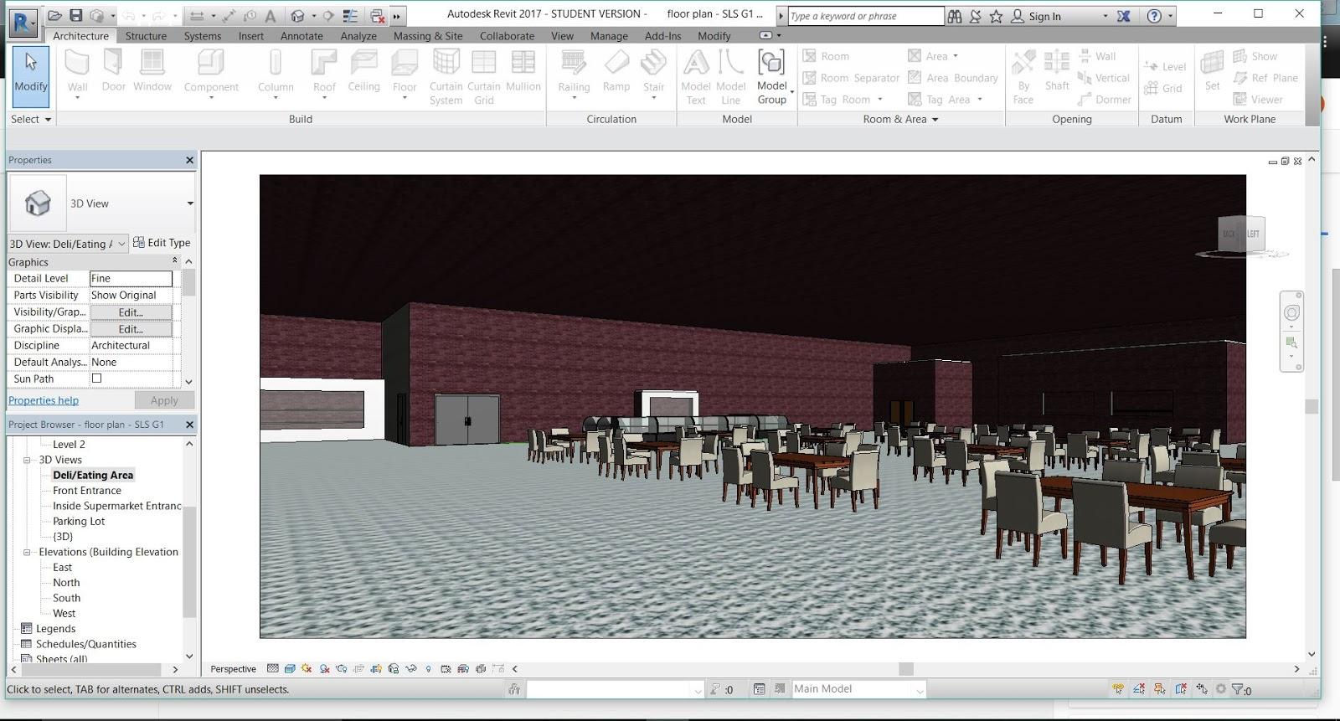
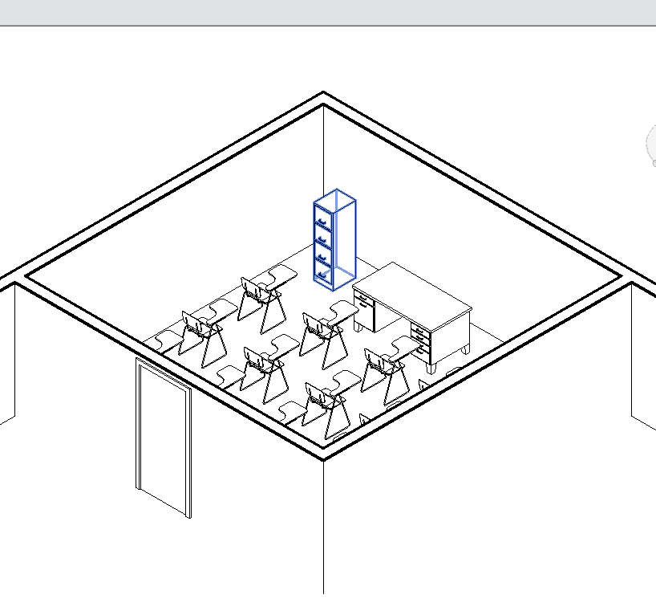
SLDP Options
Housing and Innovation in Revit (HIR)
Examples:

Slide 44
SLDP Options
Rapid Assembly and Design Challenge
RAD Challenge exists to give students with prior experience in STEM the opportunity to devise their own semester long design project with a group of their peers.
Students are expected to complete a more challenging task, but have access to more resources than other SLDP groups
Follows regular benchmark schedule, and includes deadlines for 2 additional reports

Slide 45
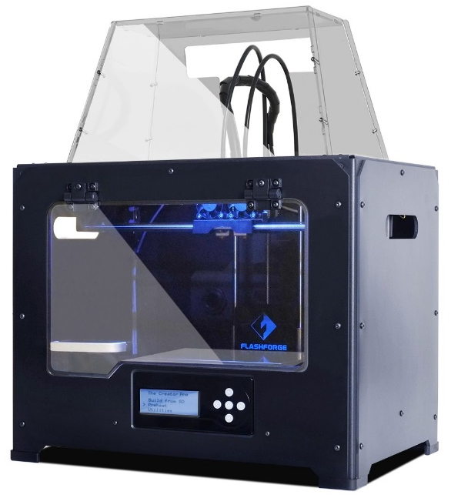
3D Printing Extra Credit
Design your own SLDP team logo
  Due by Milestone 2 Presentations
Be creative with your design (2 pts EC)
  Your design will need approval by a 3D printing TA
  Can’t be text like Lab 1
  Multiple colors are available: purple, black, white,
  yellow, red, green, pink, light blue, blue, clear
  More info on 3D Printing Extra Credit page on lab manual

Slide 46
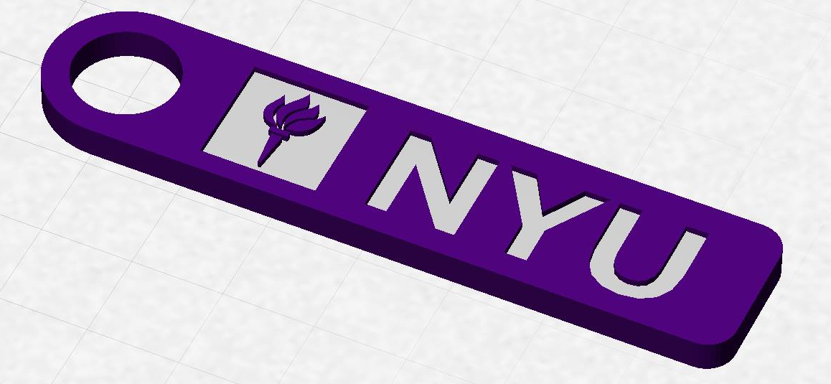
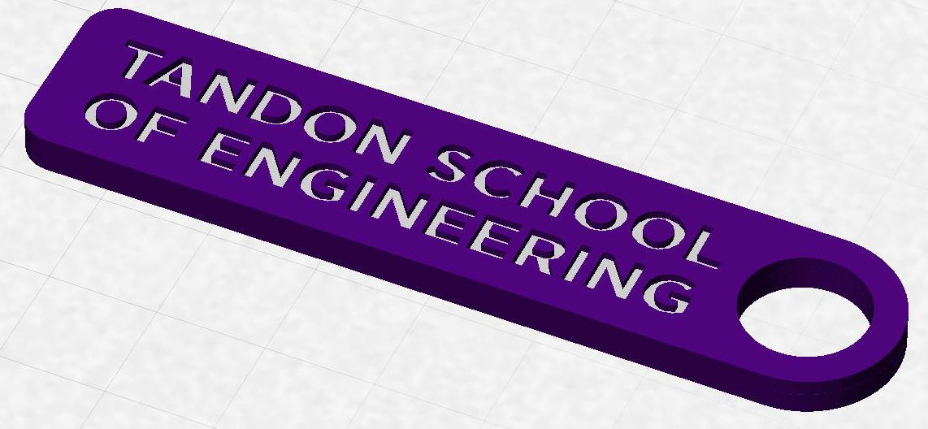
3D Printing Extra Credit
Constraints:
  Maximum weight of 15 grams
  No copyrighted logos
  Must be attached to robot or worn
  as pin during Final Presentation

Slide 47
3D Printing Extra Credit ADVANCED
An experimental opportunity to create a prototype of a custom,
3D-printed robot part or terrain modification (4 pts EC)
Constraints:
  Due by Milestone 2 Presentations
  YOU MUST HAVE A CONTINGENCY PLAN if the piece does not
  work or cannot be printed
  For full list of constraints see the 3D Printing Extra Credit page on lab manual
You may print parts at the MakerSpace, or you can receive one-on-one instruction in the EG Prototyping Lab (in the modelshop)

Slide 48
3D Printing Extra Credit Submission
Submit your design at eg.poly.edu under the
3D Printing Submission tab
  Your first submission is due by Milestone 2
  Your design must be a .stl file
  After your submission has been received you will be contacted by a TA to come start your print

Slide 49
Closing
Refer to manual.eg.poly.edu for details
Think about which project interests you
Brainstorm ideas
Speak with professors and TAs regarding projects

Slide 50

Semester-Long Design Project
QUESTIONS?

