Slide 1
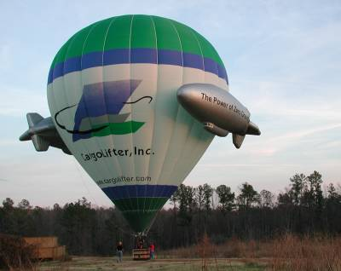
Hot Air Balloon Competition
Notes:
L.Mexhitaj 2009

Slide 2
Overview
Objective
Background
Materials
Procedure
Report / Presentation
Closing

Slide 3
Objectives
Demonstrate basic principles of buoyancy and thermodynamics
Use concept of minimal design

Slide 4
Hot Air Balloon Principles - Buoyancy
Archimedes’ Principle
Object immersed in fluid is buoyed up by force equal to weight of fluid displaced by object

Slide 5
Hot Air Balloon Principles - Thermodynamics
Air pressure, volume, and temperature are related via Ideal Gas Law
Raising air temperature at constant volume (balloon envelope) causes air density within to drop
Excess air will escape
Balloon weighs less than displaced air
Buoyant forces cause balloon to rise
Ideal Gas Law:
V =Volume
P = Pressure
n = # of Moles of Air
T = Absolute Temperature (Kelvin)
R = Gas Constant (0.0821 L atm/mol K)

Slide 6
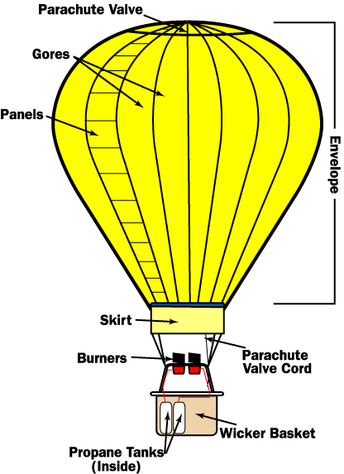
Components of Hot Air Balloon

Slide 7
Problem Statement
Design/construct balloon
Maximize payload (paperclips)
Maximize flight time
Minimize cost
Materials must be “purchased”

Slide 8
Competition Rules
Add paperclip payload to finished design
TA positions balloon above personal heater, releases when balloon temperature stabilizes
Time aloft and # of paperclips recorded by TA
TA times flight duration with a stopwatch/timer
Balloon must rise from release point & fly for at least 1 second
Competition ratio used to judge design
Team with highest ratio wins
3 trials maximum: design changes permitted (cumulative cost)
Note: Payload is equal to # of paperclips
Balloon Ratio:

Slide 9
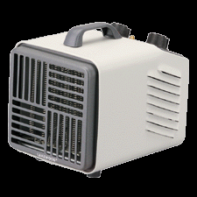
Materials
Glue stick
Scissors
Paper clips
Personal heater
Tissue paper
8½ " x 11" paper
Drawing paper
Kevlar string
Plastic straws
Plastic tape

Slide 10
Material Price List
Tissue paper………………………..$0.10/sheet
8½" x 11" paper…………..……..$0.05/sheet
Drawing paper……………………..$0.10/sheet
Kevlar string..……………….……..$0.05/ft
Tape……………………………………$0.03/ft
Plastic straws……………………….$0.00

Slide 11
Procedure
Assess provided materials
Brainstorm possible designs
Sketch design on paper
Maximum allowable balloon size of 1m³
Label properly
TAs must initial sketches
Major design revisions must also be initialed

Slide 12
Procedure
Create price list detailing your design
Materials must be “purchased” from TA
Unused materials will not be refunded
Construct design based on initialed sketch
Note design changes
Have TA photograph final flight configuration
Still shot or video

Slide 13
Assignment: Report
Individual Bonus (!) Lab Report
Title Page
Discussion topics in the manual
Include original data with TA’s signature
Include class results and photo of balloon

Slide 14
Assignment: Presentation
Team presentation
State rules of competition
Describe your design and its concepts
Include table of class results and photo/video of balloon
How could your current design be improved?
Refer to “Creating PowerPoint Presentations” found on EG website

Slide 15
Closing
Have all original data signed by TA
Submit all work electronically
Return all unused materials to TA

Slide 16
GOOD LUCK!

