Slide 1

Software for Engineers
EG1003: Introduction to Engineering and Design

Slide 2


Overview
Objectives
Materials
Background
Procedure
Report
Closing

Slide 3


Objectives
Familiarization with relevant software
Explore Microsoft software tools
  Word
  Excel

Slide 4
Software Tasks
Microsoft Word
  Copy generic document
  Personalize copied version
  Record information
Microsoft Excel
  Replicate table of values
  Create computed values column
  Plot graph based on tabulated data

Slide 5
Materials
Computer equipped with:
  MS Word
  MS Excel

Slide 6
Background Information:
Microsoft Office Software
Word
  For lab reports, proposals, documents
Excel
  For tables, charts/graphs, data analysis

Slide 7
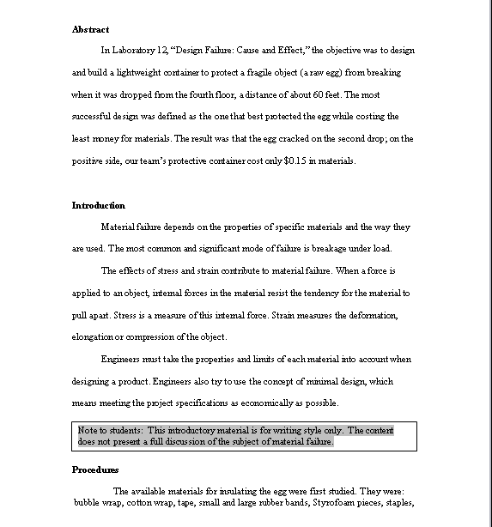
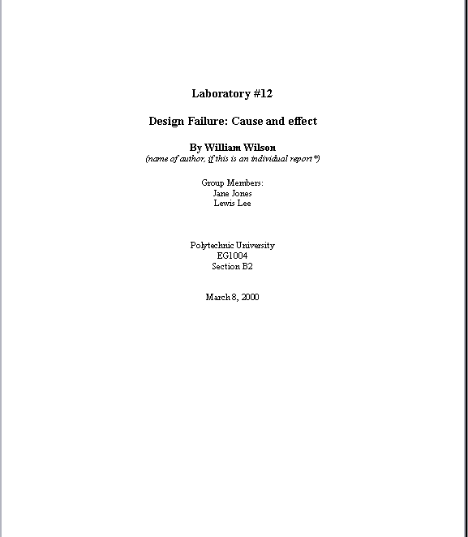
Example: MS Word

Slide 8

Example: MS Excel

Slide 9
Procedure: MS Word
Copy generic document
  Information includes name, address, schedule, etc.
  Manual has exact specifications
Edit document to include your information
Save original and updated files for submittal and presentation

Slide 10
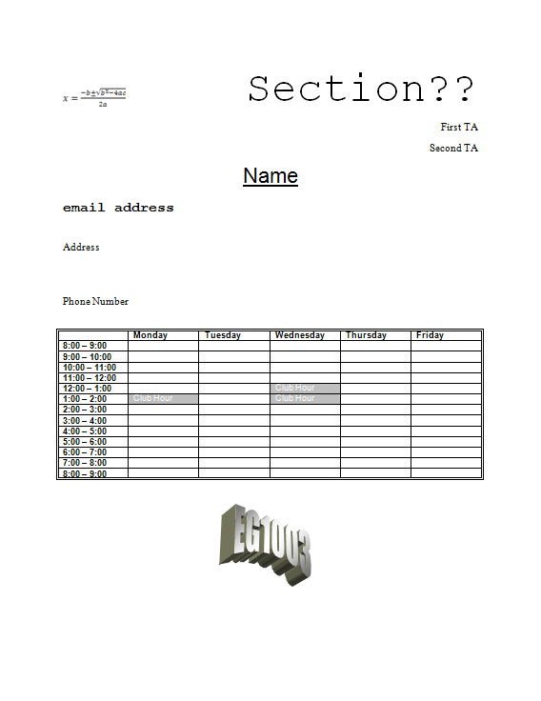
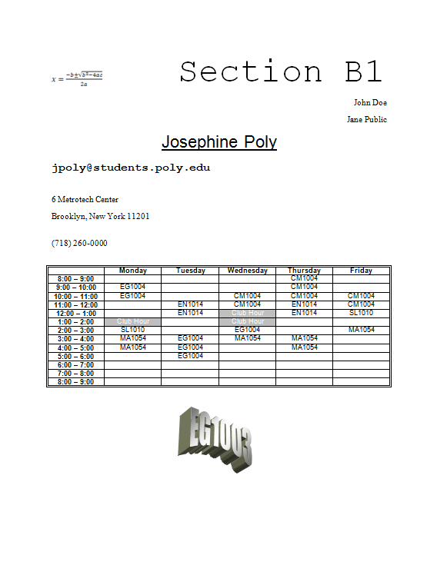
Procedure: MS Word Documents

Slide 11
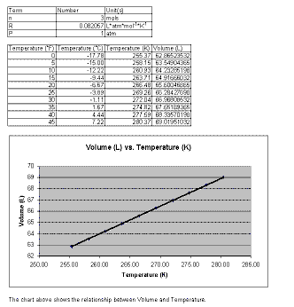
Procedure: MS Excel
Create 2 tables based on Charles’ Law
  Temperature data values are provided by TAs
  Using Charles’ Law, calculate volumes at specified temperatures
Plot volume vs. temperature based on generated tables

Slide 12
Assignment: Written Report
Independent report (one report per student)
Standard lab report submission
Submit online (eg.poly.edu) before midnight of day of Lab #2
One Word Document Containing:
  Title Page (MS Word: name, partner, lab title, etc.)
  Generic Schedule
  Personalized Schedule
  Mousetrap competition report
Excel File: Two tables & graph

Slide 13
Closing
Each team member must use software
Submit all work electronically by 11:59pm before Lab #2
Work together with your partner
  TA is always available for assistance
Mousetrap Car Competition
  Following MS Office Exercise

