Slide 1


EG1003: Introduction to Engineering and Design
Software for Engineers

Slide 2


Overview
Objectives
Software Tasks
Background
Procedure
Assignment
Closing

Slide 3
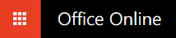

Objective
Familiarization with relevant software
Explore software tools
Word
Excel
PowerPoint
AutoCAD

Slide 4
Software Tasks
Microsoft Office Enter Excel equations Create Word template for lab reports Create PowerPoint template for lab presentations | Autodesk AutoCAD Learn the basics of CAD software Practice 2D and 3D drawing functions Build an EG logo keychain Export to 3D print file

Slide 5
Background Information
Microsoft Excel or Google Sheets
For tables, charts/graphs, data analysis
Microsoft Word or Google Docs
For lab reports, proposals, documents
Microsoft PowerPoint or Google Slides
For professional slideshow presentations

Slide 6
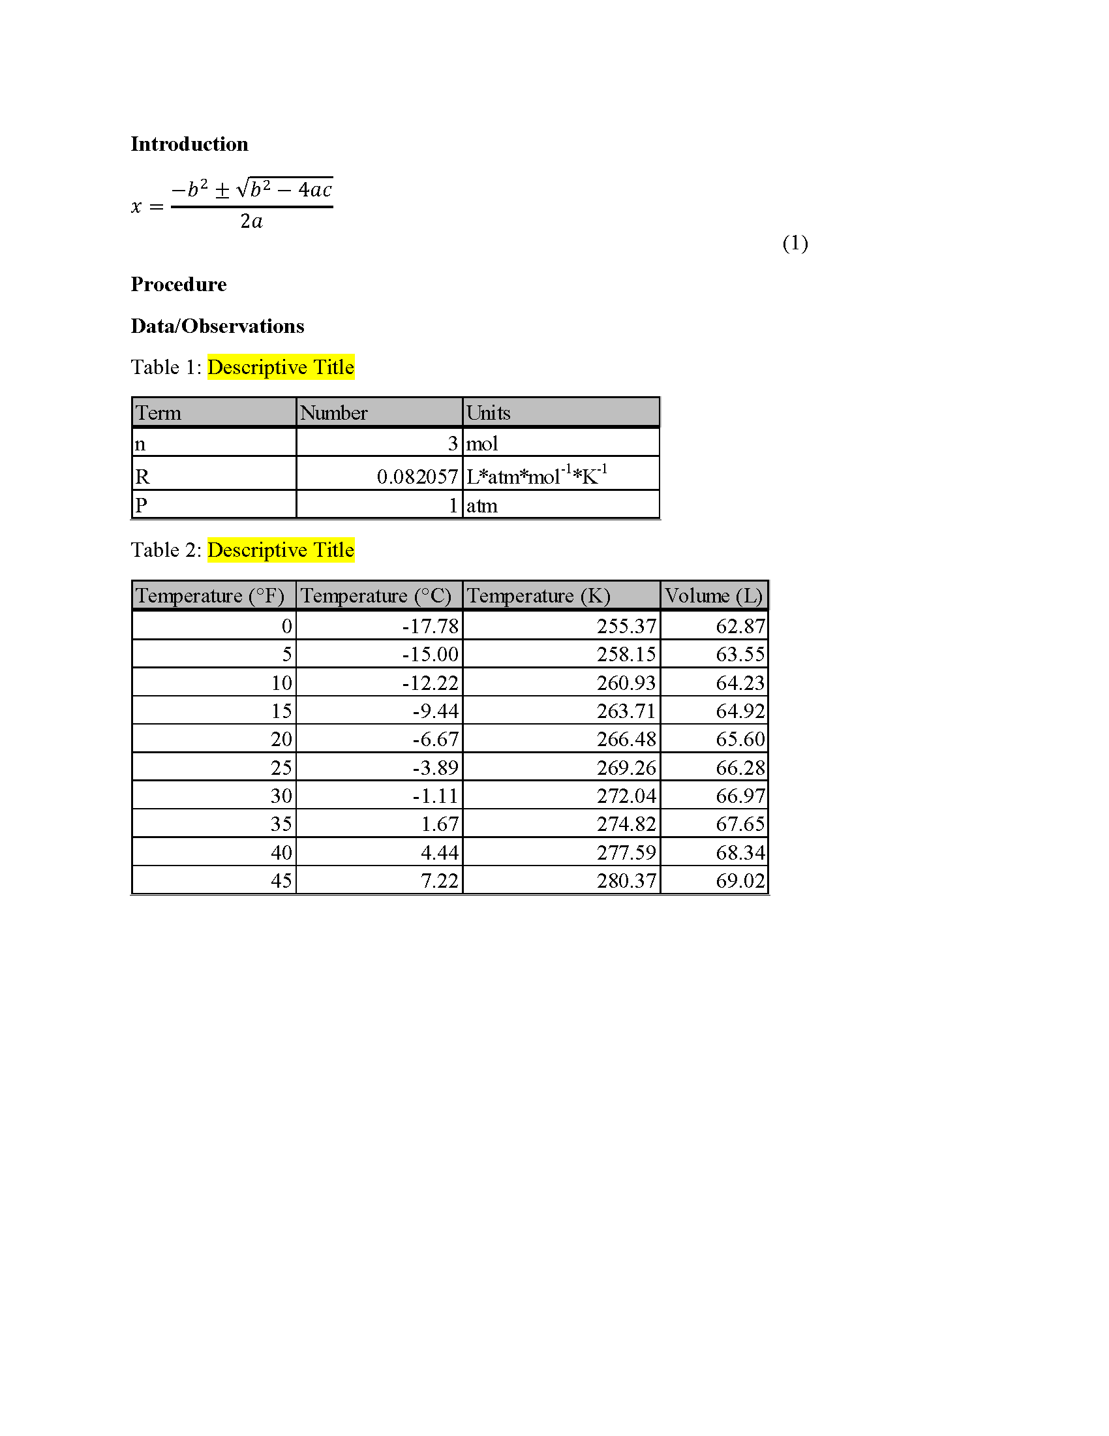
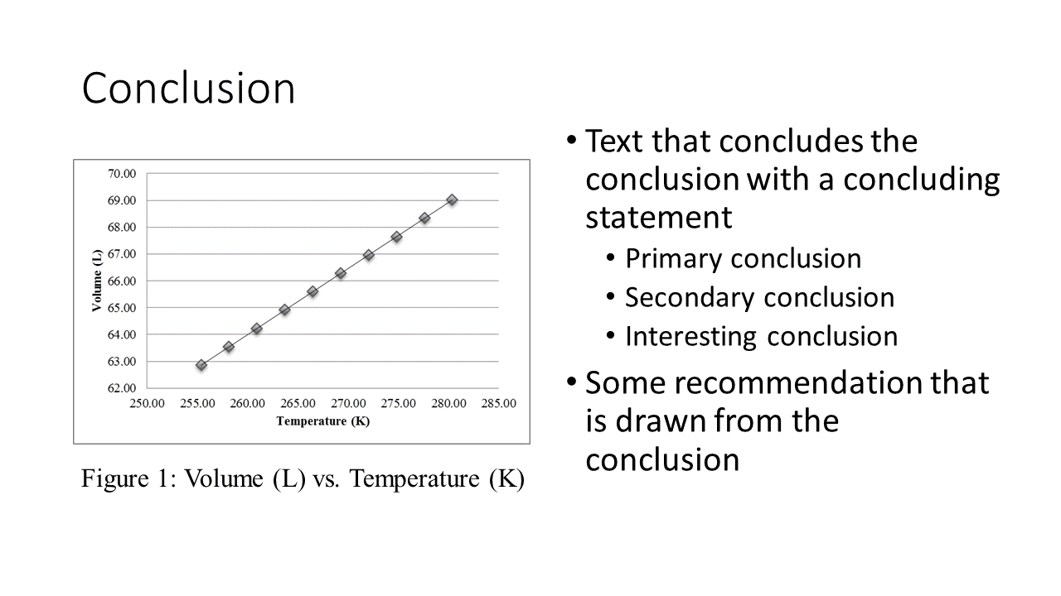
Example: Word and PowerPoint

Slide 7
Example: Excel

Slide 8
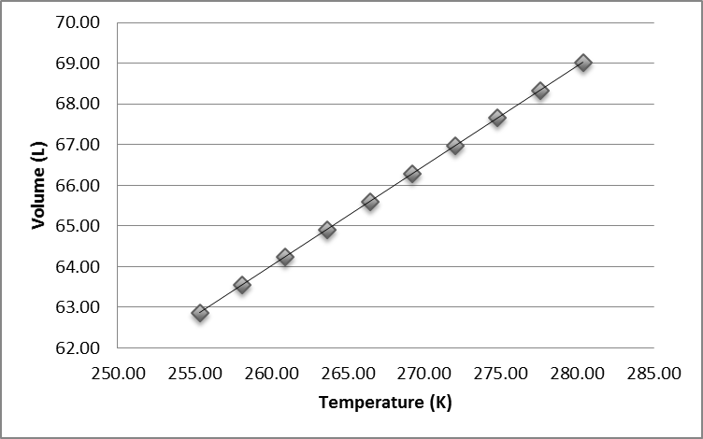
Procedure: Excel
Create tables and figure based on Ideal Gas Law
All data values are provided in an Excel file
Using Ideal Gas Law, calculate volumes at specified temperatures
Plot volume vs. temperature based on generated tables

Slide 9
Procedure: Word and PowerPoint
Create templates to use for this class
Change highlighted text to your info
Use online resources, partners, and TAs
Focus on professional formatting (paste as image)
Attention to detail is a critical skill for engineers
    Match the given templates accurately

Slide 10
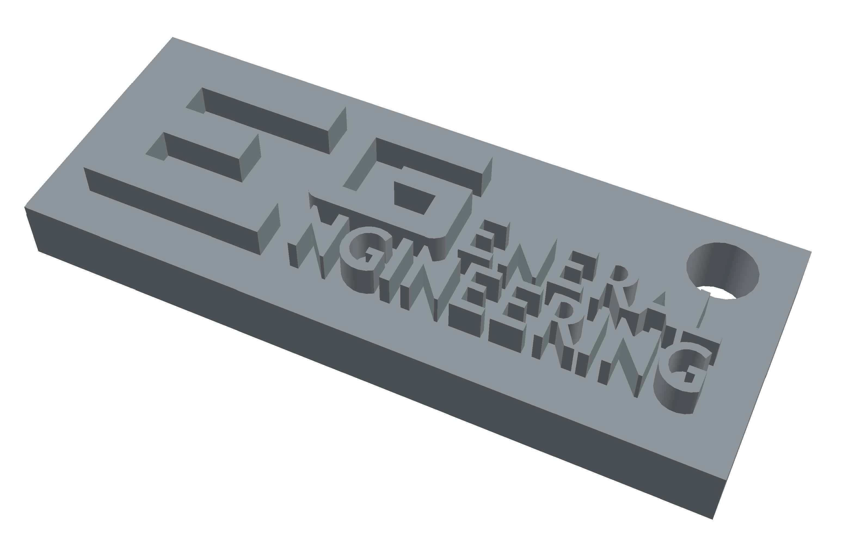
Procedure: AutoCAD
Use the AutoCAD template and tutorial to create a 3D model of EG logo keychain
Export to 3D printer file (STL)
If your team has time before the mousetrap car competition, explore Thingiverse or design your own 3D ideas with CAD

Slide 11
Assignment: Written Report
Independent report (one report per student)
Standard lab report submission
Submit online (eg.poly.edu) before midnight of day of Lab #2
Submission includes (3 files)
  Microsoft Word lab report template
  Microsoft PowerPoint lab presentation template
  Mousetrap competition report

Slide 12
Closing
Each team member must use software
Work together with your partner
TA is always available for assistance
Mousetrap Car Competition
Following MS Office and AutoCAD Exercise

Slide 13
Closing
When importing into Microsoft from Google docs, slides, and sheets formatting errors may occur
Submissions must be Microsoft files, so recheck your final Microsoft formatting
Copy and paste all figures and tables as pictures

Slide 14

Closing

