Slide 1


Software for Engineers

Slide 2


Overview
Objectives
Software Tasks
Background
Procedure
Assignment
Closing

Slide 3
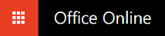

Objective
Familiarization with relevant software
Explore software tools
  Word
  Excel
  PowerPoint
  Inventor

Slide 4
Software Tasks
Microsoft Office | Autodesk Inventor
Enter Excel formulas Create Word template for lab reports Create PowerPoint template for lab presentations | Learn the basics of CAD software Practice 2D and 3D drawing functions Build an NYU Tandon logo keychain Export to 3D print file

Slide 5
Background Information
Microsoft Excel or Google Sheets
For tables, charts/graphs, data analysis
Microsoft Word or Google Docs
For lab reports, proposals, documents
Microsoft PowerPoint or Google Slides
For professional slideshow presentations

Slide 6
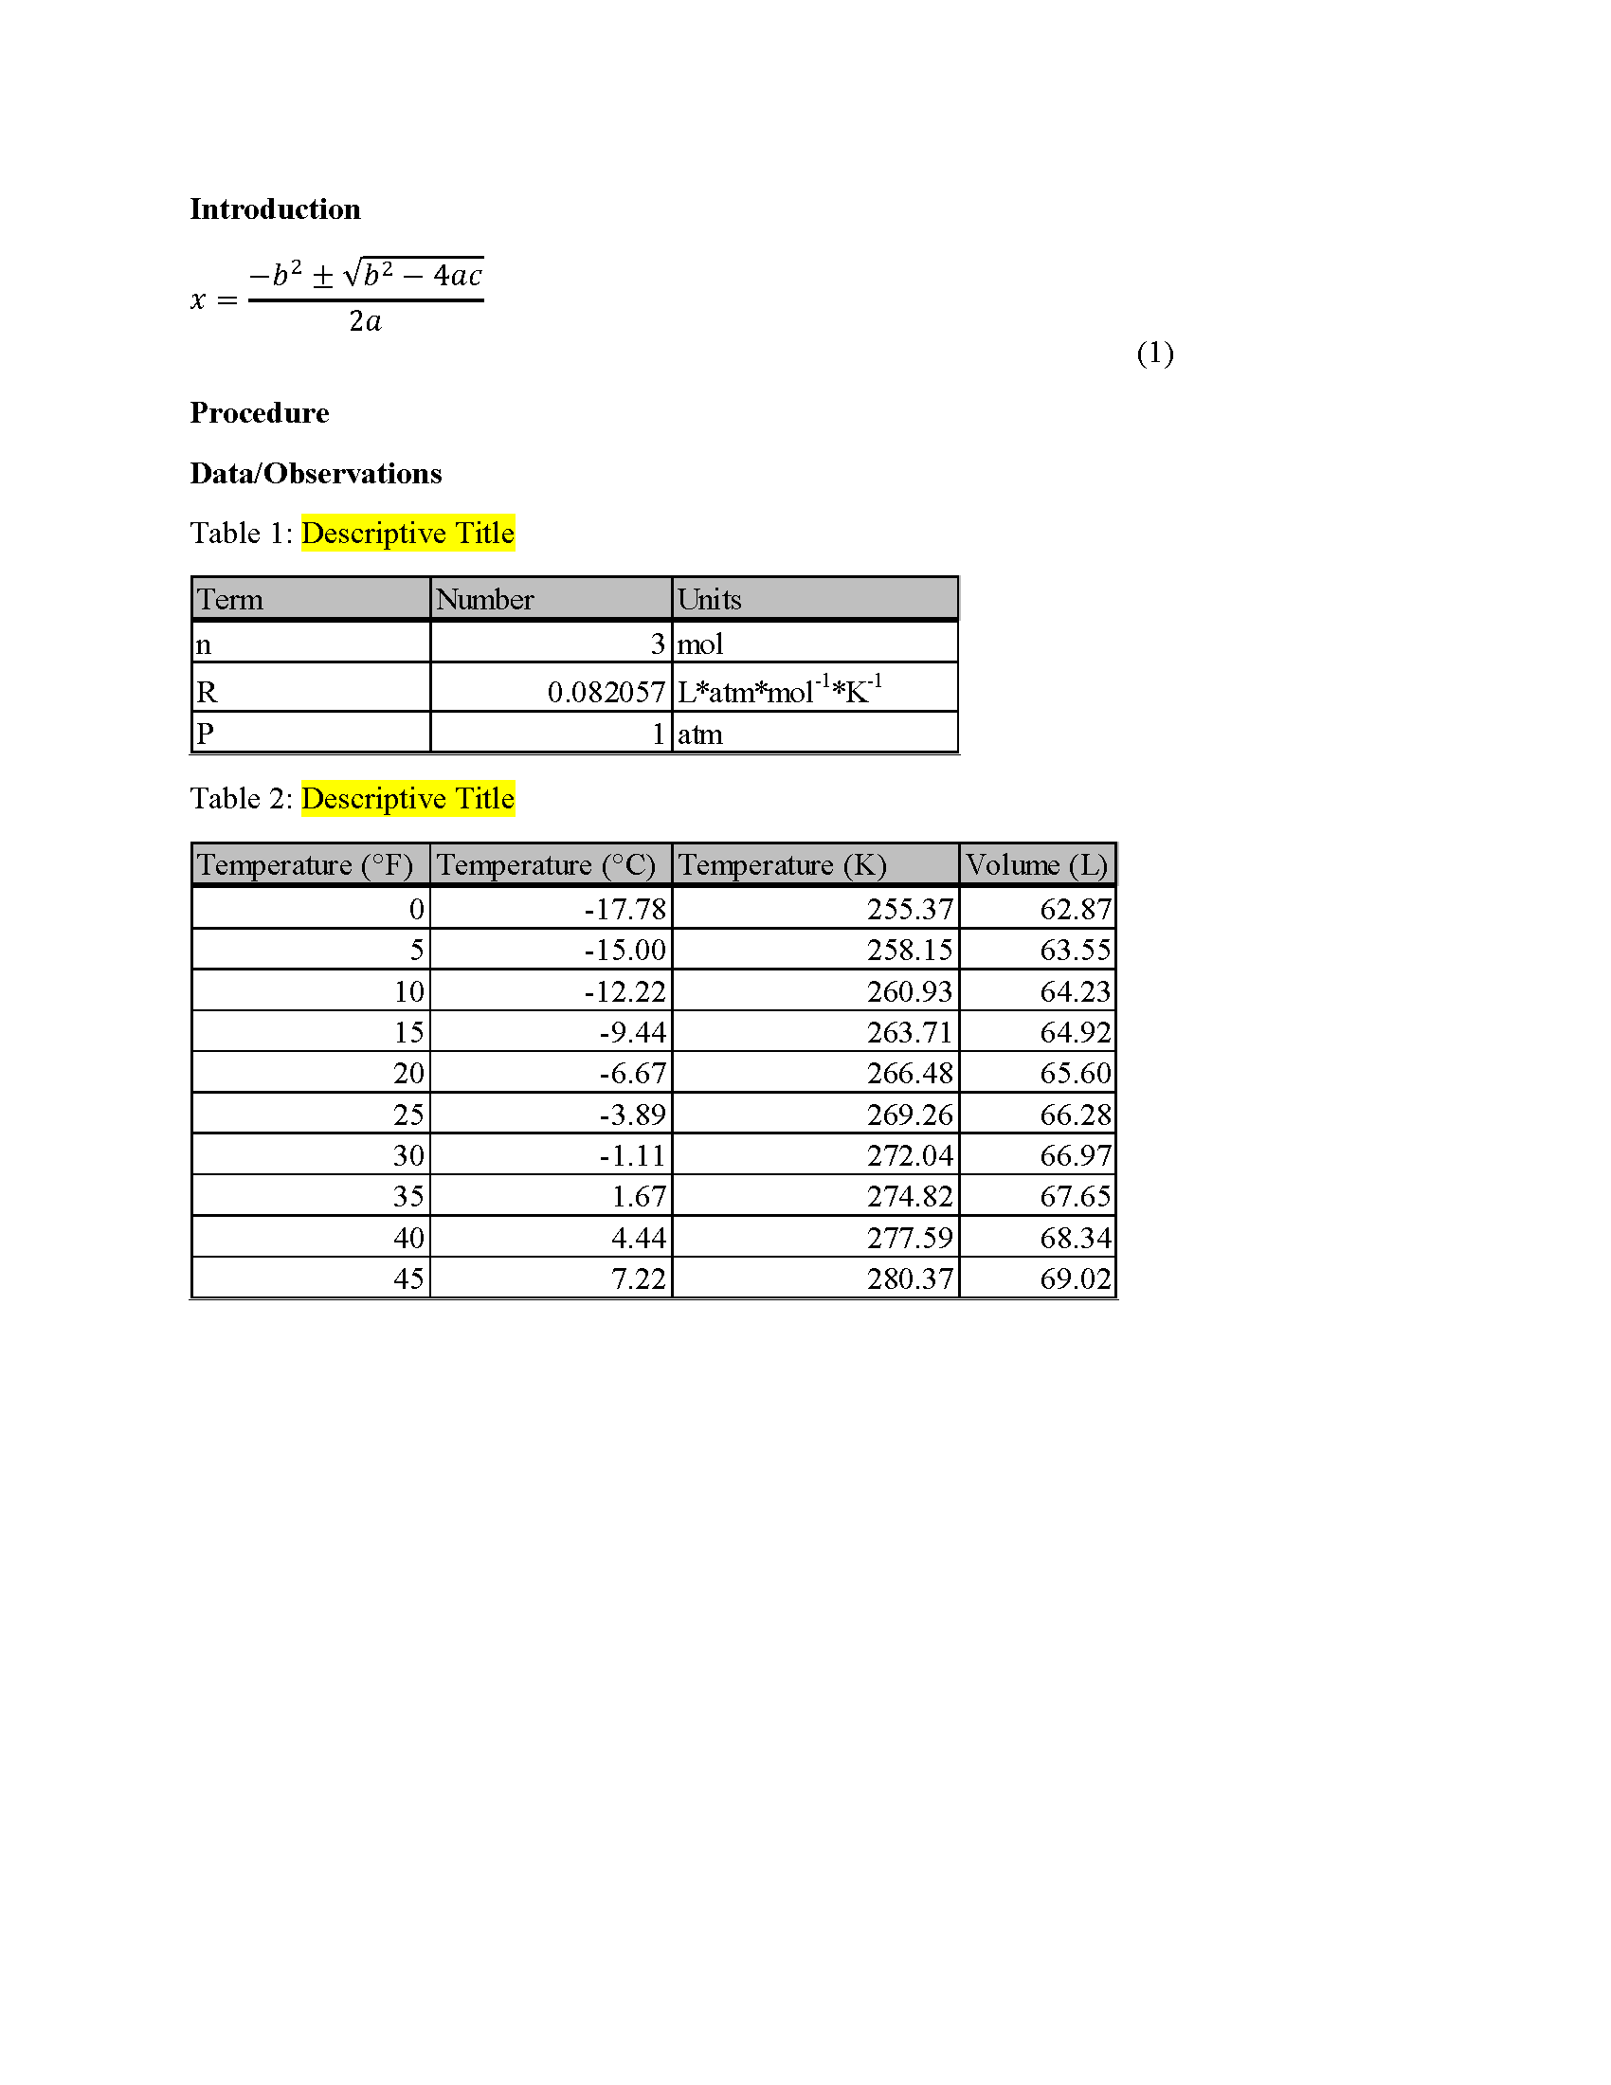
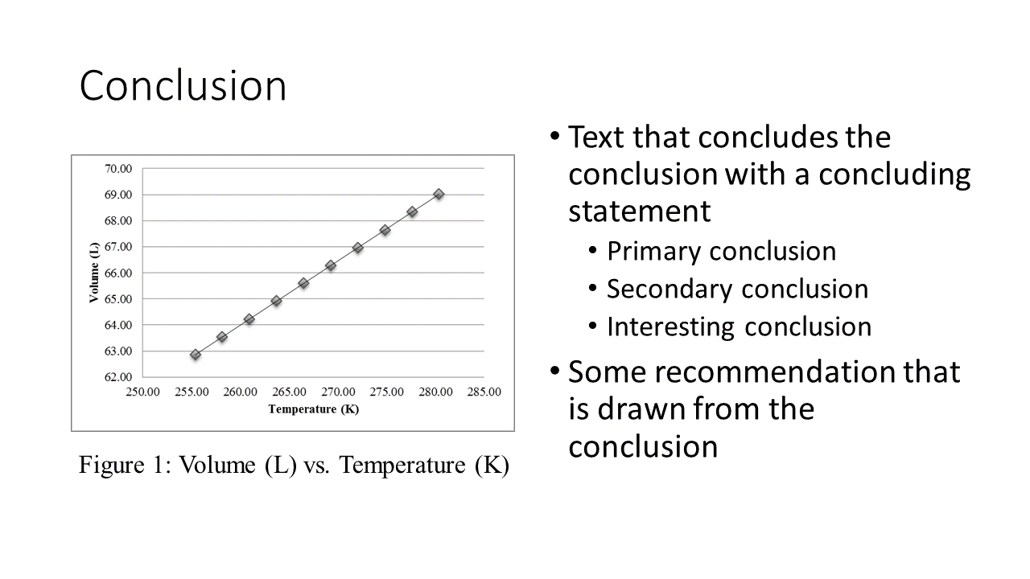
Example: Word and PowerPoint

Slide 7
Example: Excel

Slide 8
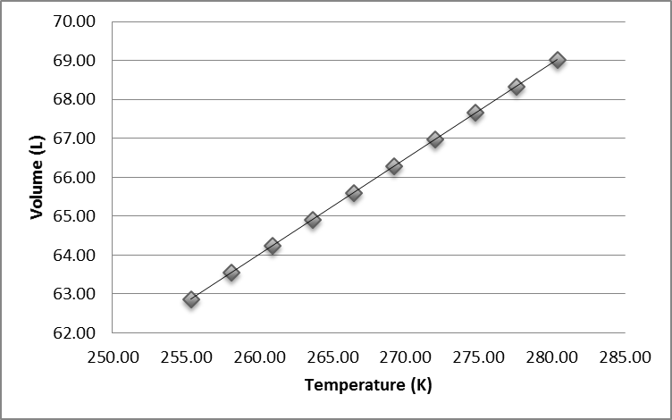
Procedure: Excel
Create tables and figure based on Ideal Gas Law
All data values are provided in an Excel file
Using Ideal Gas Law, calculate volumes at specified temperatures
Plot volume vs. temperature based on generated tables

Slide 9
Procedure: Word and PowerPoint
Create templates to use for this class
  Change highlighted text to your info
  Use online resources, partners, and TAs
Focus on professional formatting (paste as image)
Attention to detail is a critical skill for engineers
  Match the given templates accurately

Slide 10


Procedure: Inventor
Use the Inventor template and tutorial to create a 3D model of NYU Tandon School of Engineering keychain
Convert the .STL files to .THING
If your team has time before the mousetrap car competition, explore Thingiverse or design your own 3D ideas with CAD

Slide 11
Assignment: Written Report
Independent report (one report per student)
Standard lab report submission (Lab 1C only)
Submit online (eg.poly.edu) before midnight of day of Lab #2
Submission includes (1 file, do not include 1A and 1B)
  Mousetrap competition report

Slide 12
Closing
Each team member must use software
Submit all work electronically by 11:59 PM before Lab #2
Work together with your partner
  TA is always available for assistance
Mousetrap Car Competition (winner get 3D printed keychain)
  Following MS Office and Inventor Exercise

Slide 13
Closing
When importing into Microsoft from Google Docs, Slides, and Sheets formatting errors may occur
Submission must be Microsoft files, so recheck your final Microsoft formatting
Copy and paste all figures and tables as pictures
All files needed are available in Lab 1A and 1B
  Write-ups on the EG manual (2 PDF templates, 1 Excel file with data, 1 Inventor file)

Slide 14

Closing

Slide 15
Software for Engineers
QUESTIONS?

