Slide 1
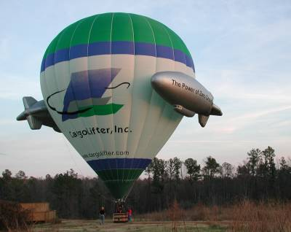
Hot Air Balloon Competition

Slide 2
Overview
Objective
Background Information
Problem Statement
Materials
Procedure
Assignment
Closing

Slide 3
Objective
Demonstrate basic principles of buoyancy and thermodynamics
Use concept of minimal design

Slide 4
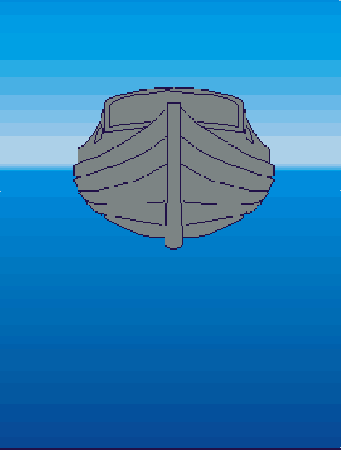
Background Information
Buoyancy
Archimedes’ Principle
Object immersed in fluid is buoyed up by force equal to weight of fluid displaced by object
Buoyant forces cause balloon to rise

Slide 5
Background Information
Thermodynamics
Air pressure, volume, and temperature are related via Ideal Gas Law
Raising air temperature at constant volume (balloon envelope) causes air density within
to drop
Excess air will escape
Balloon weighs less than displaced air
Ideal Gas Law:
V =Volume
P = Pressure
n = # of Moles of Air
T = Absolute Temperature (Kelvin)
R = Gas Constant (0.0821 L*atm/(mol*K))

Slide 6
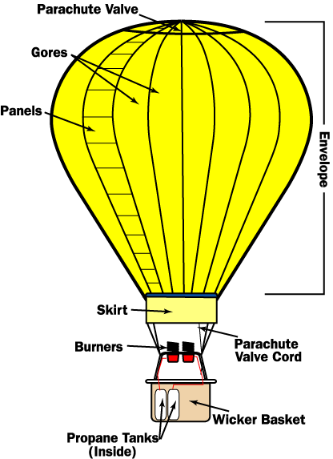
Background Information

Slide 7
Problem Statement
Design/construct balloon
  Maximize payload (paperclips)
  Maximize flight time
  Minimize cost
Materials must be “purchased”

Slide 8
Problem Statement
Competition Rules
Add paperclip payload to finished design
TA positions balloon above heater, releases balloon temperature stabilizes
Time aloft and payload (# of paperclips) recorded by TA
  TA times flight duration with a timer
  Balloon must rise from release point & fly for at least 1 sec
Competition Ratio used to judge design
  Team with highest ratio wins
  3 trials maximum: design changes permitted (cumulative cost)

Slide 9
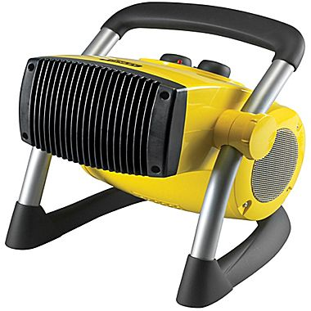
Materials
Glue sticks
Scissors
Paper clips
Personal heater
Tissue paper (65 x 48cm)
21.5 x 27.9cm paper (US letter)
Drawing paper (43 x 50cm)
Kevlar string
Plastic straws
Plastic tape

Slide 10
Materials
Price List
Tissue Paper | $0.10/sheet
8.5” x 11” Paper | $0.05/sheet
Drawing Paper | $0.10/sheet
Kevlar String | $0.05/30cm
Tape | $0.03/30cm
Plastic Straws | $0.00

Slide 11
Procedure
Assess provided materials
Brainstorm possible designs
Sketch design on paper
  Maximum allowable balloon size of 1 m³
  Label properly
  TAs must initial sketches
  Major design revisions must also be initialed

Slide 12
Procedure
Create price list detailing your design
Materials must be “purchased” from TA
  Unused materials will not be refunded
Construct design based on initialed sketch
  Note design changes
Take a photograph of final flight configuration
  Still shot or video

Slide 13
Assignment
*BONUS* Individual Lab Report
Title Page
Discussion topics in the manual
Include class results and photo of balloon

Slide 14
Assignment
Team presentation
State rules of competition
Describe your design and its concepts
Include table of class results and photo/video of balloon
How could your current design be improved?
Refer to “How to Give a Recitation Presentation” in the lab manual

Slide 15
Closing
Have all original data signed by TA
Submit all work electronically
Return all unused materials to TA

Slide 16

Hot Air Balloon Competition
QUESTIONS?

