Slide 1

VIRTUAL PRODUCT DISSECTION
EG1003 | LAB 1B

Slide 2
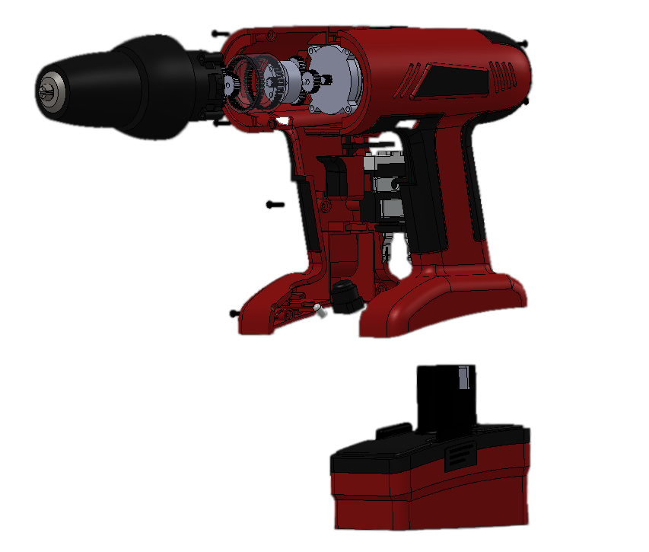
OVERVIEW
Objective
Background
Materials
Procedure
Assignment
Closing
Figure 1: Product dissection of cordless drill
2

Slide 3
OBJECTIVE
To evaluate the functional design of an existing product to apply to the ideation of a new product
To develop and design an idea for a water toy to be used by children ages 4 – 6
Figure 2: Child at a water park courtesy of BabyCouture
3

Slide 4
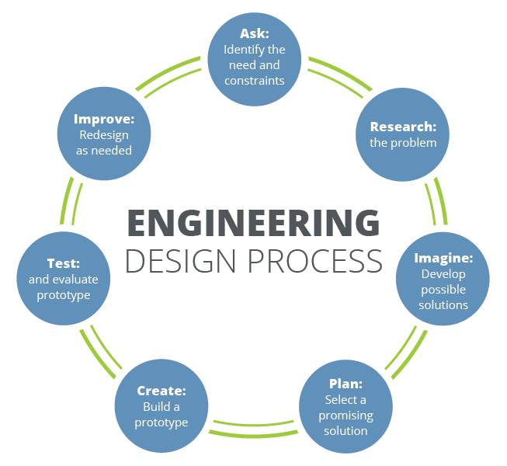
BACKGROUND
Engineering design process
  Systematic approach to designing a new product
  Idea generation occurs during the “Imagine” phase
Design fixation – having preconceived notions of an initial idea and the inability to think of alternatives
Reverse engineering – process of reproducing a product by examination of the product’s components and functions
Figure 3: Engineering design process
courtesy of Teach Engineering
4

Slide 5
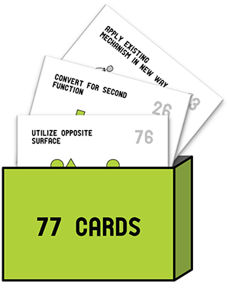

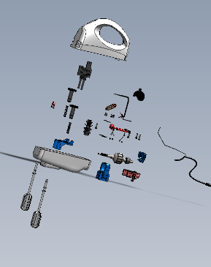
BACKGROUND
Design fixation can be overcome with these idea generation methods:
Substitute
Combine
Adapt
Modify
Put to another use
Eliminate
Reverse
Design Heuristics
Brainstorming
Product Dissection
Scamper
Figure 4: Idea generation methods
5

Slide 6













RULES FOR BRAINSTORMING
No (self) judgement
Encourage wild ideas
Stay focused on the topic
Be visual
Go for quantity
(9 or more)
Combine and improve ideas
Figure 5: Rules for brainstorming
6

Slide 7
MATERIALS
SolidWorks eDrawings
Product dissection files
Virtual product dissection handout
Any materials needed for hypothetical design of a water toy
7

Slide 8

PROCEDURE
Part 1: Creativity (10 minutes)
  Get in groups and take out paper and a pencil
  Write down as many alternative ways as possible to use a paperclip (2 minutes)
  Count the number of ideas generated as a group
  Identify the greatest number of ideas generated – winner gets a prize!
Figure 6: Paperclip
8

Slide 9
PROCEDURE
Part 2: First Idea Generation Session (10 minutes)
  Work individually
  List down all ideas for a water toy for use by children ages 4 – 6
  Focus on a fun and safe toy
Figure 7: Child at a water park courtesy of BabyCouture
9

Slide 10
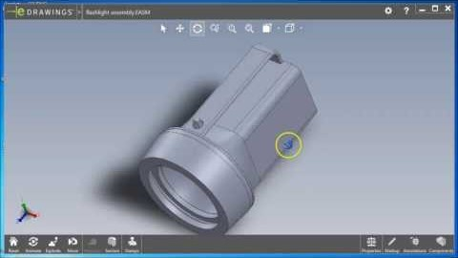
PROCEDURE
Figure 8: SolidWorks eDrawings tutorial courtesy of Elizabeth Starkey
10

Slide 11
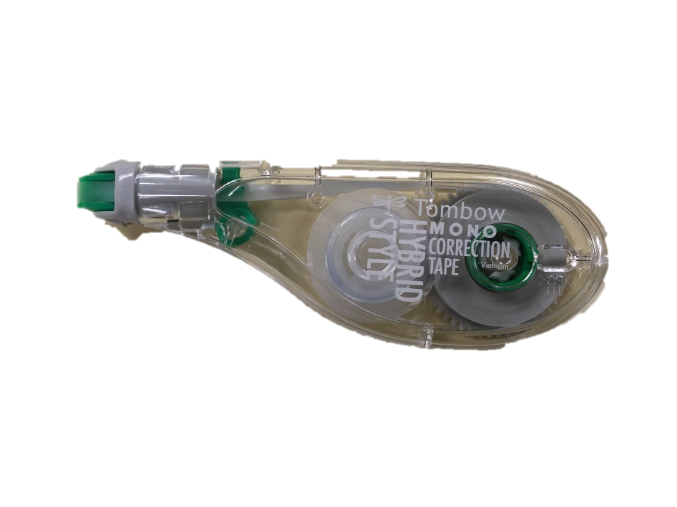
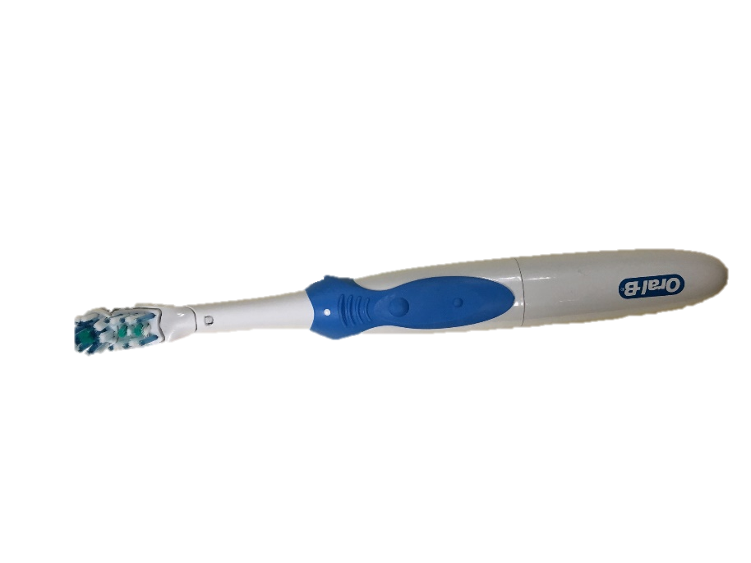
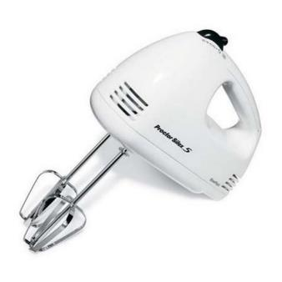
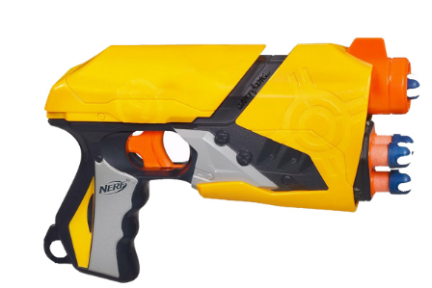
PROCEDURE
Part 3: Product Dissection Activity (20 minutes)
  Go to Lab 1B – Virtual Product Dissection
  Download products to dissect – different for each team member
  Fill out the virtual product dissection handout individually
  Take screenshots of product and components for lab report
Figure 9: Products available for dissection
11

Slide 12
REFLECTION
Share your ideas with your teammates and think about the following questions:
  In what way did the product dissection activity help you develop ideas?
  Did the product you dissected impact the ideas you developed?
  Do you think it is useful to dissect different products when working in a group?
12

Slide 13
ASSIGNMENT
Individual lab report:
  Only for Lab 1B
  Follow the lab report format given for this lab in the manual
  Answer discussion questions
  Include pictures from the product dissection
  Due at 11:59 PM the night before Lab 2
  Submit on the EG1003 website (eg.poly.edu)
Team presentation:
  No presentation for Lab 1B
13

Slide 14
CLOSING
Think about this:
  In what ways did the product dissection activity help you develop ideas?
  Designers should limit interactions with physical examples
  in the early stages of design to mitigate fixation
  Did the product you dissected impact the ideas you developed?
14

Slide 15
QUESTIONS?

