Slide 1

RECITATION 12
EG1003

Slide 2
AGENDA
Entrepreneurial Mindset
The Semester In Review
1

Slide 3
ENTREPREURIAL MINDSET

Slide 4
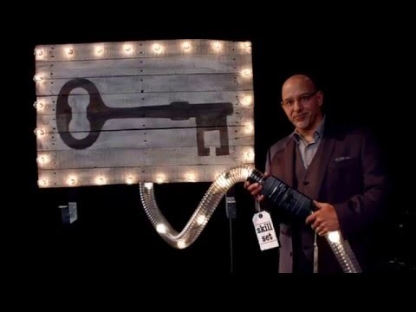

4

Slide 5

KERN ENTREPRENEURIAL ENGIEERING NETWORK
KEEN mission
  Curiosity
  Connections
  Creating value
Entrepreneurial mindset vs. entrepreneurship
“We help create entrepreneurs not companies.”
– Bill Aulet, Managing Director, The Martin Trust Center for MIT Entrepreneurship
4

Slide 6
ENTREPRENEURIAL MINDSET
Curiosity
    DEMONSTRATE constant curiosity about our changing world
    EXPLORE a contrarian view of accepted solutions
Connections
    INTEGRATE information from many sources to gain insight
    ASSESS and MANAGE RISK
Creating value
    IDENTIFY unexpected opportunities to create extraordinary value
    PERSIST through and learn from failure
5

Slide 7
ACTIVITY - MINDSET
Imagine you own a Boeing 707 airplane and you have all the money in the world to spend on the airplane.
What would you do with the airplane?
6
Notes:
**Have students brainstorm for one minute and then share with a group for two minutes. Ask for the best idea in the group to be shared with the class**
What’s mindset have to do with flight? Turns out, a lot! Guess which person most companies like to hire? A person with just a skillset, one with mindset, or one with both?
By the way, Boeing 707 was Boeing’s first commercial aircraft which had jet engines.

Slide 8
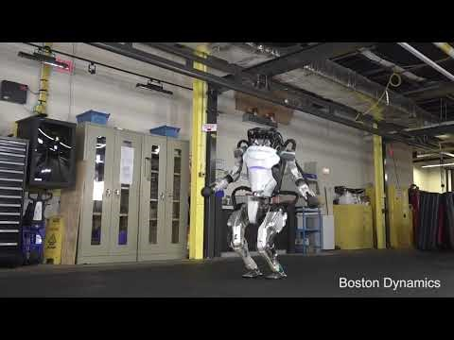
8
Notes:
Skillset. The Boston Dynamics team clearly has an excellent and diverse skillset to create such an advanced robot.

Slide 9


MINDSET
THERANOS
8
Notes:
Mindset. Elizabeth Holmes was successful in growing a large startup on the premise of having invented a process to expedite and make blood testing more accessible. Theranos employed 800 people in 2015 before news of the scandal had broken. In 2014, Theranos had a valuation of 9 billion dollars and a large retail partnership with Wallgreens. Elizabeth clearly had an entrepreneurial mindset, but not the skillset to have made any scientific progress.

Slide 10
QUESTIONS?

Slide 11
SEMESTER IN REVIEW

Slide 12
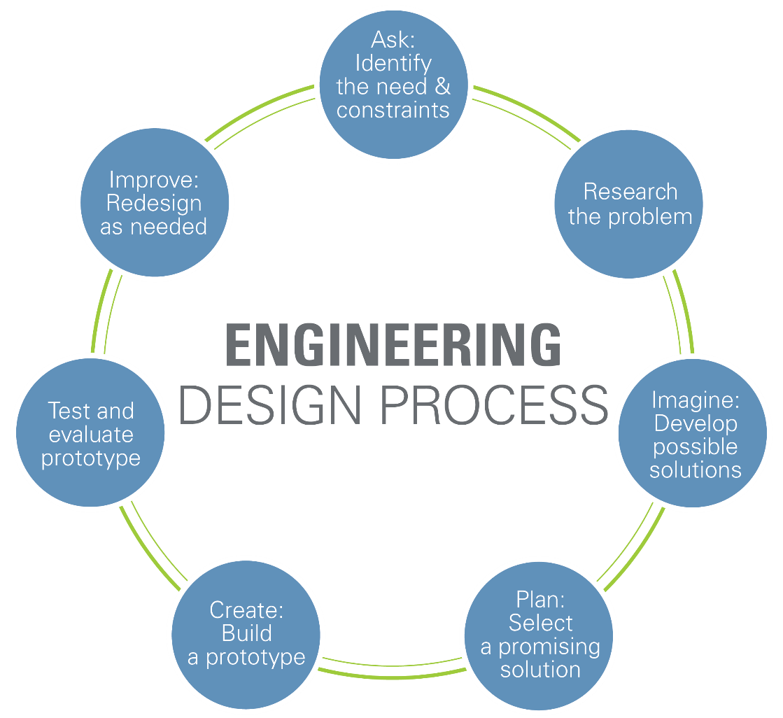
ENGINEERING DESIGN PROCESS
Figure 1: Engineering design cycle courtesy of Teach Engineering
11

Slide 13


PROJECT-BASED CURRICULUM
Senior Design Capstone
1st Year
2nd & 3rd Year
4th Year
12

Slide 14
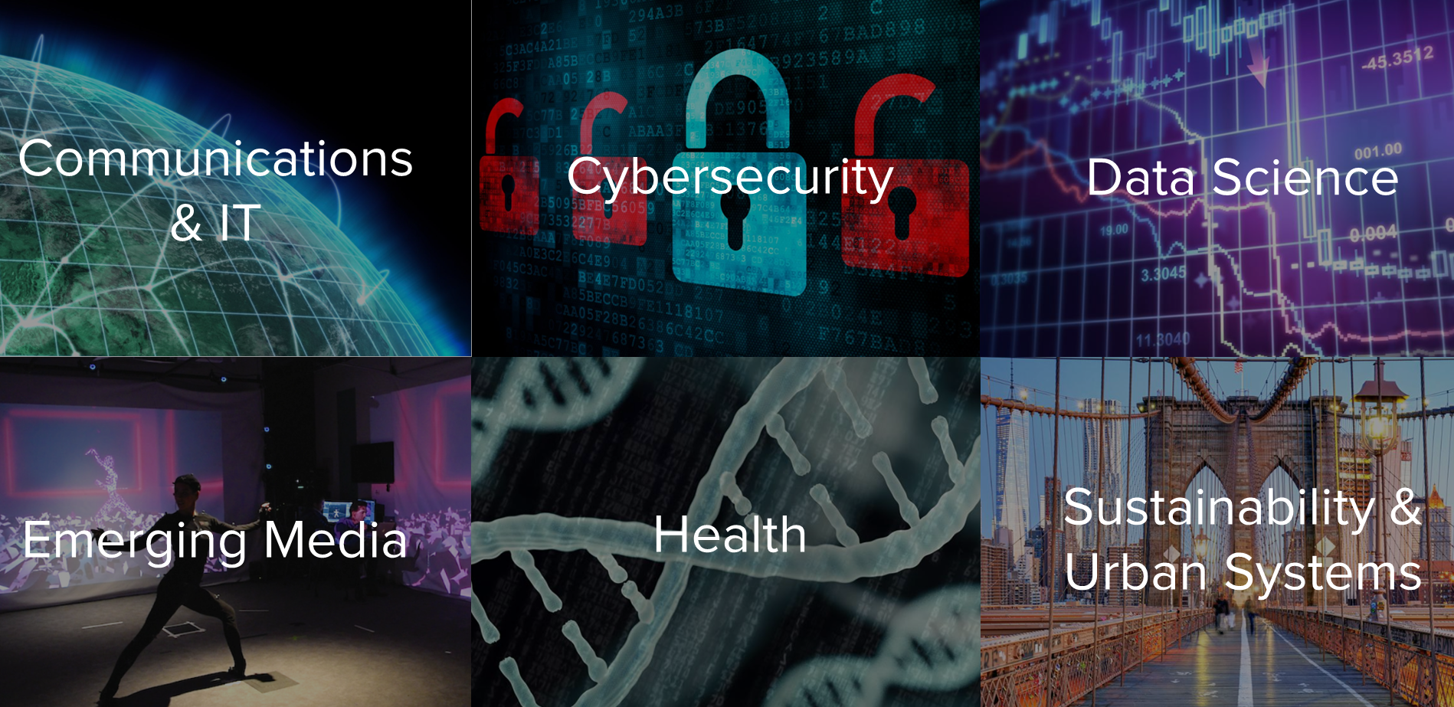
TANDON SPECIALIZATIONS
Figure 2: NYU TSE’s Specialization Areas courtesy of NYU
13

Slide 15




GREAT PROBLEMS IN ENGINEERING
Ten Big Ideas for
Future Investment
14 Grand Challenges | 10 Big Ideas | 17 United Nations Goals
Cyber Security
Artificial Intelligence
Harness
Data
Urban Infrastructure
Zero Hunger
Sustainable Communities
Climate Action
Virtual Reality
Fusion Energy
Human Computer Interaction
Quantum Computing
Clean Energy
Climate Action
14

Slide 16

i²e
15

Slide 17
SKILLSETS
Software and programming
Design and reverse engineering
Quality control and improvement
Forces and motion
3D modeling and 3D printing
Energy production and electrical circuits
Stress and strain
Conductors and insulators
16

Slide 18
MINDSETS
Working in teams
Giving public presentations
Writing technical reports
Building a resume
Managing projects
Teaching yourself new material
Applying ethics to your profession
17

Slide 19

Thank You

Slide 20
QUESTIONS?

