Slide 1

RECITATION 4
EG1004

Slide 2
AGENDA
The Scientific Method
The Engineering Design Process
Technical Writing Standards
How to Give a Milestone Presentation
Lab 3 Presentations
1

Slide 3
THE SCIENTIFIC METHOD
Notes:
Many students are familiar with the scientific method from high school or middle school. **Ask the class to name the parts of the scientific method**

Slide 4
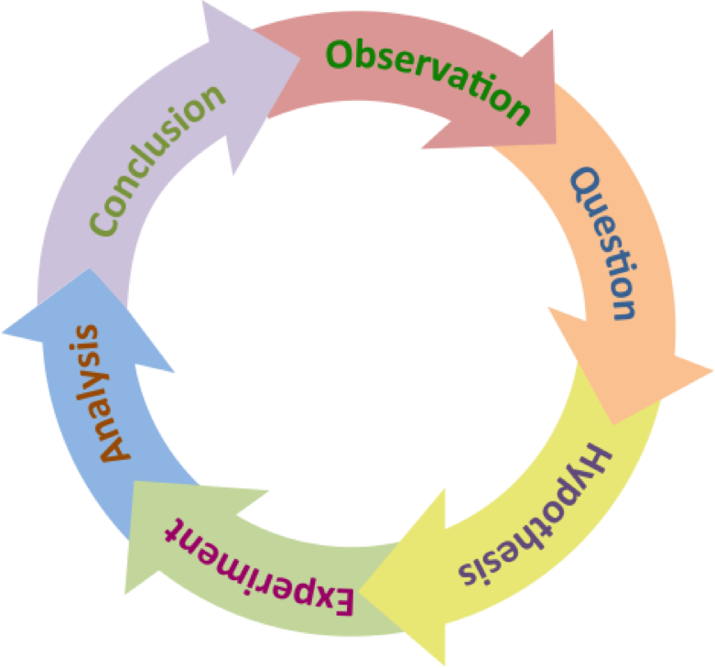
THE SCIENTIFIC METHOD
Research
Questions
Research
Method
Figure 1: Scientific method cycle courtesy of The Biology Primer
3
Notes:
**Briefly describe the scientific method** Perhaps the most important part of the scientific method is that it is cyclical and that often we follow this process intuitively as scientistic and engineers. The cycle can be broken up into two main parts: research questions and research methods.

Slide 5
THE ENGINEERING DESIGN PROCESS
Notes:
Many students are familiar with the scientific method from high school or middle school. **Ask the class to name the parts of the scientific method**

Slide 6
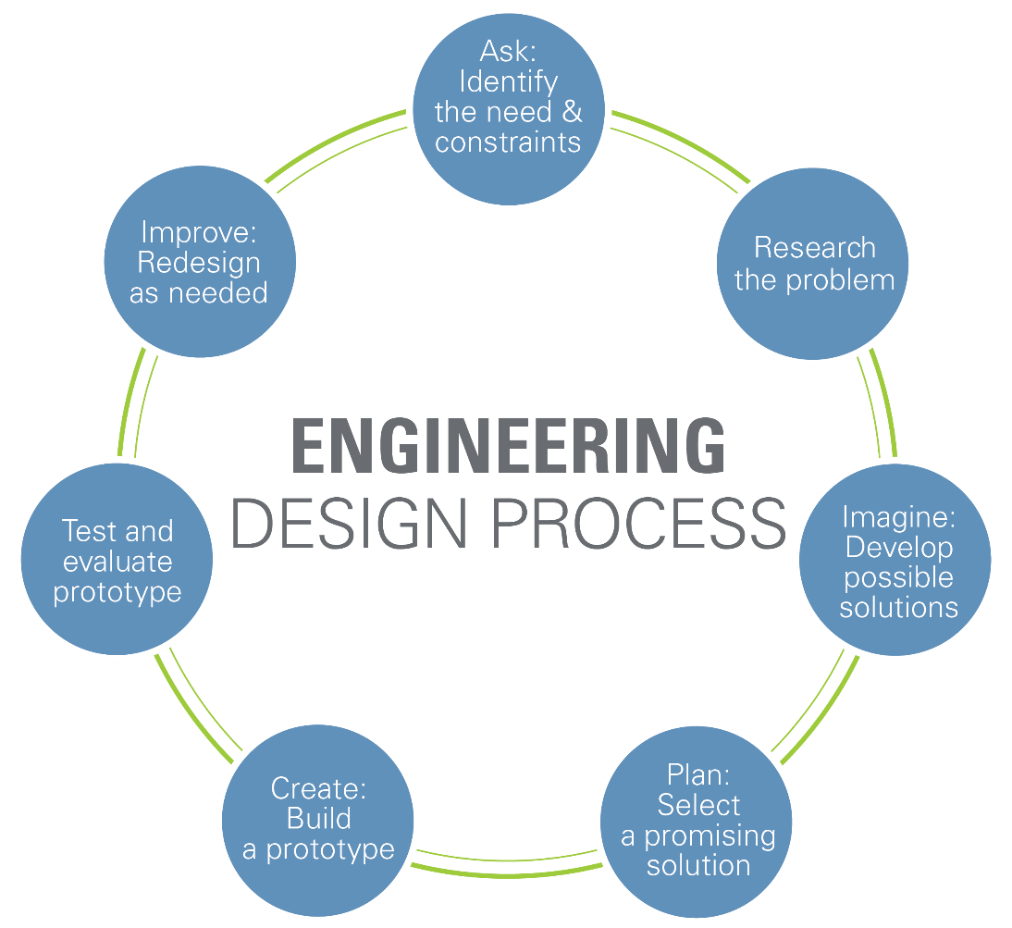
ENGINEERING DESIGN PROCESS
Figure 2: Engineering design cycle courtesy of Teach Engineering
5
Notes:
Similar to the scientific method, the engineering design process is also cyclical and follows the same general structure as the scientific method: proposing a question or a challenge and then testing with a certain methodology. **Breifly go over the engineering design process**. The prototyping steps are iterative and may require many different approaches in order to help address the need. It is important to note that no prototype is perfect and can always be further iterated to better solve the original problem using a set of standards to determine its effectiveness.

Slide 7
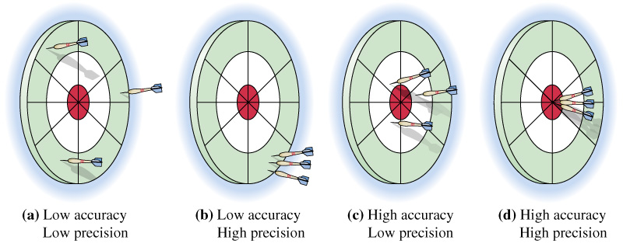
ACCURACY & PRECISION
Figure 3: Accuracy and precision visual courtesy of Extension Engine
6
Notes:
One of the considerations when reviewing the success of a prototype is the prototype’s accuracy and precision. If the determination of success is landing the darts in the red circle, high precision represents the repeatability of results and the accuracy represents the prototype’s ability to complete the goal.

Slide 8
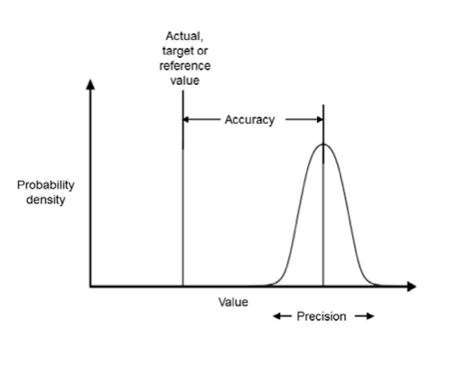
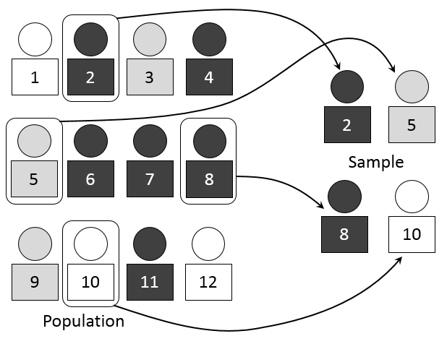
VARIABILITY & SAMPLING
Figure 4: Accuracy and precision graphically courtesy of All Sensors
Figure 5: Simple random sample courtesy of Mathprofdk
7
Notes:
Variability helps to describe the spread of the overall data compared to a reference value, The blue line in figure 6 above represents the reference value and the variance of the data is shown by the red spikes.

Slide 9
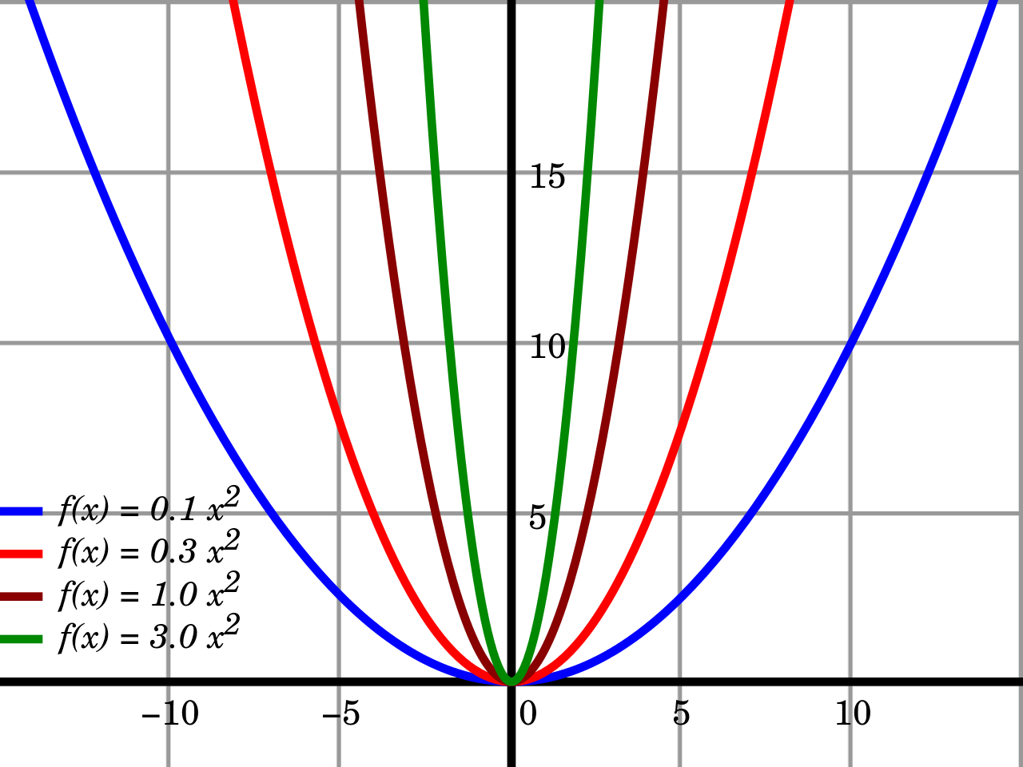
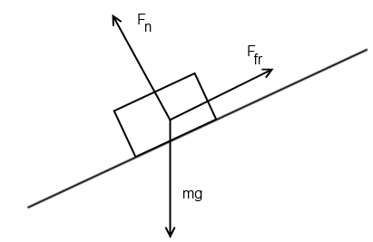
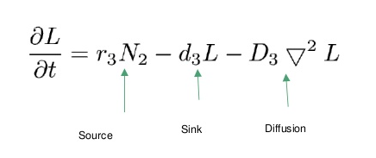
RELATIONSHIPS & ASSUMPTIONS
Figure 6: Mathematical relationships
you’re learning in calculus
Figure 7: Free-body diagram
assumptions
Figure 8: Differential equation for
cancer spread & treatment
8
Notes:
In order to make scientific progress, we build off the work of those in the past – luckily, we can use math and the results of those who came before us to create mathematical models that help describe and predict the behavior of what is being studied. For example, we know the relationship between a mass sitting on a slope experiencing the force of gravity, this mathematical equation which you will learn in physics is a result of combining a lot of observations and measurements into a model. As you go along in your academic career, you will find these models will become more complex and will help you solve less intuitive problems.

Slide 10

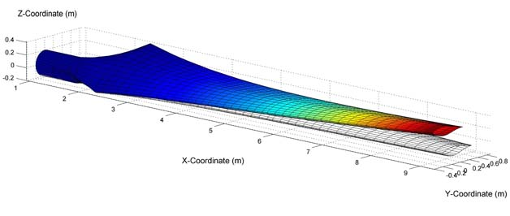
OPTIMAL DESIGN
Equation 1: Factor of safety calculation
Figure 9: Wind turbine model courtesy of University of Minnesota
9
Notes:
Mathematic relationships discovered overtime enable engineers to optimally design with a high level of precision and accuracy. With optimal designs, engineers can create technology that is useful and safe. These mathematical models are incorporated into CAD software to allow computerized prototyping.

Slide 11
QUESTIONS?

