Slide 1
Lab 500: Stock Car Racer
EG1003 Section A2
Dates of Experiment: January 15, 2009 through April 1, 2009
Date due: April 6, 2009
Richard Petty and Sarah Fisher

Slide 2
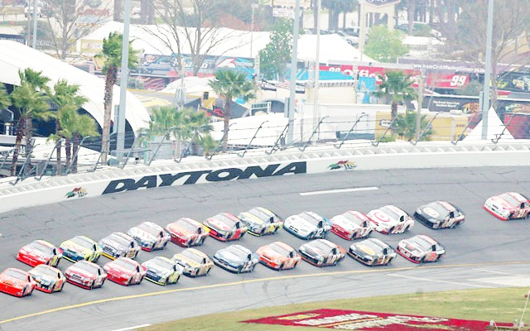
Overview
Experimental Objective
Introduction
Background Information
Materials
Procedure
Data/Observations
Results
Conclusion

Slide 3
Experimental Objective
Build a stock car racer that can compete in the Daytona 500 and DirecTV 500
Win the competition against the other Poly teams

Slide 4
Introduction
NASCAR racing has improved safety on consumer cars
  Crash-proof passenger compartments
  Hoods that crumple instead of shearing off
  Rear decks that crumple
  Seat belts
NASCAR racing improves car performance (aerodynamics, horsepower)

Slide 5
Background Information
NASCAR racer has two different types of races
Short track races have short laps, tight turns
  Need high maneuverability
Super speedway races have long laps, high speeds
  Need for aerodynamic efficiency and power
Notes:
Lirdi Mexhitaj Jan 2010

Slide 6
Background Information
Poly EG1003 teams competed in a “real world” environment
  Against each other
  Against other NASCAR teams
Competed in Daytona 500 (high speed)
Competed in DirecTV 500 (short track)

Slide 7
Background Information
Daytona 500 was held early February
  Car had to qualify to be allowed to race
  Based on lap times run before the race
DirecTV was held in early April
  Enough time to repair damage from Daytona 500
  Car had to qualify again, based on times
Failure to qualify disqualified you from EG1003 competition

Slide 8
Background Information
Competition rules:
Enter Daytona 500 at Daytona International Speedway and record place
Enter DirecTV 500 at Martinsville Speedway and record place

Slide 9
Background Information
Calculate car cost
Best Car Competition Ratio wins:

Slide 10
Materials
2006 Chevrolet Monte Carlo
200 feet steel tubing
Dual electronic ignition
400 pounds fiberglass
Simpson racing seat + 5 point safety belts
400 HP turbocharged supercharged engine
Fuel cell

Slide 11
Materials (continued)
Small tubing for fuel cell
40 sets of racing tires
Cargo net for driver window
3 electrical switches

Slide 12
Experimental Procedure
Review rules, come up with design
Secure sponsorship (Sid’s Hardware)
Obtain car, replace engine, redesign body
Construct passenger cage, install seat and belts
Put body on cage, add hood and trunk
Add spoiler, tires, paint, and decals
Select driver (Richard Petty)

Slide 13
Experimental Procedure (Continued)
Qualify for Daytona 500, compete, record finishing position
Fix damage
Qualify for DirecTV 500, compete, record finishing position
Calculate cost of car and compute Car Competition Ratio
If winner, fix damage and put in lobby

Slide 14
Data/Observations
Car first tested at Floyd Bennett Field
  Top speed of 140 MPH estimated
Car taken to Daytona
  First test run 160 MPH using speed gun
Car qualified
  Speed was 195 MPH, 10th best
  Started on outside of 5th row
Car competed, came in 8th
  Minor collision hurt aerodynamics

Slide 15
Data/Observations (continued)
Minor damage at Daytona, easily repaired
Car taken to Martinsville, qualified 24th
Started on outside of 12th row
Finished 28th
  Poor placement due to intentional accident caused by Tony Steward in #20 car
  Considerable time spent repairing damage, costing us time and positions

Slide 16
Results
Cost of Car:

Slide 17

Results (continued)
Car Competition Ratio Calculation:
Team’s standing in EG1004 competition:
WE FINISHED FIRST!

Slide 18
Conclusion
Successfully built and raced a NASCAR racer
We won the EG1003 competition
  … and got to put our car in the lobby!
Possible improvements
  Make the car more crash proof
  Put machine guns under the hood in case Tony Stewart comes back

