Slide 1

BOOM CONSTRUCTION COMPETITION (VIRTUAL)
EG1003 | LAB 7

Slide 2
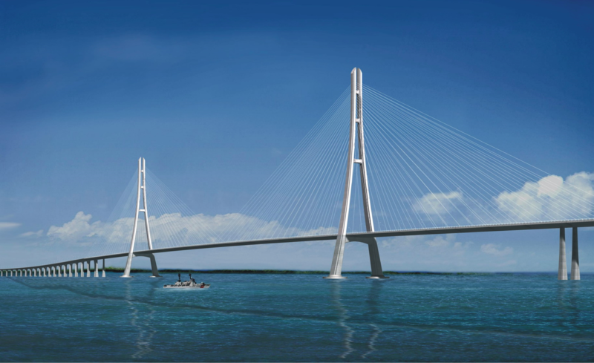
OVERVIEW
Objective
Background
Materials
Procedure
Competition Rules
Assignment
Closing
Figure 1: Cable-Stayed (Cantilever) Bridge
1

Slide 3
OBJECTIVE
Design lightweight boom in Fusion 360 to hold significant load and minimally deflect
Consider material properties when designing a boom
  Stress and strain
Test boom using Fusion 360 Simulation
Enter virtual boom into competition to obtain highest design ratio
2

Slide 4
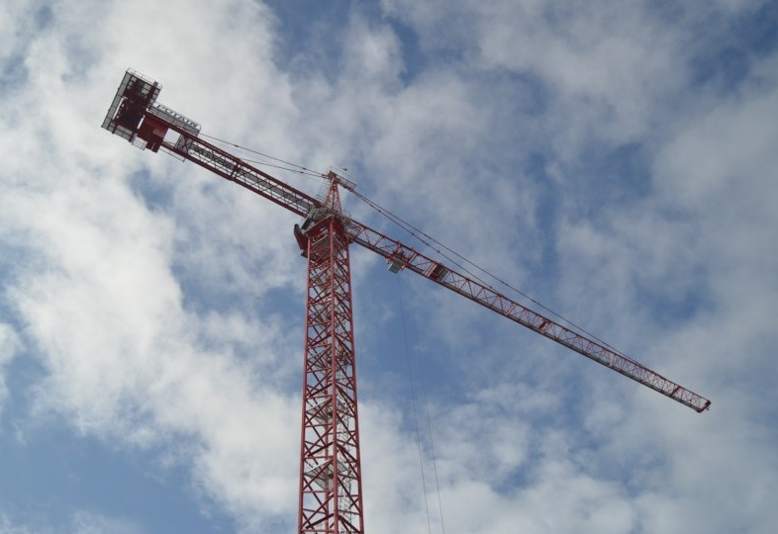
BACKGROUND INFORMATION
Boom:
  Lifts and moves heavy objects
  Objects much heavier than the boom
Examples:
  Construction cranes
  Cantilever bridges
  Swing bridges
Figure 2: Tower Crane Courtesy of
Philadelphia Magazine
3

Slide 5
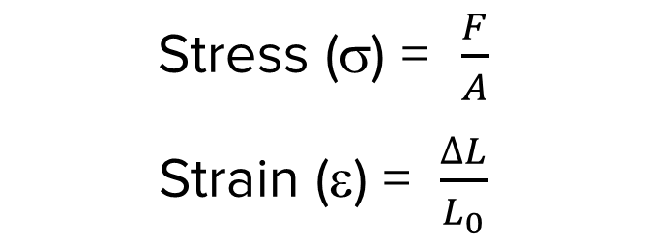
BACKGROUND INFORMATION
Stress: external force acting on an object per unit cross-sectional area
Strain: measure of deformation resulting from an applied stress
Fixed Support
Stress (σ) = $\frac{F}{A}$
Strain (ε) = $\frac{∆L}{L_{0}}$
Cross-Sectional
Area of Bar (A)
L_{o}
F = applied force
A = cross-sectional area
ΔL = change in length
L_{o} = original length
ΔL
F
4

Slide 6
BACKGROUND INFORMATION
UTS
Stress-strain curve
Key points/regions
  Elastic limit
  Ultimate tensile strength (UTS)
  Fracture stress
  Elastic region {E}
  Plastic region {P}
{P}
Stress (σ)
{E}
Elastic Limit
Fracture Stress
Strain (ε)
5

Slide 7
BACKGROUND INFORMATION
UTS
Elastic limit – point where the material becomes permanently deformed
Ultimate tensile strength (UTS) – greatest amount of stress a material can withstand
Fracture stress – point where the material fails
{P}
Stress (σ)
{E}
Elastic Limit
Fracture Stress
Strain (ε)
6

Slide 8
BACKGROUND INFORMATION
UTS
Elastic region {E} – material will return to its original shape when load is removed
Plastic region {P} – material will permanently deform even after load is removed
{P}
Stress (σ)
{E}
Elastic Limit
Fracture Stress
Strain (ε)
7

Slide 9
BACKGROUND INFORMATION
The Nervous Student & Pen Cap Example
1. Elastic Region – The student applies a force, bending the tip of the pen cap back. When they let go, the tip of the cap returns to its original position.
2. Plastic Region – The student twists and bends the tip of the cap. When they let go, the tip of the cap stays slightly twisted and bent.
3. UTS – The student bends the cap more. The cap is still in one piece, but certain areas are very weak and are on the verge of breaking.
4. Fracture Stress – The student bends the cap one more time. The cap
finally breaks into two pieces.
1
2
3
4
8

Slide 10
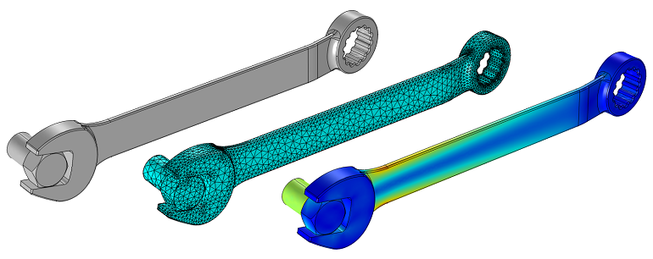
BACKGROUND INFORMATION
Simulation – computer-based software that models real phenomena and predicts the performance of a design
Finite element analysis (FEA) – a simulation method to determine the stresses and deformation that a design undergoes
Mesh – a subdivision of a part into smaller polygons in order to calculate the static properties at each polygon
Figure 3: FEA on Wrench
Courtesy of COMSOL Multiphysics
9

Slide 11


MATERIALS
A computer with Fusion 360
Parts in Fusion 360:
  2 thick dowels (1.1 cm x 122 cm)
  2 thin dowels (0.8 cm x 122 cm)
  6 bamboo skewers (30.5 cm)
  3D-printed dowel connectors
  Boom anchor
10

Slide 12
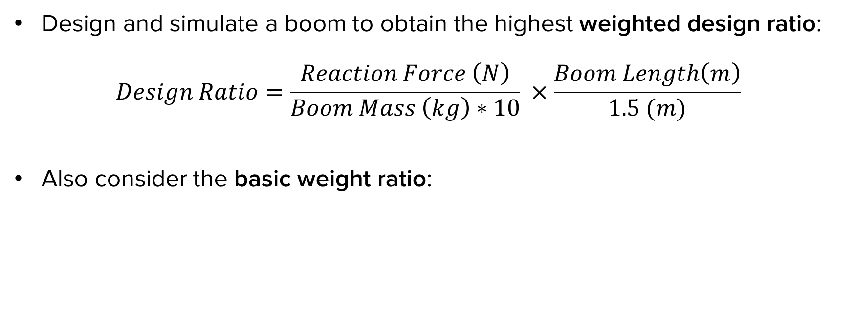
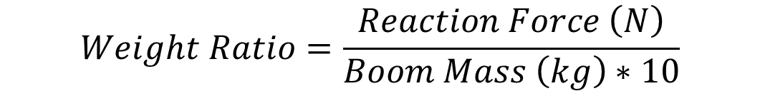
PROCEDURE
Design and simulate a boom to obtain the highest weighted design ratio:
$$Design Ratio=\frac{Reaction Force \left(N\right)}{Boom Mass \left(kg\right)∗10} ×\frac{Boom Length\left(m\right)}{1.5 (m)}$$
Also consider the basic weight ratio:
$$Weight Ratio=\frac{Reaction Force \left(N\right)}{Boom Mass \left(kg\right)∗10}$$
11

Slide 13
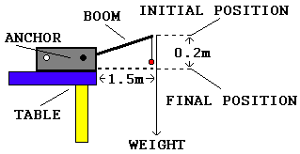
PROCEDURE
Figure 4: Setup for Competition
12

Slide 14
PROCEDURE
Make an initial sketch of the boom design
Use the imported parts in Fusion 360 to construct the boom digitally
Evaluate the length and mass of the virtual boom
Simulate a deflection of the boom
Find the boom’s reaction force
Calculate the weighted design ratio and basic weight ratio
13

Slide 15
COMPETITION RULES
Boom must be anchored to the white plastic anchorage
Boom may not be fixed to anything besides the anchorage
Boom must extend at least 1.5 meters horizontally from the edge of the anchorage
14

Slide 16
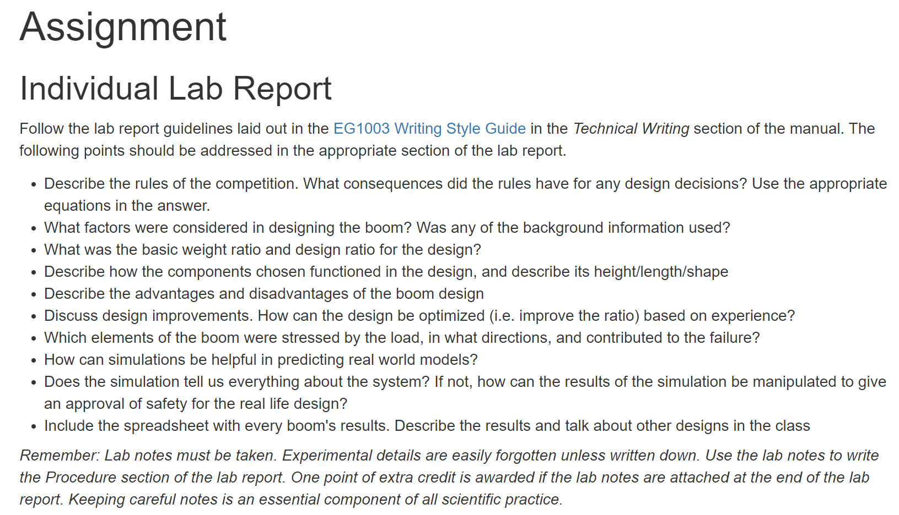
ASSIGNMENT
Individual lab report:
  Answer discussion questions in manual
  Include competition scoresheet results
  Include screenshots of the boom
  Due at 11:59 PM the night before Lab 8
Team presentation:
  Address discussion points in manual
  State rules of the competition
  Include pictures, competition scoresheet, sketches
  Due at 11:59 PM the night before the next Recitation
15

Slide 17
CLOSING
Read the instructions in the manual closely
Get a TA to help if having difficulties with Fusion 360
Make sure the simulated boom appears as it should
Submit all work electronically
Take screenshots of the boom and simulation
16

Slide 18
QUESTIONS?

