Slide 1
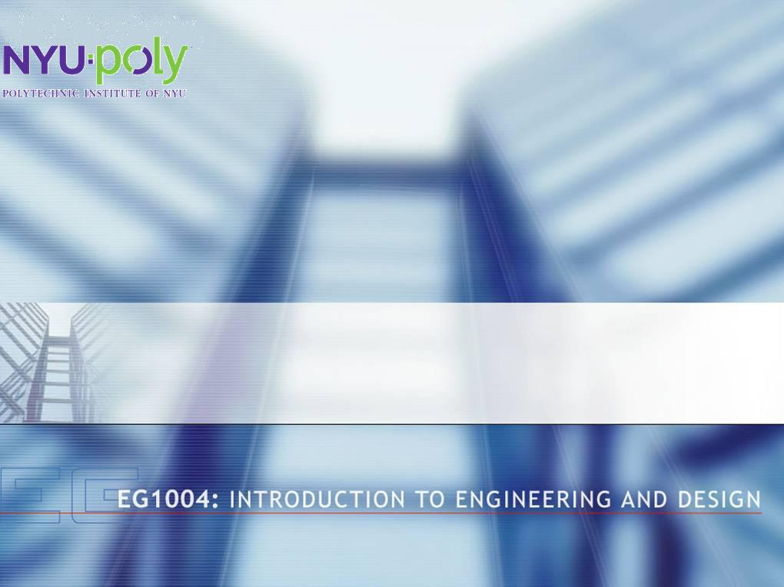
Extraction and Gel Analysis of DNA
Notes:
Paul-Henry Volmar, Anthony Ferrara, Reema Albahri Oct 2008

Slide 2
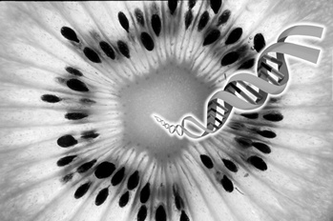
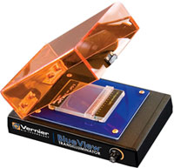
Overview
Objectives
Background information
Materials
Procedures:
  Part 1: Gel Analysis of DNA samples
  Part 2 : DNA Extraction
Closing and Feedback

Slide 3
Objectives
Extract a sizable amount of DNA
Obtain banding pattern in Gel
Understand and use basic biochemical techniques:
  Isolation and purification methods
  Chemical separation methods
  Digital bio-imaging
  Gel analysis
Understand role of ingredients used in experiment

Slide 4
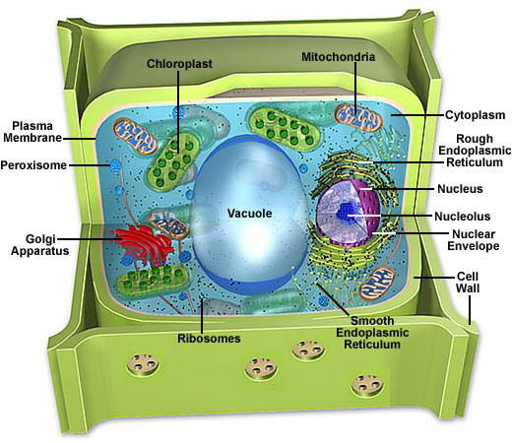
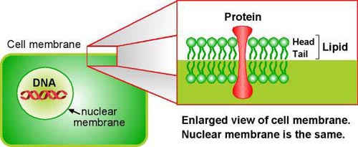
Plant Cell Structure
Cell wall: specific to plant cells
  composed of cellulose and biological plastic
  High mechanical strength to provide rigidity
  Protects intra-cellular contents
Plasma membrane:
  Double layer of lipids and proteins
  Semi-permeability for transport

Slide 5
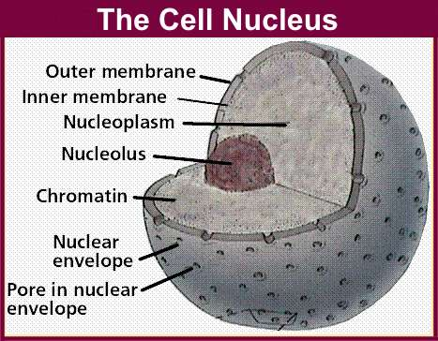
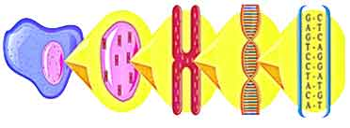
Plant Cell Structure: The Nucleus
Nuclear envelope
  Double layer of lipids
  Protect DNA from DNAses
Chromatin
  Made of DNA and protein
chromatin
DNA
cell
nucleus
chromosome
Notes:
http://www.becomehealthynow.com/images/organs/cells/nucleus_sm.jpg (fig 1)
http://www.uihealthcare.com/topics/medicaldepartments/pediatrics/vanderwoudesyndrome/images/celldna.jpg (fig 2)

Slide 6
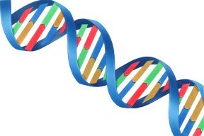
DNA Properties
Structure
  Long polymer, double-helix shaped
  Sugar-phosphate backbone
  Phosphate group make DNA negatively charged
Polarity and solubility: “like dissolves like”
  Most polar of all biopolymer
  Soluble in polar solvent: water
  Precipitated in non-polar solvent: alcohol
Helical backbone
DNA strands

Slide 7
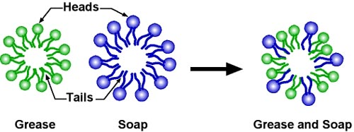
Soap Molecules
Head likes water (hydrophilic) hate fat (lipophobic)
Tail hate water (hydrophobic) likes fat (lipophilic)
Traps fats (lipids) and washes them away in water

Slide 8
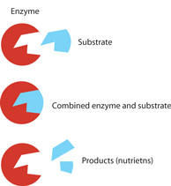
Enzymes
General characteristics:
  Specificity : lock and key principle
    Enzyme is specific to target molecule
  Sensitivity to
    Temperature: low activity at low or high temperature
    ph: works within small range
Different types of enzymes
  Restriction enzymes cut DNA at specific locations
  Maximum activity at 37°C

Slide 9
Chemical Separation: Precipitation
  Precipitation reaction:
    Reduce repulsion among likely charged ions
    Neutralize with and oppositely charged ion
    Ion⁻ + Ion⁺ → precipitated molecule
    Dissolved salt has positive ions: Na⁺ and negative ions: Cl⁻

Slide 10
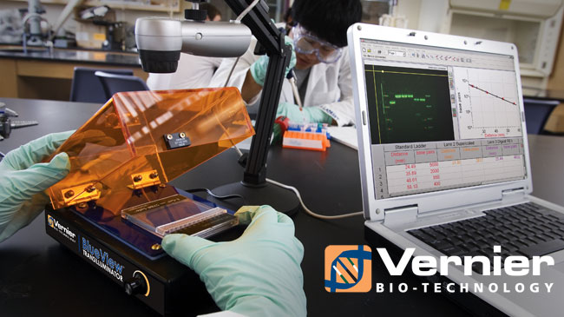
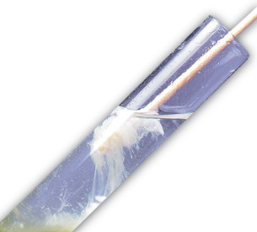
Materials
Fruit Sample
Non-Iodized Table Salt (NaCl)
Hand Soap (clear, unscented)
95% Isopropyl Alcohol (ice cold)
Distilled Water
Strainer (1 per group)
Plastic Cup (3 per group)
Ziploc Bag (1 per group)
Restriction Enzyme
Micropipettes and Tips (5 µl and 10 µl)
Incubator
Eppendorf Tube (1 per group)
Precast Agarose Gel
Electrophoresis System
Blue Digital Bioimaging System
Foam plate (1 per group)
Spoon (1 per group)

Slide 11
Experiment Design: A Guide
Where is DNA?
What are the obstacles to get to DNA?
How to overcome these obstacles?
How to protect DNA when released?
How to bring DNA molecules together?
How to take it out of the solution?
If we provide something it might be useful!!!
Use the background information presented; Think!

Slide 12
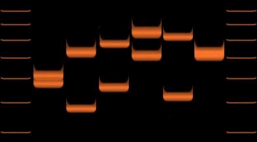
DNA Gel Analysis
Gel Electrophoresis:
  Move DNA molecules fragment through Agarose matrix using electric field
  Negatively charged DNA migrates to positive side
  DNA fragments separated by size
  Smaller fragments go farther
  Application: DNA fingerprinting
Differentiating samples from 6 individuals.

Slide 13
Procedural Steps
DNA digestion
Gel Electrophoresis
DNA imaging
Homogenization of fruit sample
Disruption of membranes and walls
Precipitation of DNA
DNA rinsing
Steps in red require TA assistance

Slide 14
Closing and Feedback
Never let solution foam when or after adding soap
Once DNA is extracted, remember to rinse twice
After rinsing DNA, ask for TA assistance
Keep clear lab notes, have it scanned
Have a picture taken of your extracted DNA
Have a picture of the banding patterns on gel
Give improvements suggestions in lab report
Remember to include answers to questions asked in lab manual (YOUR ASSIGNMENT)

