Slide 1

RECITATION 8
EG1004

Slide 2
AGENDA
Areas of Engineering
Tandon Specializations
Innovation and Design
Undergraduate Academics at NYU
Presentation Activity
1

Slide 3
AREAS OF ENGINEERING

Slide 4
FUNDAMENTALS OF ENGINEERING
Organization of Exam (Major Specific)
Math
Physics
Chemistry
Ethics
Engineering Economics
Probability and Statistics
Mechanics of Materials
Statics and Dynamics
Circuits and Electronics
Thermodynamics
Heat Transfer
Fluid Mechanics
Computer Systems
Major specific: Civil, Electrical, Computer, Chemical, Mechanical
3
Notes:
FE=Fundamental Engineering. The fundamental engineering exam is the first step to becoming a professional licensed engineer. These are a list of topic areas tested on the exam. Exams are based on engineering disciplines: civil, electrical & computer, chemical and mechanical. Not all disciplines with involve all topics. Many students choose to take this exam their senior year while the material is still fresh in their minds.

Slide 5
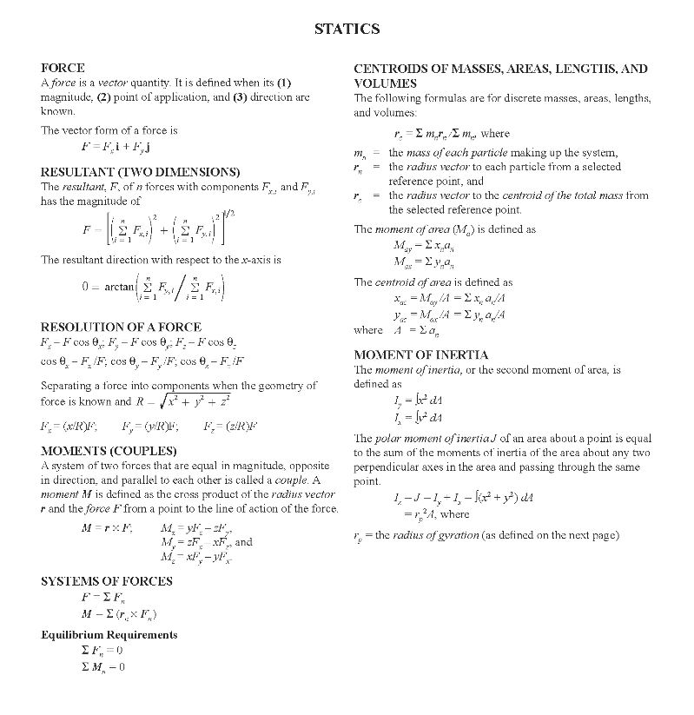
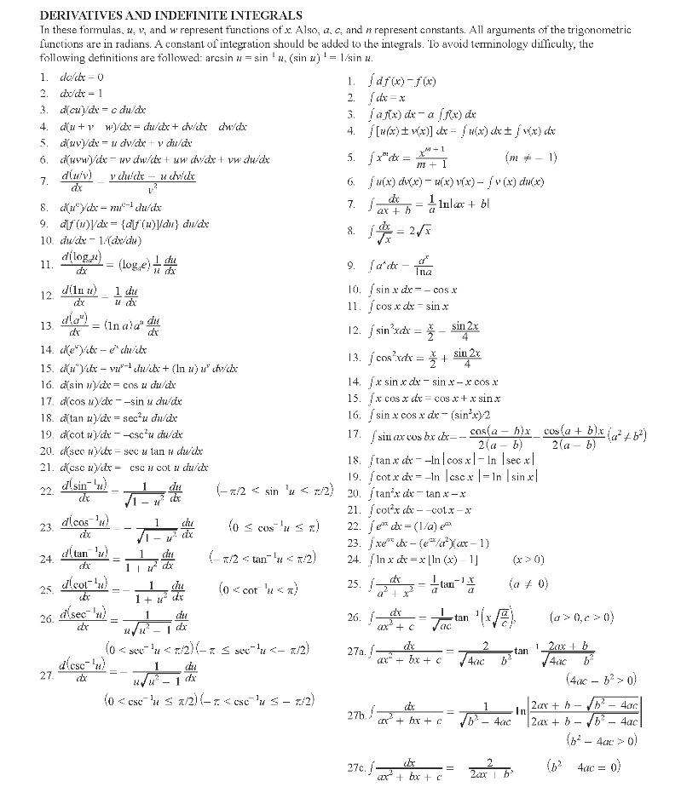
FE REFERENCE MANUAL
Learn More
4
Notes:
Beyond being the reference sheet that is provided during the FE exam, the manual is also a great quick reference for you as you continue through your academic career.

Slide 6
ENGINEERING DEPARTMENTS
Biomedical Engineering
Chemical and Biomolecular Engineering
Civil and Urban Engineering
Computer Science and Engineering
Electrical and Computer Engineering
Finance and Risk Engineering
Mechanical and Aerospace Engineering
5
Notes:
This is the list of engineering departments here, at NYU Tandon. Tandon also has several other majors that are not engineering based degrees.

Slide 7
TANDON SPECIALIZATIONS

Slide 8
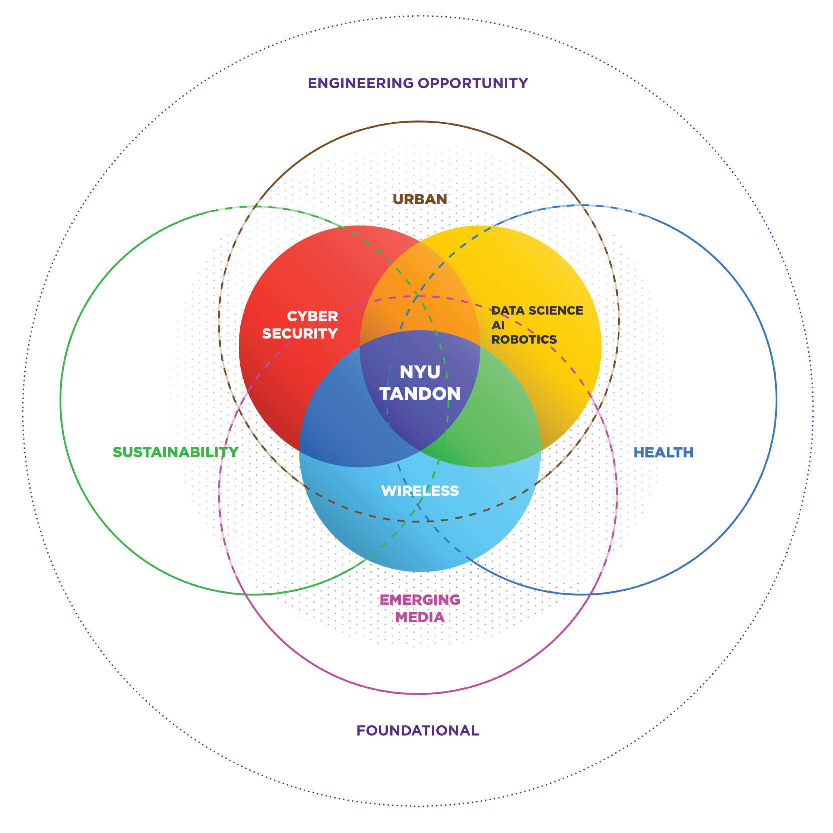
TANDON SPECIALIZATIONS
Figure 1: NYU TSE’s Specialization Areas courtesy of NYU
7

Slide 9
TANDON SPECIALIZATION
Biomedical & Health
Chemical
Biomolecular
Biomedical
Bioinformatics
Biotechnology
Mechatronics
Figure 2 & 3: Prosthetic hand & DNA structure courtesy of Johns Hopkins & Science Magazine
Learn More
8

Slide 10
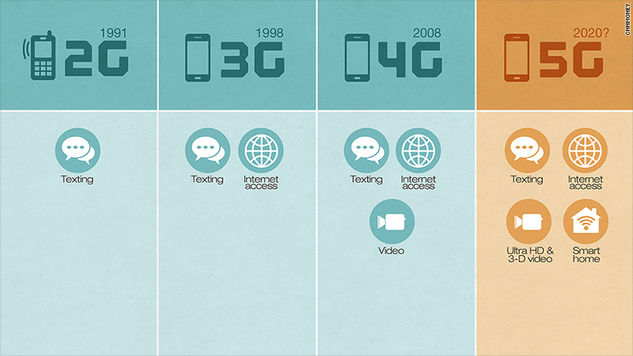
TANDON SPECIALIZATION
Information Technology & Automation
Computer science
Cybersecurity
Wireless
Artificial Intelligence
Data Science
Robotics
Learn More
Figure 4: Wireless data types courtesy of CNN
9

Slide 11
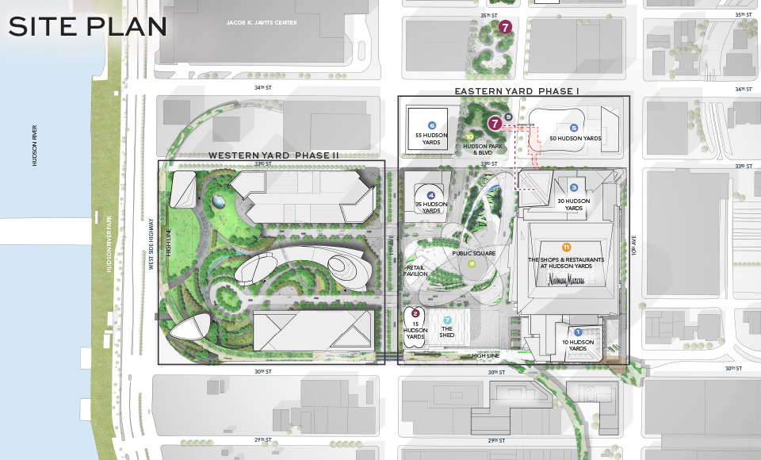
TANDON SPECIALIZATION
Urban Design & Sustainability
Environmental
Transportation
Construction
Urban Informatics
Energy
Internet of Things
Learn More
Figure 5: Hudson Yards development plan courtesy of
Hudson Yards NYC
10

Slide 12
INNOVATION AND DESIGN

Slide 13

PROJECT DEVELOPMENT
Funding & resources
Project-based courses
MakerSpace
Future Labs
  Data
  Urban
  Digital
  Veteran
Figure 6: NYU Tandon MakerSpace courtesy of NYU
12
Notes:
The I-squared-e culture can be seen throughout Tandon in multiple ways. The MakerSpace is a popular resource for students due to vast array of machines available. The MakerSpace also offers trainings and workshops to help you learn more about the equipment. From the very beginning of your academic career you take a project-based course – EG1003 Student competition teams such as Baja and Concrete Canoe teams offer even more project experience beyond coursework.

Slide 14



FUNDING & SUPPORT
Venture Competitions
  Prototyping Fund
  InnoVention
  Green Grants
  Innovation Corps (I-Corps)
  NYU Entrepreneurs Challenge
Learn More
13

Slide 15


PROJECT-BASED CURRICULUM
Senior Design Capstone
1st Year
2nd & 3rd Year
4th Year
14

Slide 16

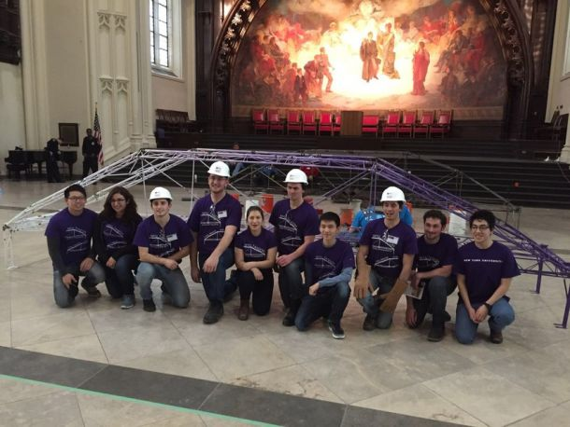
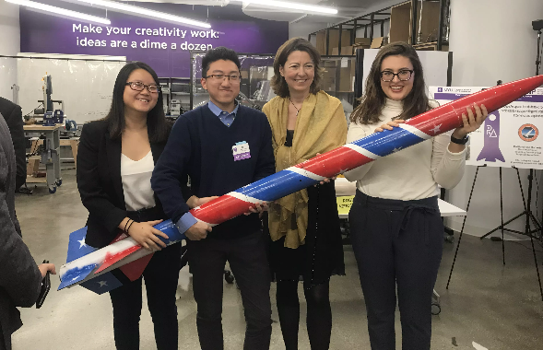
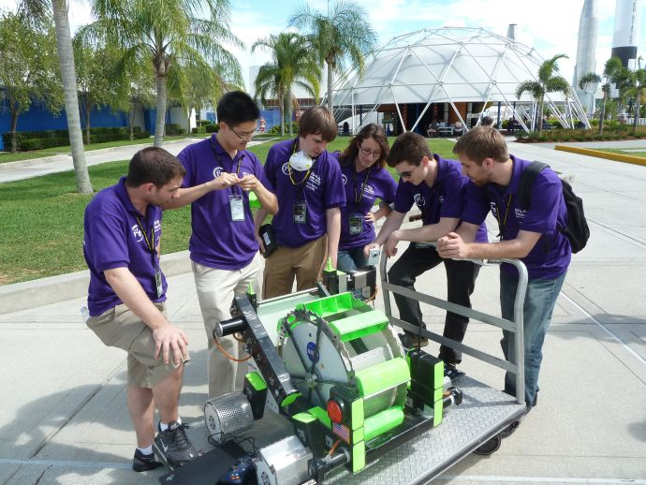


TEAMWORK OPPORTUNITIES COMPETITIONS
15

Slide 17
UNDERGRADUATE ACADEMICS AT NYU

Slide 18


ACADEMIC OPPORTUNITIES
Undergraduate Summer Research
Global Leaders and Scholars in STEM (GLASS)
BS/MS (3.4 or better throughout, apply 2nd year)
NYU Cross School Minors
Study Abroad (London, Abu Dhabi, Shanghai)
16

Slide 19

VALUABLE MINORS
Common Minors for Engineers
Business (CAS & Stern)
Finance (Tandon)
Computer Science
Robotics
Technology, Management & Design
Engineering Innovation
17

Slide 20












TANDON LABS & CENTERS
18

Slide 21
NYU SCHOOLS & CAMPUSES
P
19

Slide 22
PRESENTATION ACTIVITY

Slide 23
PRESENTATION ACTIVITY
Following each presentation, all teams discuss and share one effective aspect and one improvement for the group that just presented
20

Slide 24
QUESTIONS?

