Slide 1


RESUMES, REVISITED
EG1003 | RECITATION 11

Slide 2
COMMON MISTAKES - RESUME WRITING
Include a mailing address, even when applying to remote positions.
    Yes: “111 Tandon Ave, Apt 3, Brooklyn, NY 55555”
    No: “Brooklyn, NY”
Include location/city for each position.
    Yes: “Etsy, Data Science Intern, Brooklyn, NY”
    No: “Etsy, Data Science Intern”
    Remote Work: “Etsy, Data Science Intern (Remote)”
Include anticipated graduation year.
    Use best judgement—it’s ok if you’re not sure of your exact graduation date just yet, but be realistic.

Slide 3
COMMON MISTAKES - RESUME WRITING
Avoid unnecessary adjectives or qualifiers.
    Yes: “Addressed customer service concerns.”
    No: “Gave incredible customer service to build a lot of brand loyalty.”
Too much detail in descriptions.
    Yes: “Organized merchandise displays.”
    No: “Set up new merchandise and making sure it doesn’t get too messy.”
Figure 1: screenshot from “Succession” on HBO

Slide 4
COMMON MISTAKES - RESUME WRITING
Skills section is only for concrete, industry-specific skills. Think programming language proficiencies; verbal/written language proficiencies; industry-related software.
    Yes: “Python, C++, Javascript, Microsoft Office Suite”
    No: “teamwork,” “leadership,” “collaboration,” “fast learner,” “gifted,” etc.
Tiny font size
    Doesn’t matter if you fit in all your experience if we can’t read the text!
    Try not to use below size 12 or 11

Slide 5
COMMON MISTAKES - SUBMITTING
Whenever possible, upload/attach your resume as a PDF.
    Worried about formatting? Email it to a friend.
File Name: Include your name OR your name + specific position you are applying for.
    Resume.pdf
    Swift, Taylor_Resume.pdf
    Swift, Taylor_TikTokInternship_Resume.pdf

Slide 6
OK, I HAVE A RESUME. NOW WHAT?
Standard Resume:
    Polished resume that details your experience.
    Update every 6-12 months.
    Used for general professional inquiries, job fairs, last minute interviews
LinkedIn:
    Standard resume can be a great starting place.
    Still important to have a separate, up-to-date resume file.

Slide 7
TAILORING YOUR RESUME
Tailoring your resume: editing with a specific job, position, or company in mind.
Benefits:
    Optimize file for HR software
    Demonstrate previous applicable knowledge/skills
    Strengthen likelihood of preliminary interview.
Drawbacks:
    Time-consuming
    Potential new errors

Slide 8
TAILORING YOUR RESUME
Tailoring your resume may include:
    Adjusting active verbs
    Highlighting or adding relevant experience
    Emphasizing positions related to the job posting
Figure 1: Courtesy of Resume Genius

Slide 9
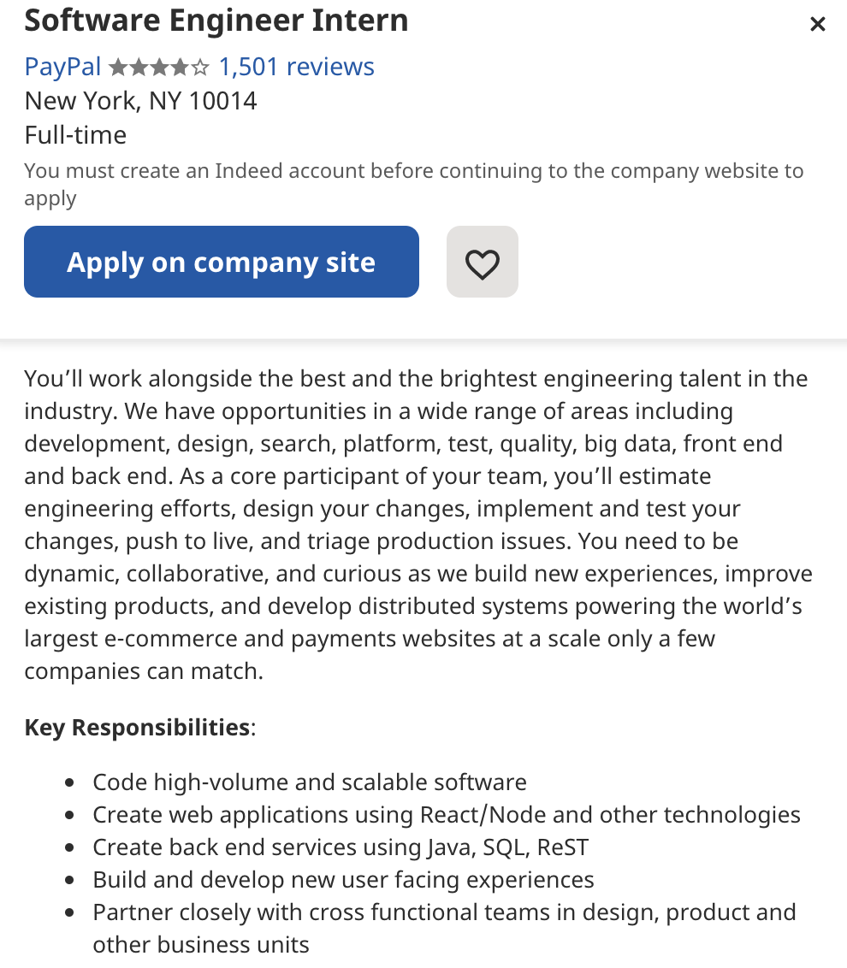
New York University, Tandon School of Engineering. Brooklyn, NY.
Research Assistant, Computer Science. January 2021-May 2021.
    Analyzed datasets produced in AI robotics experiments.
    Compiled relevant AI robotics articles from industry publications.
Starbucks. Paris, TX.
Part-Time Barista. January 2020 - September 2021.
    Fulfilled drink orders at drive-thru.
    Trained new baristas.
    Restocked pastries, drinks, and coffee accessories as needed.
Sadie’s STEM Summer Camp for Kidz. Paris, TX.
Camp Counselor. June 2020-August 2020.
    Led group of 10 second and third grade campers.
    Came up with and taught “Rad Robotics 101” workshop.
    Worked on a team with 5 other camp counselors.
    Participated in a week-long training.

Slide 10
RESOURCES
EG1003 Student Manual:
  EG1003 Writing Style Guide
  Sample Lab Report
Writing Center:
  Schedule an appointment online: nyupoly.mywconline.com
Writing Consultants:
  Available during recitation to answer questions
13

Slide 11
QUESTIONS?

