Slide 1


BOOM CONSTRUCTION COMPETITION
LAB 7
EG 1004 Introduction to Engineering & Design

Slide 2
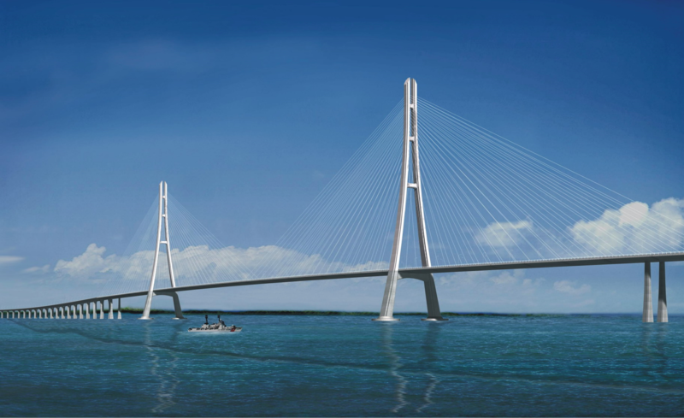
OVERVIEW
Objective
Background Information
Materials
Procedure
Competition Rules
IDBE Implementation
Assignment
Closing
Figure 1: Cable-Stayed (Cantilever) Bridge

Slide 3
OBJECTIVE
Design lightweight boom to hold significant load and minimally deflect
Consider material properties when designing a boom
  Stress and strain
Construct and test boom
Enter boom into competition to obtain highest competition ratio

Slide 4
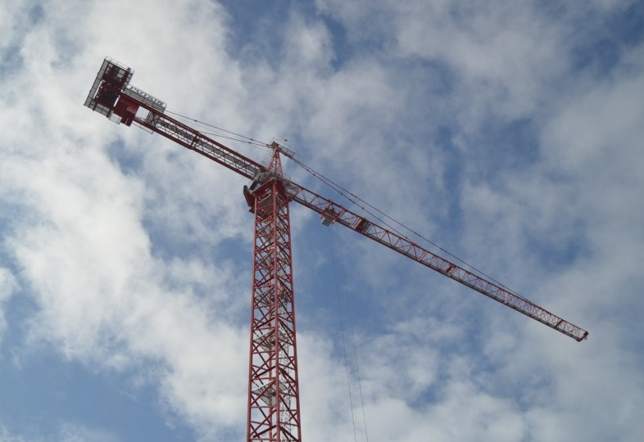
BACKGROUND INFORMATION
Boom
Lifts and moves heavy objects much heavier than the boom
Examples
Construction cranes
Cantilever bridges
Swing bridges
Figure 2: Tower Crane Courtesy of
Philadelphia Magazine
Notes:
Tandon Areas of Excellence
Sustainability
Urban
Telecommunications & IT
Health
Artificial Intelligence
Professional Skills & Tandon Resources
MakerSpace & RAD
Teamwork & Vertically Integrated Projects
Career Services
Project Management & Technical Writing
World Trade Center Construction

Slide 5


BACKGROUND INFORMATION
Fixed Support
Stress
Strain
External force acting on an object per unit cross-sectional area
Stress ($σ$) = $\frac{F}{A}$
Measure of deformation resulting from an applied force
Strain ($ε$) = $\frac{∆L}{L_{0}}$
Cross-Sectional
Area of Bar (A)
L_{o}
ΔL
F
F = applied force
A = cross-sectional area
ΔL = change in length
L_{o} = original length
Notes:
Tandon Areas of Excellence
Sustainability
Urban
Telecommunications & IT
Health
Artificial Intelligence
Professional Skills & Tandon Resources
MakerSpace & RAD
Teamwork & Vertically Integrated Projects
Career Services
Project Management & Technical Writing
World Trade Center Construction

Slide 6
BACKGROUND INFORMATION
UTS
Stress-strain curve
Key points/regions
  Elastic limit
  Ultimate tensile strength (UTS)
  Fracture stress
  Elastic region {E}
  Plastic region {P}
{P}
Stress (σ)
{E}
Elastic Limit
Fracture Stress
Strain (ε)
Notes:
Tandon Areas of Excellence
Sustainability
Urban
Telecommunications & IT
Health
Artificial Intelligence
Professional Skills & Tandon Resources
MakerSpace & RAD
Teamwork & Vertically Integrated Projects
Career Services
Project Management & Technical Writing
World Trade Center Construction

Slide 7
BACKGROUND INFORMATION
UTS
Elastic Limit
Point where the material becomes permanently deformed
{P}
Ultimate Tensile Strength (UTS)
Stress (σ)
{E}
Elastic Limit
Greatest amount of stress a material can withstand
Fracture Stress
Fracture Stress
Point where the material fails
Strain (ε)
Notes:
Tandon Areas of Excellence
Sustainability
Urban
Telecommunications & IT
Health
Artificial Intelligence
Professional Skills & Tandon Resources
MakerSpace & RAD
Teamwork & Vertically Integrated Projects
Career Services
Project Management & Technical Writing
World Trade Center Construction

Slide 8
BACKGROUND INFORMATION
UTS
{P}
Elastic Region {E}
Material will return to its original shape when load is removed
Stress (σ)
{E}
Elastic Limit
Plastic Region {P}
Fracture Stress
Material will permanently deform even after load is removed
Strain (ε)
Notes:
Tandon Areas of Excellence
Sustainability
Urban
Telecommunications & IT
Health
Artificial Intelligence
Professional Skills & Tandon Resources
MakerSpace & RAD
Teamwork & Vertically Integrated Projects
Career Services
Project Management & Technical Writing
World Trade Center Construction

Slide 9
EXAMPLE DEMONSTRATION
UTS
{P}
Stress (σ)
{E}
Fracture Stress
Strain (ε)
Notes:
Tandon Areas of Excellence
Sustainability
Urban
Telecommunications & IT
Health
Artificial Intelligence
Professional Skills & Tandon Resources
MakerSpace & RAD
Teamwork & Vertically Integrated Projects
Career Services
Project Management & Technical Writing
World Trade Center Construction

Slide 10
EXAMPLE DEMONSTRATION
UTS
{P}
Stress (σ)
{E}
Fracture Stress
Strain (ε)
Notes:
Tandon Areas of Excellence
Sustainability
Urban
Telecommunications & IT
Health
Artificial Intelligence
Professional Skills & Tandon Resources
MakerSpace & RAD
Teamwork & Vertically Integrated Projects
Career Services
Project Management & Technical Writing
World Trade Center Construction

Slide 11
EXAMPLE DEMONSTRATION
UTS
{P}
Stress (σ)
{E}
Fracture Stress
Strain (ε)
Notes:
Tandon Areas of Excellence
Sustainability
Urban
Telecommunications & IT
Health
Artificial Intelligence
Professional Skills & Tandon Resources
MakerSpace & RAD
Teamwork & Vertically Integrated Projects
Career Services
Project Management & Technical Writing
World Trade Center Construction

Slide 12



MATERIALS
Thin dowels (0.8 cm diameter)
Thick dowels (1.1 cm diameter)
3D-printed dowels connectors
Cellophane tape
String

Slide 13

PROCEDURE
Design a boom to obtain the highest competition equation
$$Competition Equation= {(Mass Ratio)}^{2}+\frac{60 [s]}{Anchor time \left[s\right]+30 [s]}+\frac{Boom length [m]}{1.5 [m]}$$
Consider the basic mass ratio
$$Mass Ratio=\frac{Mass supported [g]}{Boom mass [g]}$$

Slide 14
PROCEDURE
Assess materials to design the boom
Construct and test the boom

Slide 15
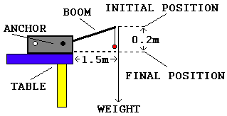
PROCEDURE
Figure 4: Setup for Competition

Slide 16
COMPETITION RULES
Boom must be anchored to the white plastic anchorage
Boom must be anchored in less than two minutes
Boom may not be fixed to anything besides the anchorage
Boom must extend at least 1.5 meters horizontally from the edge of the anchorage for the entire run
Any number of dowels can be used, as long as the total length is less than or equal to the length of 4 uncut dowels
Boom basic weight ratio MUST be greater than 1

Slide 17
COMPETITION RULES
Make a sketch of your design and get a TA to sign off on it
Anchor time will be timed from when the TA says “go” to when all hands are off the boom
TA will place a holder for the weights at the end of the boom
TA will place weights in the holder until the boom deflects 20 cm or fails
Boom must start at least 0.30 m from the ground after adding 15 grams of preload
Values will be entered into a competition scoresheet which will be available on the EG1004 Website

Slide 18
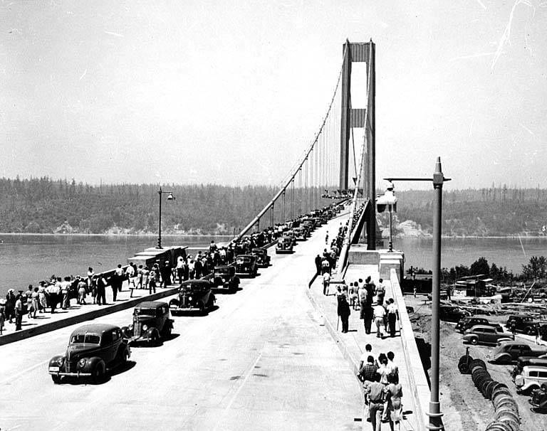
IDBE IMPLEMENTATION
Engineering Responsibility
  Must uphold industrial and ethical standards
  Risks are large and impact is widespread
  Cost of failure is catastrophic: human life
Case Study: Tacoma Narrows Bridge
  Windy conditions led to bridge oscillations
  Design could not support the elasticity of the vibrations
  Catastrophic failure of the bridge
  No deaths
Figure 5: Tacoma Narrows Bridge
Notes:
Tandon Areas of Excellence
Sustainability
Urban
Telecommunications & IT
Health
Artificial Intelligence
Professional Skills & Tandon Resources
MakerSpace & RAD
Teamwork & Vertically Integrated Projects
Career Services
Project Management & Technical Writing
World Trade Center Construction

Slide 19
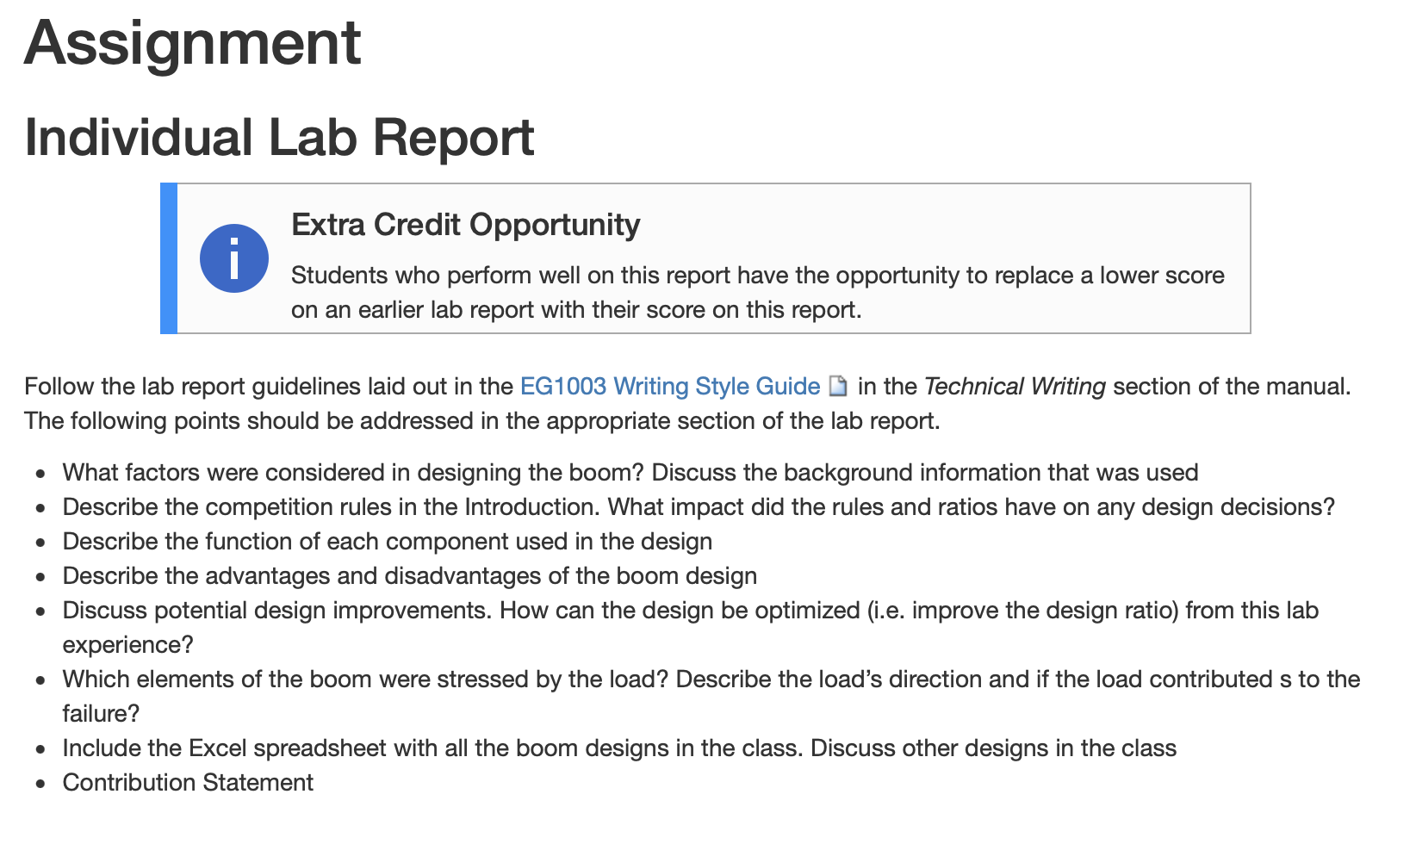
ASSIGNMENT
Individual lab report:
  Answer discussion questions in manual
  Include competition scoresheet results
  Include pictures of the boom
  Due at 11:59 PM the night before Lab 8
Extra credit opportunity:
  Can replace a lower grade on either Lab 3 or Lab 5 if this lab report grade is higher
Notes:
Tandon Areas of Excellence
Sustainability
Urban
Telecommunications & IT
Health
Artificial Intelligence
Professional Skills & Tandon Resources
MakerSpace & RAD
Teamwork & Vertically Integrated Projects
Career Services
Project Management & Technical Writing
World Trade Center Construction

Slide 20
ASSIGNMENT
Team presentation:
  Address discussion points in manual
  State rules of the competition
  Include pictures, competition scoresheet, digital sketches
  Due at 11:59 PM the night before the next Recitation
Notes:
Tandon Areas of Excellence
Sustainability
Urban
Telecommunications & IT
Health
Artificial Intelligence
Professional Skills & Tandon Resources
MakerSpace & RAD
Teamwork & Vertically Integrated Projects
Career Services
Project Management & Technical Writing
World Trade Center Construction

Slide 21
CLOSING
Think safety! Be careful not to poke classmates with the dowels
Get a TA to help if dowels need to be sawed
Have all original data signed by a TA
Submit all work electronically
Take pictures
Clean up workstations
Return the dowel connectors – do not throw them away
Return all unused materials to the TA
Notes:
Tandon Areas of Excellence
Sustainability
Urban
Telecommunications & IT
Health
Artificial Intelligence
Professional Skills & Tandon Resources
MakerSpace & RAD
Teamwork & Vertically Integrated Projects
Career Services
Project Management & Technical Writing
World Trade Center Construction

Slide 22
QUESTIONS?

