Slide 1

BIOMEDICAL FORENSICS
EG1004 | LAB 11

Slide 2
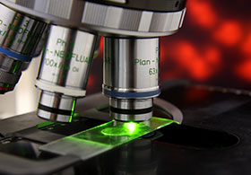
OVERVIEW
Objective
Background Information
Materials
Procedure
IDBE Implementation
Assignment
Closing
Figure 1: Biomedical Forensic Science
Courtesy of Boston University
1

Slide 3
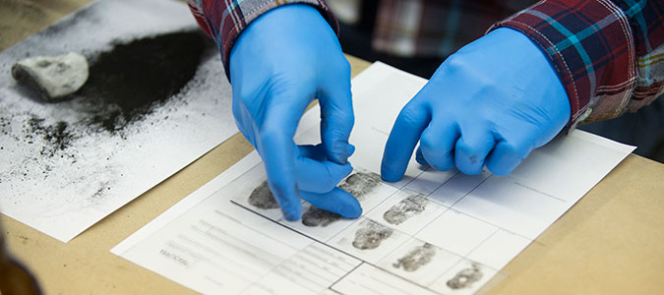
OBJECTIVE
Use basic forensic techniques
  DNA extraction
  Fingerprinting
  Toxicology Report
  Blood typing
Solve a murder mystery
Figure 2: Fingerprinting Courtesy of Marian University
2

Slide 4
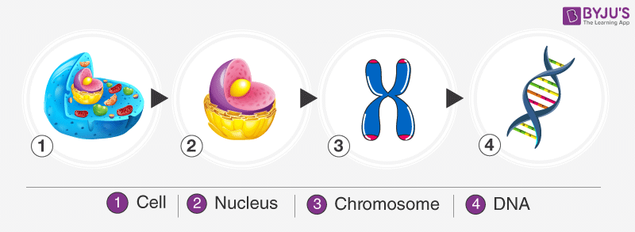
BACKGROUND INFORMATION
Deoxyribonucleic acid (DNA)
  Packaged in the form of chromatin (which make up chromosomes)
  Exist in the nuclei of cells
  Plant cells have a cell wall that must be penetrated to access the DNA
Figure 3: DNA Packaging Sequence Courtesy of Byju’s
3

Slide 5
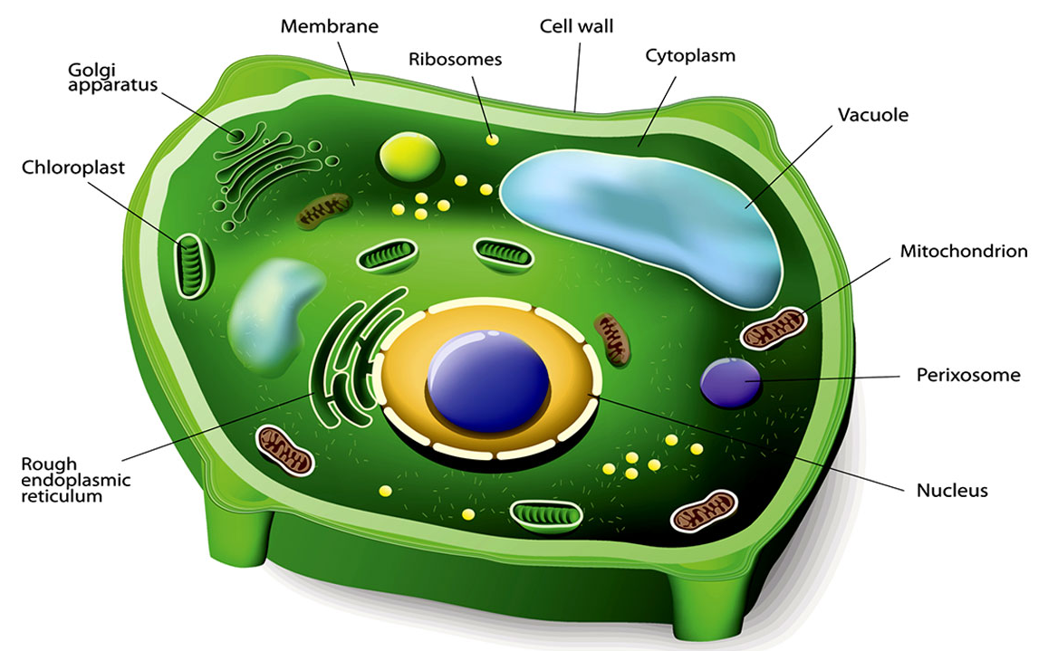
BACKGROUND INFORMATION
DNA extraction (of a plant cell)
  Break the cell wall (cell lysis) to expose the DNA within the cell
  Destroy the plasma membrane
  to further expose the DNA
  Precipitate the DNA to make
  the DNA visible
Figure 4: Plant Cell Structure Courtesy of Biology Wise
4

Slide 6
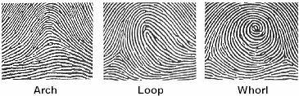
BACKGROUND INFORMATION
Fingerprints – unique patterns consisting of friction ridges and burrows
  Loops – 60% of pattern types
  Whorls – 35% of pattern types
  Arches – 5% of pattern types
Figure 5: Fingerprint Types Courtesy of
Headlines on Human Hands
5

Slide 7
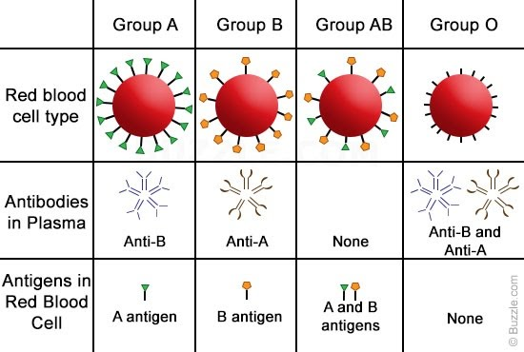
BACKGROUND INFORMATION
Blood typing (ABO system)
  Existence of antigens on red blood cells determine blood type
  A and B antigens determine type of blood (A, B, AB, or O)
  Rh antigen determines presence of Rhesus factor (indicated by +/-)
Figure 6: ABO Blood Type System Courtesy of Buzzle.com
6

Slide 8
MATERIALS
Strawberry
Non-iodized table salt (NaCl)
Hand soap (clear, unscented)
95% isopropyl alcohol (0°C)
Distilled water
Strainer
Plastic cups
Ziploc bag
Iron magnetic wand
Iron powder
Blood typing kit
Pipettes
Beaker
Test tubes
Microcentrifuge tubes
Plexiglass pieces
Baby wipes
Meter stick
7

Slide 9

PROCEDURE
Follow the video story to solve the
murder mystery
Learn techniques in Forensic Academy
  DNA extraction
  Toxicology Report
  Fingerprinting
8

Slide 10

PROCEDURE
Conduct the crime scene investigation
  Biological dimensional analysis
  Toxicology Report
  Blood typing
  Fingerprinting
Compare data to the Suspect
Information Sheet
Determine, as the expert witness, which suspects matches the data
9

Slide 11
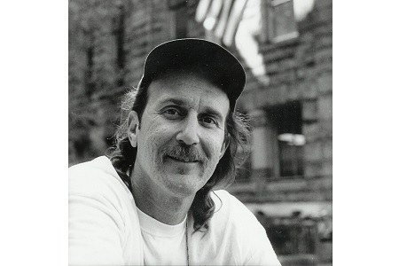

IDBE IMPLEMENTATION
Bite mark analysis
  Used in court since the 1960’s
  Many contest admission of it in court due to questions about its scientific validity
  >30 people originally incarcerated for bite mark evidence have been since exonerated
Crucial that engineers and scientists regularly re-evaluate the validity of their standard practices
Figure 7: Ray Krone was convicted partially on bite mark evidence and was later exonerated after the evidence was found to be faulty
10

Slide 12
ASSIGNMENT
No lab report
Team presentation:
  Author a presentation using (nearly) all images
  Where text is allowed:
    Title slide
    Overview slide
    Materials slide
    Captions for figures, tables, and equations
    Suspect list/table
    Data tables
    References to suspect names
11

Slide 13
CLOSING
Take pictures of the extracted DNA, fingerprint on murder weapon, and drug present in victim’s blood
Record data in the Suspect Information Sheet
Tell a TA who you think the killer is before leaving lab
Submit all work electronically
Clean up workstations – this is a messy lab
Return all unused materials to the TA
12

Slide 14
QUESTIONS?

