Slide 1
Sensors Training

Slide 2
Sensors Overview
Evaluates the robot’s surroundings
Creates inputs to control loops and switches
Three sensors primarily used for SLDPs
  Light sensor (measures light properties)
  Gyro sensor (measures orientation)
  Ultrasonic sensor (measures distance)

Slide 3
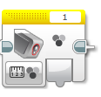
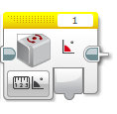
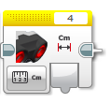
Sensors Overview
Types of Sensors
Light (Color) Sensor
Gyro Sensor
Ultrasonic Sensor

Slide 4
Switches & Loops
Switches perform different actions depending on the input
  “If-else” statements
Loops continuously loop sections of code repeatedly until the end statement occurs
  Set amount of time, distance from wall, etc.

Slide 5
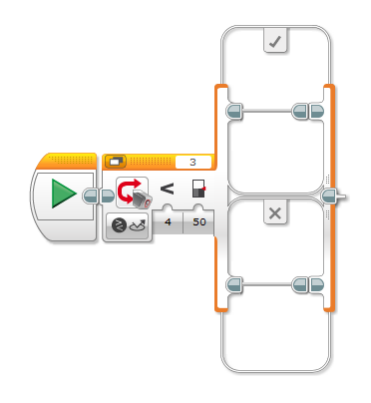
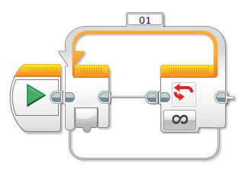
Switches and Loops

Slide 6
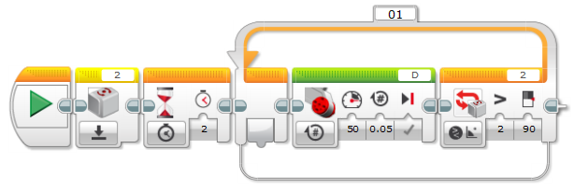
Example Code – Gyro Sensor
Gyro sensor must be reset prior to every reading
  Change type to “Reset”
Inserting a “Wait” block increases gyro sensor accuracy
Use a loop to continuously turn the robot until a specific angle is reached

Slide 7
Ports
Ports 1, 2, 3, and 4 are for sensors and other inputs
Ports A, B, C, and D are for motors and other outputs
Port View displays sensor readings in real-time on the EV3 brick
  Ex. information for light intensity must be determined using port view to make the line-following code

Slide 8
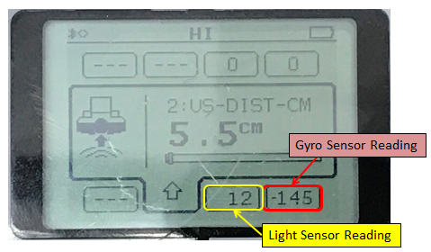
Port View
Ultrasonic Sensor Reading

Slide 9
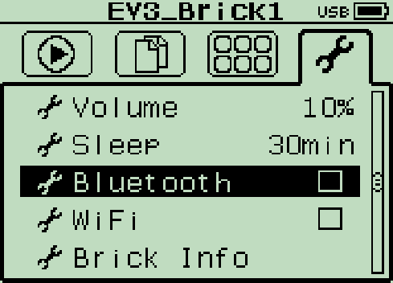
Bluetooth
Enable Bluetooth to upload and run code immediately from computer to robot

Slide 10
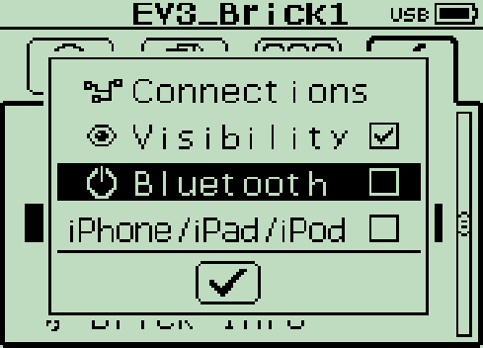
Enabling Bluetooth
Go to the wrench-shaped symbol
Check both “Bluetooth” and “Visibility”

Slide 11
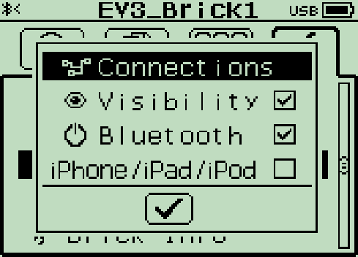
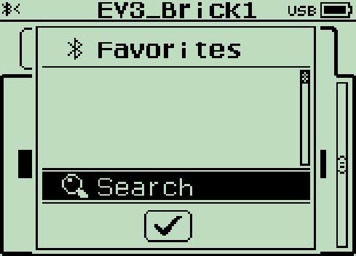
Enabling Bluetooth
Go to “Connections” and click “Search”

Slide 12
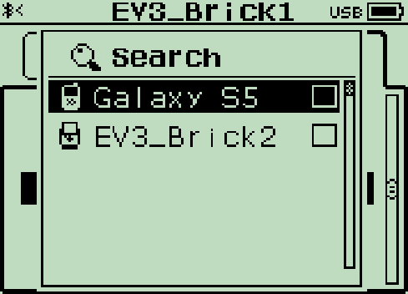
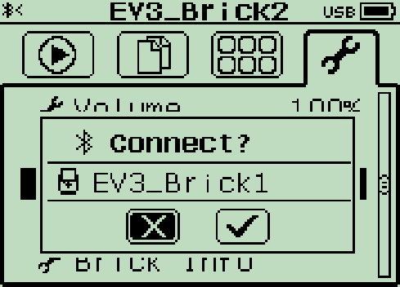
Enabling Bluetooth
Select Device Name
Press check mark for “Connect?”

Slide 13
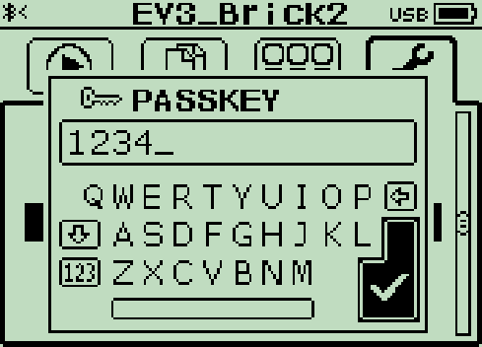
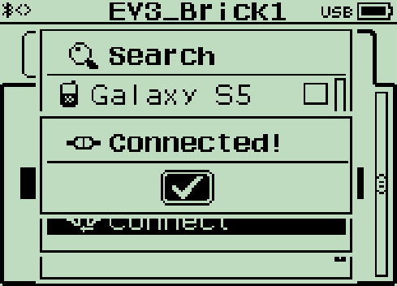
Enabling Bluetooth
Enter a passkey (must match on both devices; default is 1234)
If all goes well, symbol in top left corner will look like “<>” and “Connected!” will appear in the middle of the screen

Slide 14
Closing
For further information, refer to “Sensor Tutorial” under Help & How-To’s for SLDPs on the manual
  “Product Evaluation (Sensors)” may also be helpful
Share tasks – each team member should take a turn building the code
Save your work on Google Drive
Return all unused materials to TAs

Slide 15

Sensors Training
QUESTIONS?

