Slide 2
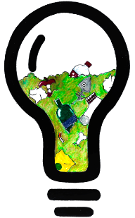
Energy Resource Technology Hacks
Bulb

Slide 3
Agenda
Who We Are
Problem
What did we do about it?
Why do you care?
Design
What’s Next
FAQ

Slide 4
ERTH: Energy Resource Technology Hacks
Mission Statement: Our goal is to offer low
cost renewable energy to rural areas through biomass and experimental procedure.
Miata Laverley
Lead Programmer & Manager
NYU Tandon 2022
Chemical and Biomolecular
Amy Liu
Structural Engineer
NYU Tandon 2021
Chemical and Biomolecular
Blazej Raszewski
Research & Development Director
NYU Tandon 2022
Chemical and Biomolecular

Slide 5
problem
“When fossil fuels are burned, they release nitrogen oxides into the atmosphere, which contribute to the formation of smog and acid rain.”
“There’s literally a ton of plastic garbage for every person on Earth”
“Within its work on renewable energy, UNDP supports the development of on- and off-grid renewable energy technologies and delivery services. ”

Slide 6
What did we do about it?
Create a low-cost energy source
Test trash in the chemistry lab to produce energy
Code an Arduino to output the energy produced in volts
Build Bulb, a biomass powered generator
Established a basic structure that is conducive to feasible improvements through research

Slide 7
Why should you care?
$0.15 per Kwh (biomass) vs $0.17 per Kwh (fossil fuels)
Reduces Greenhouse Gasses
Reduces trash at homes, business, and schools, and in our oceans
Will keep our environment cleaner, healthier, and more habitable.

Slide 8
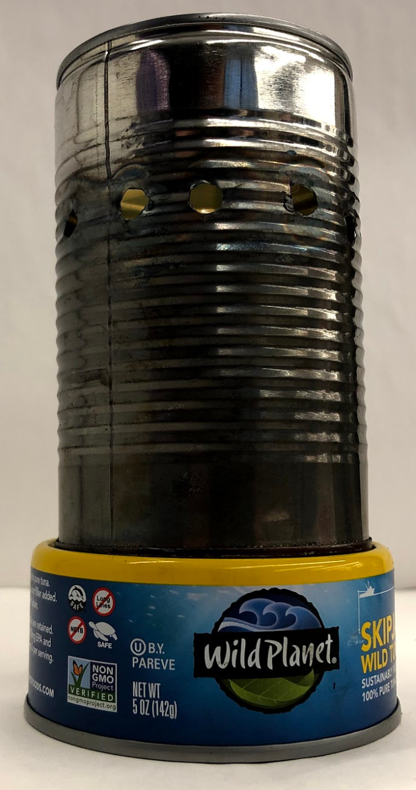
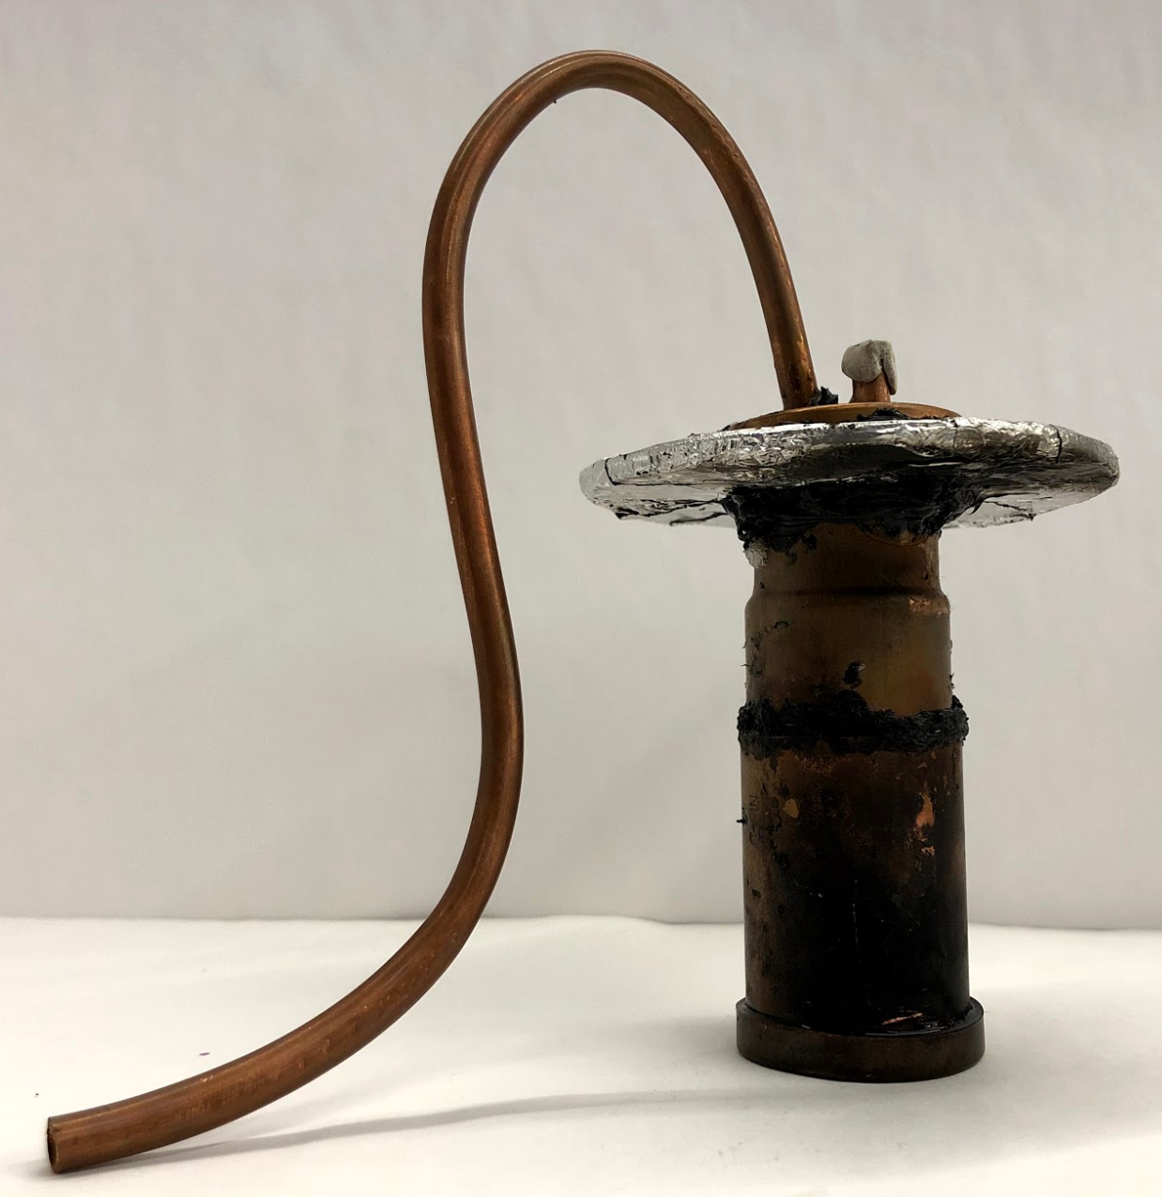
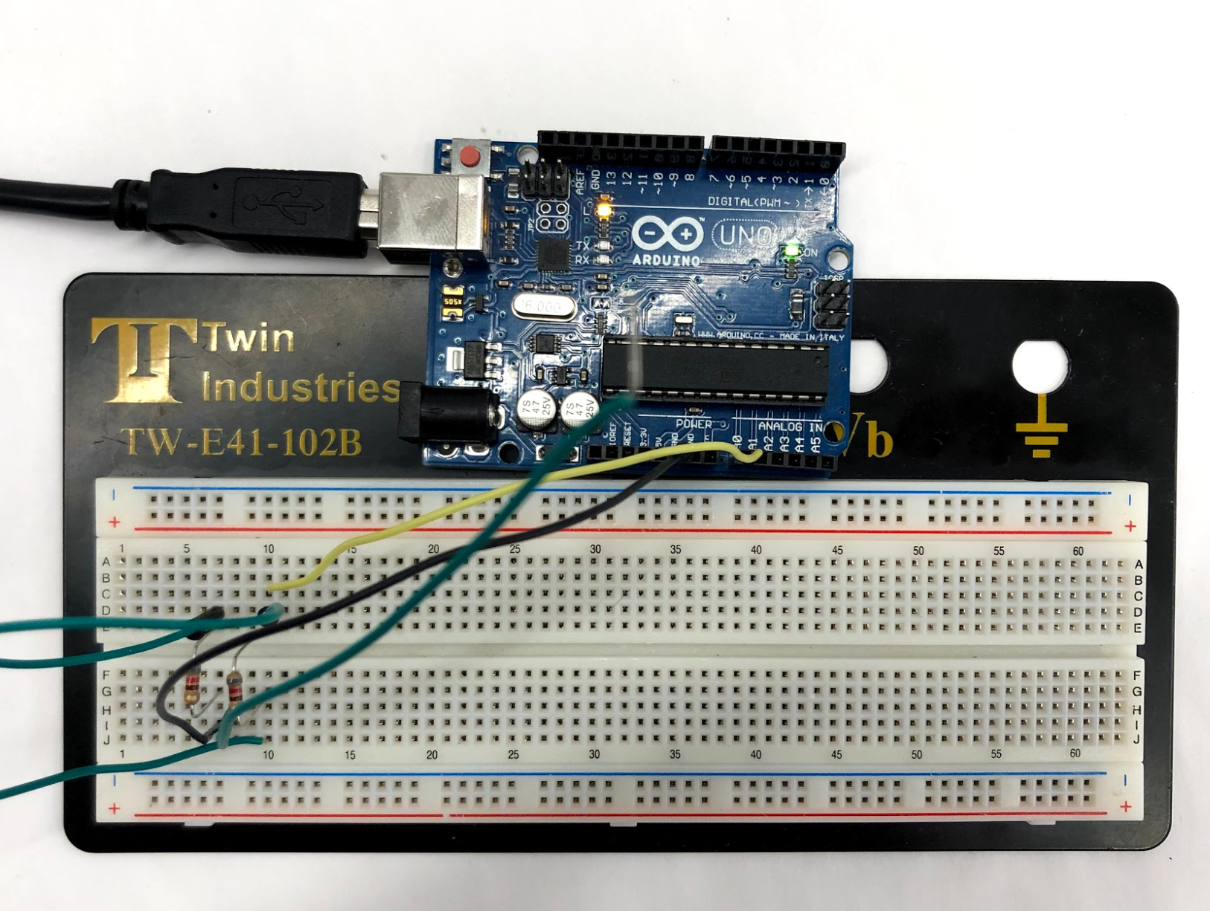
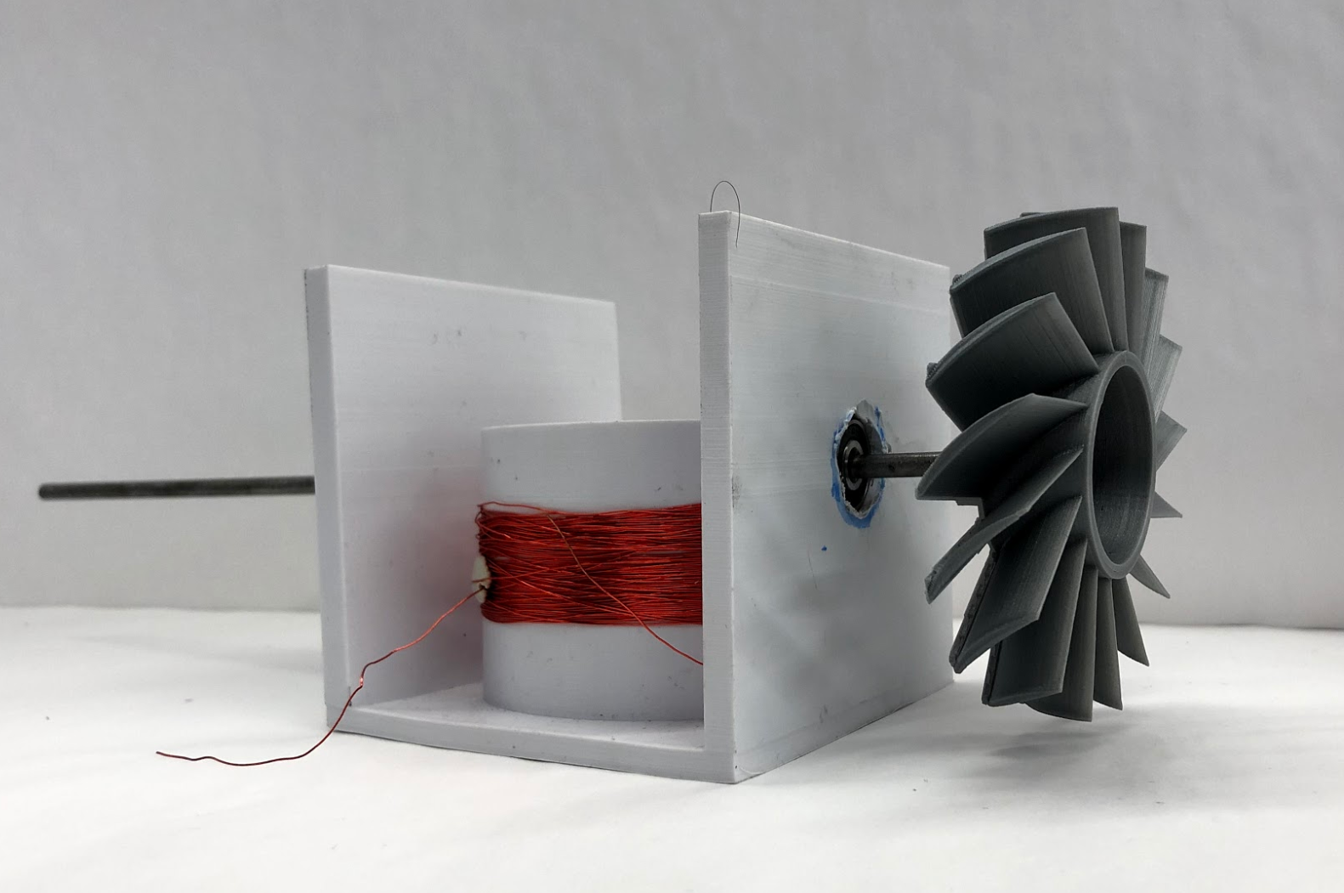
Design
Combustion Chamber
Burns biofuels
Boiler
Arduino
Generator
Registers Voltage
Creates Stream for Turbine
Creates alternating current

Slide 9
What’s Next
Increase Output
Refine Design
More Biomass
Recycle CO₂

Slide 10
FAQ
Why not just use current forms of renewable energy?
Reduce waste, save space and money
Other Competitors?
Governments and private users
How does ERTH differ from other electrical companies?
Equipment rental
What kind of trash fuels the generator?
Fibrous waste

Slide 11
Energy Resource Technology Hacks
Bulb

