Slide 1
WELCOME TO ELEMENTARY ENGINEERING AND DESIGN
ENGR-NY 2 | ORIENTATION

Slide 2
OVERVIEW
1
Introductions
2
Course Structure and Policies
3
Tour of EGED Facilities

Slide 3
COMMUNITY AGREEMENTS
Take care of your needs
Your physical, mental, and emotional health come first.
Respect each other
Support each other as we grow as engineers together in this space.
Be present and participate
Unplug from your day-to-day and mindfully engage.

Slide 4
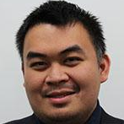
INTRODUCTIONS
Peter Li
Instructor
Ingrid Paredes
Instructor
Nat Ku
Lab Facilitator
Roman Rich
Lab Facilitator

Slide 5
HELLO, MY NAME IS
Your chosen name
Your pronouns
What is something that brought you joy lately?

Slide 6
GOALS OF OUR COURSE
Provide Exposure to Engineering Disciplines
Put Engineering Design Process to Use
Practice Technical Communication

Slide 7
COURSE STRUCTURE
Contact Information for Absences, Questions, Concerns
Peter Li
Li@eg.poly.edu
Ingrid Paredes
ijparedes@nyu.edu
LAB/PROJECT HRS – JAB573
Mondays from 8:30 - 11:30 AM
RECITATION – JAB773
Mondays from 12:30 - 2:00 PM

Slide 8
PROJECT INTRODUCTION
7
Week Project
Three Project Options:
Self-watering Flowerpot
Autonomous Robot
Wearable Tech
2-4
Team Members

Slide 9
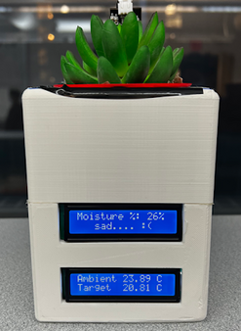
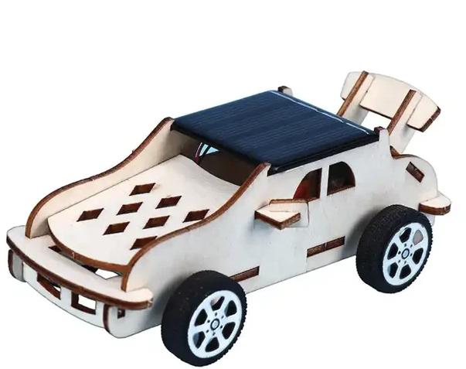
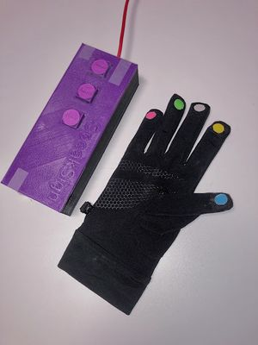
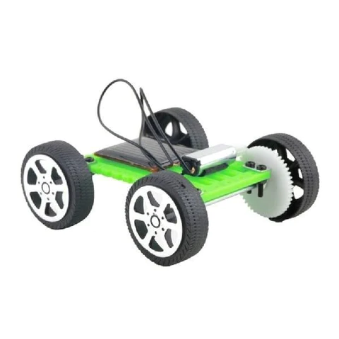
WHAT YOU’LL DO: CREATE A PRODUCT
Option 1: Self-Watering Flower Pot
Option 2: Autonomous Robot
Option 3: Wearable Tech

Slide 10
PROJECT STRUCTURE
Skills workshops provided for:
Circuitry
Microcontrollers (Arduino)
Coding
Computer-Aided Design
Manufacturing
Every other week, you will have time to work on your projects in lab, focusing on the skills acquired during the most recent workshop

Slide 11
MONITORING YOUR PROGRESS
Benchmark + Milestone
One benchmark
Completion of certain portions of project
Project documentation due (templates will be provided)
Due dates on Google Calendar
Penalties for late completion

Slide 12
MONITORING YOUR PROGRESS
Benchmark
Checkpoint midway through the program during lab hours
Tasks will depend on the project type chosen
TAs + faculty will review and evaluate progress from documentation and device performance
Milestone
5 minute presentation detailing your progress, delivered in recitation
Opportunity to get and provide feedback for your teammates

Slide 13
SLDP TEAM GOOGLE DRIVE
Your team must create a Drive folder for your team and share it with your professors & TAs!
All files you create for your SLDP must be in this Drive folder:
Engineering notebook
CAD files
Code
Circuit diagrams
Progress pictures
Product videos
Presentations
Budget spreadsheets
Microsoft Project schedules
Preliminary Design Investigation
Final Design Report

Slide 14
YOUR TO-DO LIST
1
Consider what project interests you most!

Slide 15
QUESTIONS?

