Slide 1

RECITATION 6
EG1003

Slide 2
AGENDA
Course tips
The Scientific Method
The Engineering Design Process
1

Slide 3
COURSE TIPS
Notes:
Many students are familiar with the scientific method from high school or middle school. **Ask the class to name the parts of the scientific method**

Slide 4
COURSE TIPS
Organize your course files and folders
  Download manager Chrome extension or Firefox Add-on
EG 1003 teamwork experience for interviews
Mac users, partition your HD for windows or run a virtual machine
3

Slide 5
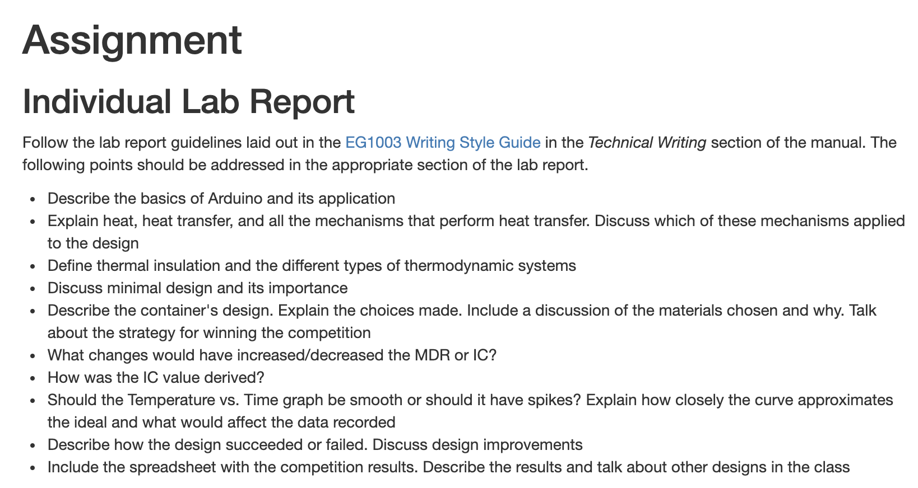
MASTERING THE EG1003 LAB REPORT
Answer lab report questions
Use objective language
One idea per paragraph
Avoid pronouns
Tables=above ; figures=below
Entire figure/table on one page
Formulas get entire line
Figure 1: Student Manual assignment prompts
4
Notes:
Many students wonder at this point in the semester how they can improve their lab report scores. Here are a few tips that you should use on every report. For each lab, at the bottom of the Student Manual page there are a list of questions and prompts that you should address in depth in your lab report. These questions vary between lab reports. As engineers it is important that we can report data objectively, without opinion or bias, utilizing facts and observation. To organize your paper and aid in writing your report, stick to one idea per paragraph. Remember that tables are labeled above and figures are labeled below. After proofreading your report, check the formatting of your report. Sometimes tables and images will get split onto multiple pages. Ensure that your label for the media is also on the same page. When inserting a formula into Microsoft Word, use the equation tool under the “Insert” tab. Do not incorporate equations into paragraphs, they need their own line in the report.

Slide 6
THE SCIENTIFIC METHOD
Notes:
Many students are familiar with the scientific method from high school or middle school. **Ask the class to name the parts of the scientific method**

Slide 7
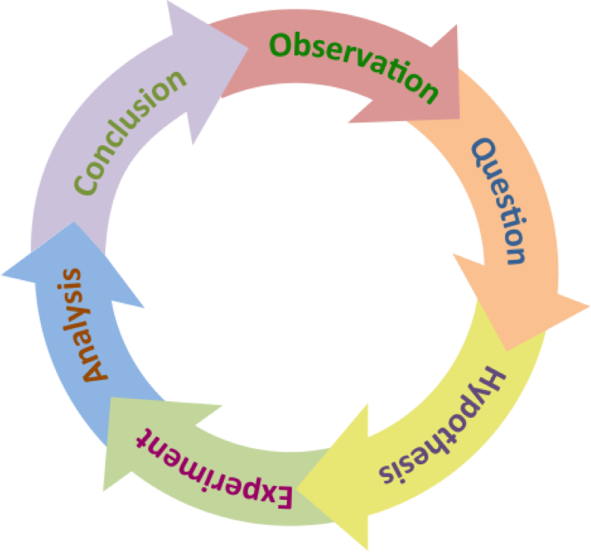
THE SCIENTIFIC METHOD
Research
Questions
Research
Method
Figure 2: Scientific method cycle courtesy of The Biology Primer
6
Notes:
**Briefly describe the scientific method** Perhaps the most important part of the scientific method is that it is cyclical and that often we follow this process intuitively as scientistic and engineers. The cycle can be broken up into two main parts: research questions and research methods.

Slide 8
THE ENGINEERING DESIGN PROCESS
Notes:
Many students are familiar with the scientific method from high school or middle school. **Ask the class to name the parts of the scientific method**

Slide 9
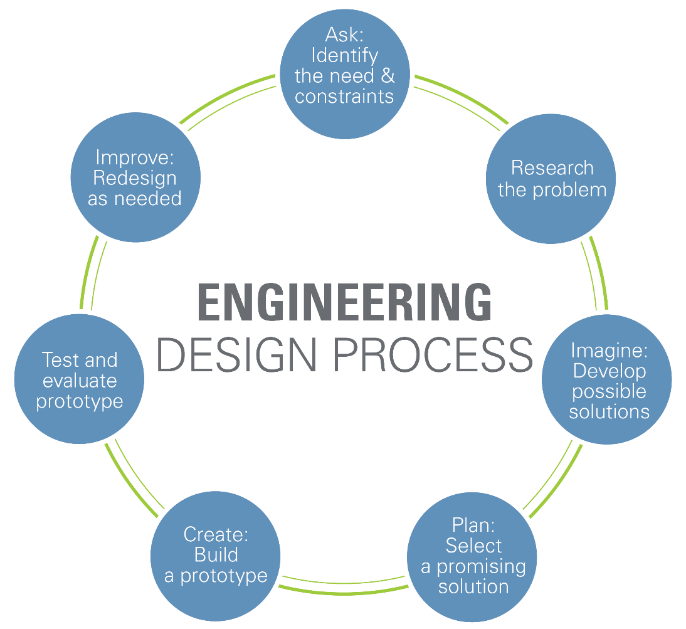
ENGINEERING DESIGN PROCESS
Figure 3: Engineering design cycle courtesy of Teach Engineering
8
Notes:
Similar to the scientific method, the engineering design process is also cyclical and follows the same general structure as the scientific method: proposing a question or a challenge and then testing with a certain methodology. **Breifly go over the engineering design process**. The prototyping steps are iterative and may require many different approaches in order to help address the need. It is important to note that no prototype is perfect and can always be further iterated to better solve the original problem using a set of standards to determine its effectiveness.

Slide 10
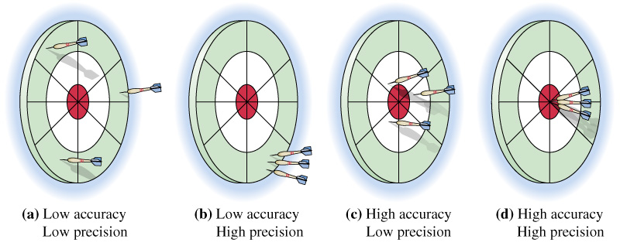
ACCURACY & PRECISION
Figure 4: Accuracy and precision visual courtesy of Extension Engine
9
Notes:
One of the considerations when reviewing the success of a prototype is the prototype’s accuracy and precision. If the determination of success is landing the darts in the red circle, high precision represents the repeatability of results and the accuracy represents the prototype’s ability to complete the goal.

Slide 11
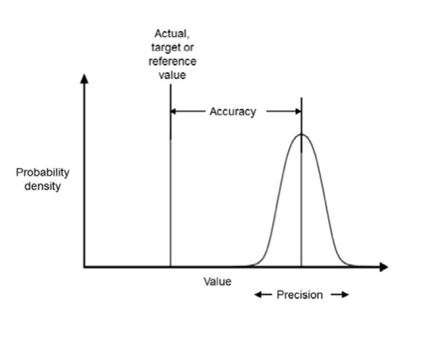
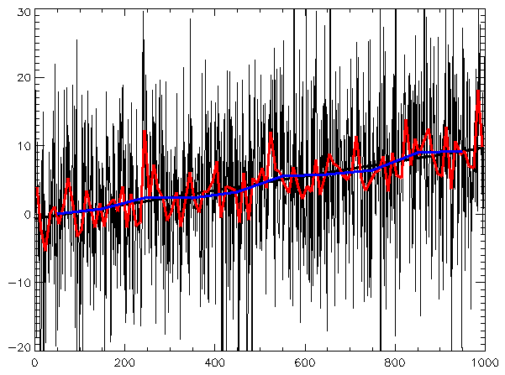
VARIABILITY
Figure 5: Accuracy and precision graphically courtesy of All Sensors
Figure 6: Variability and standard courtesy of Maksim
10
Notes:
Variability helps to describe the spread of the overall data compared to a reference value, The blue line in figure 6 above represents the reference value and the variance of the data is shown by the red spikes.

Slide 12
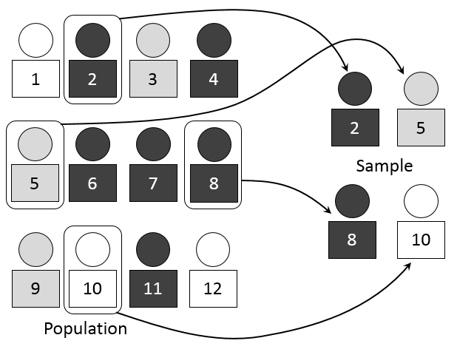

SAMPLING
Figure 7: Simple random sample courtesy of Mathprofdk
11
Notes:
When trying to complete a statistical analysis and draw conclusions for a given problem that involves a large population of many individuals, it is virtually impossible to record data from every single individual in a population. Simple random sampling, as show in Figure 7, shows a population of 12 people. Simple random sampling selects 4 people from this sample completely at random and records the data from these individuals. How do we know that the results we obtained represent the population instead of just the four people sampled? The equation on the right allows calculation of a minimum sample number considering various statistical factor values that help define the desired variance of the data.

Slide 13
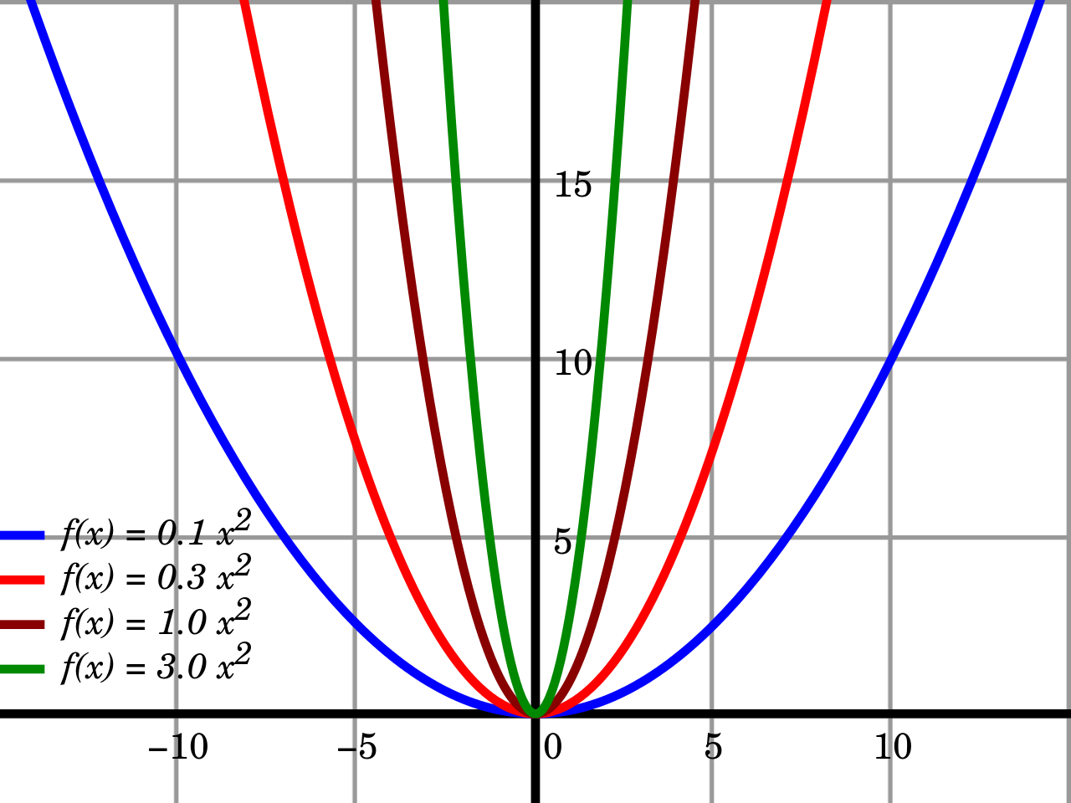
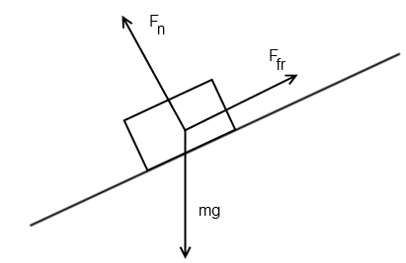
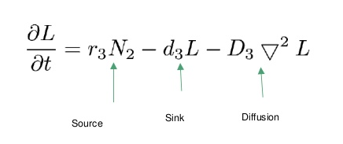
RELATIONSHIPS & ASSUMPTIONS
Figure 8, 9 &10: Mathematical relationships
12
Notes:
In order to make scientific progress, we build off the work of those in the past – luckily, we can use math and the results of those who came before us to create mathematical models that help describe and predict the behavior of what is being studied. For example, we know the relationship between a mass sitting on a slope experiencing the force of gravity, this mathematical equation which you will learn in physics is a result of combining a lot of observations and measurements into a model. As you go along in your academic career, you will find these models will become more complex and will help you solve less intuitive problems.

Slide 14
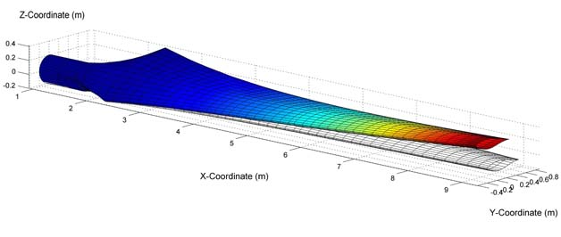

OPTIMAL DESIGN
Figure 11: Wind turbine model courtesy of University of Minnesota
13
Notes:
Mathematic relationships discovered overtime enable engineers to optimally design with a high level of precision and accuracy. With optimal designs, engineers can create technology that is useful and safe. These mathematical models are incorporated into CAD software to allow computerized prototyping.

Slide 15
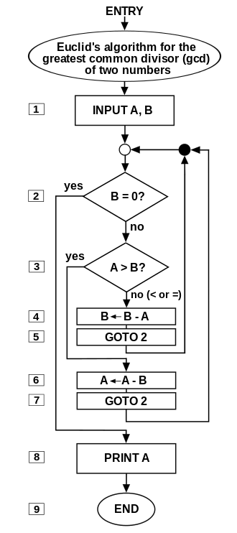
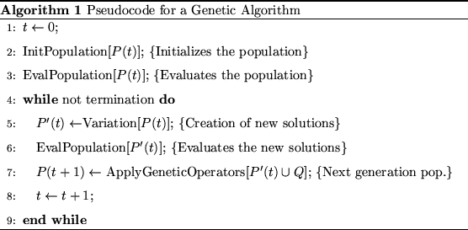
ALGORITHMS
Figure 12 & 13: Algorithm flow chart and code courtesy of Somepics and University of Maine at Augusta
14
Notes:
When combined together, mathematical relationships and models can create algorithms which further simplify the process for scientists and engineers and allows computerized processing.

Slide 16
QUESTIONS?

