Slide 1

DIGITAL LOGIC
EG1003 | LAB 11

Slide 2

OVERVIEW
Objective
Background Information
Materials
Procedure
Assignment
Closing
Figure 1: Semiconductor courtesy of Scoop.it
1

Slide 3
OBJECTIVE
To design a combinational logic circuit for a given problem statement
To activate and test the circuit in LabVIEW
To build the circuit on an NI-ELVIS board
2

Slide 4
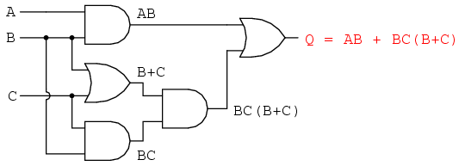
BACKGROUND INFORMATION
Boolean logic:
  Two values of true and false (1 and 0)
  Describes logical operations through arithmetic equations
Truth table – shows all the possible input combinations and their associated outputs
Figure 2: Boolean circuit courtesy of
All About Circuits
3

Slide 5
BACKGROUND INFORMATION
Think of this example
An ATM has three options:
  Print statement
  Withdraw money
  Deposit money
The ATM will charge a fee when:
  Money is withdrawn
  A statement is printed without depositing money
Inputs |  |  | Output
P (Print) | W (Withdraw) | D (Deposit) | C (Charge)
0 | 0 | 0 | 0
0 | 0 | 1 | 0
0 | 1 | 0 | 1
0 | 1 | 1 | 1
1 | 0 | 0 | 1
1 | 0 | 1 | 0
1 | 1 | 0 | 1
1 | 1 | 1 | 1
Table 1: Truth table for the ATM example
4

Slide 6
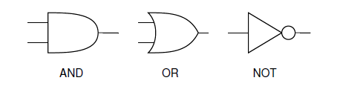
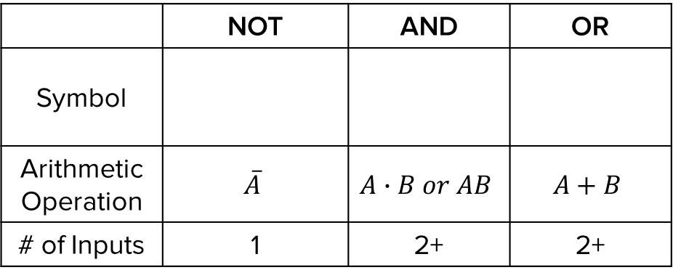
BACKGROUND INFORMATION
Logic gates:
  NOT gate – inverts the input
  AND gate – both inputs have to be true for the output to be true
  OR gate – if either input is true the output will be true
 | NOT | AND | OR
Symbol
Arithmetic Operation | $$\overline{A}$$ | $$A∙B or AB$$ | $$A+B$$
# of Inputs | 1 | 2+ | 2+
Table 2: Logic gates
5

Slide 7
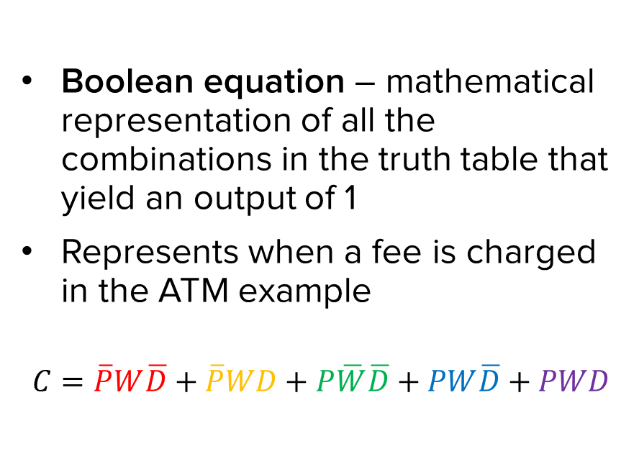
BACKGROUND INFORMATION
Inputs |  |  | Output
P (Print) | W (Withdraw) | D (Deposit) | C (Charge)
0 | 0 | 0 | 0
0 | 0 | 1 | 0
0 | 1 | 0 | 1
0 | 1 | 1 | 1
1 | 0 | 0 | 1
1 | 0 | 1 | 0
1 | 1 | 0 | 1
1 | 1 | 1 | 1
Boolean equation – mathematical representation of all the combinations in the truth table that yield an output of 1
Represents when a fee is charged in the ATM example
$$C=\overline{P}W\overline{D}+\overline{P}WD+P\overline{W}\overline{D}+PW\overline{D}+PWD$$
Table 3: Truth table for the ATM example with true combinations
6

Slide 8
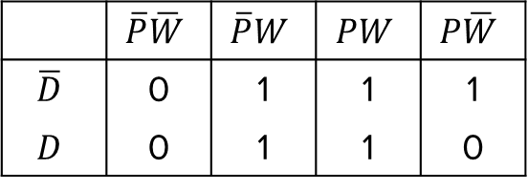
BACKGROUND INFORMATION
Karnaugh map (K-map) – two-dimensional representation that shows the common characteristics of the inputs
Only one value can change at a time between adjacent rows and columns
$$C=\overline{P}W\overline{D}+\overline{P}WD+P\overline{W}\overline{D}+PW\overline{D}+PWD$$
 | $$\overline{P}\overline{W}$$ | $$\overline{P}W$$ | $$PW$$ | $$P\overline{W}$$
$$\overline{D}$$ | 0 | 1 | 1 | 1
$$D$$ | 0 | 1 | 1 | 0
Table 4: K-map for the ATM example
7

Slide 9

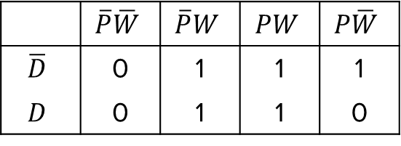
BACKGROUND INFORMATION
Simplified Boolean equation – mathematical representation of true values in the K-map
  Box together 1s in the K-map
  Number of cells in a box must be a
  power of 2 (1, 2, 4, 8, etc.)
  Look for the biggest boxes first
  Boxes can overlap
Simplified equation is determined by constant variable(s) in each box
 | $$\overline{P}\overline{W}$$ | $$\overline{P}W$$ | $$PW$$ | $$P\overline{W}$$
$$\overline{D}$$ | 0 | 1 | 1 | 1
$$D$$ | 0 | 1 | 1 | 0
$$C=W+P\overline{D}$$
Figure 3: Simplified Boolean equation for
the ATM example
8

Slide 10






BACKGROUND INFORMATION
Combinational logic circuit – graphical representation of the simplified Boolean equation
$$W$$
OR
$$P$$
$$C=W+P\overline{D}$$
AND
$$D$$
NOT
$$P\overline{D}$$
$$\overline{D}$$
Figure 4: Combinational logic circuit for the ATM example
9

Slide 11
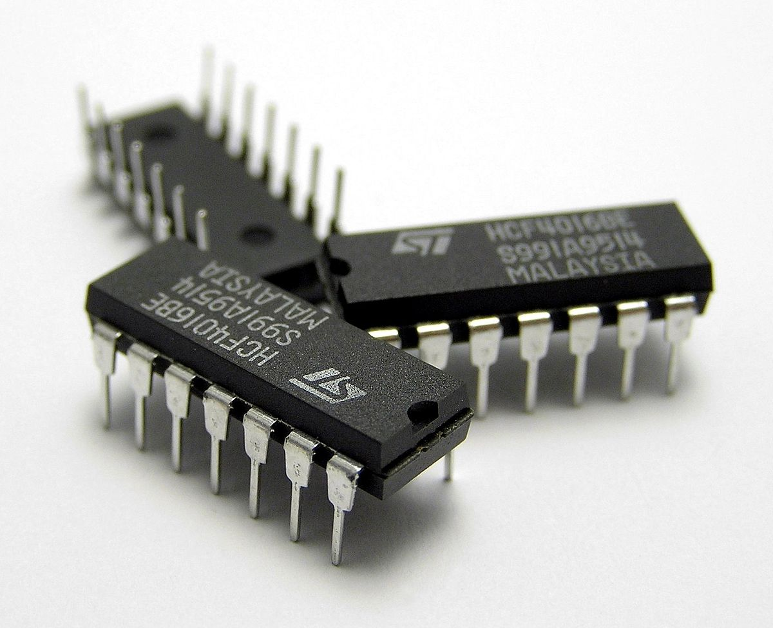
MATERIALS
A 7432 IC (4 dual-input OR gates)
A 7408 IC (4 dual-input AND gates)
A 7404 IC (6 single-input NOT gates)
A lab PC with LabVIEW 2019 software
An NI-ELVIS II+ with prototyping board
Electrical leads
Figure 5: Integrated circuit (IC) chips
courtesy of Wikipedia
10

Slide 12
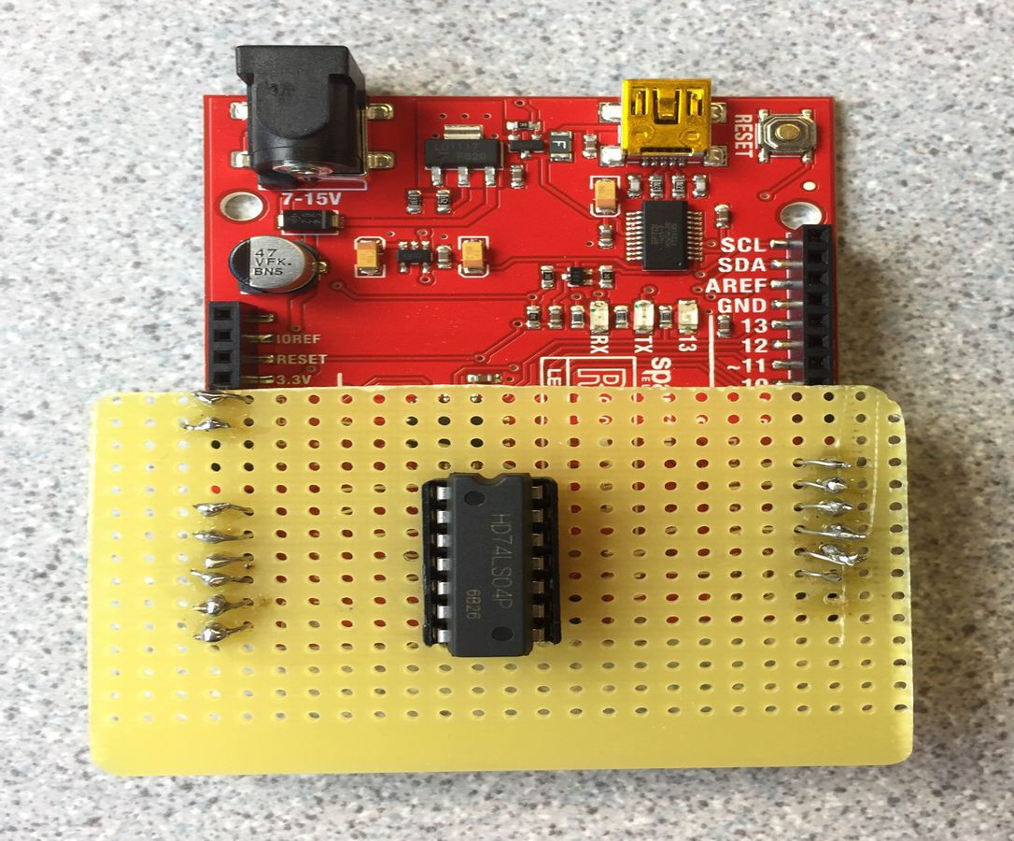
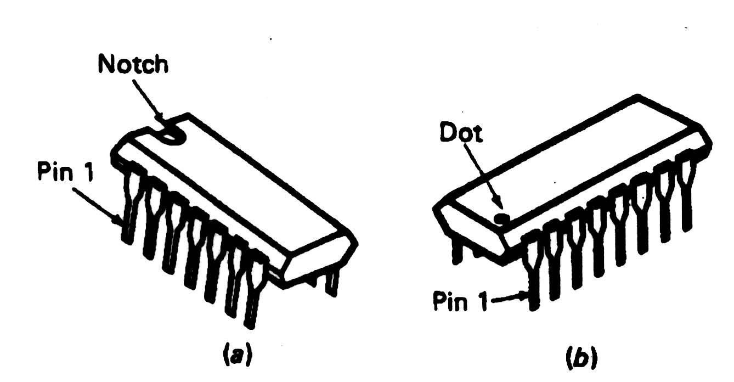
PROCEDURE
Part 1: Test the IC chips
  Use the Arduino board setup by the TAs to test the NOT/OR/AND IC chips
  The Arduino program will determine if the IC chips are functional or not
  Orient the IC chips properly
Figure 6: IC chip tester
11

Slide 13
PROCEDURE
Part 2: Build and test a logic circuit for the problem statement
  Farmer Georgi has two barns
    Think of Barn 1 as “1” and Barn 2 as “0” in the truth table
  A fox, hen, and corn can be in either barn at anytime
  Design an alarm system that will sound when:
    The fox and hen are in the same barn
    The hen and corn are in the same barn
12

Slide 14
PROCEDURE
Part 2: Build and test a logic circuit for the problem statement
  On paper:
    Build a truth table
    Create a Boolean equation
    Build a K-map
    Create a simplified Boolean equation
    Draw a combinational logic circuit
13

Slide 15



PROCEDURE
Part 2: Build and test a logic circuit for the problem statement
  In LabVIEW:
    Build the combinational logic circuit
    Use three control switches and one Boolean indicator
Hint:
NOT
AND
OR
14

Slide 16
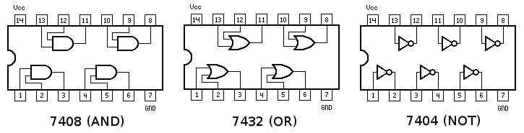
PROCEDURE
Part 2: Build and test a logic circuit for the problem statement
  On the NI-ELVIS board:
    Wire the combinational logic circuit using the IC chips
    Power (+5V) and ground the IC chips
    Orient the IC chips properly
Figure 7: Pins and identification numbers of IC chips
15

Slide 17
ASSIGNMENT
Team lab report:
  Answer discussion questions in manual
  Include a screenshot of the LabVIEW VI
  Due at 11:59 PM the night before the next lab session
Team presentation:
  Address discussion points in manual
  Include a screenshot of the LabVIEW VI
  Include a photo of the NI-ELVIS board wiring and LED
16

Slide 18
CLOSING
Save (or take a screenshot) of the LabVIEW VI
Take turns using the software and wiring the NI-ELVIS board
Submit all work electronically
Clean up workstations
Return all unused materials to the TA
17

Slide 19
QUESTIONS?

