Slide 1
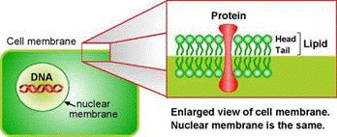
Biomedical Forensics

Slide 2
Overview
Experimental Objective
Background Information
Materials
Procedures:
Part 1: Forensic Academy
Part 2: Murder Mystery
Conclusion

Slide 3
Experimental Objective
Understand and use basic forensic techniques:
DNA Extraction
Blood Typing
Fingerprinting
Solve a murder mystery

Slide 4
Background Information
DNA Extraction
DNA Properties
Forensic Techniques

Slide 5
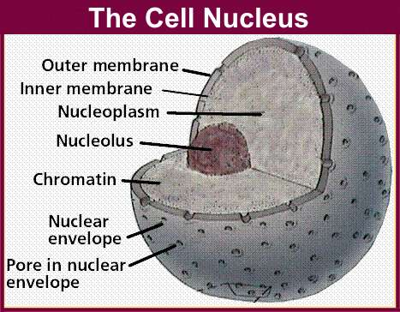
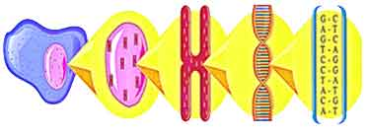
DNA Extraction
Process of breaking down cells to reach the nucleus
Double layer of lipids
Chromatin
Made of DNA and protein
chromatin
DNA
cell
nucleus
chromosome

Slide 6
DNA Properties
Structure:
Long polymer, double-helix shaped
Sugar-phosphate backbone
Phosphate group make DNA negatively charged
Polarity and solubility: “like dissolves like”
Most polar of all biopolymers
Soluble in polar solvent: water
Precipitated in non-polar solvent: alcohol
Helical backbone
DNA strands

Slide 7
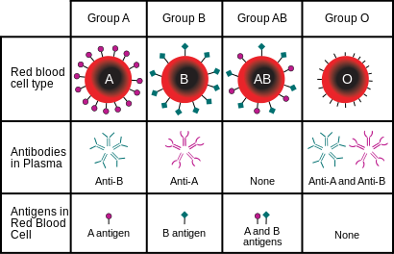
Forensic Techniques
Blood Typing
Using reactions to decode blood
Fingerprinting
Using observations to determine each type
Arch, whirl, loop
Drug Testing
Using reagents to determine unidentified powder substances

Slide 8
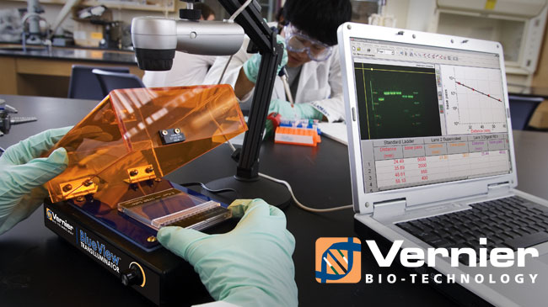
Materials
Fruit sample
Non-iodized table salt (NaCl)
Hand soap (clear, unscented)
95% isopropyl alcohol (0°C)
Distilled water
Strainer
Plastic cups
Ziploc bag
Iron Magic Wand
Iron powder
Blood typing kit
White paper
String
Meter stick

Slide 9
Procedure
Part 1: Forensic Academy
DNA Extraction
Fingerprinting
Drug Testing

Slide 10
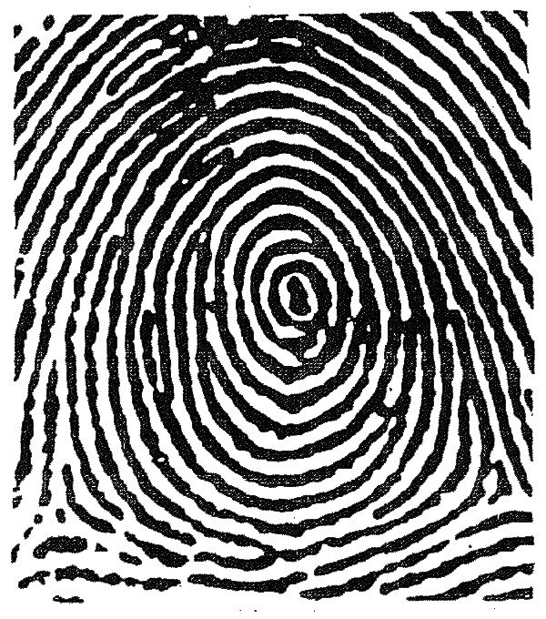
Procedure
Part 2: Murder Mystery
Biological Dimensional Analysis
Blood Typing
Fingerprinting Testing

Slide 11
Assignment: Report
Team report
Title page
Discuss topics in manual
Scan in lab data and notes

Slide 12
Assignment: Presentation
Team presentation
Include photos of:
DNA Extraction
Fingerprinting Test
Include table of blood splatter results
State who the killer is

Slide 13
Conclusion
Never let solution foam when or after adding soap
Keep clear lab notes, have it scanned
Have a picture taken of your extracted DNA
Suggest improvements in lab report
Answer questions in lab manual in report

Slide 14
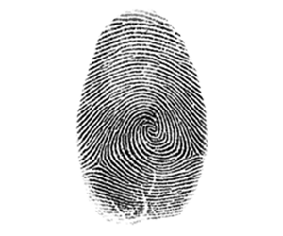
Biomedical Forensics
Questions?

