Slide 1
Professional Tone

Slide 2
Professional Tone
Respect your readers
Maintain gender neutrality
Discuss only the professional situation

Slide 3
Readers Have Different Backgrounds
Omit Local Idioms and Sayings
Instead of “bootleg parts” use “inauthentic components”
Instead of “the most bang for the buck” use “the best return on the investment”
Provide Generic Explanations of Trade Names
Instead of “the Mindstorms kit” use “the Mindstorms kit, a modular construction set used to create programmable toys”

Slide 4
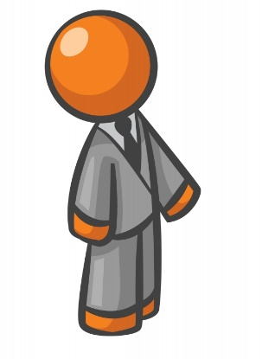
Readers Are Professional
Avoid Contractions
Instead of “don’t” use “do not”
Instead of “can’t” use “cannot”
Use Figure Numbers Instead of Pointing
Instead of “as shown here in this chart” use “as shown in Figure 1”
Substitute Colloquial Ideas with Professional Terms
Instead of “need to keep the heat in” use “need to reduce heat loss”
Instead of “program was full of bugs” use “program had many errors”
Instead of “new model was a lot better” use “new model was improved by 15%”

Slide 5
Write As If You Are Professional
Avoid Educational Goals
Instead of “the purpose of the lab was to learn about digital logic” use “the objective was to design and test an alarm system”
Omit Details Specific to the School Situation
For example “the design was approved by the TA”
Use Simple Past Tense
Instead of “First, the truth table had to be created. Then, it was required to draw a simplified equation.” use “First, the truth table was created. Then, a simplified equation was drawn.”

Slide 6
“You” Implies Familiarity
Avoid “You”
Instead of “when you use the formula you find the result” use “when one uses the formula, the result is found”
Avoid “Your”
Instead of “it is important to test your design before putting it on the market” use “it is important to test a design before putting it on the market”

Slide 7
Professional Tone
Respect your readers
Maintain gender neutrality
Discuss only the professional situation

Slide 8
Ways to Avoid Sexist Pronouns
When an engineer receives a product, he will be curious about how it works. | Not all engineers are men
When an engineer receives a product, they will be curious about how it works. | Okay, but some people may take issue with the use of the singular “they”
When engineers receive a product, they will be curious about how it works. | Make the subject plural
When an engineer receives a product, he/she will be curious about how it works. | Use a slash or the word “or”, but this assumes that gender is binary
When an engineer receives a product, curiosity develops about how it works. | Rewrite the sentence

Slide 9
Discuss the Professional Situation
Omit feelings and opinions not backed up by facts
Avoid empty, redundant phrases like “the team believes”, “it is concluded”, or “it was felt”
Present a hypothesis and support it with data and observations

Slide 10
Professional Tone
QUESTIONS?

