Slide 1

LAB REPORT OVERVIEW
EG1003 | RECITATION 4

Slide 2

EQUATIONS
On a separate line, not in text
Centered
Number usually on right
${(x+a) }^{n} =\sum_{R−0}^{n}{k=\left({n \atop k}\right)x^{k}a^{n−k}}$ (1)
$a^{2}+b^{2}=c^{2}$ (2)
6

Slide 3
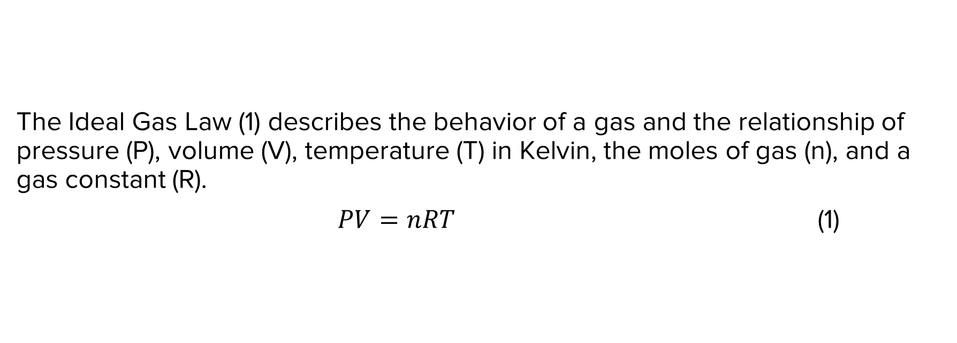
EQUATIONS
The Ideal Gas Law (1) describes the behavior of a gas and the relationship of pressure (P), volume (V), temperature (T) in Kelvin, the moles of gas (n), and a gas constant (R).
$PV=nRT$ (1)
7

Slide 4
EQUATIONS
Go to
“Insert” tab
Click on
“Equation”
Type your equation
Place # after the equation
Enter parentheses and number
Press enter
Correct font and type at “Home” tab
8

Slide 5
TABLES
Copy/paste tables from Excel using “Keep Source Formatting”
Labels must go above tables, aligned left and captioned
Number all tables consecutively, separate from figures
9

Slide 6
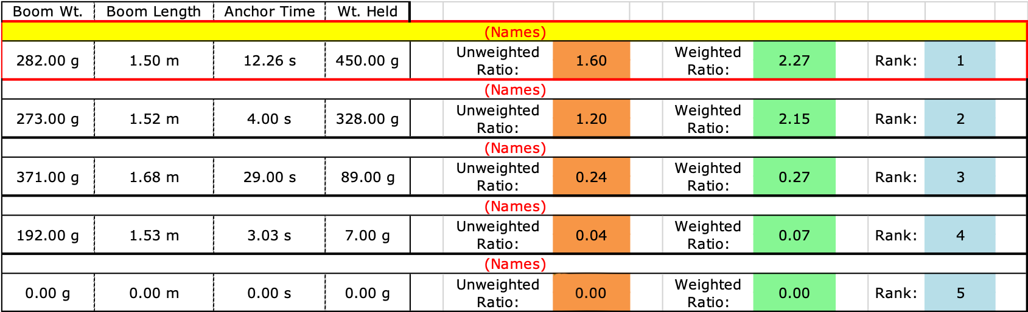
TABLES
Table 1: Boom Construction Competition Ranking
10

Slide 7
NUMBERING FIGURES
VS. TABLES
FIGURES
Graphs, charts, diagrams, infographics and images are all figures and numbered together
TABLES
Tables are their own type of item and are not numbered with figures
Labels must go over tables, aligned left and numbered consecutively
Labels must go under graphs and figures, aligned left and numbered consecutively
11

Slide 8

FIGURES
Figure 1: Anchor Time & Rank in Competition
Figure 2: Cantilever Bridge
12

Slide 9
RESOURCES
EG1003 Student Manual:
  EG1003 Writing Style Guide
  Sample Lab Report
Writing Center:
  Schedule an appointment: nyupoly.mywconline.com
  Exclusively remote until Feb 22, in-person/remote available after
  Location: LC104
Writing Consultants:
  Available during recitation to answer questions
13

Slide 10
QUESTIONS?

