Slide 1
Teamwork
Writing Consultant Presentation
EG 1003: Intro to Engineering and Design
NYU’s Polytechnic School of Engineering

Slide 2

Teamwork
Engineering is project work.
Notes:
This is the mapping slide.

Slide 3
Teamwork
Teamwork in engineering
Teamwork skills & problem solving
Project communication
Notes:
This is the mapping slide.

Slide 4
Teamwork
Teamwork in engineering
Teamwork skills & problem solving
Project communication
Notes:
This is the mapping slide.

Slide 5
Teamwork in Engineering
Successful engineers learn:
1) How to organize and manage projects
2) How to participate in project teams

Slide 6
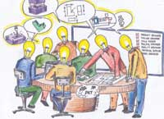
Concurrent Engineering
Sometimes called simultaneous engineering, the key ingredient is teamwork. People from many departments collaborate over the life of a product – from idea to obsolescence – to ensure that it reflects the customer’s needs and desires.

Slide 7
Design for Engineers
Design is the process of devising a system, component or process to meet a desired need
Recent work on engineering design indicates that it is more of a social process than we once thought

Slide 8
Design for Engineers
Most design work you’ll do as a technical professional will be done in teams
“Design team failure is usually due to failed team dynamics”
Larry Leifer
Director, Stanford Center
for Design Research

Slide 9
Design for Engineers
The key to your success is the mastery of the design process
“A project engineer has the best job in the business. He has the ultimate responsibility for the work as a whole. He is the real architect of the project solution. Even more than his colleagues, he looks at the job as a whole from the beginning. He watches carefully to make all the details come together in a timely economical, fresh and effective meeting of the need.”

Slide 10
Teamwork
Teamwork in engineering
Teamwork skills & problem solving
Project communication
Notes:
This is the mapping slide.

Slide 11
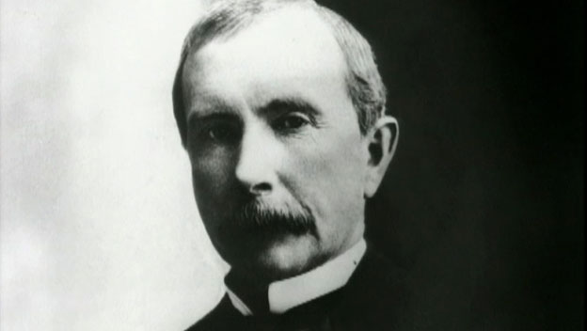
Teamwork Skills & Problem Solving
Teams must
Improve how they work together
Accomplish the task before them
“I will pay more for the ability to deal with people than any other ability under the sun.”
John D. Rockefeller

Slide 12
Improve Team Cooperation
1) Every member is responsible for the team’s success
2) Attend all team meetings, be on time, come prepared
3) Complete your assignments on schedule
4) Listen to the ideas of your team members
* Constructively criticize those ideas, not the person who expressed them
5) Resolve conflicts immediately

Slide 13

Teamwork Skills
Effective communication is at the heart of good teamwork
Listen, present,
Listen, present, persuade

Slide 14
Teamwork Skills
Leadership
According to the philosopher Walter Kaufmann, the fusion of humility and ambition is the cardinal virtue all great leaders possess

Slide 15
Teamwork Skills
Decision Making
Good teams view decision making as an inquiry process rather than an advocacy process

Slide 16
Teamwork Skills
Conflict Management
Conflicts must be resolved as soon as they arise
Although conflict is not necessarily bad, it is an issue that has to be resolved by the project manager

Slide 17
Teamwork
Teamwork in engineering
Teamwork skills & problem solving
Project communication
Notes:
This is the mapping slide.

Slide 18
Project Communication
You will have to communicate your design solutions to others, both orally and in writing
Frequently, your success will largely be dependent upon your team’s ability to write a great report or deliver a terrific presentation

Slide 19
Writing a Technical Report
Things to keep in mind
Know your audience
Know your purpose
Organize your content around your audience and purpose
Write clearly and concisely
Design your report well

Slide 20
Writing a Technical Report
When you write as a team you must divide the work equitably
Your team must consider the best way to write and present together

Slide 21
Technical Writing Techniques
Brainstorming with members of your team
Checking related research in the library/internet
Using a laboratory notebook to help keep track of experimental work in progress
Being realistic about time constraints
Guarding against distraction
Using the format of the report to help avoid roadblocks in the writing process

Slide 22
Technical Writing Techniques
Brainstorming with members of your team
Talking should be the first step in any collaborative writing assignment
Decide what format will be most effective
Assign sections of the report
Determine who will proofread the finished document
Figure out how the team will write with one voice

Slide 23
Technical Writing Techniques
2) Checking related research in the library/internet
Research will often lend your report the authority it needs to be persuasive

Slide 24
Technical Writing Techniques
3) Using a laboratory notebook to help keep track of experimental work in progress
Helps keep track of experimental details that may be easily forgotten otherwise
In EG1003 you will be required to produce lab notes for each lab

Slide 25
Technical Writing Techniques
4) Being realistic about time constraints
Leaving your writing and presentation assignments until the last minute
sloppy reports
poor presentations

Slide 26
Technical Writing Techniques
5) Guarding against distraction
Good time management skills are critical to your success
Identify the things that distract you from writing (talking on the phone, looking through social media, etc) and avoid them

Slide 27
Technical Writing Techniques
6) Using the format of the report to help avoid roadblocks in the writing process
If you are stuck on one section, switch to another section and return to it after you finish the latter
For example: say you are focused on the abstract and get stuck. You can switch to the procedure section, finish that, and then return to the abstract with a better idea of how to write it.

Slide 28
Presentations
Practice your presentations
Don’t forget to edit your writing
Small grammatical and spelling errors are easily noticeable on presentation slides

Slide 29
Teamwork
Writing Consultant Presentation
EG 1003: Intro to Engineering and Design
NYU’s Polytechnic School of Engineering

