Slide 1
EG Prototyping x Makerspace
Presents
First-Year Workshop Series

Slide 2
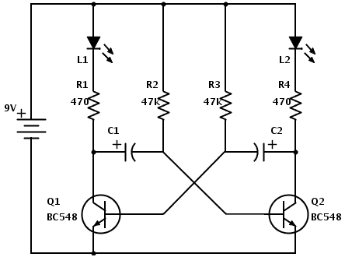
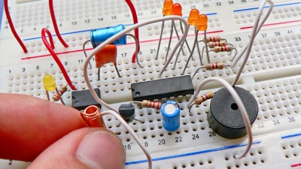
Intro to Circuitry & TinkerCAD
Spring 2021

Slide 3
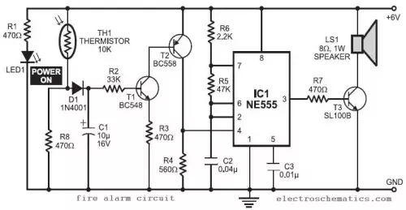
Goal of Workshop
What is circuitry?
Arrangement of electronic components for specific task.
Makes up every piece electronics that you use.
Learn to read a schematic
2. Learn to breadboard
3. Gain a rudimentary, practical understanding of electronic components

Slide 4
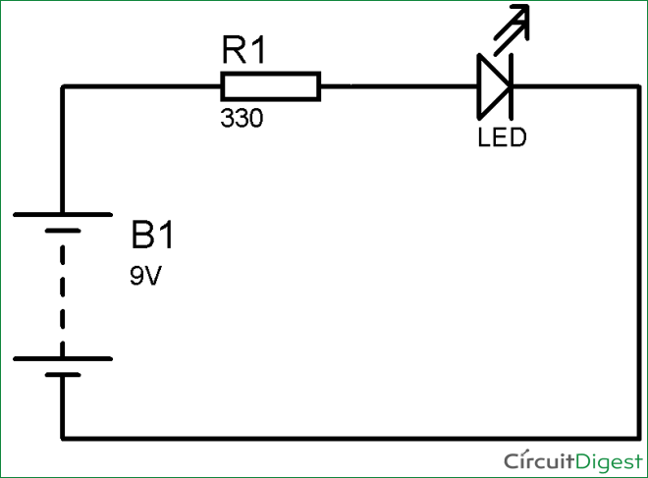
Schematic
“Blueprint of circuit”
Does not represent physical layout
Each component represented by symbol
Components connected at nodes

Slide 5
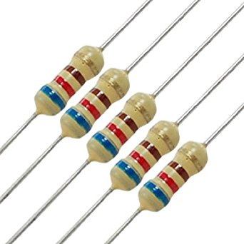
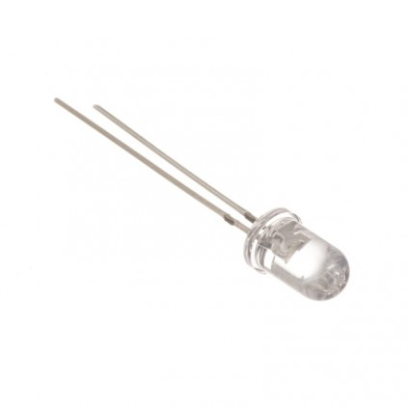
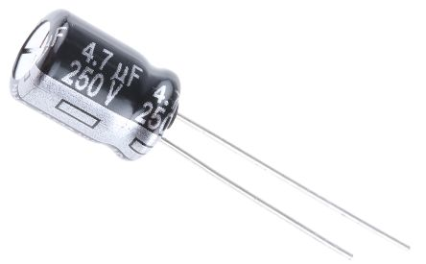
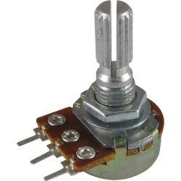
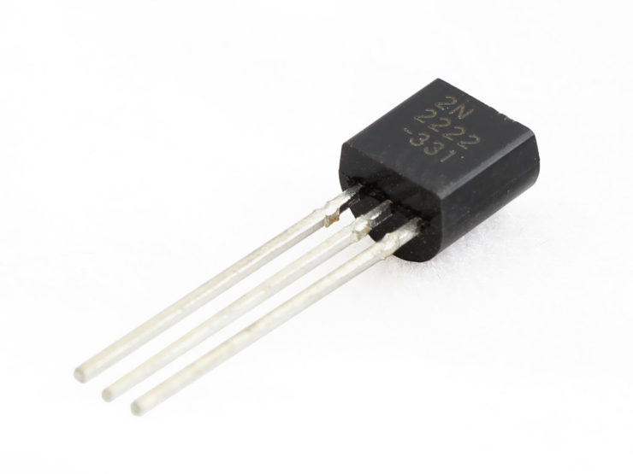
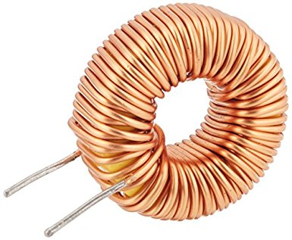
Components

Slide 6
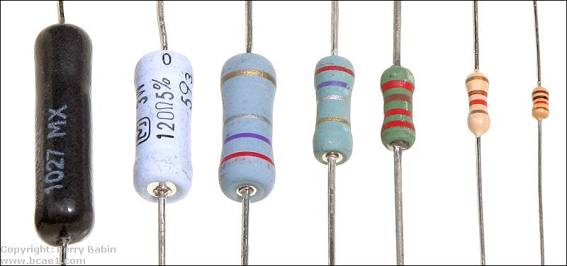
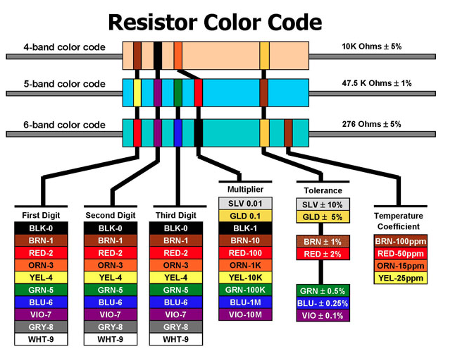
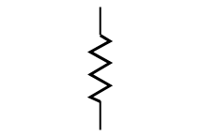
Resistor
Resists flow of current
Unit of Measure: Ohms (𝞨)
Polarity does not matters
Ohm’s Law: V = IR
Dissipates power through heat

Slide 7
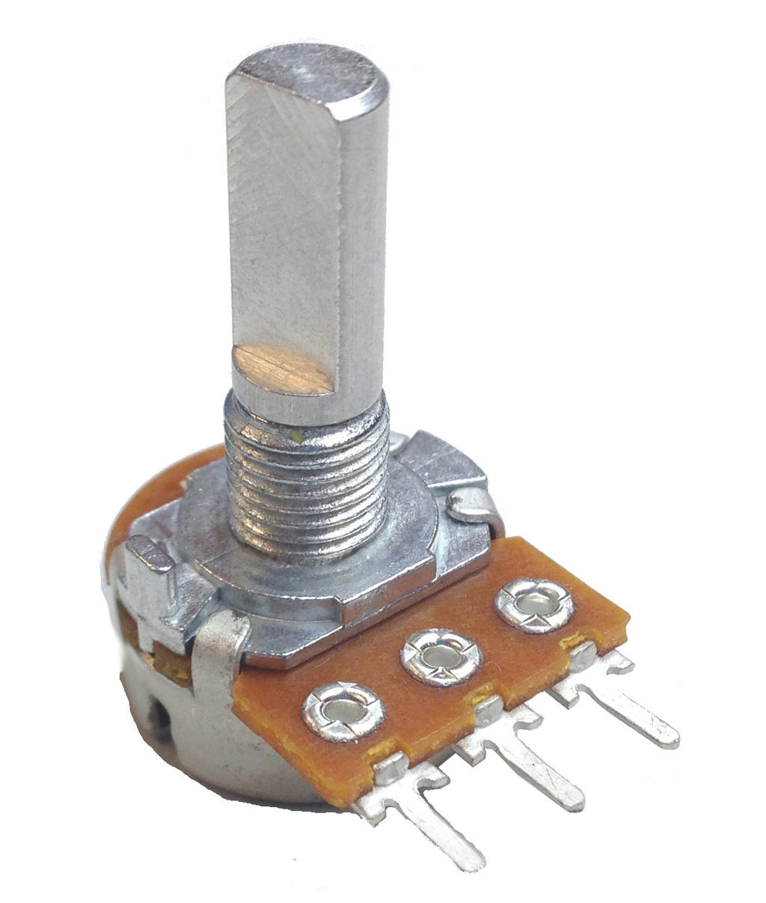
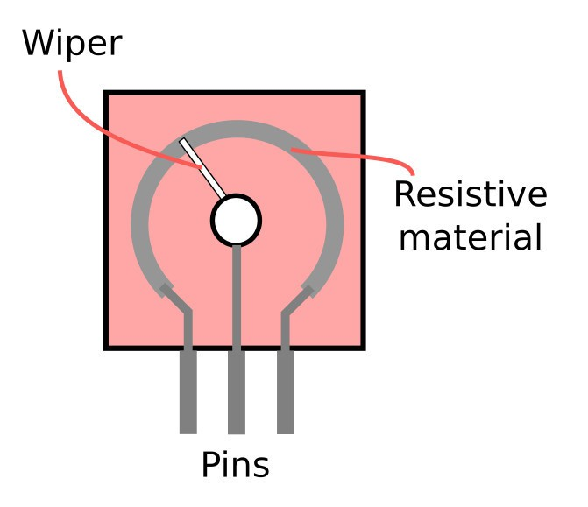
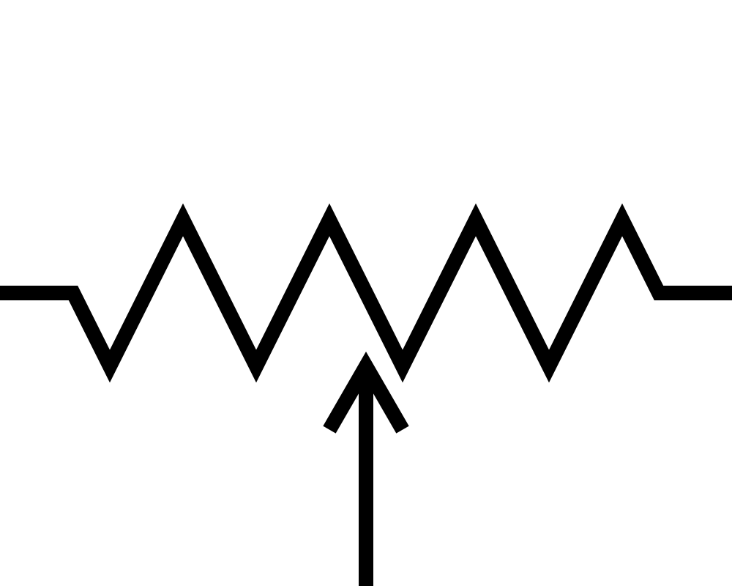
Potentiometer
Similar function as a resistor…
change the resistance value of a potentiometer by turning it’s shaft
Adjust the wiper to effect that active length of resistive material

Slide 8
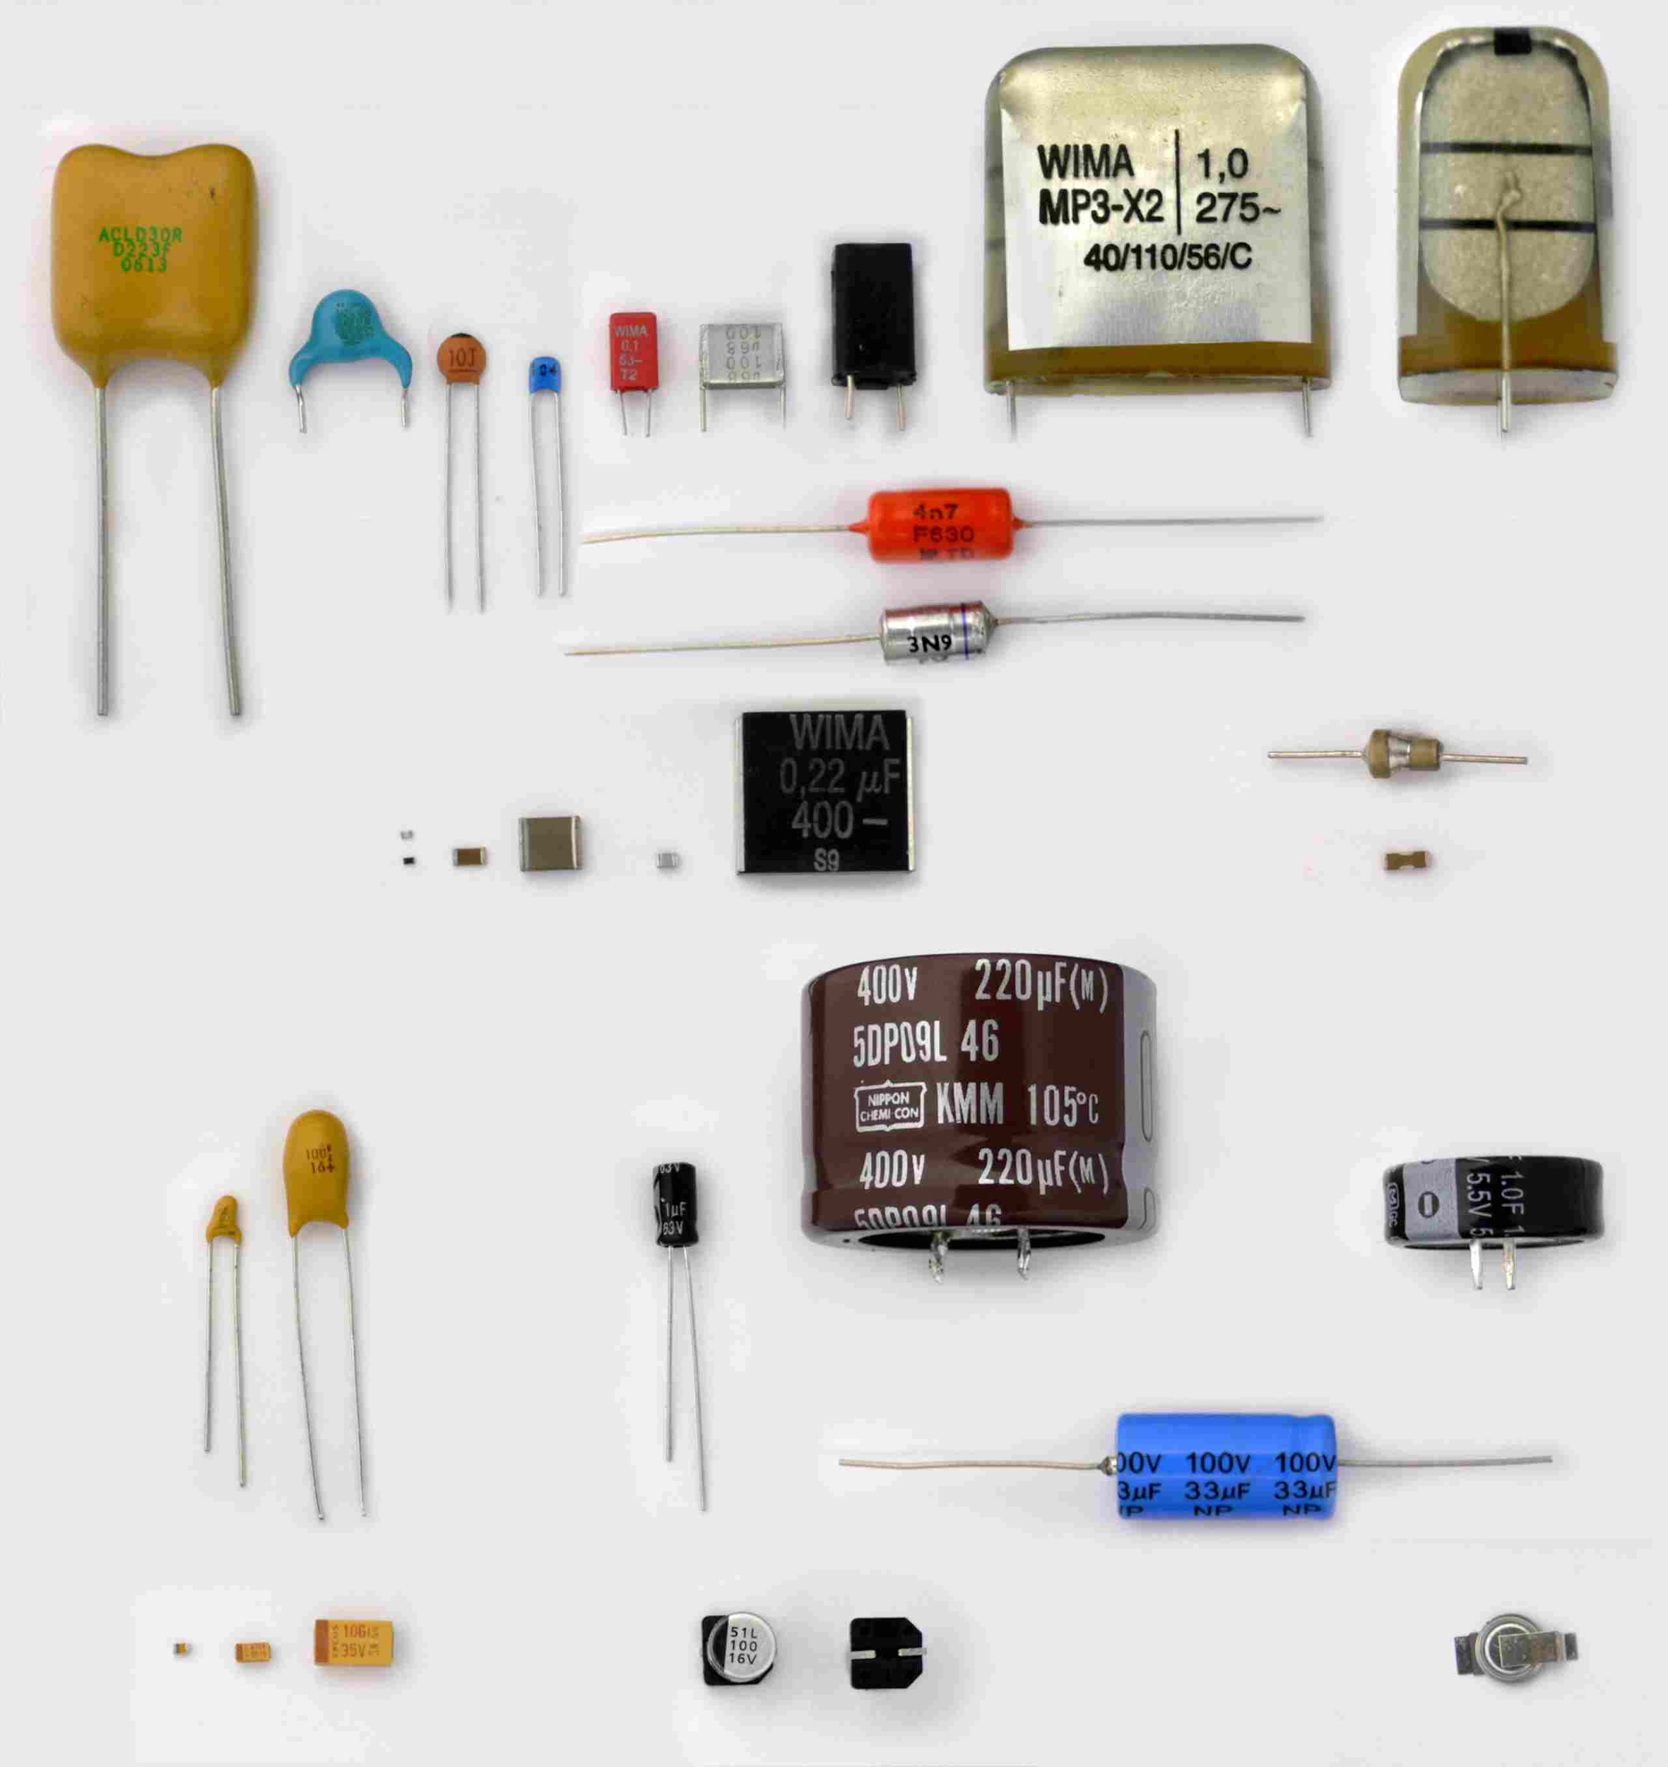
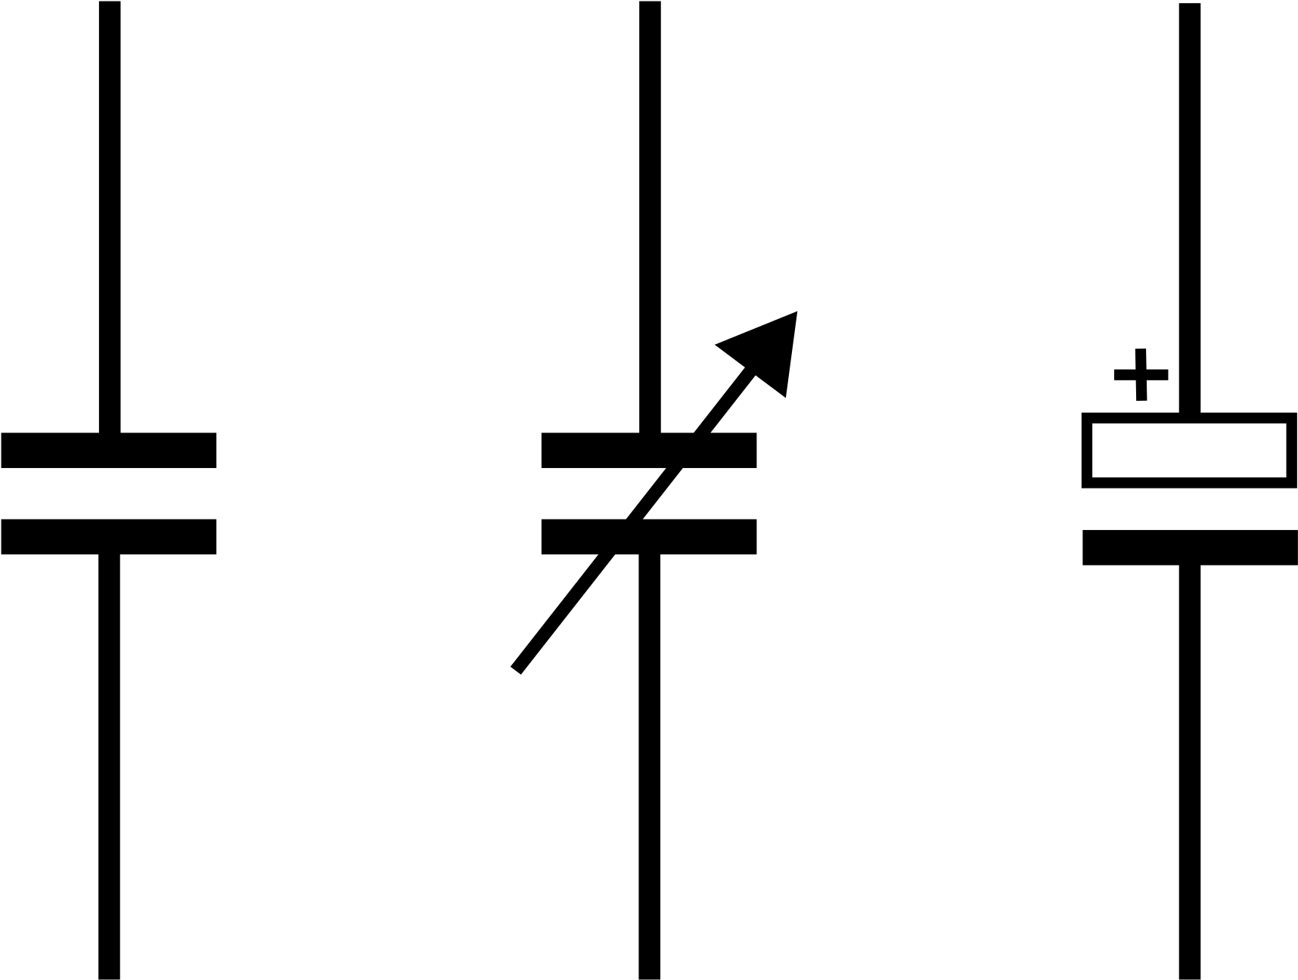
Capacitor
Stores charge
Polarity sometimes matters!
Units of Measure: Farads (F)
Larger the value = more time to charge
Resists change voltage

Slide 9
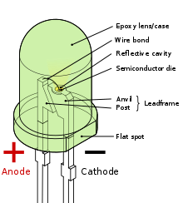
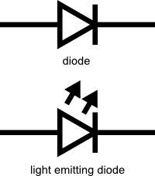
Light Emitting Diode (LED)
Diode conducts in one direction
Polarity matters
LED burnout from too much current!

Slide 10
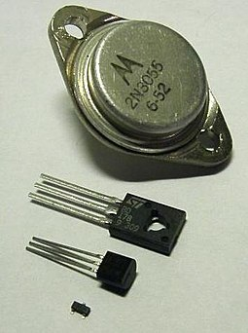
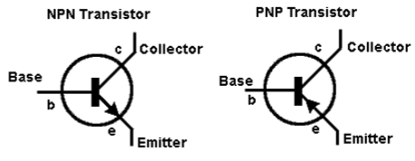
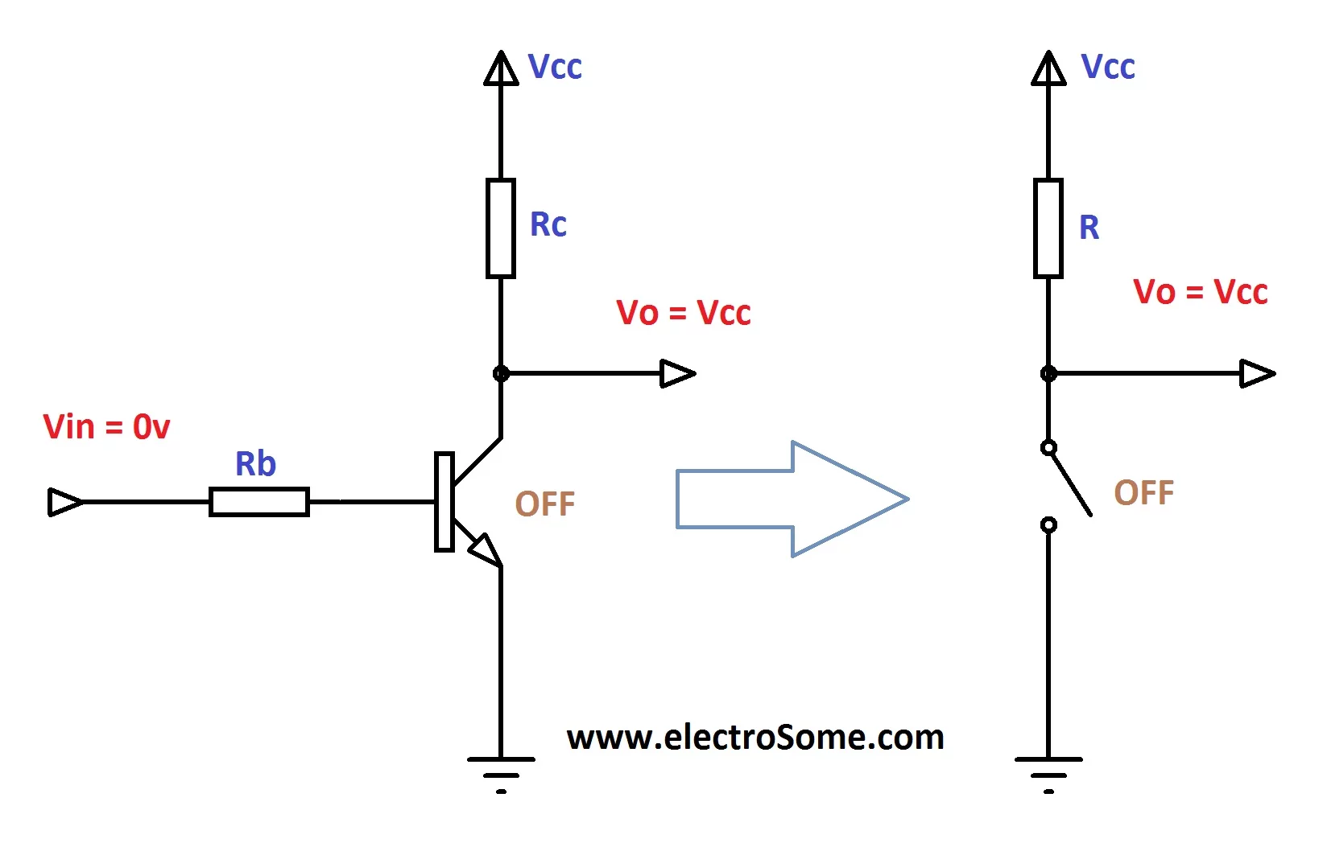
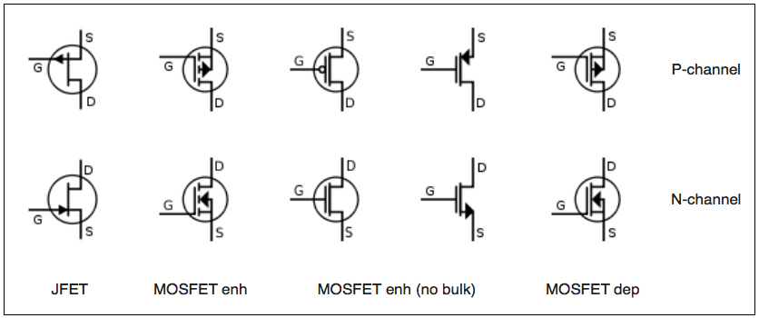
Transistor
Amplify/switch electronic signals
Polarity matters
MOSFET, JFET, BJT are types
PNP or NPN
Google!

Slide 11
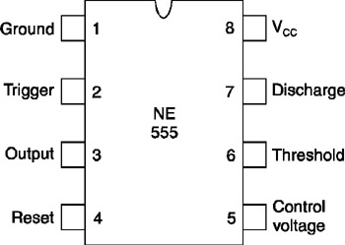
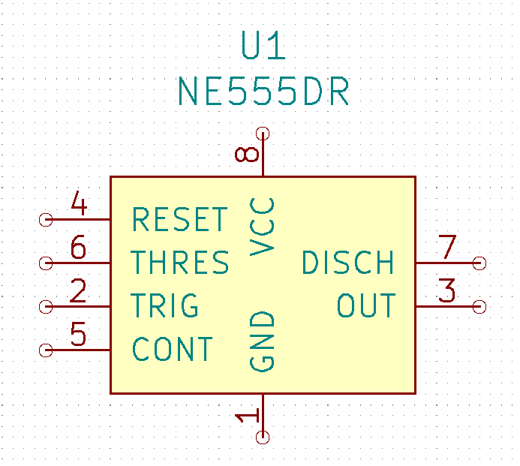
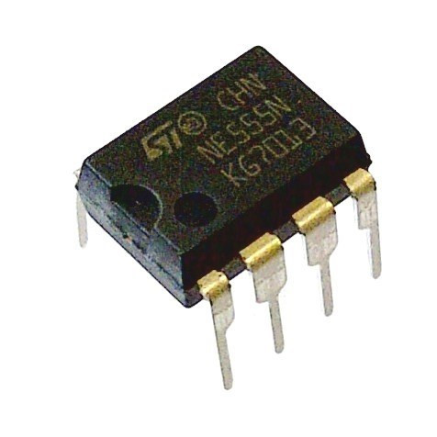
ICs (will not be using)
Multitude of functionality
Follow the pin numbers
Again, Google!

Slide 12
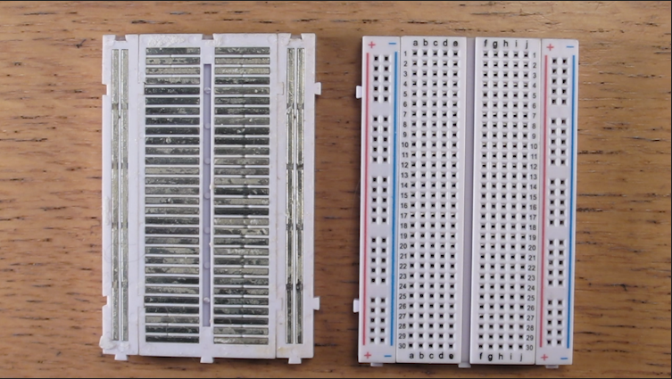
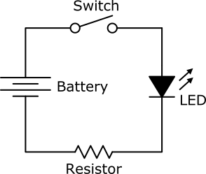
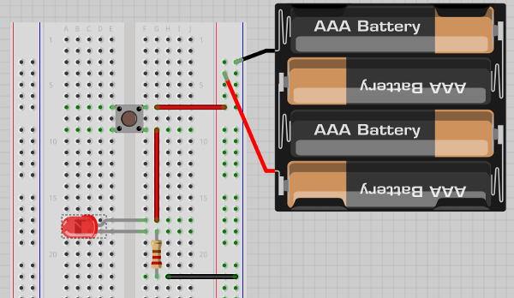
Solderless Breadboard
Used in basic electronic prototyping
Horizontal rows connected
Vertical power rails connected
Do not connect batteries til assembly complete!

Slide 13
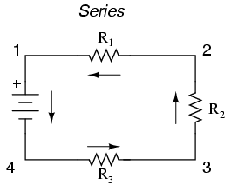
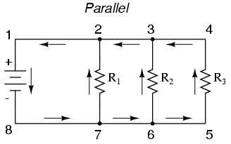
Parallel vs Series
If components share only one common node then they are in series
If components share two common nodes, then they are in parallel

Slide 14
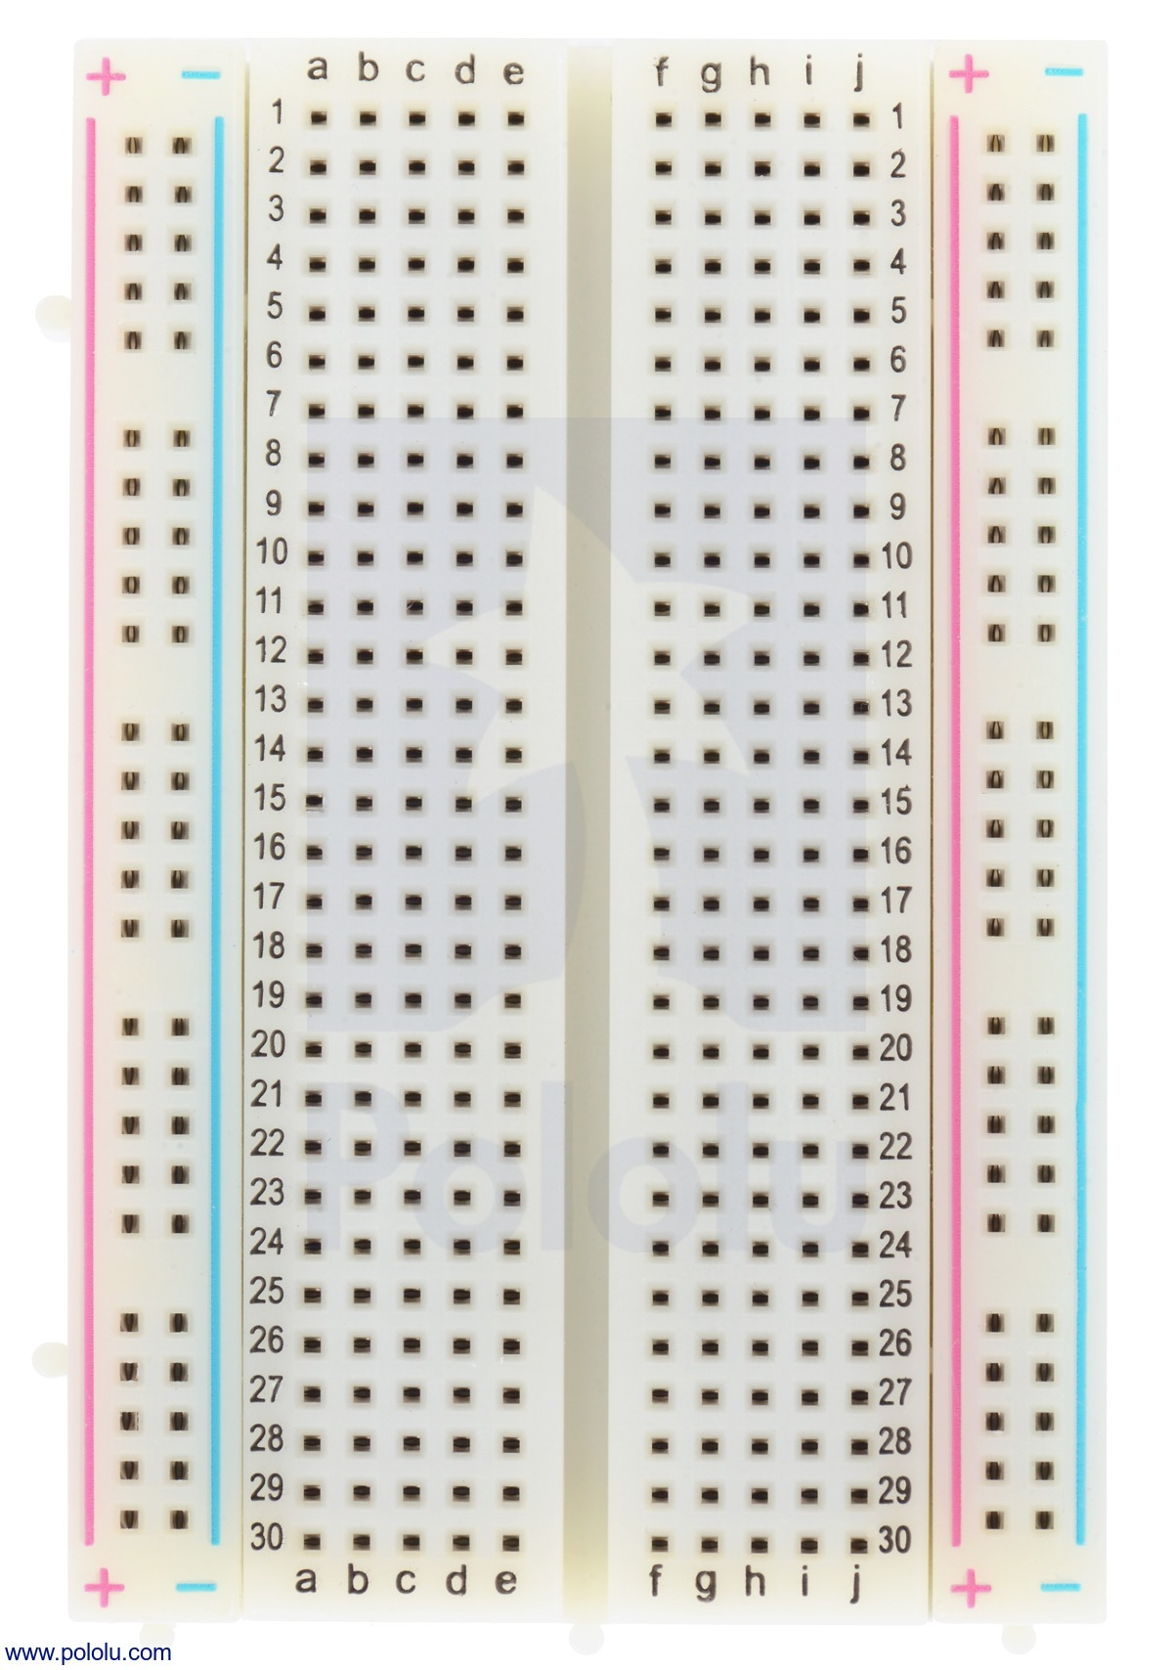
From Schematic to Breadboard

Slide 15
From Schematic to Breadboard

Slide 16
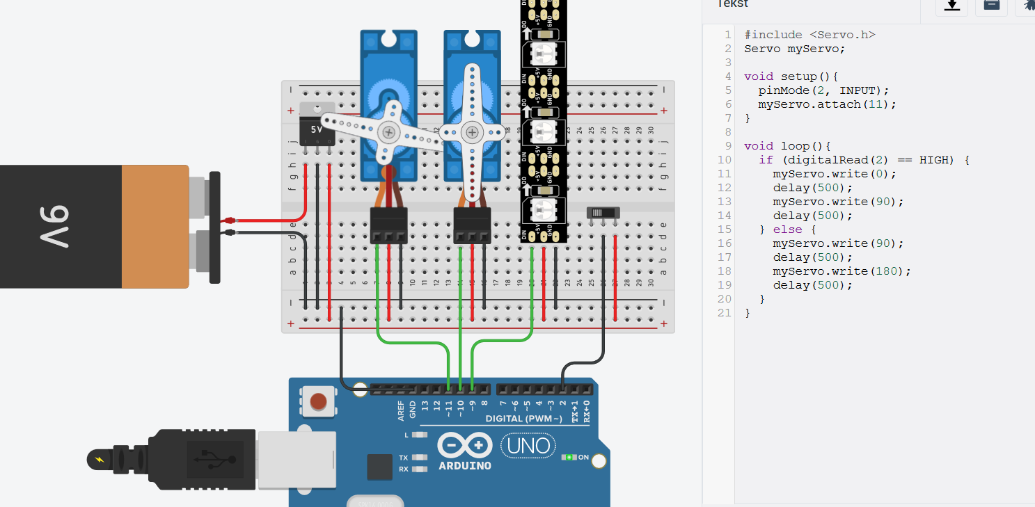
TinkerCAD Website
Free electronics software website w/ Autodesk account
Allows for the creation of an online wiring schematic
Industry standard for schematic
kept forever and easily replicable
Very limited selection of components
CAN SIMULATE WITH CODE!!
Great for proof of concept on DC motors, LCD screens etc

Slide 17
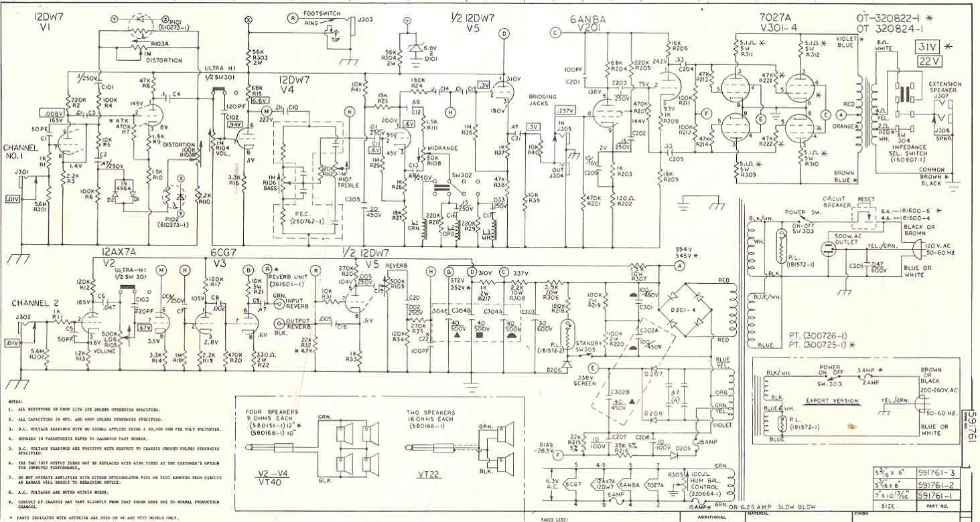
YOUR TURN

Slide 18
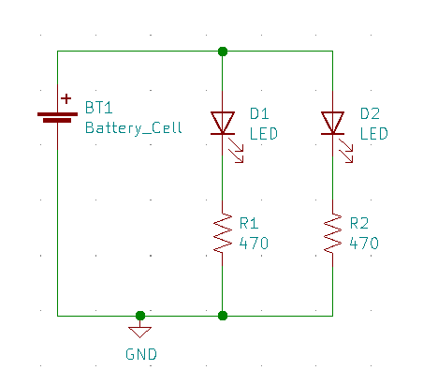
LED Circuit

Slide 19
LED Circuit

Slide 20
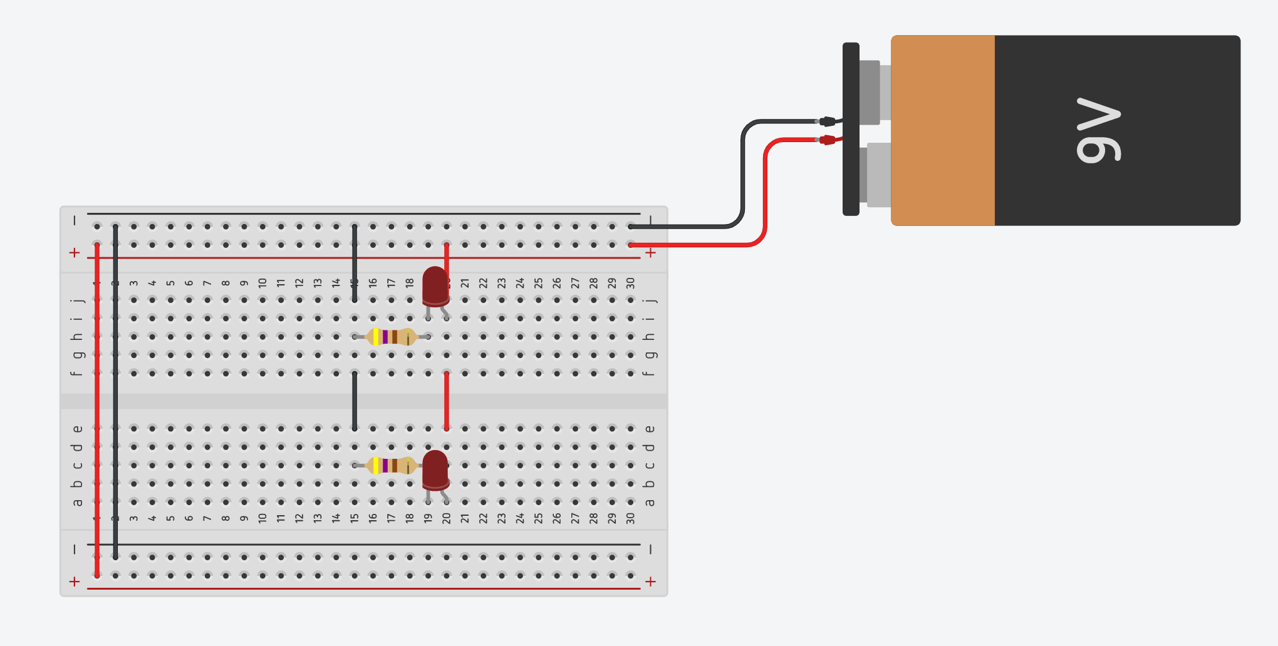
TinkerCAD | LED Circuit

Slide 21
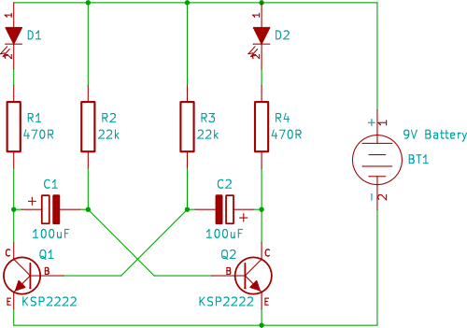
Blinker Circuit!

Slide 22
Blinker Circuit!
Notes:
More information on this:
https://www.youtube.com/watch?v=EZ0YZcC84m4
https://www.electronics-tutorials.ws/waveforms/astable.html

Slide 23
Blinker Circuit
P1
R1
220 Ω
555
R3
1,000 Ω
D1
C
B
R2
C1
E
1,000 Ω

Slide 24
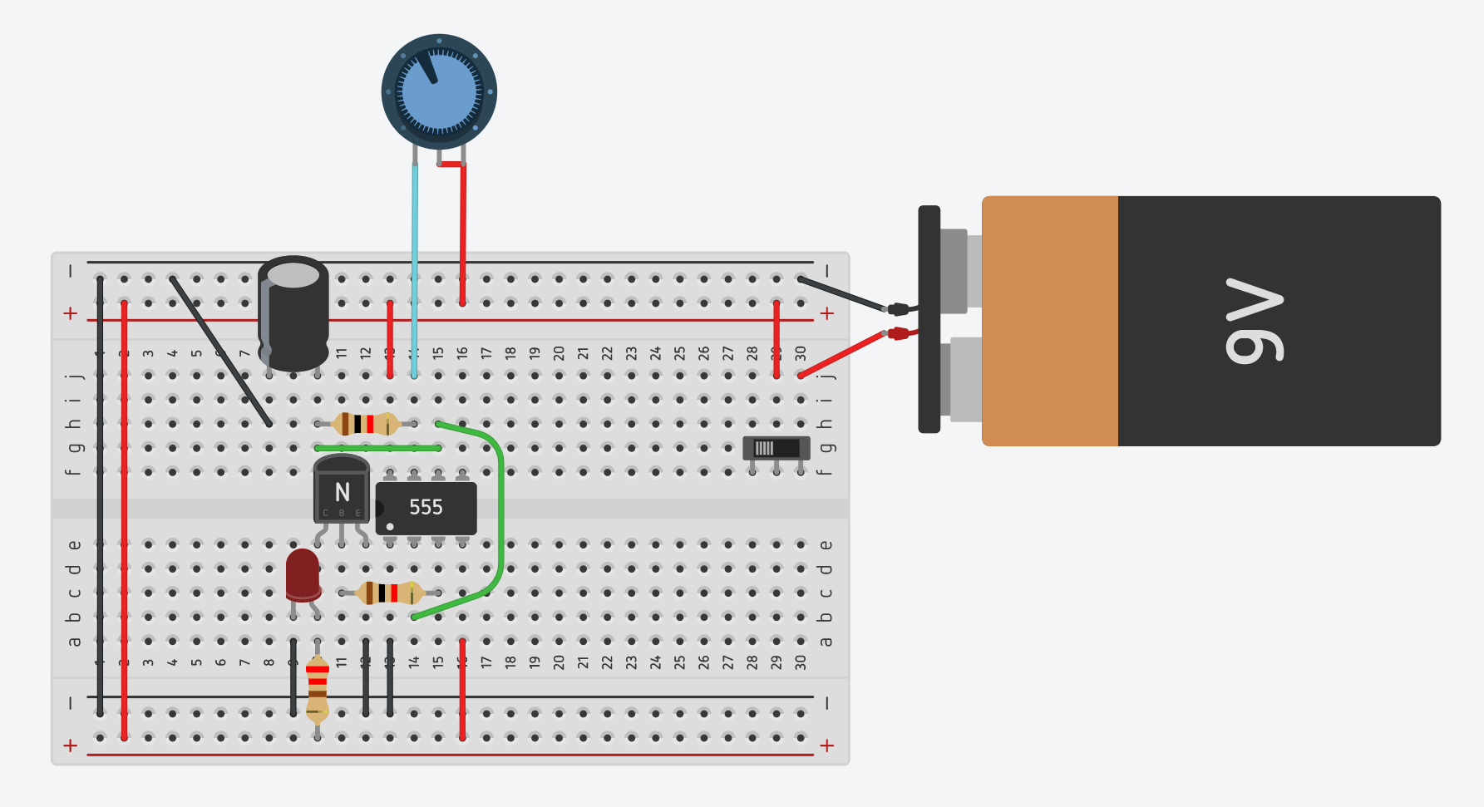
TinkerCAD | Blinker Circuit
Notes:
Link to tinkercad solution: https://www.tinkercad.com/things/7pFDAs7i409-blinker-circuit-workshop-spring-2021

Slide 25
EG Circuitry 1 Workshop
Fall 2020

