Slide 1
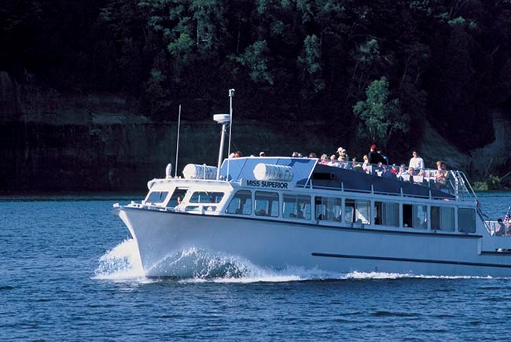
Boat Design Competition

Slide 2
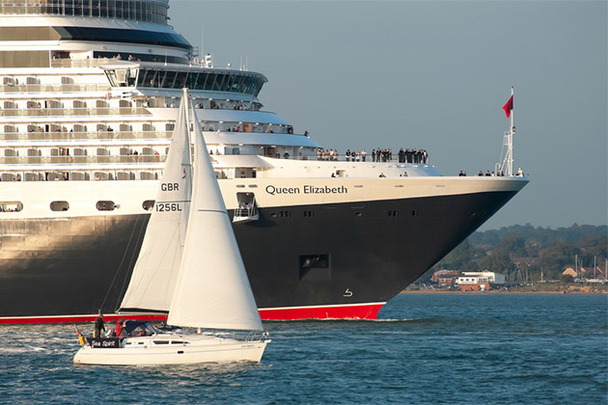
Overview
Objectives
Background
Materials
Procedure
Rules of the Competition
Report/Presentation
Closing

Slide 3
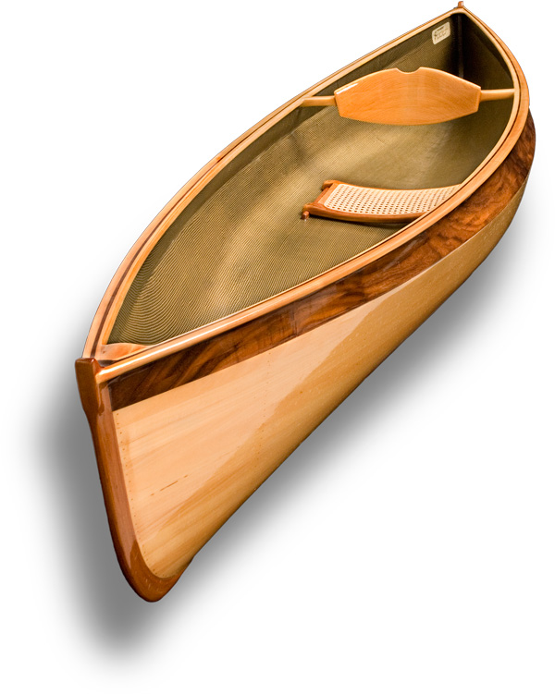
Objectives
Design lightweight boat to hold significant weight
Understand factors considered by engineers when designing a boat
Build and test a boat

Slide 4

Boats
Floating vessels made to carry a load for recreational and commercial purposes
Examples:
  Kayaks and canoes
  Sail boats
  Cruise ships
  Cargo vessels

Slide 5
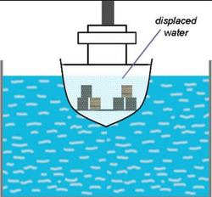
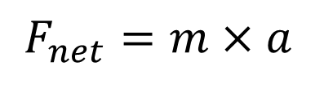
Background Information
    Two principle forces are balanced to keep the boat afloat; buoyant force and gravitational force
    The Principle of Archimedes - the upward buoyant force is equal to the weight of the fluid that the body displaces
    Newton's second law states that the net force on an object is equal to the mass times acceleration
$F_{net}=m×a$

Slide 6
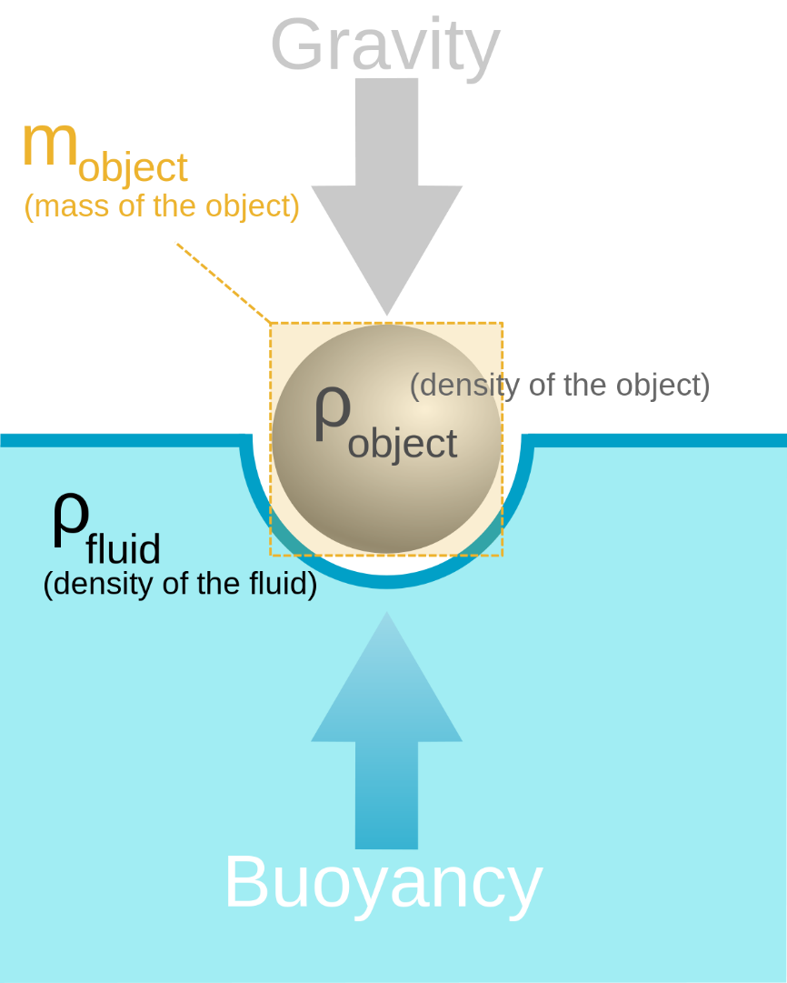
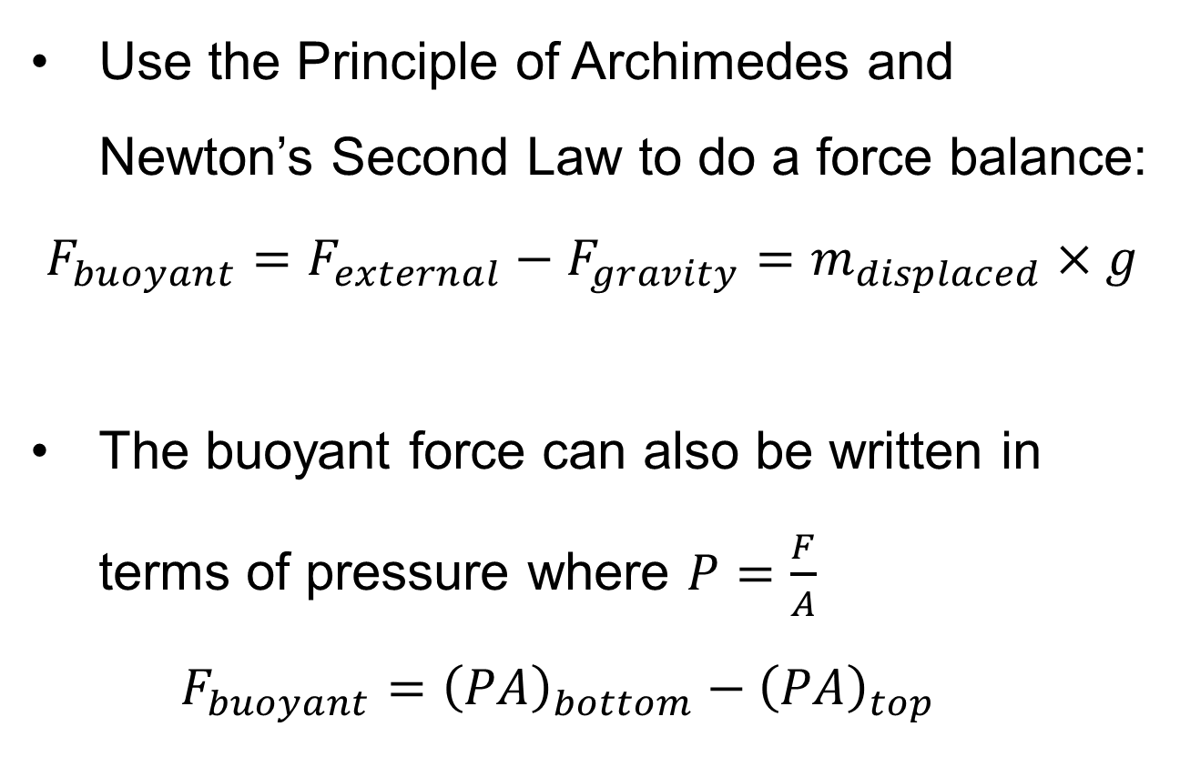
Background Information
Use the Principle of Archimedes and Newton’s Second Law to do a force balance:
$$F_{buoyant}=F_{external}−F_{gravity}=m_{displaced}×g$$
The buoyant force can also be written in terms of pressure where $P=\frac{F}{A}$
$$F_{buoyant}={\left(PA\right)}_{bottom}−{\left(PA\right)}_{top}$$

Slide 7
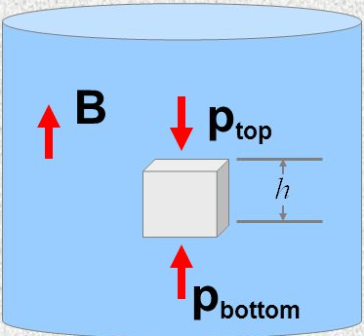
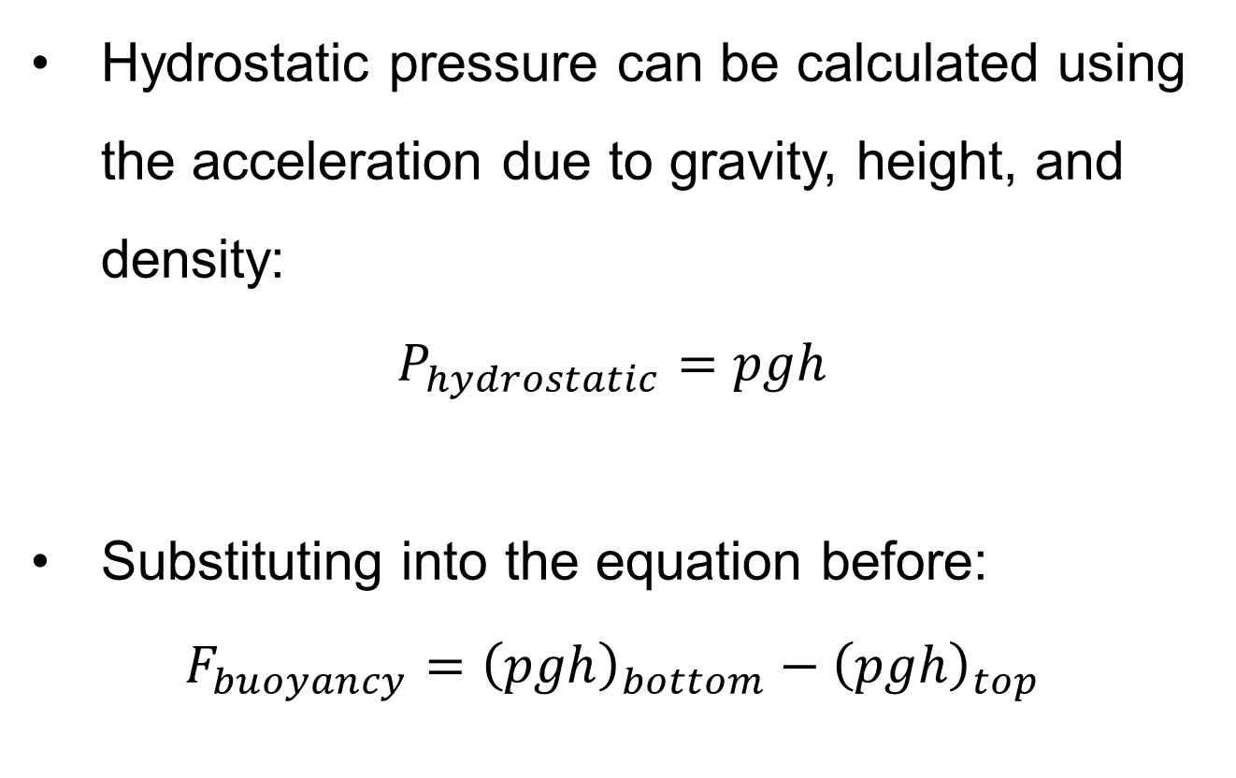
Background Information
Hydrostatic pressure can be calculated using the acceleration due to gravity, height, and density:
$P_{hydrostatic}=pgh$
Substituting into the equation before:
$$F_{buoyancy}={\left(pgh\right)}_{bottom}−{\left(pgh\right)}_{top}$$

Slide 8


Materials for Lab
2 thin dowels (0.8 cm OD x 122 cm)
2 thick dowels (1.1 cm OD x 122 cm)
6 x 30.5 cm bamboo skewers
3D-printed dowel connectors
Cellophane tape
Kevlar string

Slide 9
Procedure
The TA should initial and date the sketch of your design before materials are distributed
Build your boat based on your preliminary design
Have a TA weigh your boat
Test your design with a TA
Clean up your workstation and put back all unused materials
The design with the highest competition ratio will win the competition

Slide 10
Setup for Testing
The TA must weigh the boat before placing it in the water
A TA MUST be present during the entire trial
The TA will add the weights
The competition is over when:
  The boat sinks to the bottom of the tank and touches the rocks below
  OR when you can no longer add anymore weights to your design
All TA decisions are FINAL

Slide 11
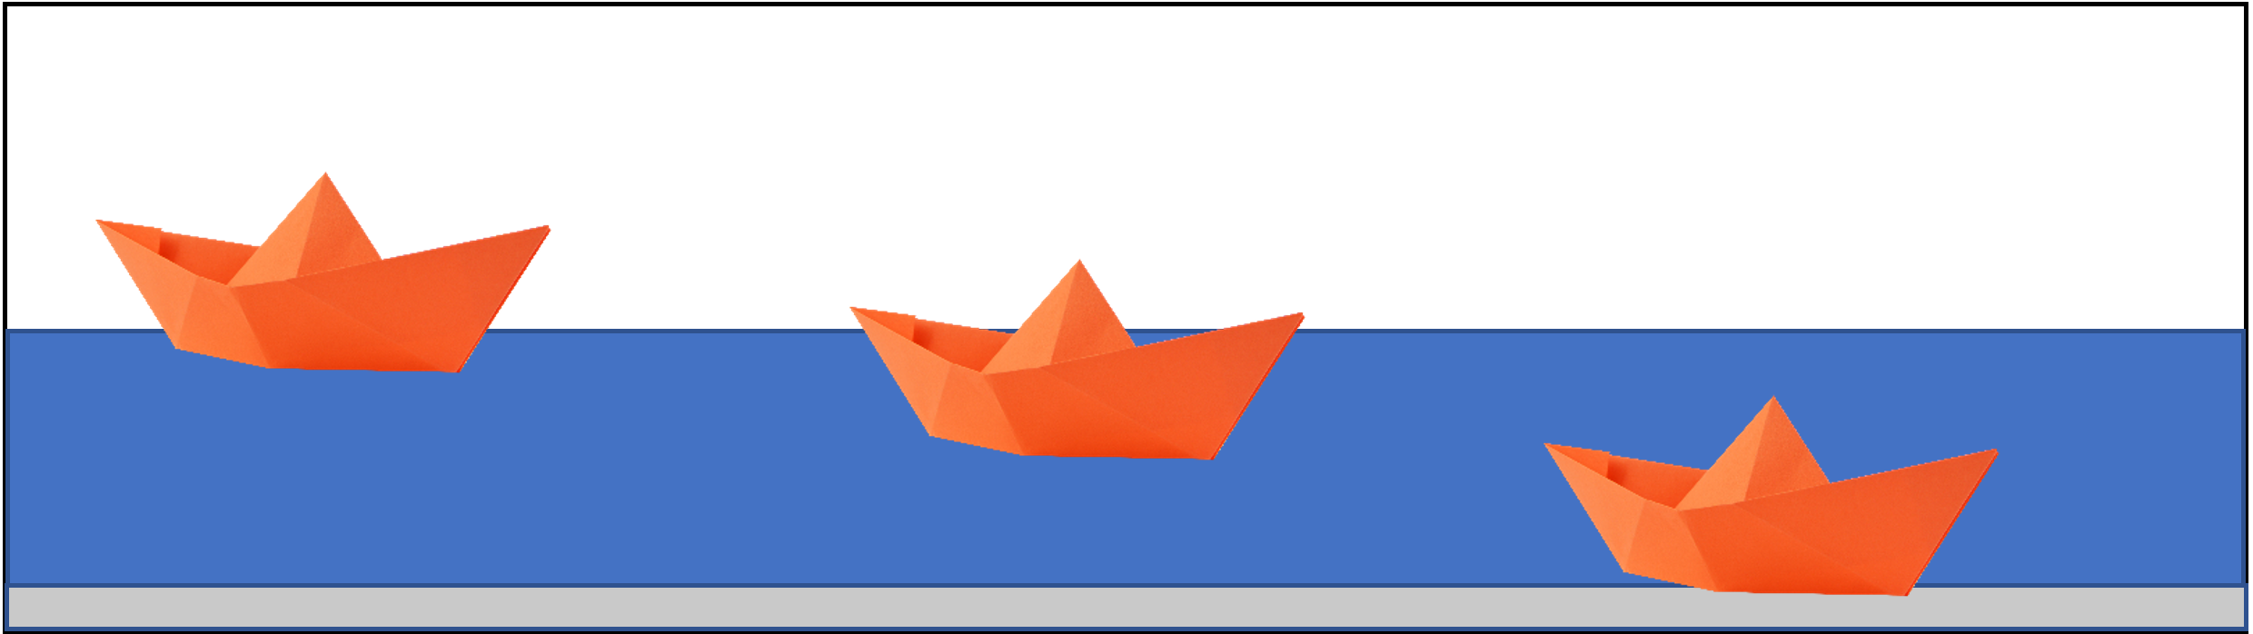
Competition Ratio
$$Design Ratio=\frac{Payload (g)}{Cost \left(\$\right)×Mass of Boat (g)}$$

Slide 12
Assignment: Report
Individual lab report
Title page
Discussion topics in the manual
Include PICTURES
Due at 11:59pm the night before your next lab

Slide 13
Assignment: Presentation
There is NO presentation for lab 1

Slide 14
Closing
Think safety!
Have all original data signed by TA
Submit all work electronically
Clean up workstations
Return all unused materials to TA

Slide 15

Boat Design Competition
QUESTIONS?

