Slide 1


Introduction to Arduino
EG1003 x MakerSpace | Workshop

Slide 2
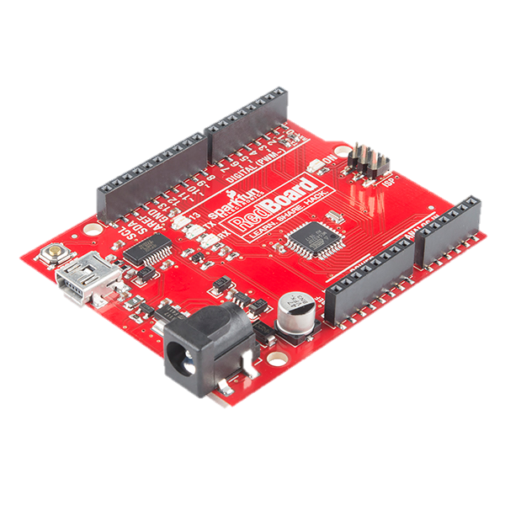
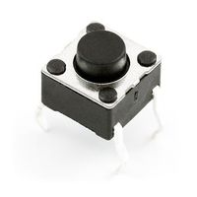
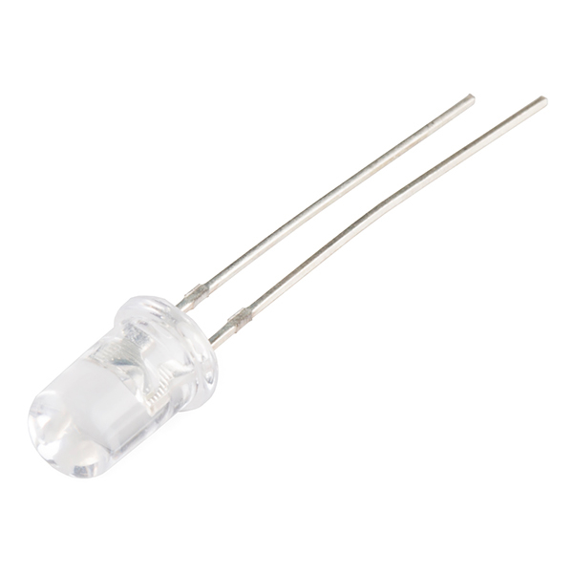
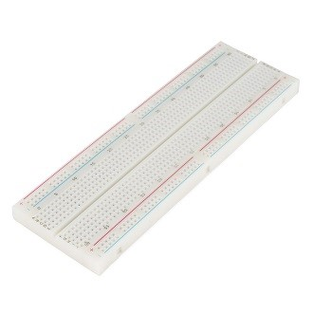
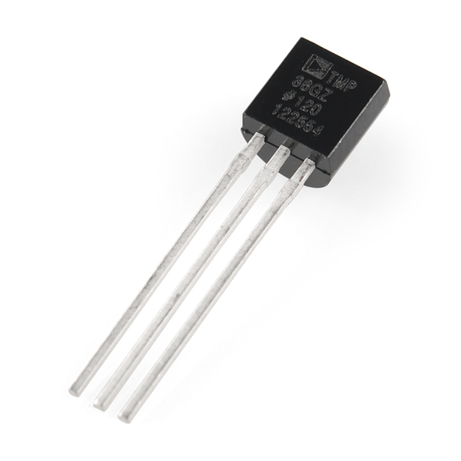
Introduction to Arduino
Spring 2021 2/16 12:30 - 2 PM

Slide 3
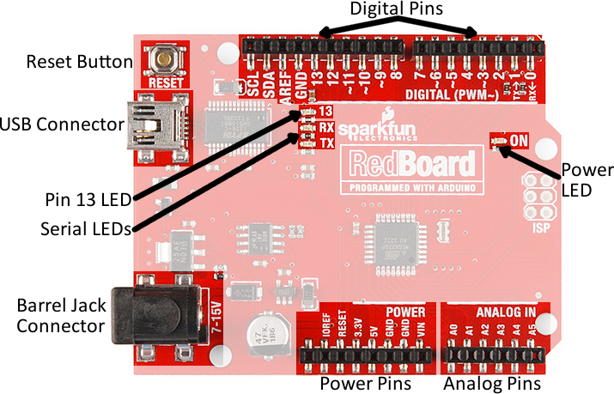
Arduino Hardware
Overview of the RedBoard
  Reset Button: restarts the board
  USB Connector: provides power and connects to computer
  Pin 13 LED: operable without making an LED circuit
  Serial LEDS: shows if the Arduino is transmitting or receiving data from pins 0, 1, or the USB connection

Slide 4
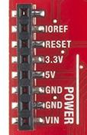
Power Pins
Power Pins
  3.3V: Usually used to power low-voltage sensors
  5V: Most common power pin used to power circuits
  GND: Ground pin (0V)
  VIN: Voltage-In can be used to power the board using a battery

Slide 5
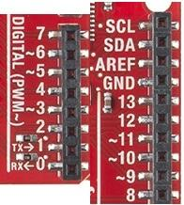
I/O Pins
I/O Pins
  A0-A5: identical analog pins that can read sensors or control analog devices
      Pins A0-A3 are more stable than A4-A5
  Pins 0-1: transmitting and receiving pins
      Not used in this workshop
  Pins 2-12: digital pins that can switch between HIGH states and LOW states
  Pin 13: connected to the on-board LED
  Can only input/output ~200 mA current (use transistors/alternate power sources)

Slide 6
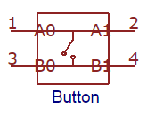
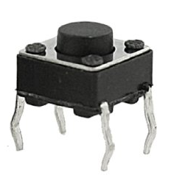
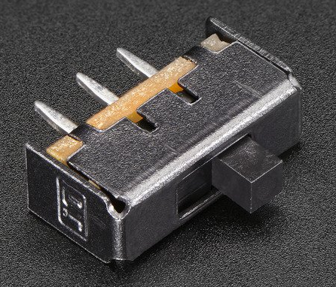
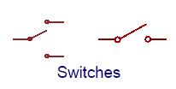
Electronic Components
Push Buttons and Switches: mechanical devices that
interrupt or divert current
  Basic push buttons are polarized
  Basic switches are not polarized

Slide 7

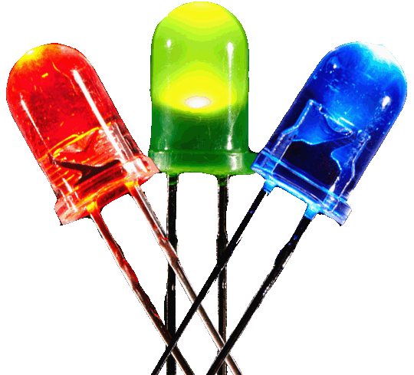
Electronic Components
Light Emitting Diodes (LEDs): small electric lights
that require low voltages and currents
  Orientation matters!
  Usually require a resistor (typically 220 Ω or 470 Ω)
  Polarized!

Slide 8
Electronic Components
Analog vs. Digital Signals
  An electrical signal is a quantifiable voltage that carries information
Digital Signals Analog Signals
Have two discrete states: LOW and HIGH When signal is LOW, most devices output a voltage level of 0V. When signal is HIGH, most devices output a voltage level of 5V (or 3.3V) | Infinite amount of voltage values The range 0V-5V is mapped to the range 0-1023 Example: Value 255 = ~1.246V Many electronic components are inherently analog

Slide 9
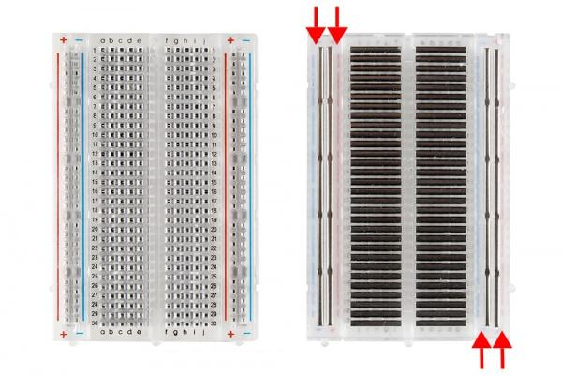
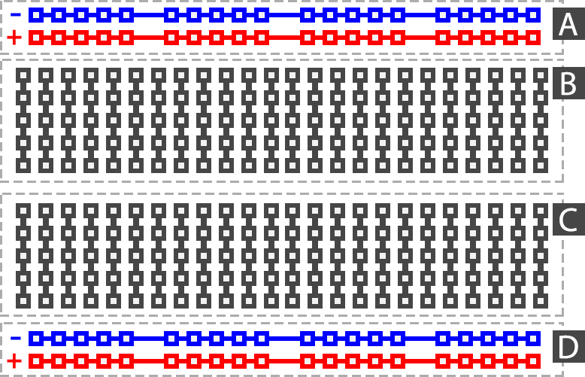
Building Circuits on a Breadboard
Breadboards: small boards that are commonly used for circuit prototyping

Slide 10
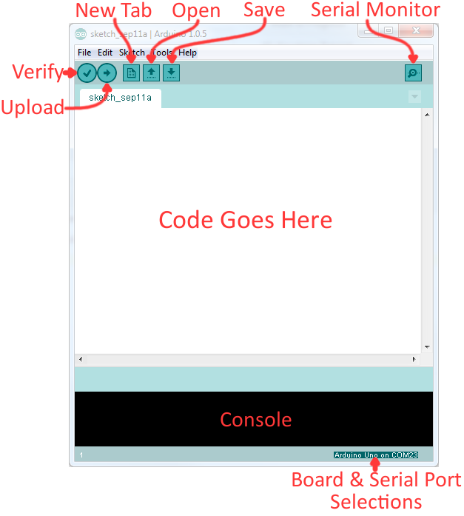
The Arduino IDE
  Verify: checks code for errors and points to where the errors occurred
  Upload: verifies and sends code to the Arduino board if no errors
  Console: shows any errors the software found in hardware
  Serial Monitor: a tool to see the program as it’s running

Slide 11
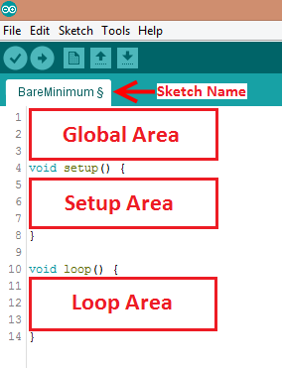
The Arduino IDE
Programs written in Arduino
are called sketches with 3 different areas:
  Global: Important variables, constants and imported libraries
  Setup: activates the pins and sensors used
      this code only runs once
  Loop: code that runs continuously
      Ex. reading sensors and turning pins HIGH or LOW

Slide 12
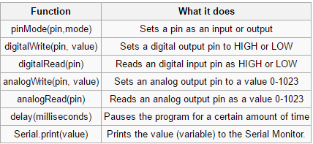
Common Functions

Slide 13
Syntax Rules
General Rules:
  Every line must end with a semicolon ‘;’ UNLESS it’s a conditional, loop, function or imported library
  Always unplug the Arduino before modifying circuit
  Don’t use Arduino as power source for high powered actuators (use transistors)
  Comments start with a ‘//’
      Text that the program ignores
      Used to label and explain code

Slide 14
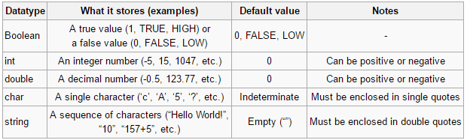
Datatypes

Slide 15
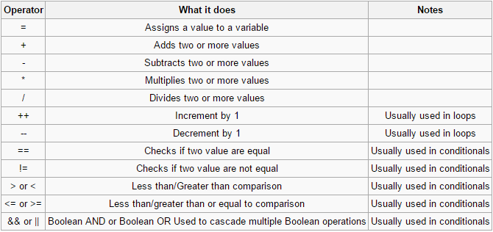
Operators

Slide 16
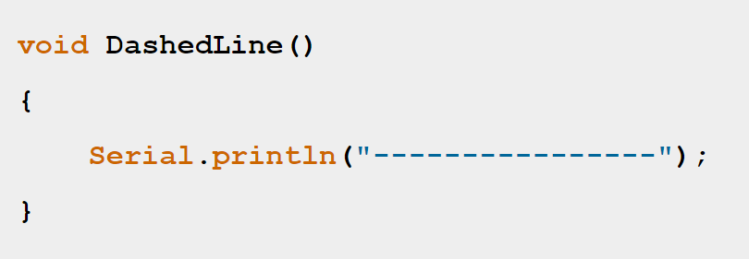
Function
  Create an automatic input → output portion of the code to make the loop area less crowded
  Great for reading sensors/powering motors and making code cleaner
  Also useful for anything repeating
  void if no return, or else datatype

Slide 17
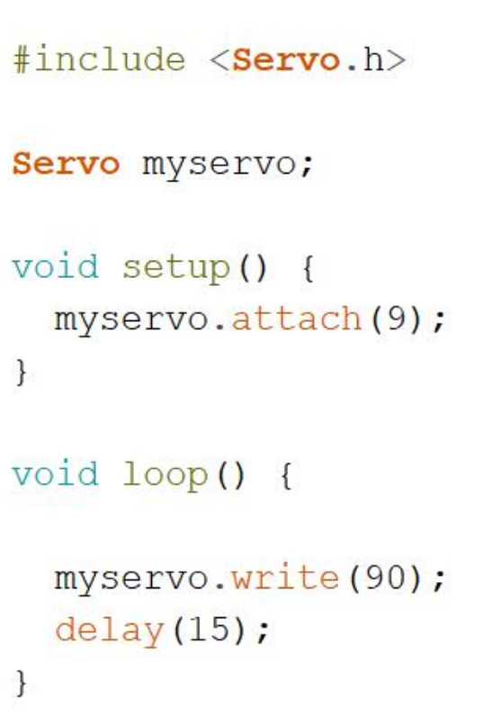
Libraries
  Premade groups of functions that are used to make using certain components easier
  Downloaded onto computer into Arduino libraries folder
  Need to be imported in global area
  Make Arduino extremely easy to use for certain electronics

Slide 18
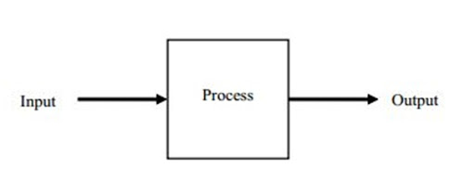
What is a Control System?
A type of system in which a mechanical or electrical input regulates an output
An oversimplification of a project in order to make it clearer
Always try to imagine a projects control system before planning code for it

Slide 19
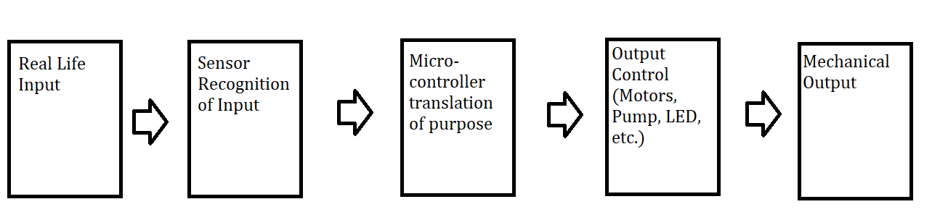
Example Control System
Most Simple Projects follow a similar Control System as Below

Slide 20
Example Control System
Real Life Input
Sensor Recognition
Translation
Actuator Control
Mechanical Output
- Use a relevant sensor to measure the real life input
- Usually can find code online for a specific sensor
- Use digitalread(), analogread() for arduino based sensors
- Find initial measurements and measurements of actions
- The actual meat of the code
- Define initial and desired measurements
- Define different options for the output
- Translate in between inputs and outputs
- Use if/else and call functions for input and output
- Controlling the output in a way that gets to the desired result
- Can find code online for specific motor/pump etc.
- Directly translates into whatever output the system desires
- Very wide variety of things
- What is the project measuring or using
- Could be an initial position, a temperature, a muscle movement, a camera input, etc
- Will probably be unique for each project
- Achieves desired output
- Can be mechanical movement, LED lighting up, buzzer making sound etc.
- Should come directly from actuator control

Slide 21
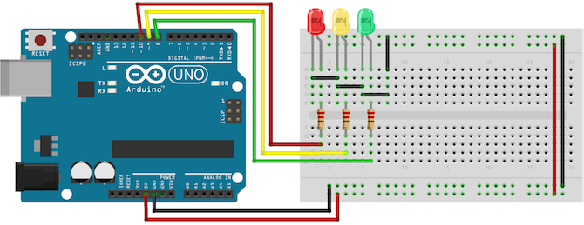
Activity 1
Automatic traffic light simulator

Slide 22
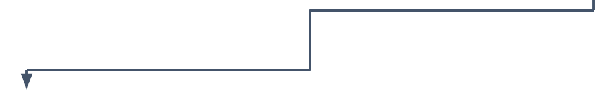
System Planning
Green Light → ON → Delay(300) → OFF
Yellow Light → ON → Delay(300) → OFF
Red Light → ON → Delay(300) → OFF

Slide 23
Step 1
Start by variables for the LED’s
const int(name) = pin number;
Example: const int red = 10;

Slide 24
Step 2
Add the setup function and configure the LED’s using the variables you created
void setup(){
pinMode(red, OUTPUT);
}
**Don’t forget to end every line with a semicolon

Slide 25
Step 3
Write out the procedure for your trafficlights() program as detailed in the system planning (you will put this into your loop):
Small sample:
void trafficlights() {
digitalWrite(green, LOW);
// turns off the green light
digitalWrite(yellow,HIGH);
// turns on the yellow light
delay(3000);
}
**Arduino measures time in milliseconds

Slide 26
Step 4
Name the program and use a function to run it continuously
void loop() {
trafficlights();
delay(1000);
//to add a 1 second delay between every //iteration of the program
}

Slide 27
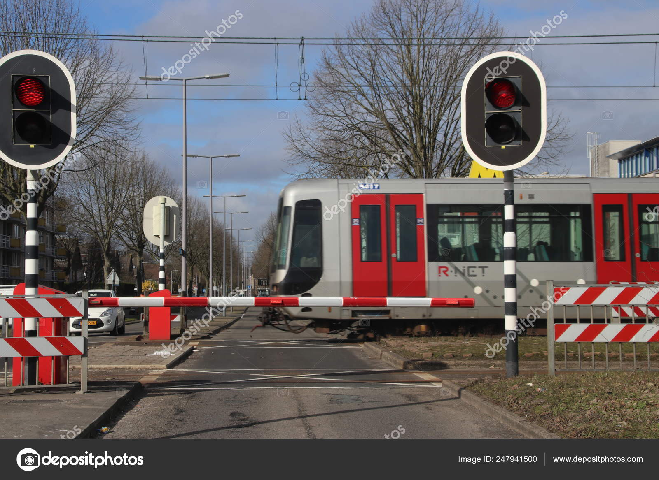
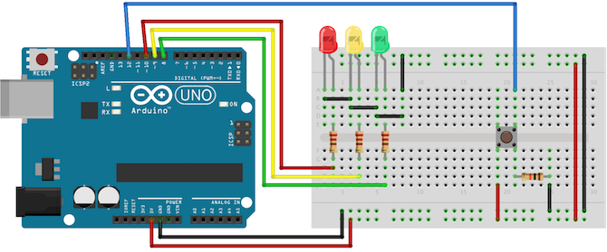
Activity 2
Traffic light simulator with Train crossing

Slide 28
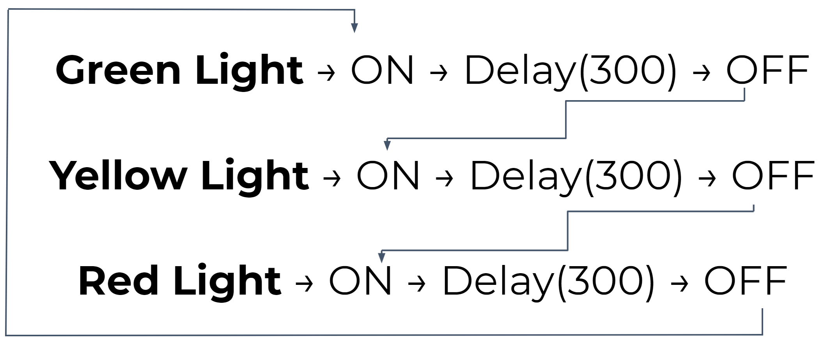
System Planning
Yes
Train’s Coming?
No
Red Light → ON

Slide 29
Step 1
Start by variables for the LED’s and the button switch
Recall:
int (name) = pin number;
Example: int red = 10;

Slide 30
Step 2
Add the setup function and configure the LED’s and the button switch using the variables you created
Recall:
Setup function:
void setup(){
pinMode(red, OUTPUT);
}
**Don’t forget to end every line with a semicolon

Slide 31
Step 3
Name the program and use a Boolean operator taking into account the button
Recall:
trainscoming = digitalread(PIN)

Slide 32
HINT: Step 3
If(button is pressed == HIGH)
red light
else
trafficlights()

Slide 33
Introduction to Arduino
EG1003 x MakerSpace | Workshop

