Slide 1
EG 1003 Overview

Slide 2
Objectives of EG 1003
To teach you about what engineers do
Technical skills
MS Office
LabVIEW
Mindstorms EV3
Professional skills
Teamwork
Oral communication
Written communication

Slide 3
Course Format
3 Credit Course
Lectures
Laboratories
Recitation
Semester-Long Design Project

Slide 4
Policy for Each Meeting
Lecture – attendance taken in first 5 minutes
Lab – doors close after 15 minutes
Speak with TA to schedule makeup lab
Due dates for reports will be specified by the TAs
Recitation – doors close after 10 minutes
After 10 minutes student is considered absent and will receive a zero, even if present

Slide 5
Lectures
One hour per week
Professors and guest lecturers talk about different aspects of engineering
Attendance is mandatory
Your ID will only be scanned during the first five minutes
Don’t be late!

Slide 6
Laboratories
Three hours per week
Students are placed in groups of 2 or 3
Lab report for each lab
Quizzes given every week
Lab material for that day
Lecture material from previous week

Slide 7
Laboratories
No extra time for quizzes, even if late
If you miss the quiz, you will receive a zero
Notify the Roaming TA of any lateness
If absent, fill out a Makeup Lab Request on EG website
Request requires professor approval
Lab will be made up in Open Lab

Slide 8
Recitations
1.5 hours per week
Presentation of preceding lab or project status
Feedback will be provided by instructor, writing consultant, and TA

Slide 9
Recitations
In general, missing a recitation will result in a zero
If you have a legitimate reason to miss class, report your situation to Student Affairs
Your partners will give the presentation without you
Notify your teammates, faculty member, and recitation TA of your absence ahead of time, if at all possible
Student Affairs will notify your professor if you require accommodation for your absence and you may receive the same presentation grade as your teammates

Slide 10
Semester-Long Design Project
Ten-week project
Students grouped in teams of 2 to 3 people
Seven projects to choose from
Section dependent
More information to come…

Slide 11
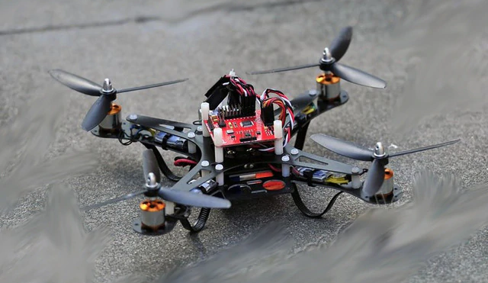
Open-Ended Projects
Rapid Assembly & Design (RAD) Challenge

Slide 12
Rapid Assembly & Design (RAD) Challenge
Students propose their own idea to be evaluated by EG admins
Approved or denied based on certain criteria
Matched with a mentor
Access to RAD Open Labs and Workshops

Slide 13
Grade Breakdown
Item | % of Grade
TA Lab Reports | 20%
WC Lab Reports | 20%
Lab Quizzes | 5%
Recitation Presentations | 15%
Semester-Long Design Project | 30%
Lecture Attendance | 10%

Slide 14
Communication
EG Website (eg.poly.edu)
Electronic Submission
Email
Grades
EG Manual (manual.eg.poly.edu)
Detailed information about labs, projects, and policies

Slide 15
Electronic Submission
All work must be submitted electronically through the EG website (eg.poly.edu)
Microsoft Word/PowerPoint files only
Midnight deadline (be mindful of connection speed!)
No negotiation of grades if work is not submitted electronically

Slide 16
Closing
Read manual ahead of time (manual.eg.poly.edu)
Use EG website regularly
Check for last minute cancellations and changes
Keep in contact with your partners
Express questions and concerns to your instructor
Ask questions!!

Slide 17
Introduction to EG 1003
QUESTIONS?

