Slide 1
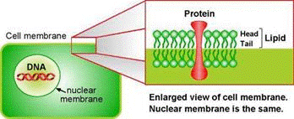
EG1003: Introduction to Engineering and Design
Extraction and Gel Analysis of DNA

Slide 2
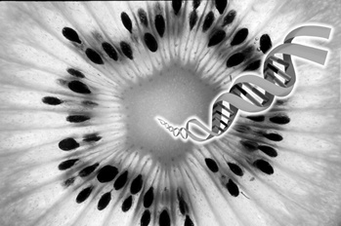
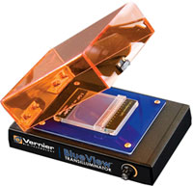
Overview
Objectives
Background information
Materials
Procedures:
Part 1: Restriction of Lambda DNA
Part 2: Gel Electrophoresis of Lambda DNA
Part 3 : DNA Extraction
Part 4: Chemical Tests
Closing and Feedback

Slide 3
Objective
Restrict Lambda DNA and analyze by Gel Electrophoresis
Extract a sizable amount of DNA
Understand and use basic biochemical techniques:
DNA isolation method
Gel electrophoresis
Biochemical tests
Understand role of ingredients used in experiment

Slide 4
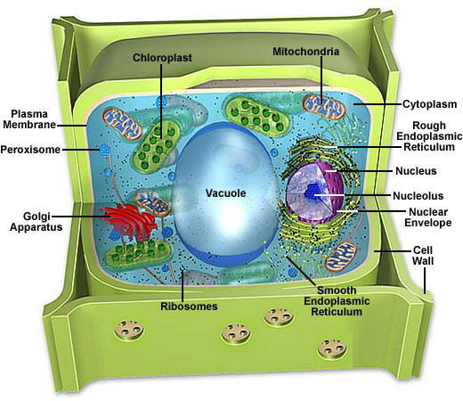
Plant Cell Structure

Slide 5
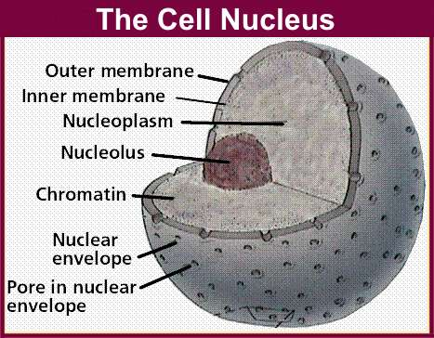
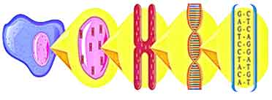
Plant Cell Structure: The Nucleus
Nuclear envelope
Double layer of lipids
Protect DNA from DNAses
Chromatin
Made of DNA and protein
chromatin
DNA
cell
nucleus
chromosome

Slide 6
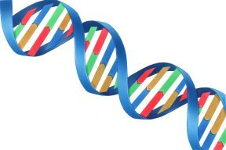
DNA Properties
Structure
Long polymer, double-helix shaped
Sugar-phosphate backbone
Phosphate group make DNA negatively charged
Polarity and solubility: “like dissolves like”
Most polar of all biopolymer
Soluble in polar solvent: water
Precipitated in non-polar solvent: alcohol
Helical backbone
DNA strands

Slide 7
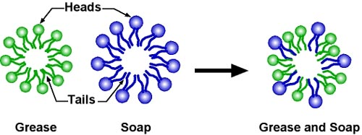
Soap Molecules
Head likes water (hydrophilic) hate fat (lipophobic)
Tail hate water (hydrophobic) likes fat (lipophilic)
Traps fats (lipids) and washes them away in water

Slide 8
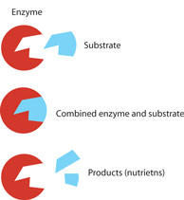
Procedure
General characteristics:
Specificity : lock and key principle
Enzyme is specific to target molecule
Sensitivity to:
Temperature: low activity at low or high temperature
ph: works within small range
Different types of enzymes
Restriction enzymes cut DNA at specific locations
Maximum activity at 37°C

Slide 9
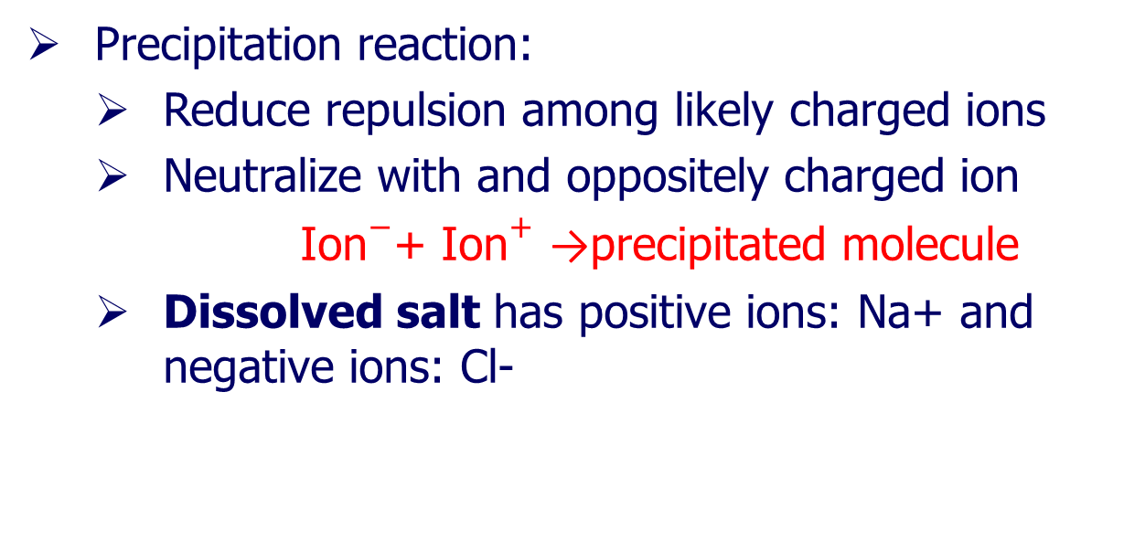
Chemical Separation: Precipitation

Slide 10
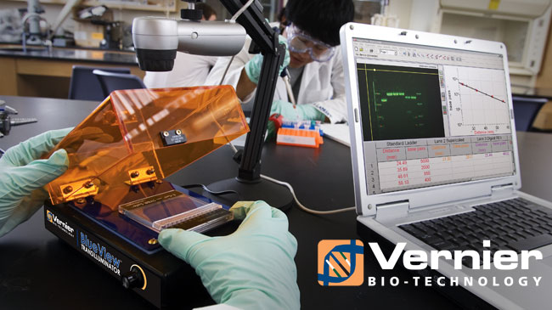
Materials
Fruit sample
Non-iodized table salt (NaCl)
Hand soap (clear, unscented)
95% isopropyl alcohol (0°C)
Distilled water
Strainer
Plastic cups
Ziploc bag
Lambda DNA
Restriction enzymes
Dye
Variable micropipette and tips
Precast agarose gel
Electrophoresis system
Bioimaging system
Biuret reagent
Benedict’s reagent
DNA sample containers
Disposable pipets
Incubator
Microcentrifuge tube

Slide 11
Experiment Design: A Guide
Where is DNA?
What are the obstacles to get to DNA?
How to overcome these obstacles?
How to bring DNA molecules together?
How to take it out of the solution?
If we provide something it might be useful!!!
Use the background information presented; Think!

Slide 12
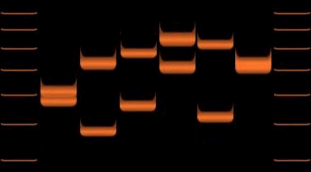
DNA Gel Analysis
Gel Electrophoresis:
Move DNA molecules fragment through Agarose matrix using electric field
Negatively charged DNA migrates to positive side
DNA fragments separated by size
Smaller fragments go farther
Application: DNA fingerprinting
Differentiating samples from 6 individuals.

Slide 13
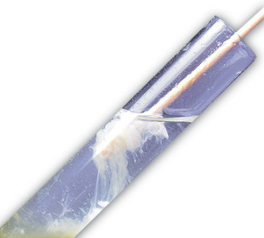
Procedural Steps
DNA restriction
Gel Electrophoresis
DNA imaging
Homogenization of fruit sample
Disruption of membranes and walls
Precipitation of DNA
Steps in red require TA assistance

Slide 14
Note
In biological labs there are long wait times within experimental procedures
Restriction
Gel electrophoresis
As a result many experiments are done at the same time

Slide 15
Closing and Feedback
Never let solution foam when or after adding soap
Once DNA is extracted, remember to rinse twice
After rinsing DNA, ask for TA assistance
Keep clear lab notes, have it scanned
Have a picture taken of your extracted DNA
Have a picture of the banding patterns on gel
Give improvements suggestions in lab report
Remember to include answers to questions asked in lab manual (YOUR ASSIGNMENT)

