Slide 1

BIOMEDICAL FORENSICS
(VIRTUAL)
EG1003 | LAB 11

Slide 2
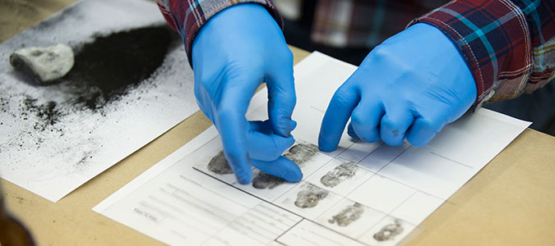
OBJECTIVE
Use basic forensic techniques
  DNA extraction
  Fingerprinting
  Drug testing
  Blood typing
Solve a murder mystery
Figure 2: Fingerprinting Courtesy of Marian University
2

Slide 3
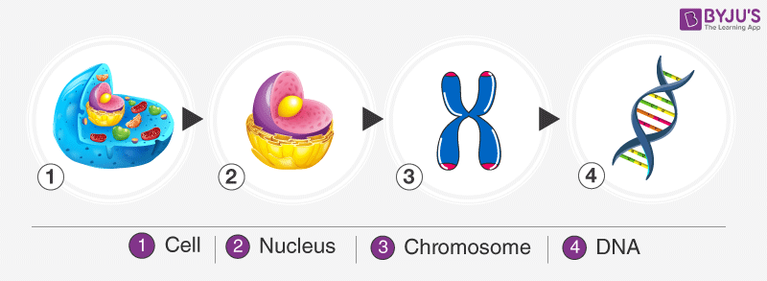
BACKGROUND INFORMATION
Deoxyribonucleic acid (DNA)
  Packaged in the form of chromatin (which make up chromosomes)
  Exist in the nuclei of cells
  Plant cells have a cell wall that must be penetrated to access the DNA
Figure 3: DNA Packaging Sequence Courtesy of Byju’s
3

Slide 4
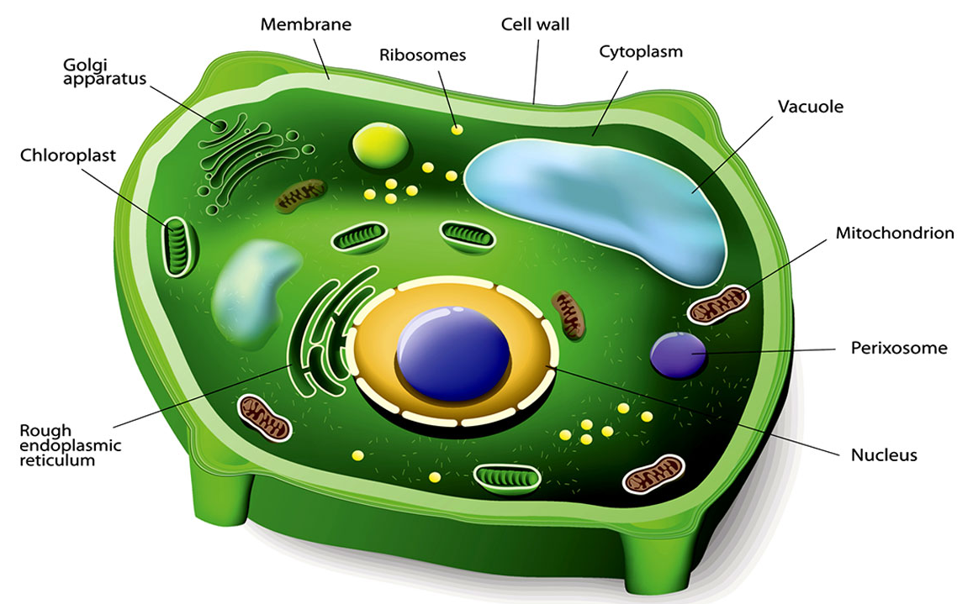
BACKGROUND INFORMATION
DNA extraction (of a plant cell)
  Break the cell wall (cell lysis) to expose the DNA within the cell
  Destroy the plasma membrane
  to further expose the DNA
  Precipitate the DNA to make
  the DNA visible
Figure 4: Plant Cell Structure Courtesy of Biology Wise
4

Slide 5
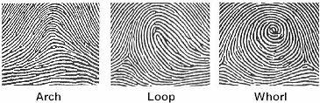
BACKGROUND INFORMATION
Fingerprints – unique patterns consisting of friction ridges and burrows
  Loops – 60% of pattern types
  Whorls – 35% of pattern types
  Arches – 5% of pattern types
Figure 5: Fingerprint Types Courtesy of
Headlines on Human Hands
5

Slide 6
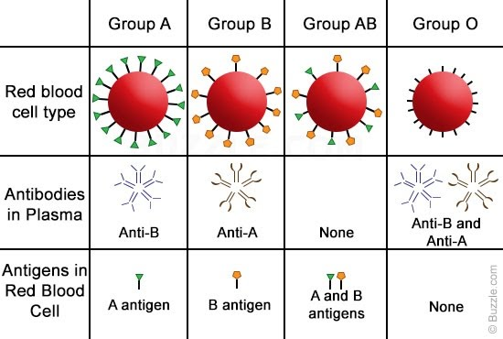
BACKGROUND INFORMATION
Blood typing (ABO system)
  Existence of antigens on red blood cells determine blood type
  A and B antigens determine type of blood (A, B, AB, or O)
  Rh antigen determines presence of Rhesus factor (indicated by +/-)
Figure 6: ABO Blood Type System Courtesy of Buzzle.com
6

Slide 7

MATERIALS
Computer with internet access
Paper
Pencil with graphite
Clear packaging tape
7

Slide 8

PROCEDURE
Follow the videos and procedure to
learn biomedical forensic techniques
Forensic Academy:
  DNA extraction
  Fingerprinting
  Drug testing
8

Slide 9

PROCEDURE
Solve a murder mystery
Crime Scene Investigation:
  Drug testing
  Blood typing
  Fingerprinting
Compare data to the Suspect
Information Sheet
Determine who is the killer
9

Slide 10
ASSIGNMENT
Team Memo and Individual Self Reflection:
  Each group does a single memo
  Each student writes their own self-reflection
  Follow format in EG1003 Lab 11 Memo and Self Reflection
  Due in two weeks
10

Slide 11
CLOSING
Take screenshots of the extracted DNA, fingerprints, blood typing, and drug present in victim’s blood
Record data in the Suspect Information Sheet
Tell a TA who you think the killer is before leaving lab
Submit all work electronically
11

Slide 12
QUESTIONS?

