Slide 1
INTRODUCTION TO COMPUTER-AIDED DESIGN (CAD)
ENGR-NY 2 | LAB 3

Slide 2
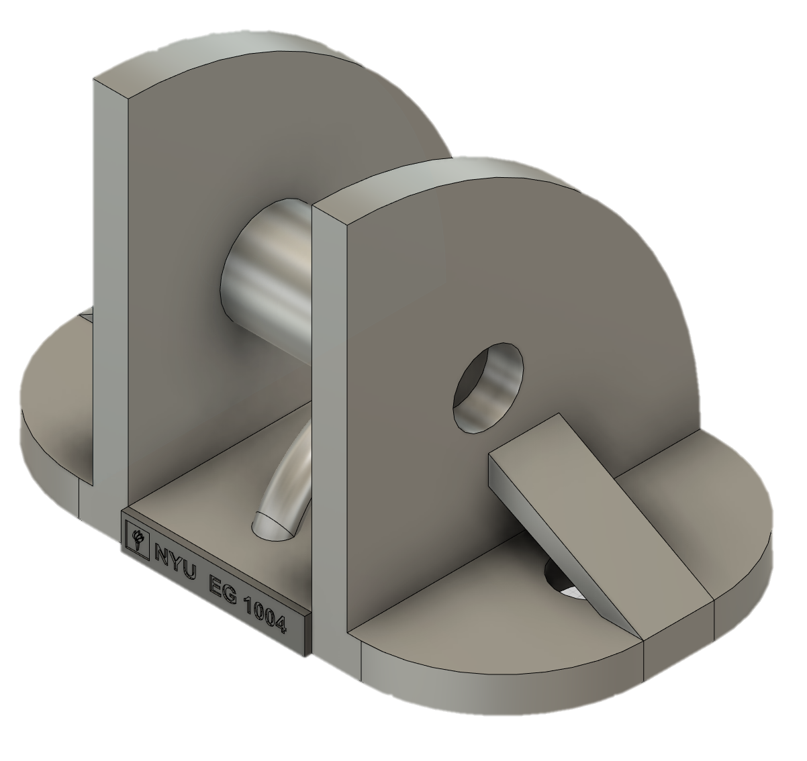
INTRODUCTION
Computer-Aided Design (CAD)
Create, modify, analyze models of real-life products
Allows engineers to create dimensioned, scaled drawings
Drawing to scale means nothing can be eyeballed
Dimensions (e.g. lengths & radii) must be exact
Figure 1: CAD example

Slide 3
HOW TO READ DIMENSIONS
Length
Diameter
Radius
Figure 2: CAD example with dimensions highlighted

Slide 4
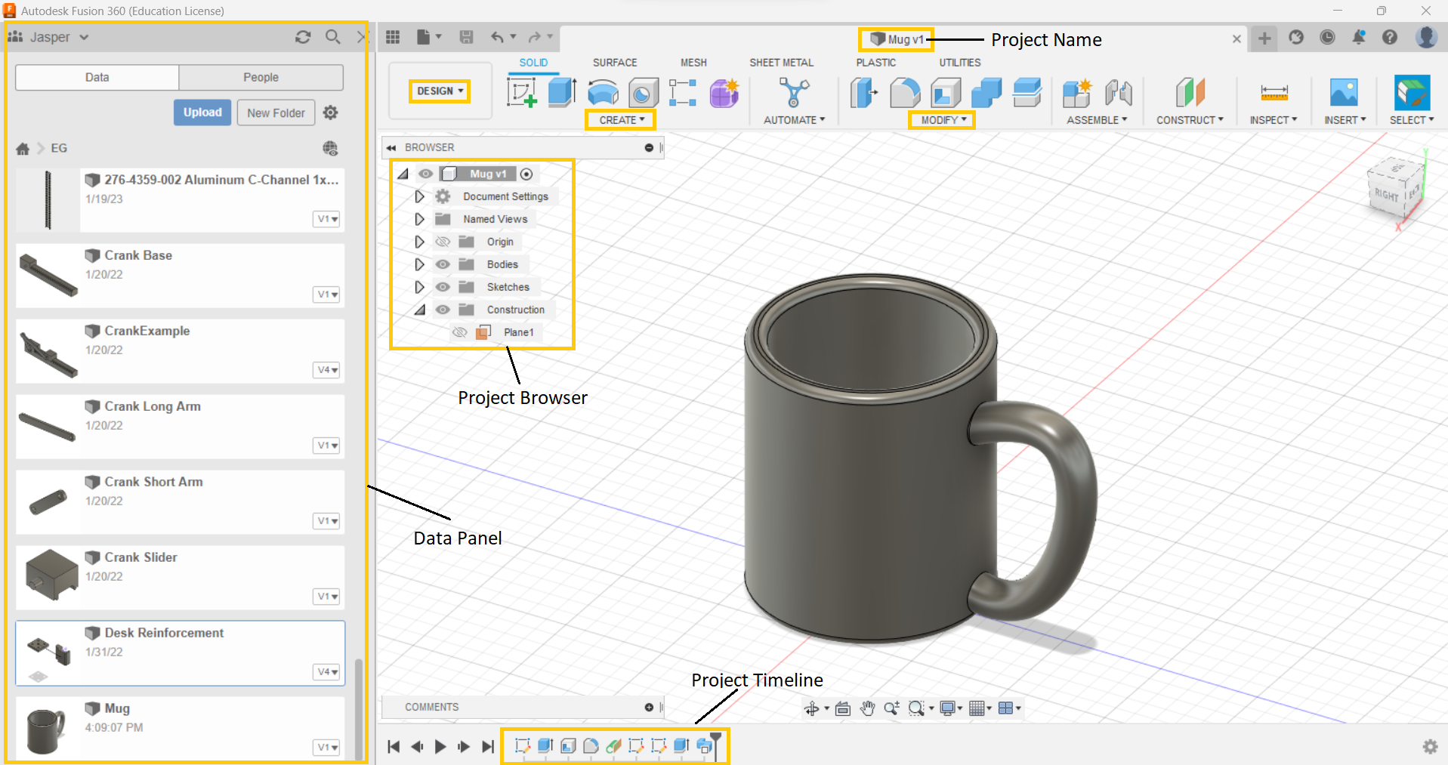
FUSION 360 DESIGN WORKSPACE
Create: Tools to create a new body
Modify: Tools to modify existing bodies
Project Timeline: Tracks changes to project
Project Browser: List of all existing sketches, bodies, etc
Data Panel: Cloud based file system for Fusion 360
Figure 3: Fusion 360 Design Workspace

Slide 5
SKETCH TOOLS
Figure 4: Line
Figure 5: Rectangle
Figure 6: Circle
Figure 7: Dimension

Slide 6
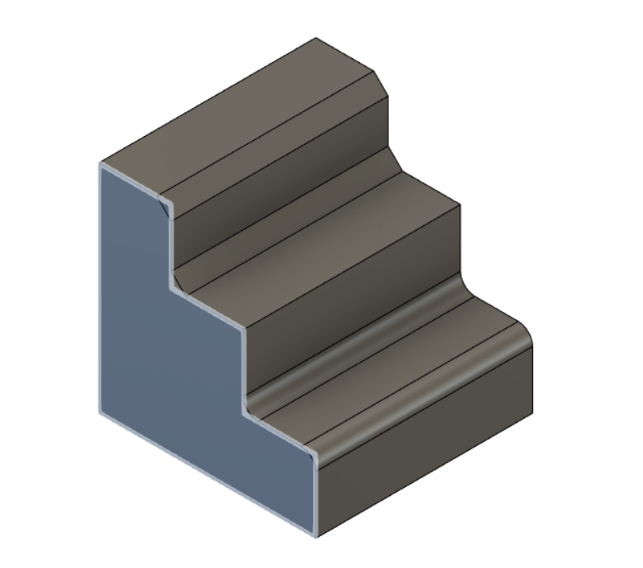
MODIFY TOOLS
Chamfer
Fillet
Figure 8: Fillet/Chamfer
Figure 9: Trim
Figure 10: Example of Chamfer & Fillet

Slide 7
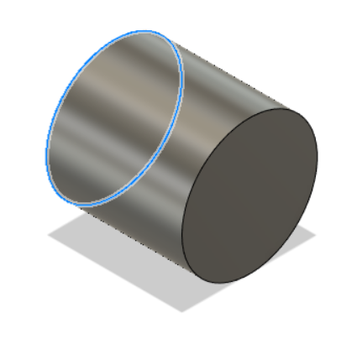
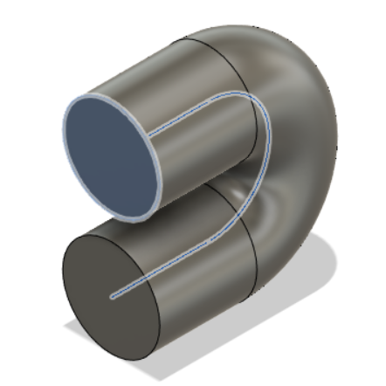
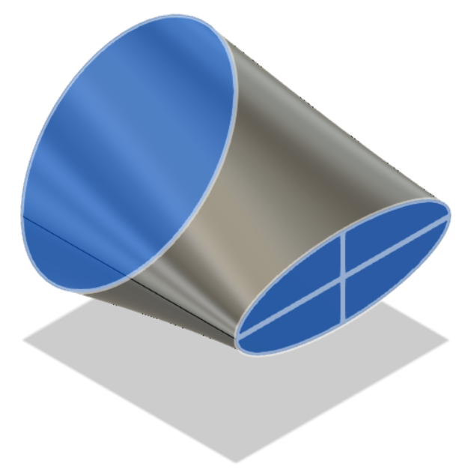
CREATE TOOLS
Figure 11: Extrude
Figure 12: Sweep
Figure 13: Loft

Slide 8
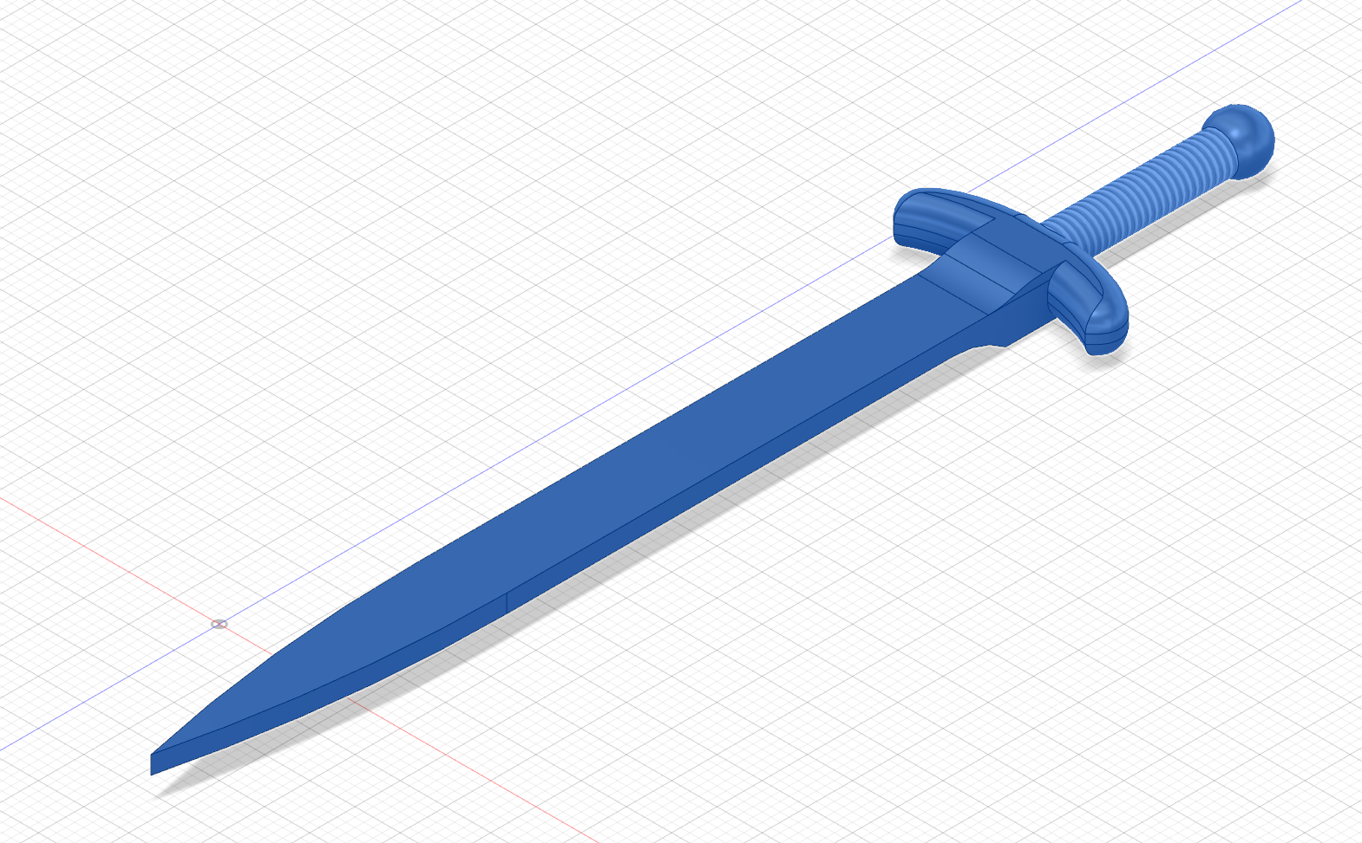
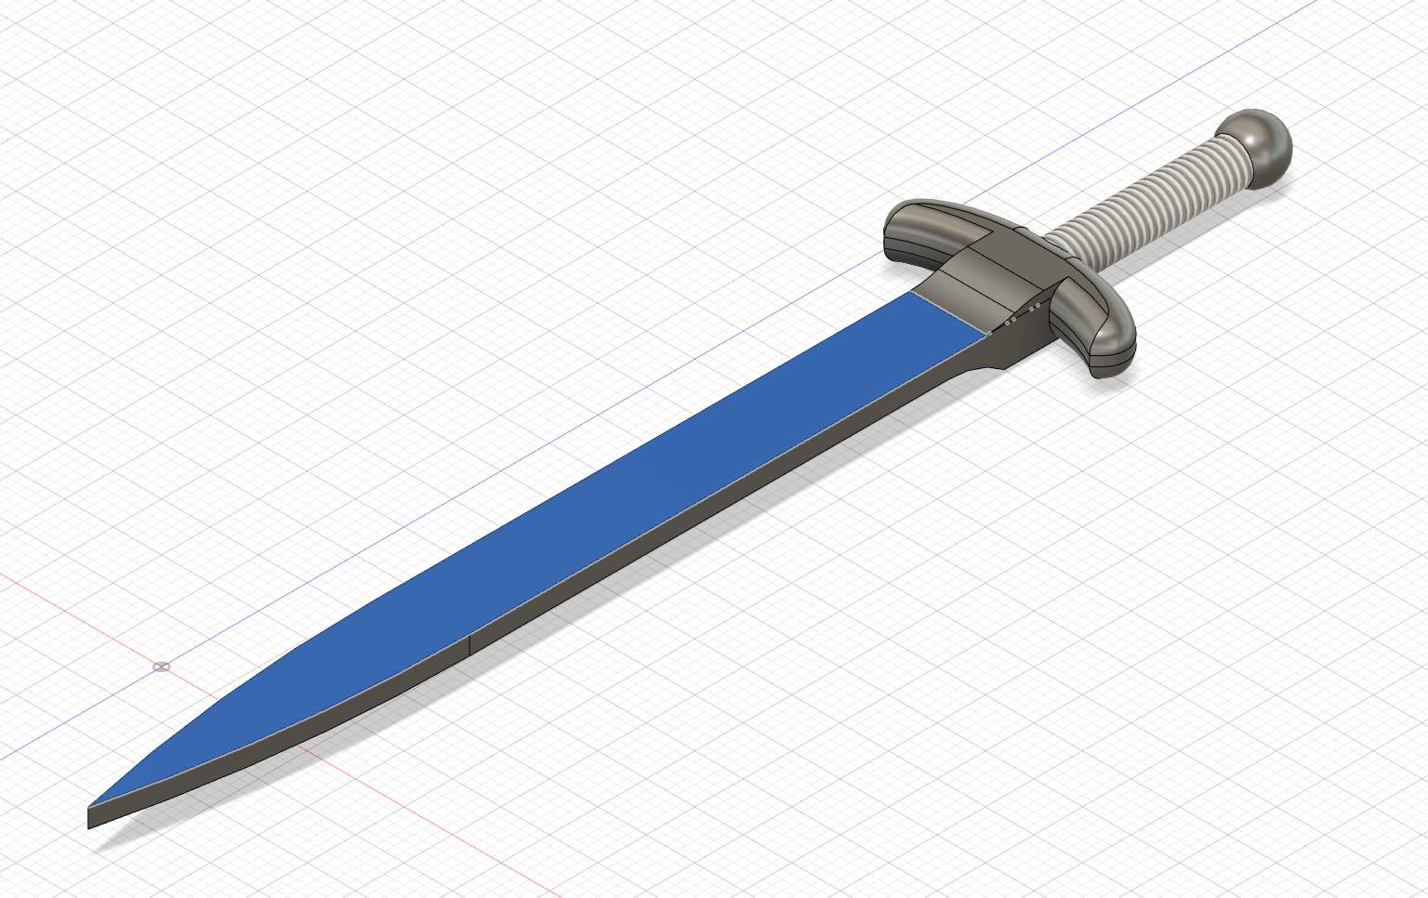
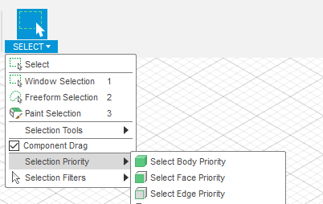
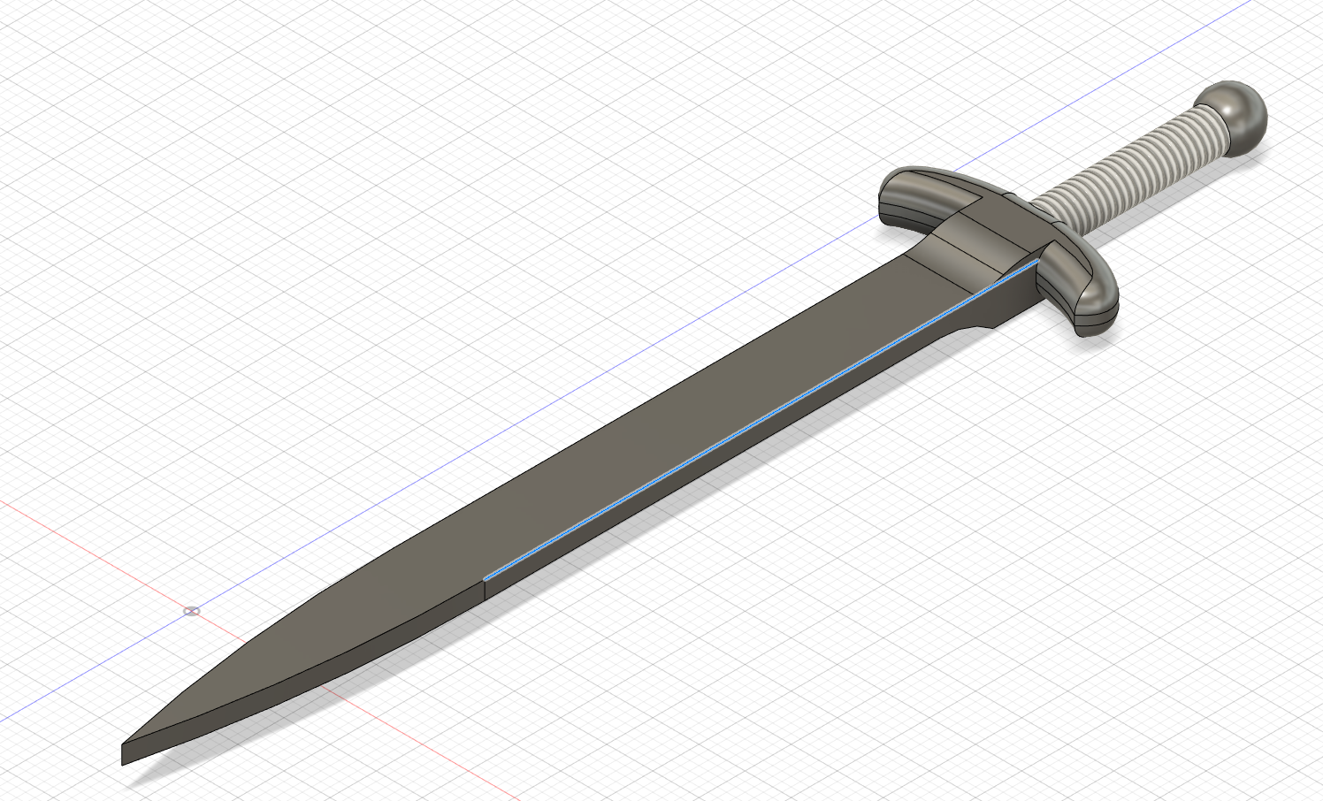
FUSION 360 TERMINOLOGY
Geometry in Fusion360
3D: Bodies
2D: Faces
1D: Edges
Body
Face
Changing the selection priority allows you to hover over an individual body/face/edge and select it without selecting other intersecting features
Edge
Figure 14: Selection Priorities

Slide 9
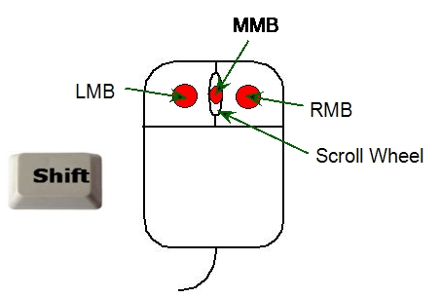
NAVIGATING FUSION 360
To Pan: Hold down MMB and move mouse through workspace
To Orbit: Hold down Shift Key + MMB and move mouse about axis of rotation
To Zoom: Scroll Wheel forward to zoom out, backward to zoom in
To select/unselect multiple objects: Use shift+LMB, or click and drag selection window
To Access Marking Menu: Hold down RMB, drag to select option
LMB = Left Mouse Button
RMB = Right Mouse Button
MMB = Middle Mouse Button
Figure 15: Mouse Anatomy (Courtesy of Autodesk Help)

Slide 10
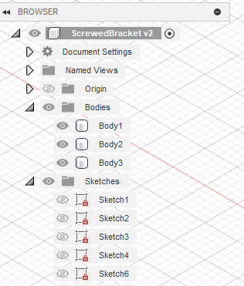
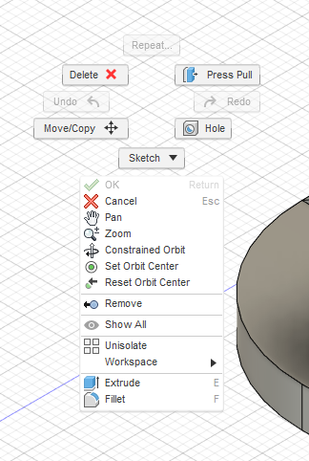
NAVIGATING FUSION 360
Project Browser: show/hide/highlight all 3D bodies and 2D sketches in design
Marking Menu: Accessed with RMB, shows quick common actions
Easy to use when body/face/edge is preselected
Figure 16: Project Browser
Figure 17: Marking Menu

Slide 11
ACTIVITY 1

Slide 12
ACTIVITY 2

Slide 13
ACTIVITY 3
Design a lamp and draw it on Fusion 360
Notes:
https://studycadcam.blogspot.com/2020/08/3d-cad-exercises-48.html

Slide 14
QUESTIONS?

